Slide 1

CF in Adults, what is different?
Prof dr Harry Heijerman
University Medical Center Utrecht
Cystic Fibrosis Center
Utrecht
The Netherlands

Slide 2
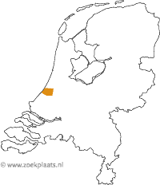
CF in The Netherlands (2017)
1600 patients with CF
2017: 900 patients > 18 years (56%)
UMC Utrecht: 250 adults
215 children
65 adults post LTx

Slide 3
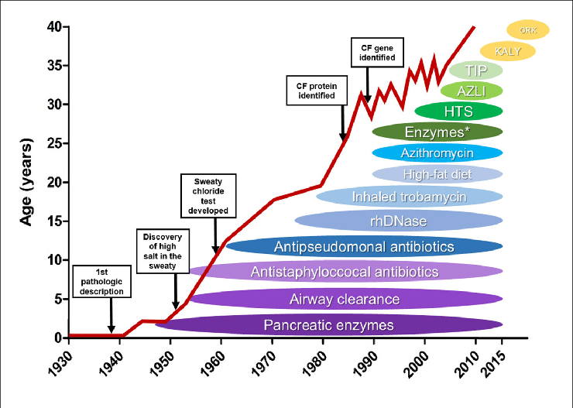

Slide 4
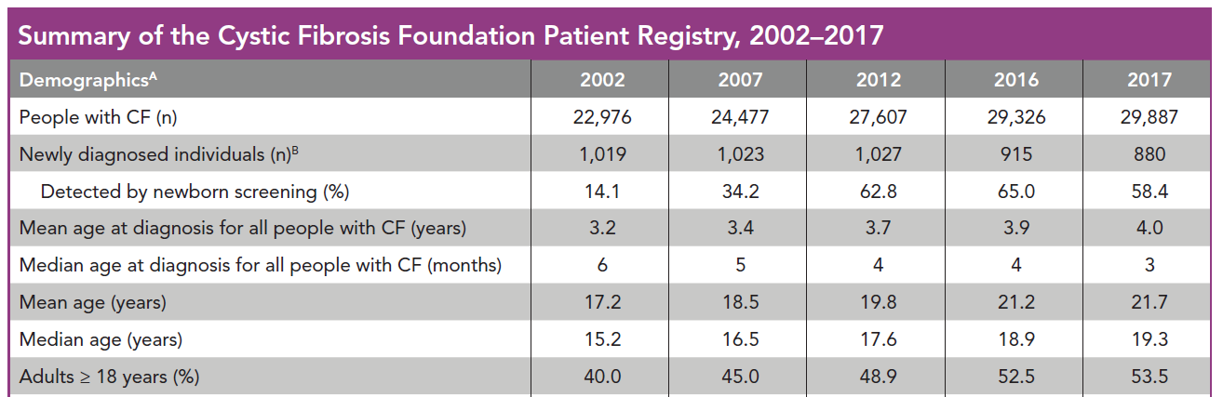

Slide 5
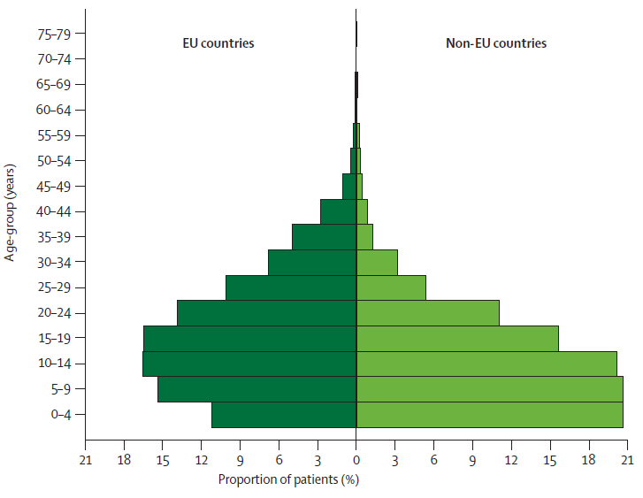
Current epidemiology of CF in Europe
50 %
28 %
ADULT
PAEDIATRIC
No data on future trends in the number of CF patients
McCormick et al. Lancet 2010; 375: 1007–13

Slide 6
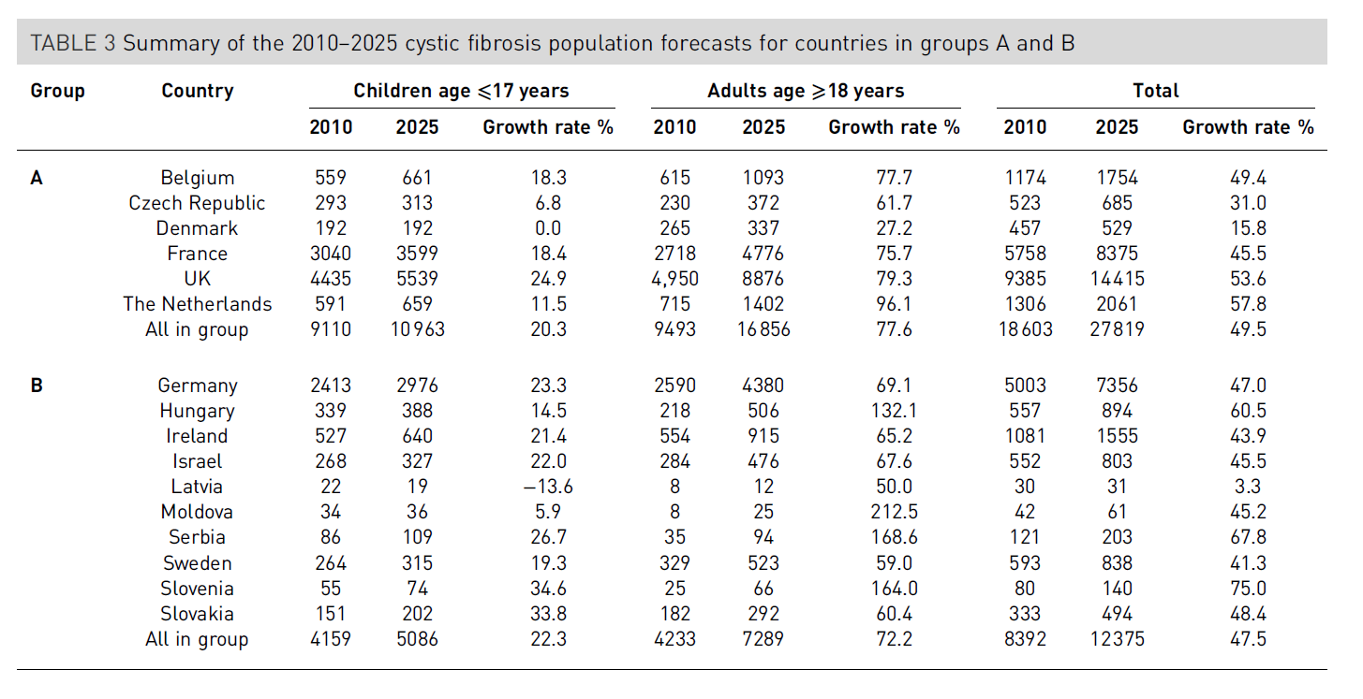
Future trends in cystic fibrosis demography in 34 European countries.
Burgel et al. ERJ 2015

Slide 7
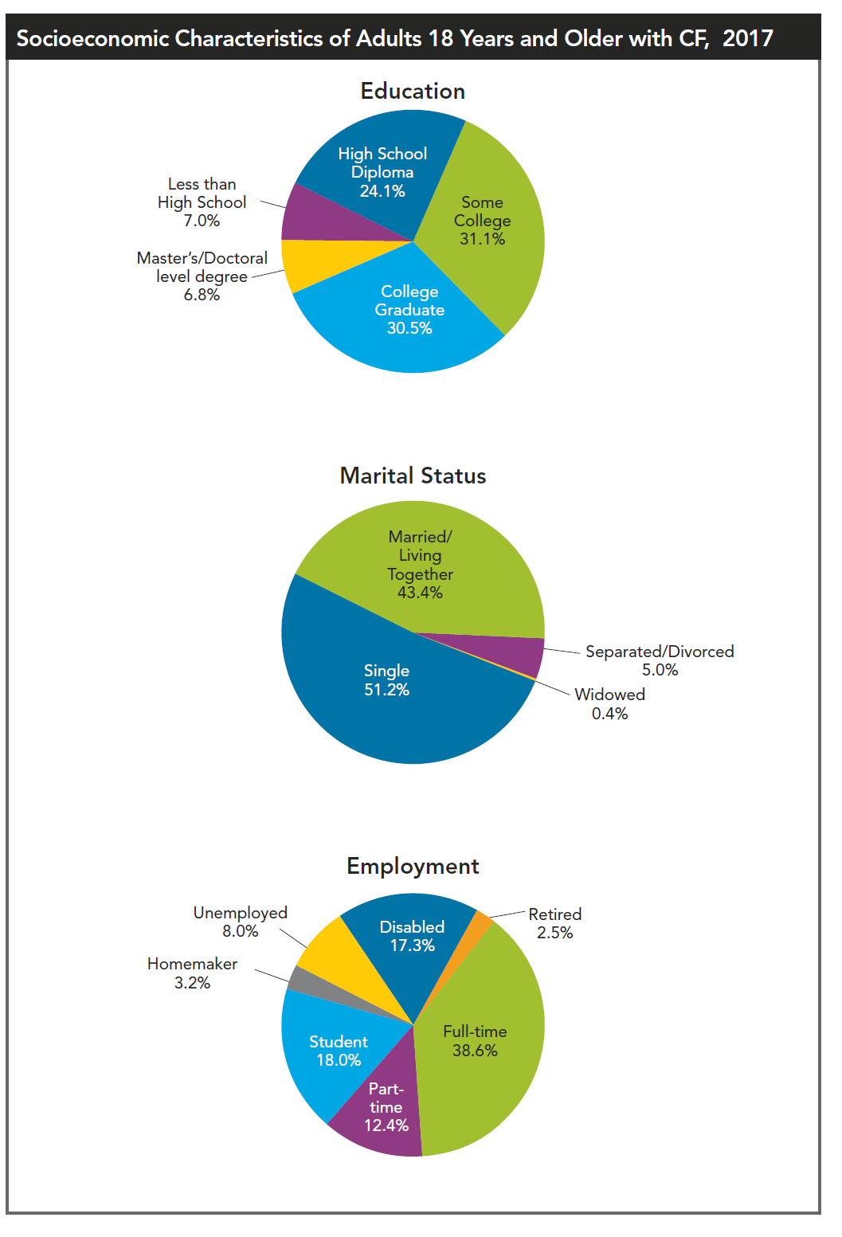
CFF annual data report 2017

Slide 8
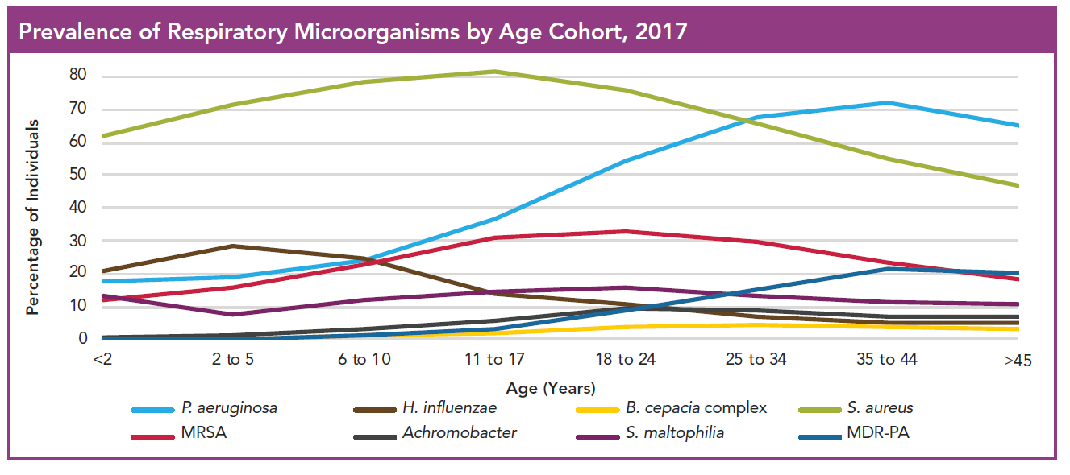

Slide 9
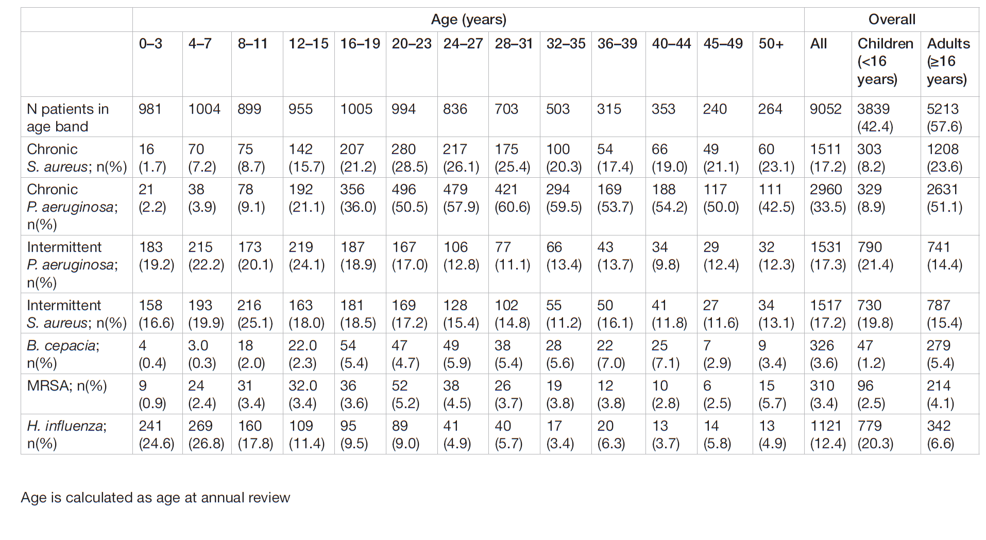
CF Trust annual report 2013

Slide 10
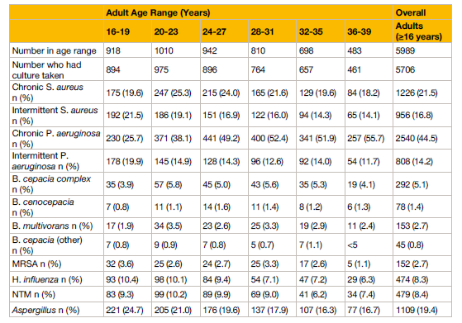
2013: 36%
UK trust registry 2017

Slide 11
Ratjen F et al. Thorax. 2010; 65:286-291.

Slide 12
Summary
Study Year age failure
Littlewood 1985 <16 35%
Frederiksen 1997 <18 15-20%
Ratjen (Elite) 2010 <18 15-20%
Treggiari (EPIC) 2011 <12 15-20%
Wainwright 1011 < 5 10-12%
Tacetti 2012 7.5 (med) 35%
Tramper Sanders 2010 <18 12% (treatment group)
Eradication therapy may be less successful in older patients
No studies in adults.
New pathogens, S. Maltophilia??

Slide 13
Microbiology in adults with CF compared to children
Same rate of aquisition of 1st Pseudomonas (no studies on eradication in adults)
More chronic infection with PA
More multidrug resistant PA
More Achromobacter
More non-tuberculous Mycobacteria
More Burkholderia cepacia complex
More Aspergillus species

Slide 14
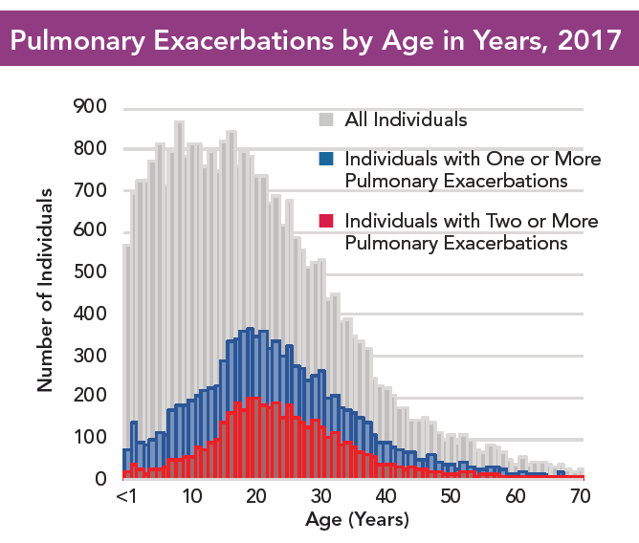

Slide 15
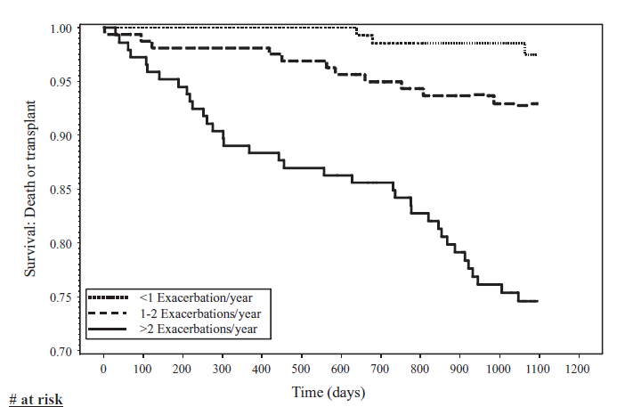
De Boer , Thorax 2011

Slide 16
Non-pulmonary complications

Slide 17
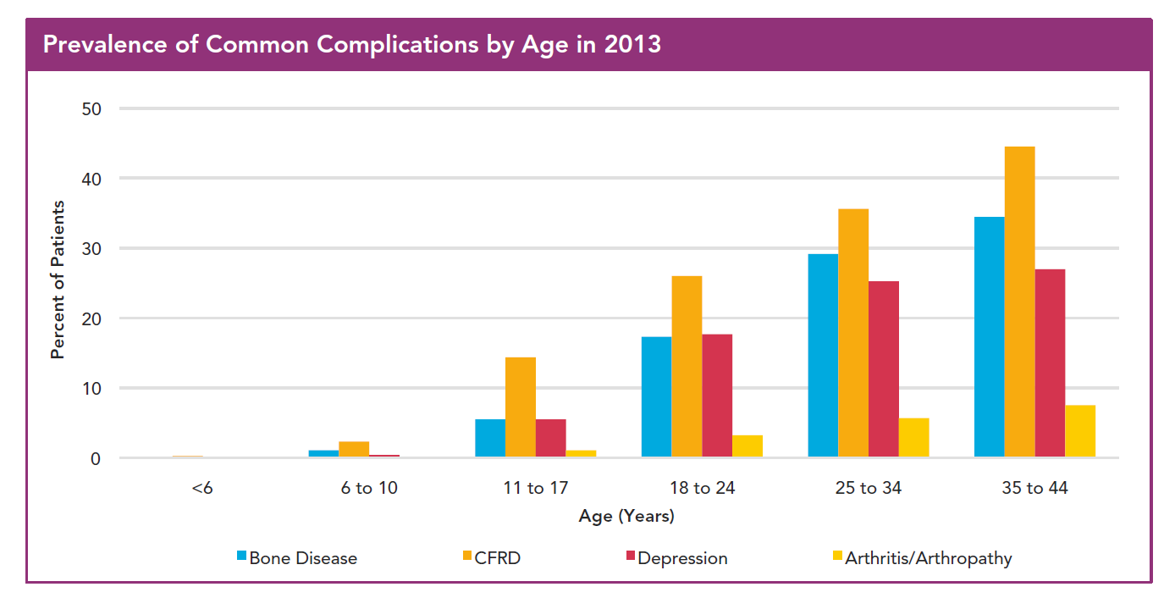

Slide 18
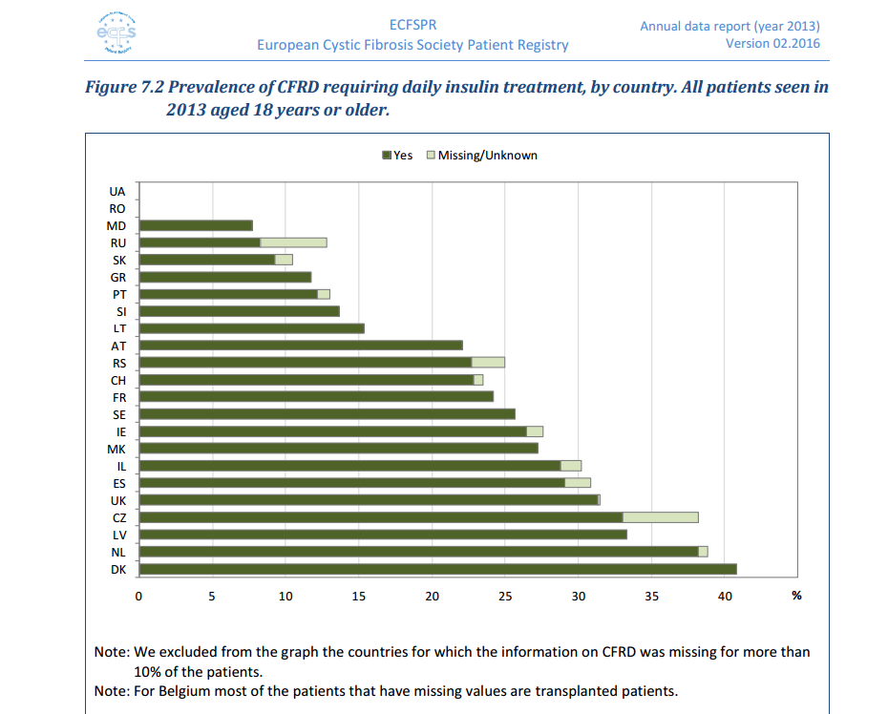

Slide 19

CFRD

Slide 20
Pathofysiology of CFRD
Normal glucose tolerance
Impaired glucose tolerance
CFRD without fasting hyperglycaemia
CFRD with fasting hyperglycaemia
_
Insulin
Resistance
+
Insulin
Production
=
time

Slide 21
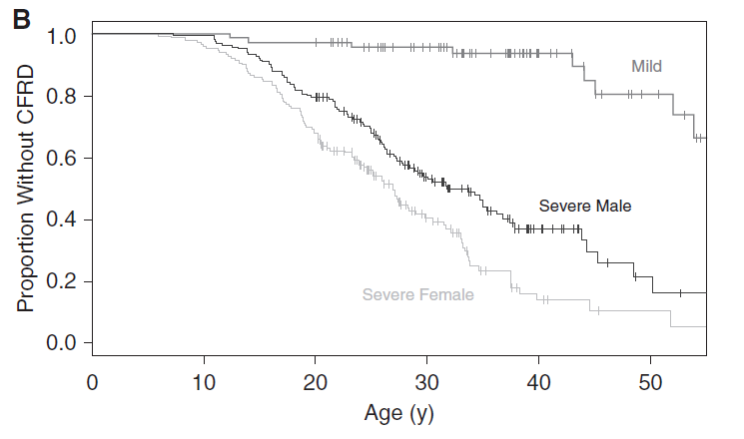
N = 462
Lewis et al. AJRCCM 2015

Slide 22
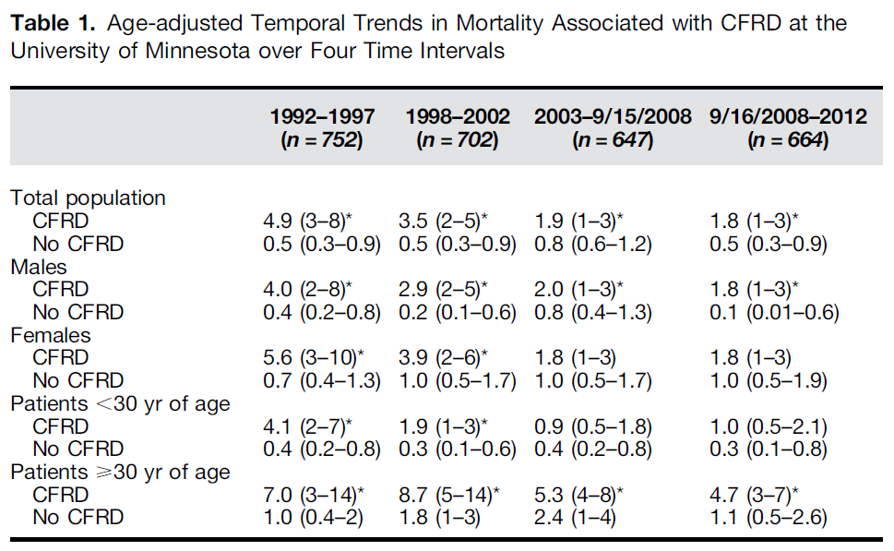
Lewis et al. AJRCCM 2015

Slide 23
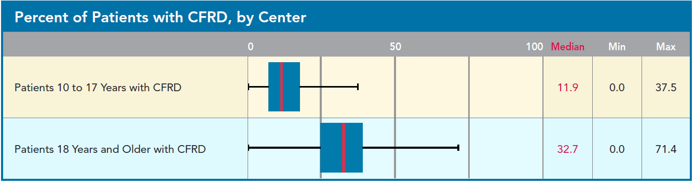

Slide 24
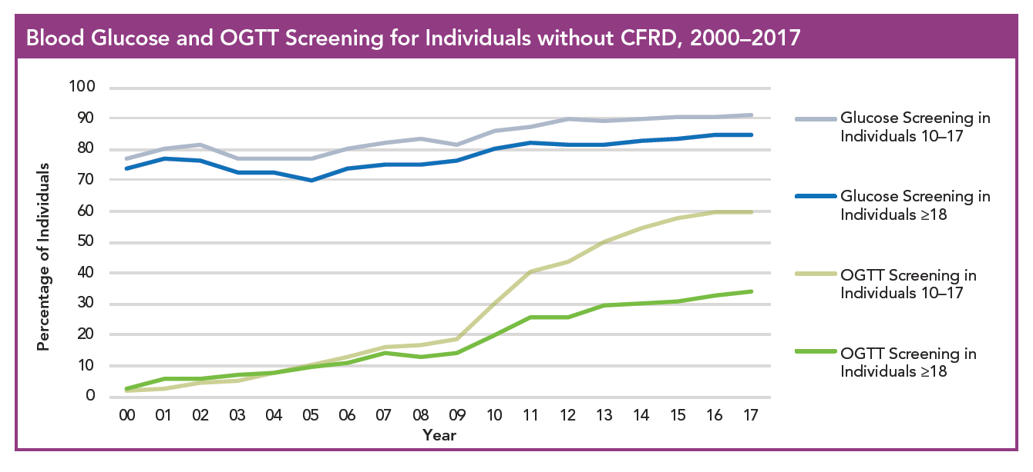

Slide 25
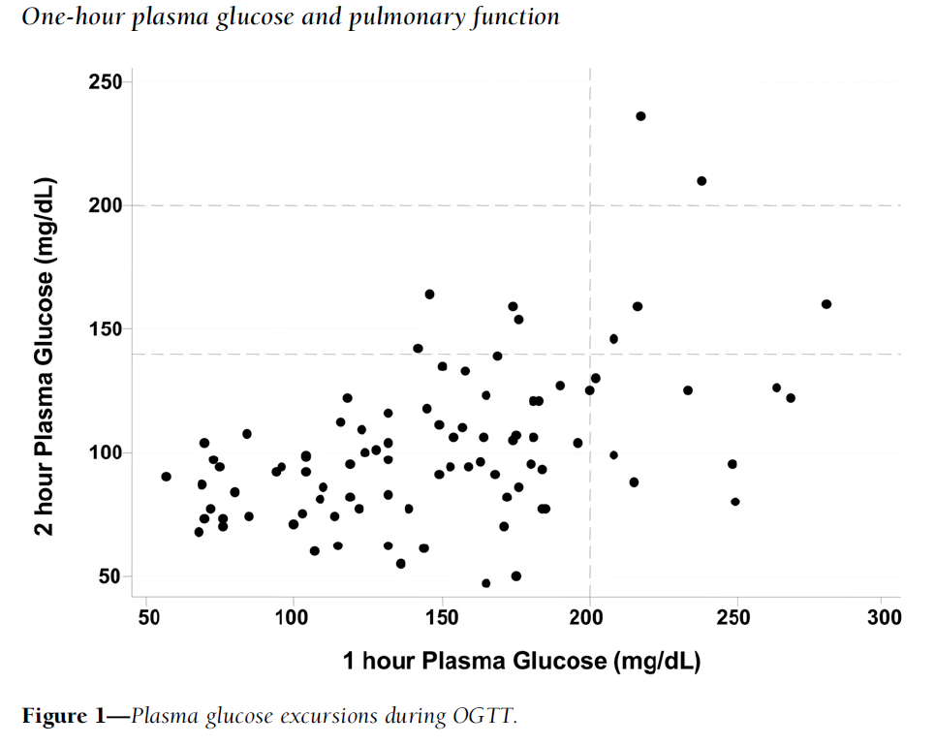
GCT: 50gr glucose oral intake followed by glucose measurement by finger prick after 60 minutes.
Brodsky et al. Diabetes Care 2011 Jackson et al. Diabet Med 2017

Slide 26
Renal disease
in CF.
Few data…..
Van den Berg et al. JCF 2008

Slide 27
Renal disease in CF
Aminoglycoside induced toxicity
Colomycin induced toxicity
Interstitial nephritis due to medication (Quinolones)
CFRD related renal disease
CF-specific nodular glomerulosclerosis?
Amyloidosis
(renal proximal tubule epithelial cells)

Slide 28
Osteoporosis

Slide 29
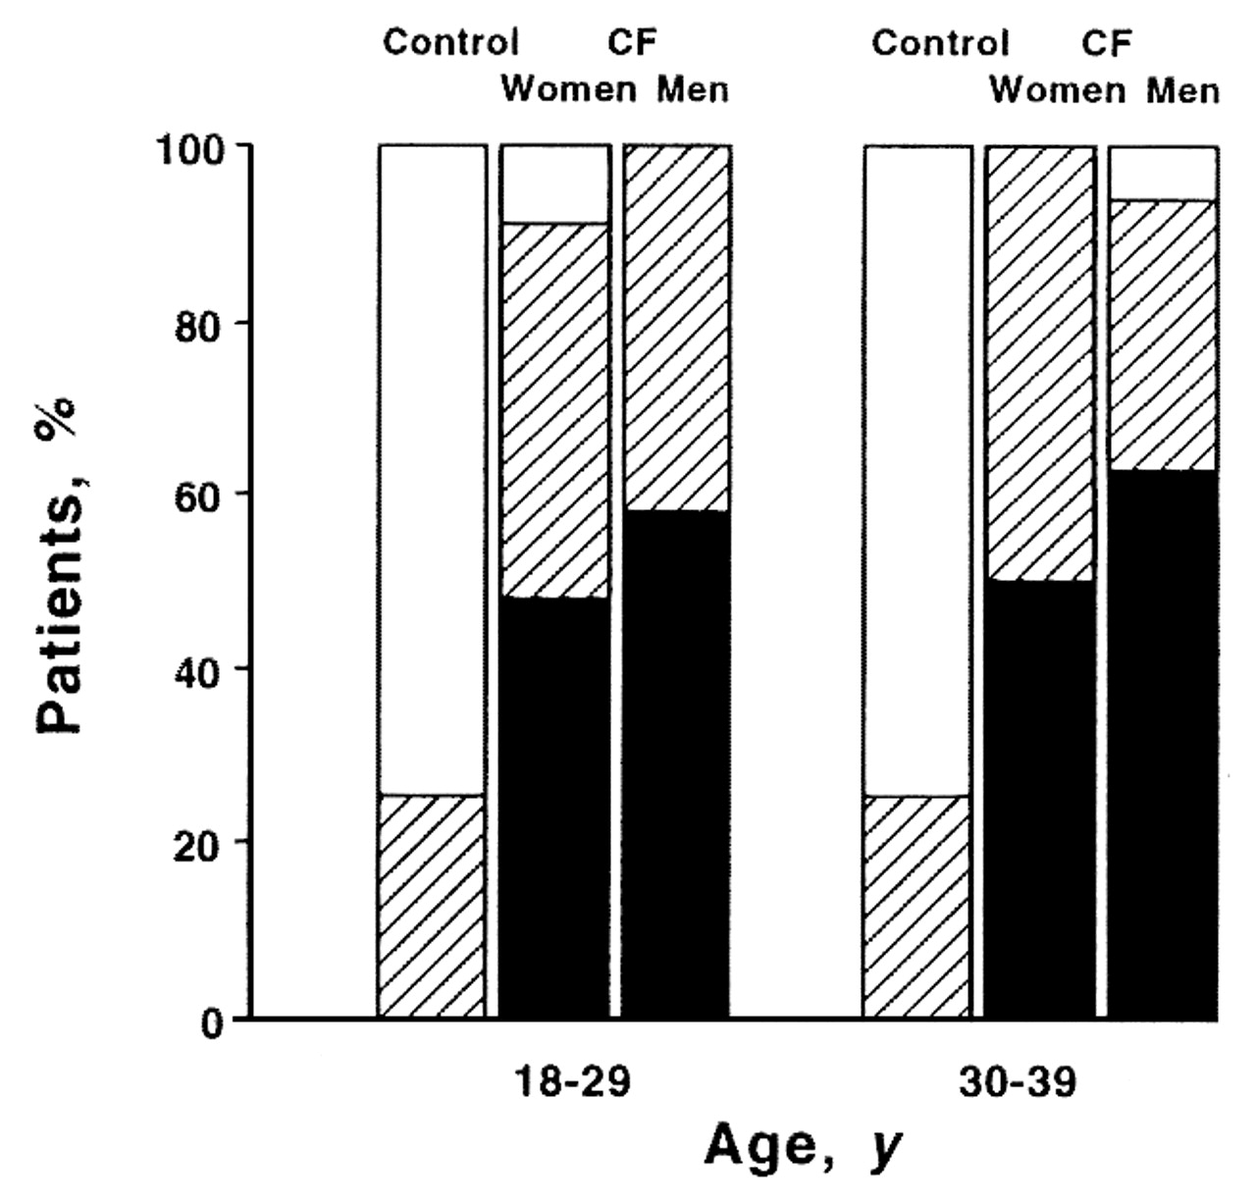
Percentage of patients with cystic fibrosis (CF) aged 18 to 29 years (16 men and 25 women) and 30 to 39 years (19 men and 10 women; 1 patient aged 40 years and 1 patient aged 46 years were included in this group) with normal bone mineral density (T-score, 0 +/- 1), osteopenia (T-score 2.5), and osteoporosis (T-score < or = to -2.5)
White bars indicate normal bone mineral density;
Striped bars indicate osteopenia; Black bars indicate osteoporosis.
Aris, R. M. et. al. Ann Intern Med 1998;128:186-193

Slide 30
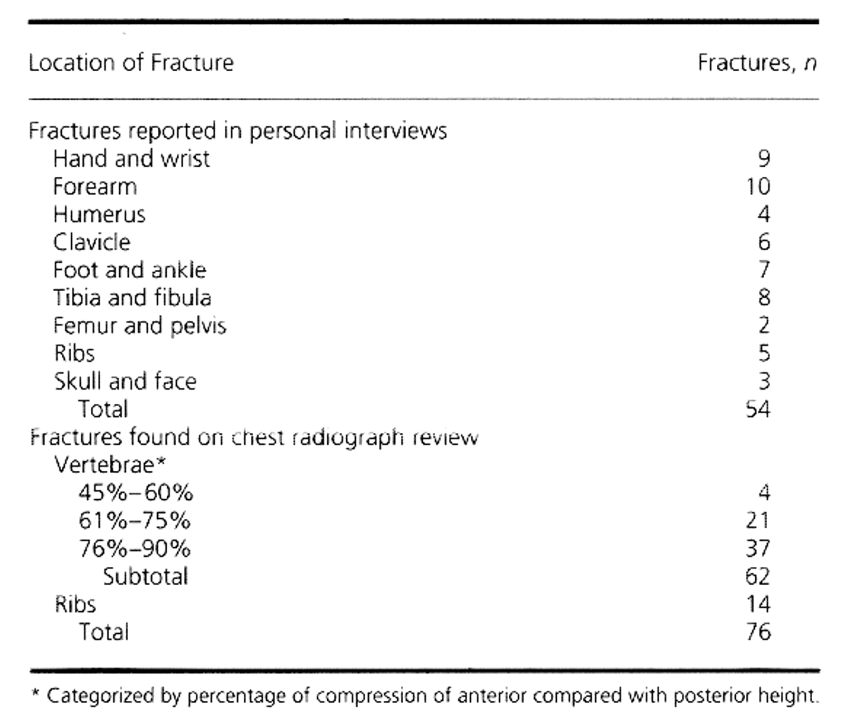
Increased Rate of Fractures and Severe Kyphosis
Sequelae of Living into Adulthood with Cystic Fibrosis
Aris, R. M. et. al. Ann Intern Med 1998;128:186-193
N = 70
CF women 17-34 years
1.7 vs 3.7 /100 pat.years (p=0,015)
CF men 25-45 years
2.8vs 8.5 /100 pat.years (p=0,04)

Slide 31
Risk factors for the development of osteoporosis
Age at puberty, BMI, cumulative steroid dose (Aris 1998)
Severe pulmonary disease, corticosteroids (Conway 2000)
Physical inactivity, BMI (Frangolias 2003)
BMI, FEV1, physical activity ( Haworth 1999)
Etc.
Malnutrition
Severe pulmonary disease
Cumulative steroid dose

Slide 32
Cancer

Slide 33
RISK of CANCER
Global risk of cancer in CF is no different from that of the general population
1- risk of colorectal cancer (CRC) in adults with CF is
5 – 10 times greater compared to the general population,
2- and 25 – 30 times greater in CF patients after an organ transplantation.
3- Testicular Cancer: up to 3 times greater
4- Lymphoid Cancer: up to 3 times greater
Global risk of cancer in CF patients after an organ tranplantation
Is up to 4 times greater compared to the general population

Slide 34
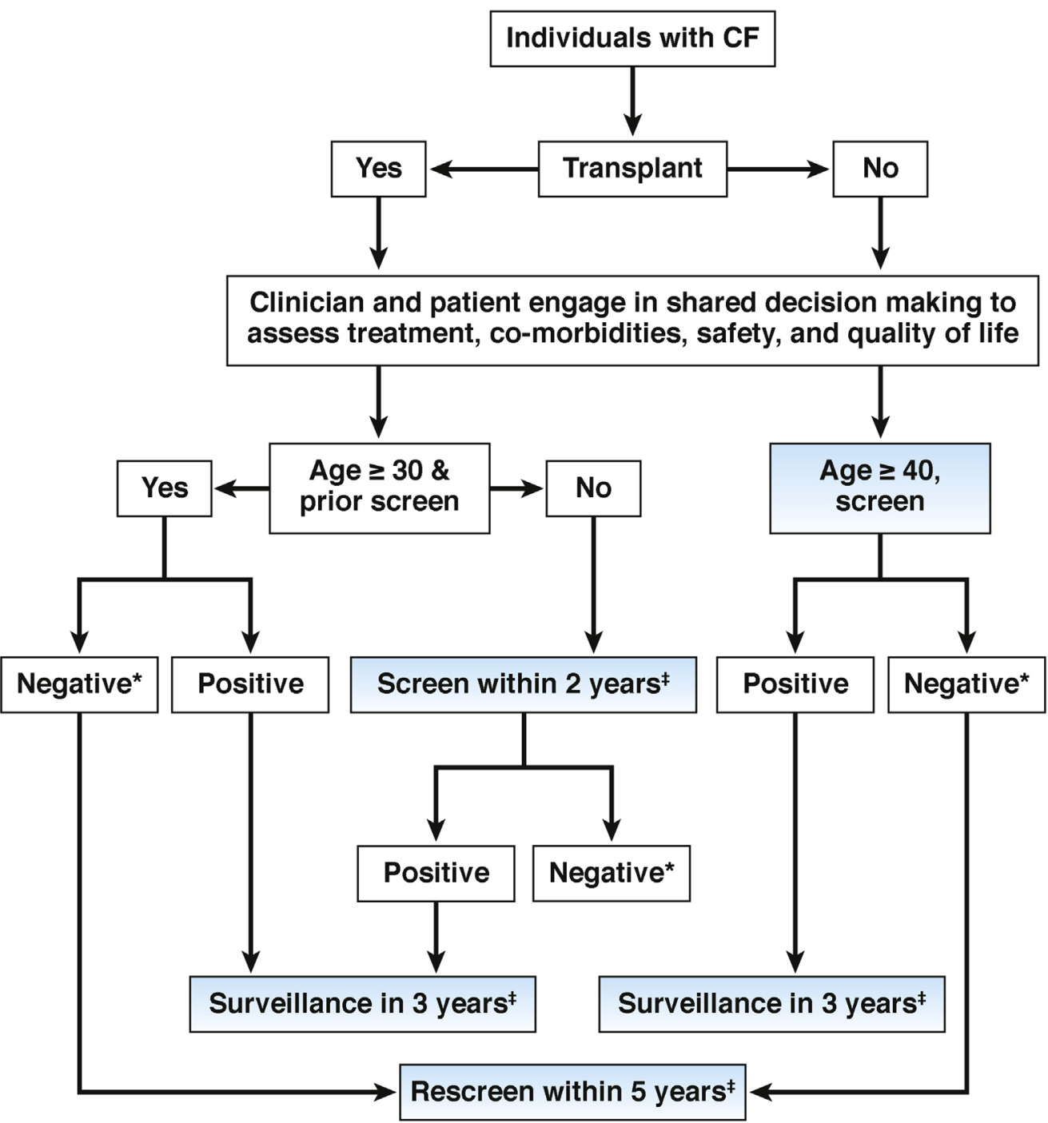
Screening for colorectal cancer
Hadjiliadis et al. Gastroenterology 2018

Slide 35
Pregnancy

Slide 36
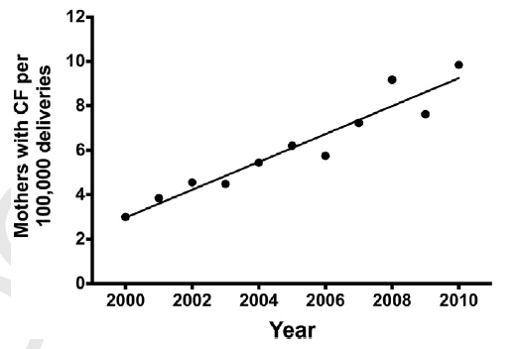
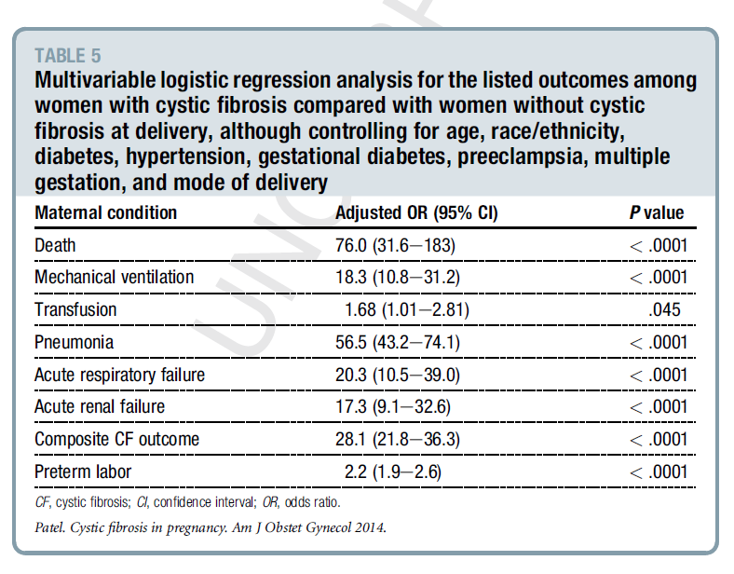

Slide 37
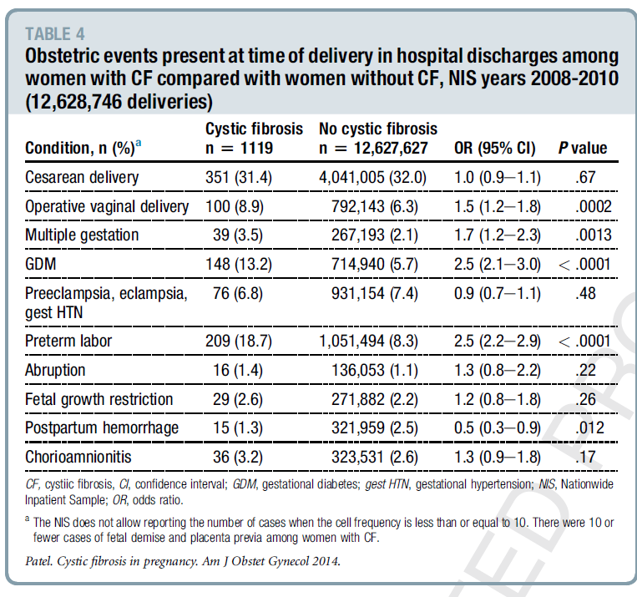

Slide 39
Pregnancy
What to advise the individual patient??
High risk??: FEV 1 < 70% or even lower (<40%)
B.cepacia, Mycobacteria
Malnutrition
CFRD
????
All data available are biased by preconceptional advise!
All adult CF centers should have a CF specialised obstetric team,
Including a clinical pharmacologist.

Slide 40
Even more than a paediatrician an adult CF doctor
should be more than a pulmonologist
Infectious disease
Endocrinology
Gastrointestinal diseases
Gynaecology
General practitioner

Slide 41
An increasing number of (adult) patients
With increased survival more complex lung disease
With increased survival more non pulmonary complications.

Slide 42
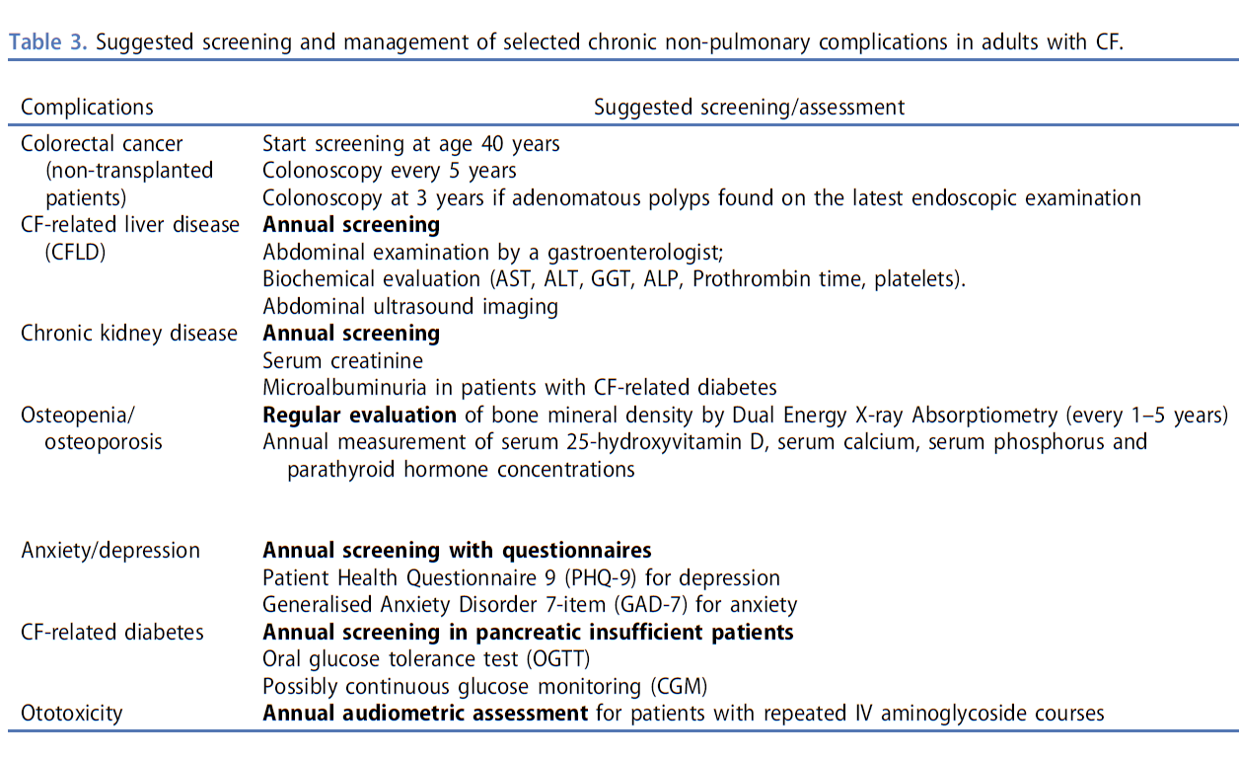

Slide 43

The End

