Slide 1
CF in Egypt: Rare or Unaware
Nader Fasseeh,
Professor of Pediatrics, Head of Pediatric Respiratory and Allergy Unit,
Head of Pediatric Department, Alexandria University, Egypt

Slide 2
Questions to be answered:
Is CF of low prevalence in Egypt?
How do they present in Egypt and why would their presentation vary from the presentations in developed countries?
What is their treatment plan?
Special care and infection control?
What is needed for CF patients in Egypt?

Slide 3
1:2664 ???
1:3000-1:12000
????

Slide 6
Questions to be answered:
How do they present in Egypt and why would their presentation vary from the presentations in developed countries?
What is their treatment plan?
Special care and infection control?
What is needed for CF patients in Egypt?

Slide 9
Delayed onset of diagnosis
Unaware of CF disease
Most of the patients are suffering from malnutrition and Failure to thrive
High rate of PICU and Hospital admissions reflecting very bad follow up and poor management
Higher rate of bacterial infection although the methodology is poor and does not correlate with the PICU and hospital admission rate

Slide 10
Age at Diagnosis
Among all individuals in the Registry in 2016,
66.9% were diagnosed in the first year of life
Cystic Fibrosis Foundation Patient Registry: Annual Data Report 2016

Slide 12
Notes:
Although the age group is young but all of them had failure to thrive, digital clubbing is present in 25% of cases.

Slide 13
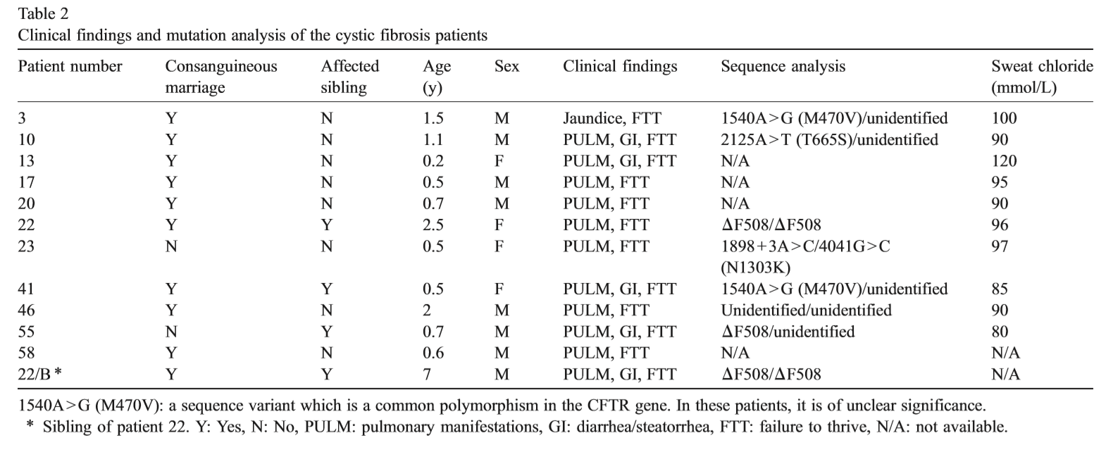

Slide 15
Notes:
Malnutrion CF patients have the highest frequency of hospital admissions. Body Mass indices BMI predicts nutrional failure more sensitive than normal anthropemetric meaurse
Height for age percentile, Weight for age percentile

Slide 16
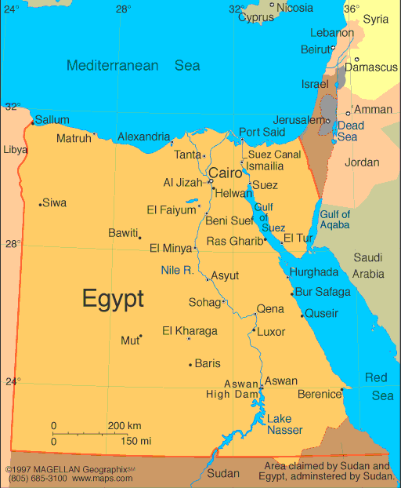
Egyptian demographics – oases, disporportionate
distribution of population
28 Governorates

Slide 18
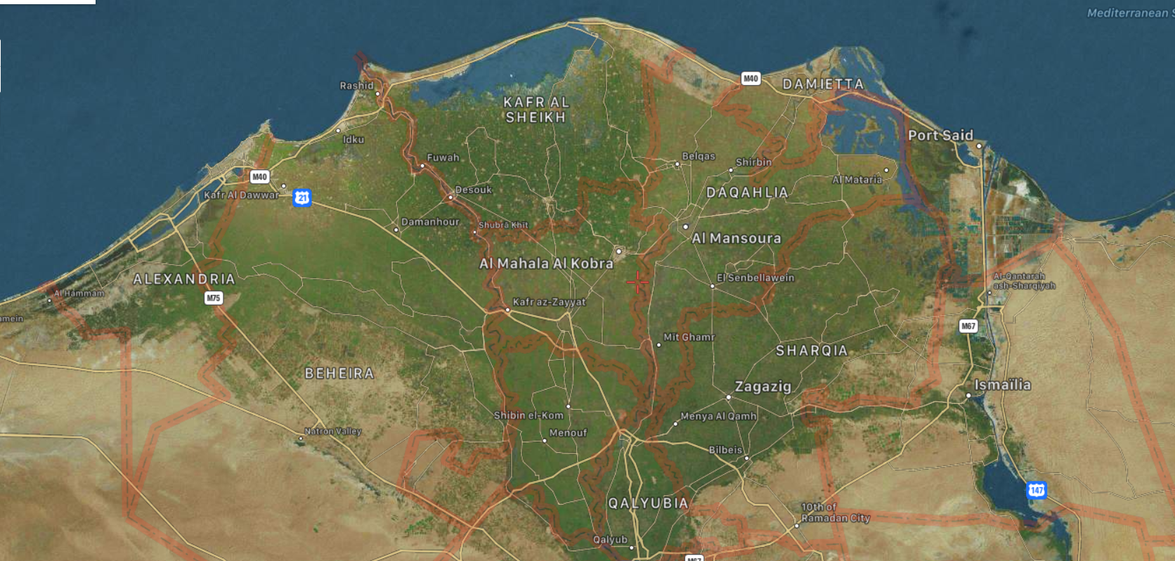
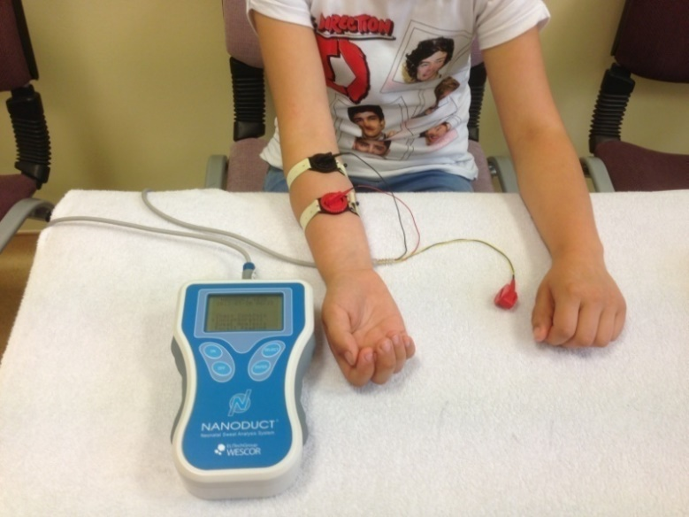
Only one lab for sweat chloride test is available in Alexandria serving 7 Governates with total 30 million people

Slide 19
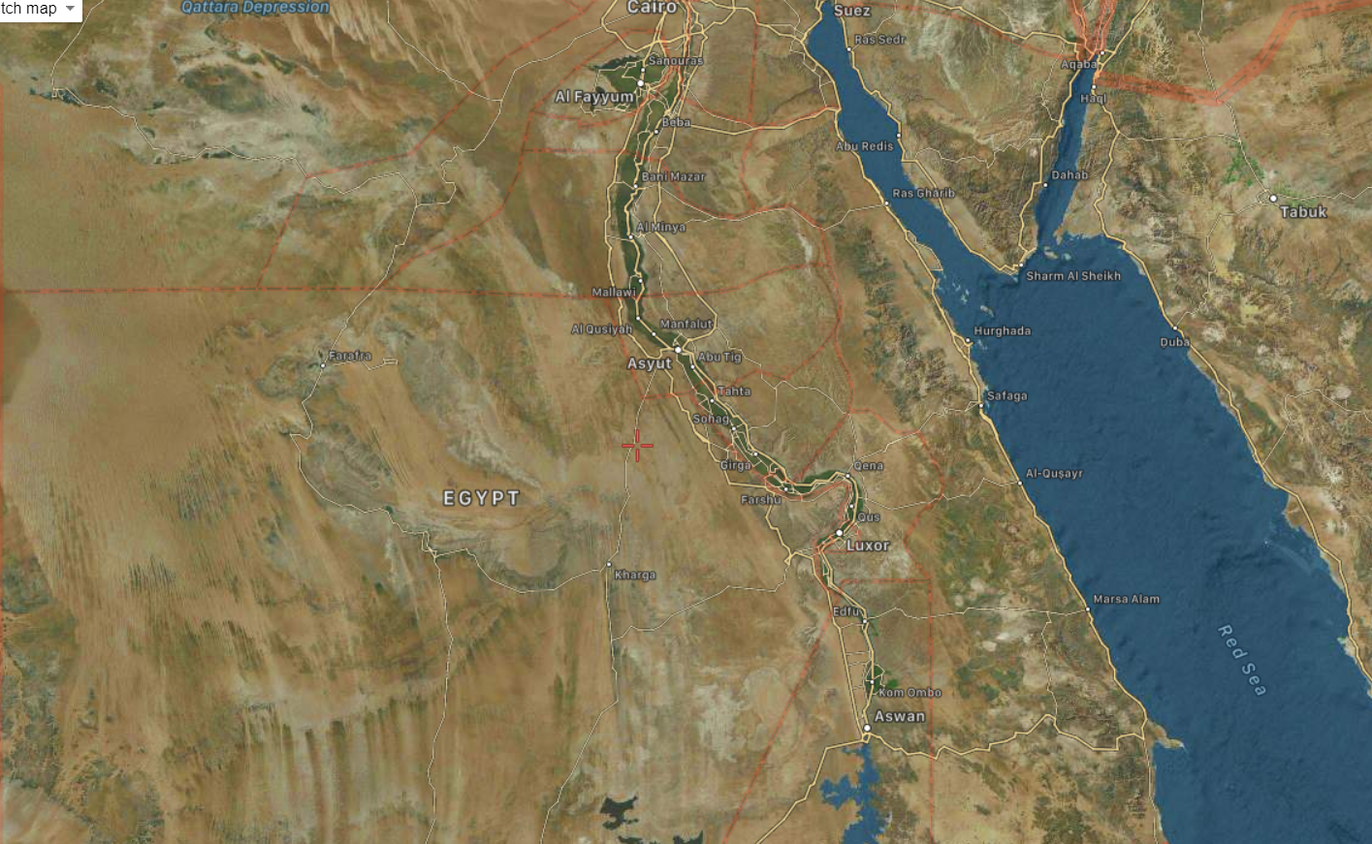
No available sweat chloride test is available in Upper Egypt which include more than 11 Governorates in which more than 35 million people are living

Slide 20
Great Cairo: 3 available laboratories are available
Two private lab
Cairo University lab
Serving 15 million people, and most of Upper Egypt which are 1000 Km far away from Cairo

Slide 21
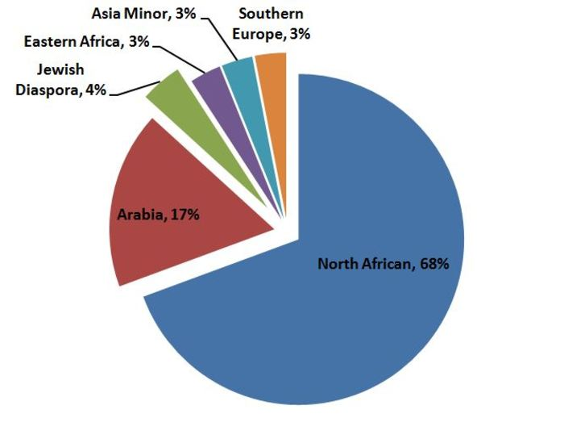
www.egyptindependent.com/dna-analysis-proves-egyptians-are-not-arabs/
genographic.nationalgeographic.com
Notes:
Egypt as Mediterranean North African country, this strategic position attracted many invaders throughout its history. Therefore, in addition to its Pharaonic origin, gene ﬂow to its population occurred from the Ethiopian, Greco-Roman, Arab, Turkish, French and English settlers (Temtamy et al., 2010). The common heritage among the countries bordering the Mediterranean is not restricted to historical or cultural aspects. There are considerable commonalities in the gene pools of the Mediterranean Northern and Southern countries. This “genetic sharing” has resulted from considerable human movements (i.e., migration, invasion, and trade) throughout history in this area (Temtamy et al., 2010). Consequently, Egypt is not like other Arab countries and mutations in theCFTRgenehavebeeninﬂuencedbygeneﬂowcomingfromdiﬀerentpopulations.Furthermore, the high rate of consanguinity, infant and neonatal mortality in the Egyptian society will, therefore, increase CF incidence and private mutations

Slide 22
CFTR mutations
Over 2000 mutations identified
One mutation is common (p.Phe508del; 70% of CF alleles)
Twenty mutations are low frequency (15% of CF alleles)
Remainder (>1900) are rare (15% of CF alleles)
Disease implications of most rare mutations are unknown – implications for screening involving DNA testing!

Slide 23
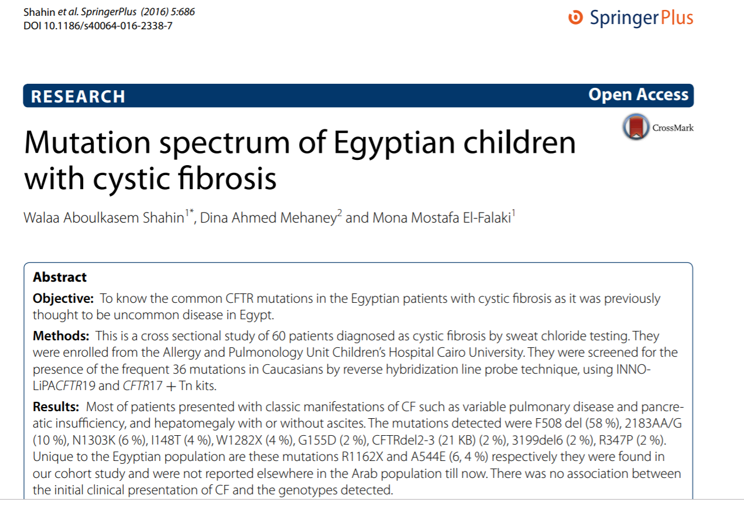

Slide 26
Egypt (148; 8 in progress) ST +/-
Number of samples | Material | Mutation | Allell counts
140 | Guthrie Cards | F508del | 63
 |  | R1162X | 8
 |  | S549R(T- >G) | 7
 |  | N1303K | 6
 |  | 3199del | 5
 |  | R334W | 5
 |  | 1548delG | 4
 |  | 2789+5G>A | 4
 |  | CFTRdele17a-18 | 4
 |  | G378X | 4
 |  | G542X | 4
 |  | R1066C | 4
 |  | R1066H | 4
 |  | 2183delAA>G | 3
 |  | 3129del4 | 3
 |  | 3670del | 3
 |  | 3272-26A>G | 2
 |  | 1525-1G>A | 2
 |  | 4382delA | 2
 |  | Glu632Thrfs*9 | 2
 |  | W1282X | 2
Dr. Eman Fouda – Ain Shams University, Dr.M.L.Naguib and Dr. Mona El Falaki – Cairo University,
Dr Nader Faseeh – Alexandria University
Notes:
Blue for triple combinations
Red for Ivacaftor

Slide 28
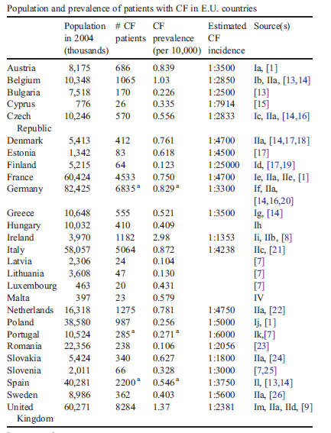
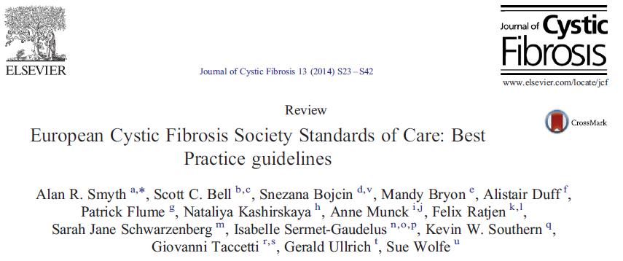
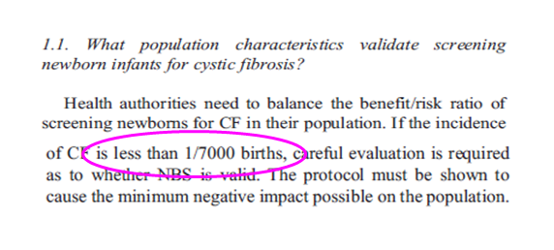
Role of disease incidence
and CF NBS !

Slide 29
CF neonatal screening program is a challenge in Egypt?
Egypt has the largest and fastest growing population in the Arab world, or even in the Mediterranean counteries
With nearly 98 million people and 2.6 million births each year
To meet the country’s goal of providing free neonatal screening to all Egyptian newborns for metabolic diseases and CF patients
Notes:
Meeting the Needs of a Growing Population With nearly 96 million people and 2.6 million births each year, Egypt has the largest and fastest growing population in the Arab world.
To meet the country’s goal of providing free neonatal screening to all Egyptian newborns, MOHP worked with PerkinElmer to construct the Egyptian Newborn Screening Laboratory in Cairo. This state-of-the-art facility features PerkinElmer’s Genetic Screening Processor® (GSP®) and Specimen Gate® Informatics, the most sophisticated neonatal screening tools available. In combination with PerkinElmer’s assistance in significantly upgrading the laboratory’s technology systems, the Egyptian Newborn Screening Laboratory now stands front and center as the world’s largest such screening facility, based on the number of heel-prick tests for congenital hypothyroidism that it conducts each year

Slide 30
Why should we need to screen CF in ME ? Egypt??????
It is good for the patients
High incidence of consanguinity (risk for OR diseases): > 50% in Egypt
Low number of diagnosed patients
Prevalence of CF in Egypt?
Need to improve CF awareness
No CF centers
Lack and paucity of standardization of sweat testing

Slide 31
Why we are in need to perform CF NBS ?
To prevent early malnutrition and vitamin deficiency (usually from 2months of age)
To decrease the early pulmonary complications
(Atelectasis, pneumonia, LRTI)
To have positive effects on long term growth, congnitive funcitons and survival rates
To give genetic advice to parents
Notes:
CF disease manifestations can start very early and are often ini- tially overlooked by health care providers as the first signs and symptoms can be non-specific. On the other hand, the natural history studies of CF disease have demonstrated that lung dis- ease can progress even in the absence of clinical symp- toms [10–12], providing a strong rationale for initiating therapy before irreversible organ damage occurs. In the absence of NBS, infants can face symptoms of severe fat and protein mal- nutrition, sometimes ‘kwashiorkor’-like, as well as symptoms of advanced pulmonary disease before a diagnosis of CF and con- sequent adequate therapy are established. It was therefore sug- gested that early identification of CF disease in infants, ideally before disease symptoms develop, will help to prevent these early disease complications.
In the Cochrane review published in 2009, the Wisconsin NBS trial was the only trial meeting randomized controlled trial cri- teria [48]. As per reviewers’ conclusion, there was an apparent nutritional benefit in screened newborns with less risk for severe malnutrition in the screened newborn groups defined as weight or height below the 10th percentile compared to new- borns identified by clinical diagnosis. Poor nutrition and low a-tocopherol levels (vitamin E, <300 mg/dl), but not the time of the CF diagnosis or a CF diagnosis itself, also had negative long-term effects on CF patients as they were associated with reduced cognitive performance of CF patients at age 10 [49]. Koscik RL, Farrell PM, Kosorok MR, et al. Cognitive function of children with cystic fibrosis: deleterious effect of early malnutrition. Pediatrics 2004;113(6): 1549-58
On the basis of the available data, the Cochrane review further concluded that CF NBS seemed to provide potential for better pulmonary outcomes, but confounding factors such as a high
infection rate with Pseudomonas aeruginosa within the Wiscon- sin NBS study affected the ability to detect differences in pulmonary disease markers between the screened and clinical diagnosed newborns. This high infection rate with P. aeruginosa was mainly due to lack of strict infection control policies sepa- rating newly diagnosed CF newborns from established and infected CF patients, which subsequently have been imple- mented [50]. The lack of association between NBS and lung dis- ease became more apparent in a recently published analysis using longitudinal lung function and chest x-ray data obtained over a 27-year observation period from the Wisconsin NBS study group. Poor growth, hospitalizations and infection with mucoid P. aeruginosa were identified as significant contributors to the decline in lung function, whereas early diagnosis by CF NBS screening had no effect on the decline in lung function in a multi-variable equation model [51]. Sanders DB, Li Z, Laxova A, et al. Risk factors for the progression of cystic fibrosis lung disease throughout childhood. Ann Am Thorac Soc 2014;11(1):63-72
Ann Am Thorac Soc. 2014 Jan;11(1):63-72. doi: 10.1513/AnnalsATS.201309-303OC.
Risk factors for the progression of cystic fibrosis lung disease throughout childhood.
Sanders DB1, Li Z, Laxova A, Rock MJ, Levy H, Collins J, Ferec C, Farrell PM.
Author information
Abstract
RATIONALE:
Previous studies of risk factors for progression of lung disease in cystic fibrosis (CF) have suffered from limitations that preclude a comprehensive understanding of the determinants of CF lung disease throughout childhood. The epidemiologic component of the 27-year Wisconsin Randomized Clinical Trial of CF Neonatal Screening Project (WI RCT) afforded us a unique opportunity to evaluate the significance of potential intrinsic and extrinsic risk factors for lung disease in children with CF.
OBJECTIVES:
Describe the most important intrinsic and extrinsic risk factors for progression of lung disease in children with CF.
METHODS:
Variables hypothesized at the onset of the WI RCT study to be determinants of the progression of lung disease and potential risk factors previously identified in the WI RCT study were assessed with multivariable generalized estimating equation models for repeated measures of chest radiograph scores and pulmonary function tests in the WI RCT cohort.
MEASUREMENTS AND MAIN RESULTS:
Combining all patients in the WI RCT, 132 subjects were observed for a mean of 16 years and contributed 1,579 chest radiographs, and 1,792 pulmonary function tests. The significant determinants of lung disease include genotype, poor growth, hospitalizations, meconium ileus, and infection with mucoid Pseudomonas aeruginosa. The previously described negative effect of female sex was not seen.
CONCLUSIONS:
Modifiable extrinsic risk factors are the major determinants of progression of lung disease in children with CF. Better interventions to prevent or treat these risk factors may lead to improvements in lung health for children with CF.
In a similar approach, CF colleagues in the UK, Wales and West Midlands, screened newborns for CF every alternating week from 1985 to 1989 in two CF centers. The investigators did not find any difference in nutritional status between the screened versus non-screened CF children in a 5-year follow-up period. However, clinically identified CF children had signifi- cantly more frequent and longer hospital admissions [52]. Less CF-related complications have also been reported in NBS-screened CF patients when compared with clinically iden- tified CF patients in a study that used the clinical data from the US CF data registry for their analysis [53]. Accurso FJ, Sontag MK, Wagener JS. Complications associated with symptomatic diagnosis in infants with cystic fibrosis. J Pediatr 2005;147(3 Suppl):S37-41
J Pediatr. 2005 Sep;147(3 Suppl):S37-41.
Complications associated with symptomatic diagnosis in infants with cystic fibrosis.
Accurso FJ1, Sontag MK, Wagener JS.
Author information
Abstract
OBJECTIVE:
To determine the complication and hospitalization rates in children with cystic fibrosis (CF) by mode of diagnosis.
STUDY DESIGN:
Newly diagnosed cases of CF were identified from the Cystic Fibrosis Foundation National Patient Registry for 2000 through 2002. Cases were categorized as symptomatic diagnosis (SYMP; n = 1760), prenatal diagnosis (PRE; n = 66), diagnosis by means of newborn screening (NBS; n = 256), or presentation with meconium ileus (MI; n = 484). Complications were defined for the calendar year of diagnosis as stunting (length <3rd percentile), wasting (weight <3rd percentile), positive Pseudomonas aeruginosa culture results, and hypoelectrolytemia or edema and hypoproteinemia.
RESULTS:
For infants (age <12 months), 70% of patients with SYMP had at least 1 complication or hospitalization, compared with 29% for patients with NBS diagnosis (P < .0001). Cross-sectional data for 2002 showed that patients with SYMP had significantly more complications compared with patients with NBS diagnosis as old as 20 years. When compared with patients with NBS diagnosis, patients with SYMP had increased mucoid P aeruginosa (P < .05) and decreased pulmonary function as assessed by means of forced expiratory volume in 1 second (P < .01).
CONCLUSIONS:
SYMP of CF is associated with increased complication rates throughout infancy, childhood, and adolescence when compared with NBS diagnosis.

Slide 32
Complexity of CF Treatment
High Treatment Burden
Daily medical treatments
Chest physiotherapy
Dietary & vitamin supplements
Pancreatic enzyme replacement
Respiratory medications
What is defective in Egypt?
Bregnballe, et al. Patient Prefer Adherence. 2011;5:507-15. Sawicki, et al. Pediatr Pulmonol.
2012;47(6):523-33.
Notes:
The treatment burdens placed on patients with CF and their families are numerous, and the burden is significant regardless of age or disease severity. Every day, patients must coordinate medical treatments, chest physiotherapy, dietary supplementation, and pancreatic enzyme replacement. In addition, multiple respiratory medications must be administered – oral and aerosolized.

Slide 33
Management of lung health in CF
Airway clearance
Treatment of infections
Treatment of inflammation
Restoring the CFTR function

Slide 34
Improving Airway Clearence
Chest physiotherapy
Postural drainage-percussion
Breathing exercises
P.E.P valve, Flutter valve
High-frequency oscillation technique (Vest, etc)
Bronchodilator (Salbutamol-Ipratropium)
Bronchodilation
Improve in ciliary functions
Mucolytic treatment
Dornase alpha/recombinant DNase
Hypertonic saline nebulisation
Mannitol
Not available in Egypt
Coast
Not available in Egypt
Coast

Slide 35
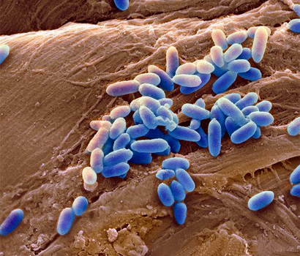
Treatment of Infections
Actual infection ? Colonisation ?
Eradication of the infection is difficult:
Antibiotic resistance
Inefficient antibiotic adherence to secretions
Mucoid Pseudomonas with alginate production (biofilm)
CF-Related Mucosal defense defects

Slide 36
Early diagnosis of bacterial infections
Routine evaluation of microorganisms in respiratory tract is an important for CF Care.
Sputum culture should be obtained at each visit.
As sputum can not be available in infants, oropharyngeal and nasopharyngeal aspiration cultures are evaluated.
Bronchoscopy and bronchoalveolar lavage should only be used in patients without response to standard therapy.
Jain K et al 2013
Mogayzel PJ et al 2014
Borowitz D et al 2009

Slide 37
Inhaled Antibiotic Treatment
Inhaled tobramycin (nebulised or DPI)
One month ON one month OFF – to reduce antibiotic resistance
Nebulised twice daily
Other options:
aztreonam,
vancomycin
Colomycine
Not available in Egypt
Coast

Slide 38
Azithromycin Treatment
Anti-inflammatuary effect depends both on antimicrobial and immunomodulator effects.
Decreases the rate of pulmonary excerbations.
An average of 5.5% increase in FEV1 and decrease in oral antibiotic needs.
Effect starts slowly ( at least 2 months). Evaluation of the treatment should be minimum after 4 months.
Once daily, 3 days per week.
5
Azithromycine
4
3
2
FEV₁ değişim (%beklenen)
1
0
-1
-2
Placebo
-3
-4
0
4
8
12
16
20
24
28
Hafta
Jaffe A, et al. 1998
Wolter J, et al. 2002
Equi A, et al. 2002
Saiman L, et al. 2003
Hoffmann N, et al. 2007
Clement A, et al. 2006
Southern KW, et al. 2012

Slide 39
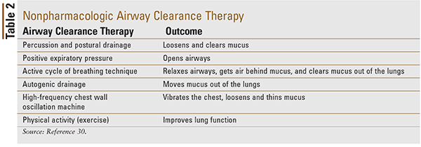
Mainstay of treatment, how correct are these data in practice?
Sorry we are missing a lot of mandatory and important medications in Egypt which significantly affect the life style, life span, and profile of the patients

Slide 40
What are we doing for improving CF management in Egypt?
Increased awareness of pediatrician about the disease prevalence in Egypt with somewhat better but slow response
Increased the availability of diagnostic lab in new Governerates:
Damanhour (Behira Governerate), Mansoura (Dakaheli Governrate)….
CF NBS is a challenge but Pilot study will start in 2020 in 4 Governerates, Alexandria, Behira, Kafr Alsheik, and Marsa Matrouh
Supporting Genetic lab for genotyping of our CF patients for better mutations panel suitable for Egyptian population
Supporting National Pharmaceutical companies for manufacturing, inhaled tobramycin, pancreatic enzymes, and other medications

Slide 41
Thank You!

