Slide 1
Procalcitonin and C-Reactive Protein in Hospitalized Adult Cystic Fibrosis and Non-Cystic Fibrosis Bronchiectasis Patients with Exacerbation
Dr. Şehnaz olgun yıldızeli
Marmara universıty school of medıcıne pendık teachıng hospıtal department of pulmonology and ıntensıve care

Slide 2
Aim
C-reactive protein (CRP) and procalcitonin (PCT) are inflammatory markers used in the diagnosis and follow-up of infectious diseases.
Diagnosis of CF exacerbation based on an increase in white blood cells (WBC) in complete blood count, inflammatory markers, C-reactive protein (CRP), and erythrocyte sedimentation rate.
Still there is no only one gold standard marker for exacerbations of CF or non CF patients

Slide 3
Procalcitonin (PCT) is a peptide precursor of the hormone calcitonin; it is also a newly identified infection marker. It can be detected at high levels in bacterial diseases
PCT also has shorter durations for reaching peak levels than CRP (8 h vs 36 h)
Although it is difficult to define a gold standard for an infectious marker, meta-analyses have shown that PCT is more sensitive (88% vs 75%) and specific (81% vs 76%) in bacterial infections
Simon L, Gauvin F, Amre DK, Saint-Louis P, Lacroix J. Serum procalcitonin and C-reactive protein levels as markers of bacterial infection: a systematic review and meta-analysis. Clin Infect Dis 2004;39:206–17. doi: 10.1086/421997

Slide 4
Aim
The aim of the study is to determine the contribution of CRP and PCT in severe acute exacerbations requiring hospitalization in adult CF and non-CF bronchiectasis patients.

Slide 5
Methods
This was a retrospective study including patients aged ≥18 years with acute CF exacerbation (study group) and non-CF bronchiectasis (control group) that were followed by the adult pulmonology clinic at our hospital between May 2013 and December 2016.
Totally, 102 non-CF bronchiectasis and 76 CF patients were reviewed and 119 hospitalizations were detected; however, 4 hospitalized patients were excluded because of transfer to other intensive care units and another 12 were excluded because of lack of data
This study was approved by ethical committee of Marmara University School of Medicine

Slide 6
Methods
CF was diagnosed based on pilocarpine iontophoresis-induced sweat chloride levels ≥60 mEq/l or genetic analyses revealing two CF-related mutations and two CF-consistent clinical findings.
Pulmonary CF exacerbation was defined according to the Clinical Practice Guidelines Signs and Symptoms of Pulmonary Exacerbation
Cystic Fibrosis Foundation. Clinical practice guidelines for cystic fibrosis. Bethesda, MD: Cystic Fibrosis Foundation 1997.
Non-CF bronchiectasis patients were defined by excluding CF but confirming bronchiectasis by high resolution computed tomography. At least two clinically elevated respiratory symptoms, such as cough, increased sputum amounts, color change of sputum, and increased dyspnea were accepted as non-CF bronchiectasis exacerbation.
PCT was measured in duplicates using 50 μl serum by the time-resolved amplified cryptate emission technology (Brahms, England), whereas CRP was measured using 25 μl serum by an automated analyzer (Abbott Architect, Illinois). Cut-off values of 0.5 ng/ml for PCT and 5 mg/l for CRP were maintained. WBC counts >10000 indicated leukocytosis.

Slide 7
Methods
Finally, a total of 52 hospitalizations of 18 CF patients and 51 hospitalizations of 20 non-CF bronchiectasis patients were included in the study.
Patient age, gender, body mass index (BMI), smoking history, chronic illness history, regular medications, colonization status, pulmonary function tests performed during last stabilization period, hospitalization history and duration, exacerbation criteria, antibiotics used during hospitalization, sputum cultures, and daily CRP and PCT levels during hospitalization were recorded
This study was approved by ethical committee of Marmara University School of Medicine

Slide 8
Statistical Analyses
Statistical analyses were performed using the SPSS program, version 23.0. Normal distribution of variables was examined using histogram graphs and the Kolmogorov–Smirnov test . The mean, standard deviation, median, and minimum–maximum values were used when descriptive analyses were presented, and 2 × 2 tables were used to compare variables with the Pearson’s chi-squared and Fisher's exact tests. When normal (parametric) variables were evaluated, the student’s t-test was used for independent groups; when non-normal (non-parametric) variables were evaluated between groups, the Mann–Whitney U Test was used. The Spearman’s correlation test was used to analyze the correlation among measured data. A P-value of <0.05 was considered statistically significant.

Slide 9
Results
Demographic data of both groups were similiar. The mean length of hospitalization was 10.6 ± 2.5 days in CF patients and 10.0 ± 1.9 days in patients with non-CF bronchiectasis (p> 0.05).
CRP and PCT levels were positively correlated with length of hospitalization (r: 0.501, p: 0.0001 and r: 0.289, p <0.04, respectively) in CF patients, but not in non-CF patients.
Upon examination of day 0 WBC, CRP, and PCT levels, no statistical significance was observed between positive and negative culture patients in both CF and non-CF patients

Slide 10
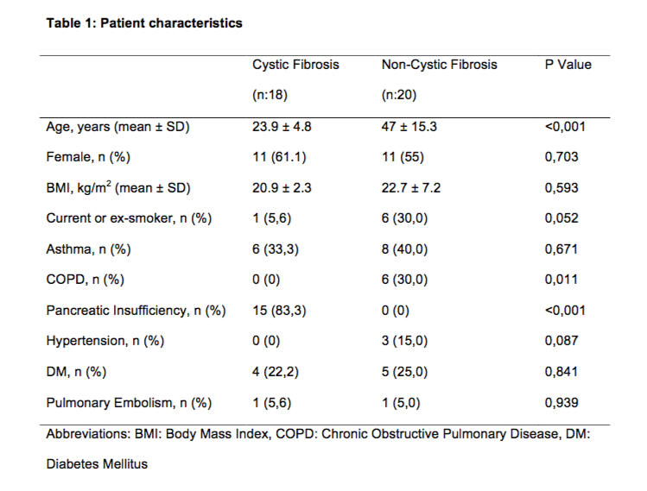
Results

Slide 11
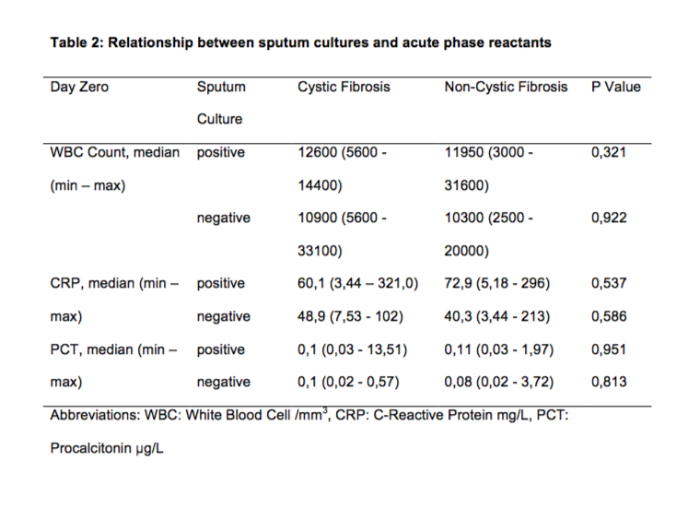
Results

Slide 12
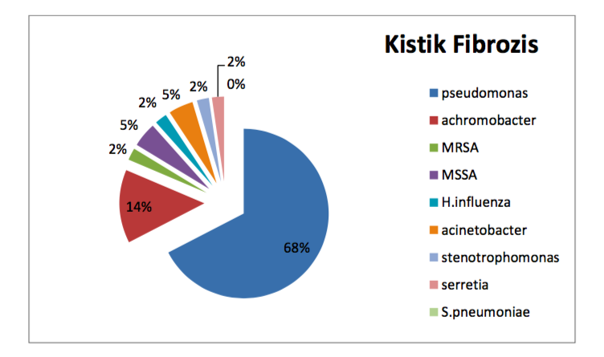
Results

Slide 13
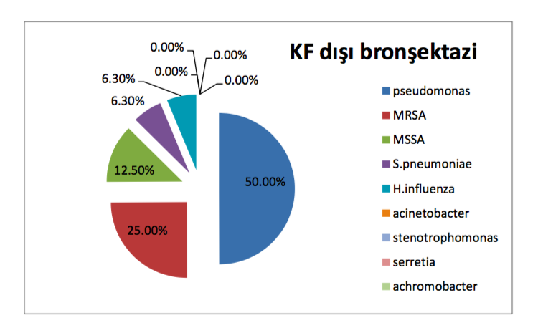
Results

Slide 14
Results
Observation of the effects of decreasing inflammatory markers on antibiotic response at 24 and 72 h revealed that CRP and PCT levels at 24 h did not show any significant change in non-CF bronchiectasis patients (P = 0.479) and remained statistically insignificant (P = 0.053) in CF patients.
At 72 h, there was a significant decrease in inflammatory markers in both CF and non-CF bronchiectasis patients (P = 0.039 vs P = 0.006,).
When patient CRP and PCT levels were analyzed under antibiotic treatment during the first 10 days of admission, the decrease in CRP levels was linear and the decrease in PCT levels was biphasic (Fig. 1-2).

Slide 15
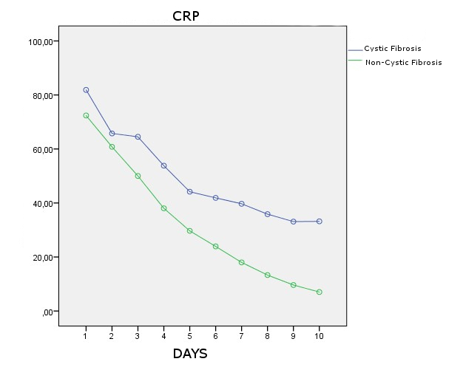
Results

Slide 16
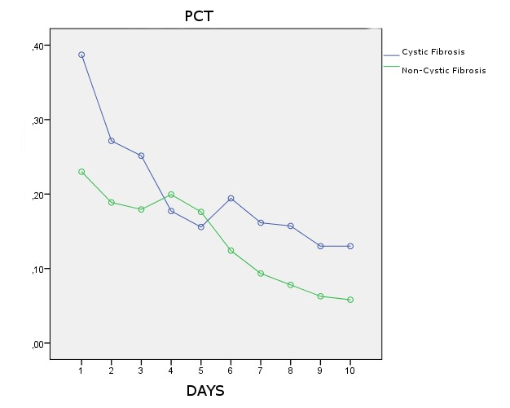
Results

Slide 17
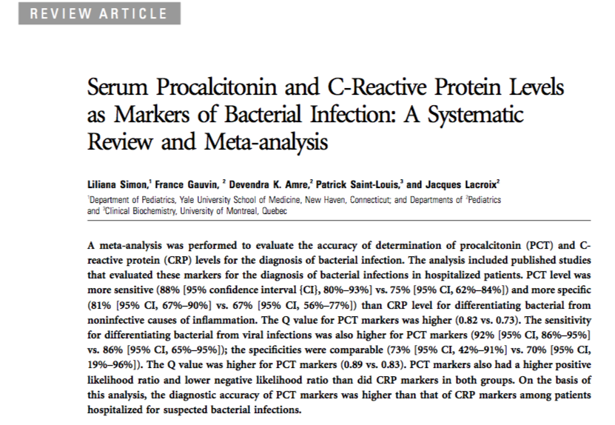
Discussion

Slide 18
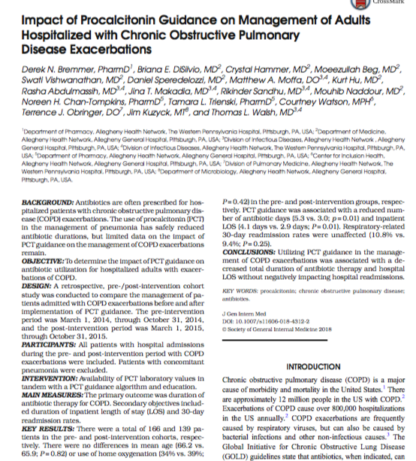

Slide 19
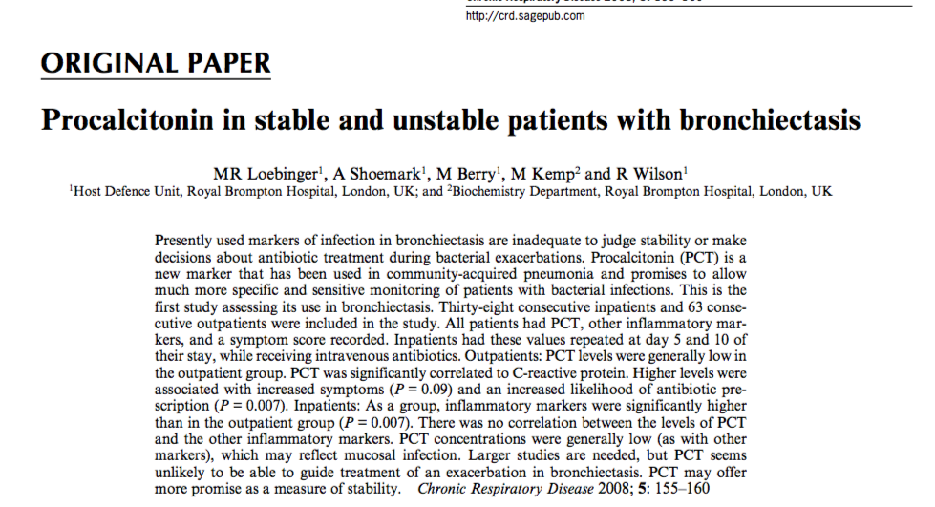

Slide 20
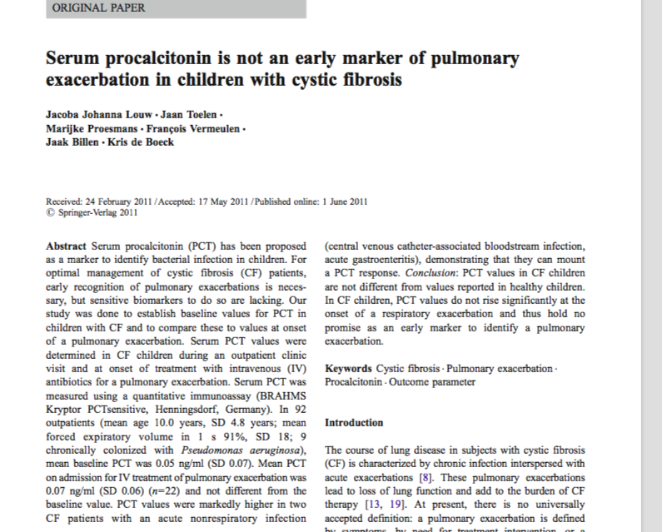
Discussion

Slide 21
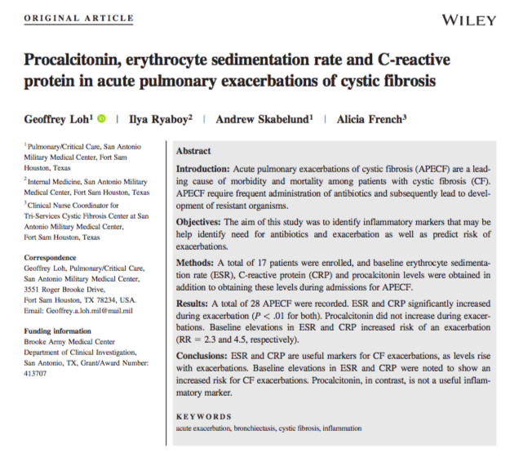

Slide 22
Limitations
Considering the shortcomings of this study, only a limited number of patients could be included because of data loss and the retrospective nature.
Also, short- and long-term outcomes of patients were not included.
Although the study population was familiar with the signs and symptoms of chronic diseases, the presence of a subjective group of symptoms potentially affected the inflammatory marker levels on the day of admission because of the admission time.
Cut-off levels for PCT marker used as in bloodstream infection levels because there is no standardized levels for respiratory tract infection

Slide 23
Conclusion
Elevated levels of CRP and PCT (at the time of diagnosis) in CF patients were associated with prolonged hospitalization.
Superiority to each other was not detected.
It should also be remembered that clinically significant reduction of CRP and PCT on the third day under treatment in both bronchiectasis groups is warranted.

