Slide 1
Establishing CF Centers, Standards and Challenges

Slide 2
Samya Nasr, M.D., C.P.I.
Professor of Pediatrics
Director, Cystic Fibrosis Center
President, Michigan Thoracic Society
Coordinator, State of Michigan CF NBS Program
University of Michigan Medical School
Ann Arbor, Michigan, USA

Slide 3
Outlines
What is A CF Center- CFF Standards
Guidelines for Personnel Time Allotments to CF Centers
Example: University of Michigan CF Center
Challenges of Establishing CF Center

Slide 4
What Is A CF Center
Over 120 CF Centers accredited by the CFF
Centers usually consist of Pediatric and Adult CF Programs
Centers could be only Pediatrics or Adults
Affiliate CF Centers are usually smaller centers. Usually affiliated with accredited CF Center geographically close to the center

Slide 5
What Is A CF Center- Continue
To be accredited:
- The CF Center should have adequate physicians
and Support Staff
- CF Center mission according to CFF Guidelines
- Have accredited Sweat Testing lab.
- CFF accreditation visit every 5 years or sooner

Slide 6
Where are CFF-accredited care programs?

Slide 7
What is the CF Center Structure
Minimum Requirement
CF Center Director
CF Center Associate Director
CF Center Coordinator
SW, Nurse, Dietician, RT, PT, administrator
Recommended: psychologist, pharmacist
Involvement of: Endocrinologist, GI, ID

Slide 8
Guidelines for Personnel Time
Allotments to CF Centers
1. M.D.’s: 1 Full Time Equivalent (FTE) per 100 – 150 patients. There is a minimum requirement of 2 M.D.’s per center.
2. R.N.: 1 FTE per 100 – 200 patients.
3. Social Worker: 1 FTE per 100 – 200 patients.
4. Dietitian: 1 FTE per 100 – 200 patients.
5. Respiratory Therapist: 1 FTE per 100 – 200 patients.

Slide 9
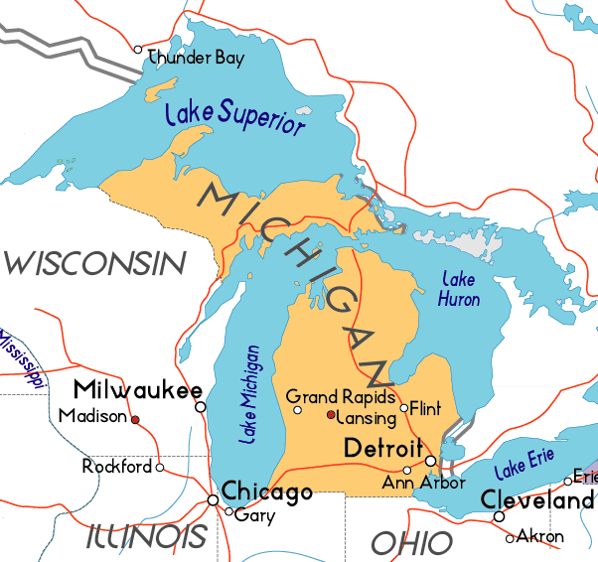
University of Michigan CF Center Where we are:
Detroit 40mi
  43min
Chicago 240mi
  3 ½ hrs
Toronto 280mi
  4 ½ hrs
Airport 25mi
  Major Hub
  25min

Slide 10
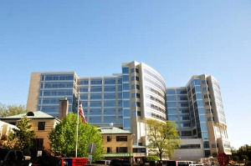
University of Michigan- CS Mott
Children’s Hospital

Slide 11
CF Center Director
Appointment has to be approved by the CFF’s Center Committee
Strong Leader, good organizational and communication skills
Overseeing the day to day CF Center operation
Overseeing hiring/ maintaining skilled/well trained staff members
Coordinate educational effort: patients, families/ medical personnel
Insure implementation of Practice Guidelines and Research
Implement Quality Improvement to improve outcomes

Slide 12
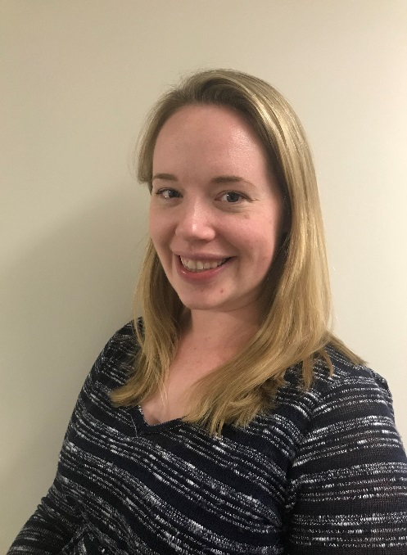
Role of the CF Center Coordinator
Two years experience working with CF& or experience as a clinic coordinator
Strong leadership skills
Good organizational/communication skills
Self-starter with initiative
Values teamwork & work with multidisciplinary team
Ability to problem-solve

Slide 13
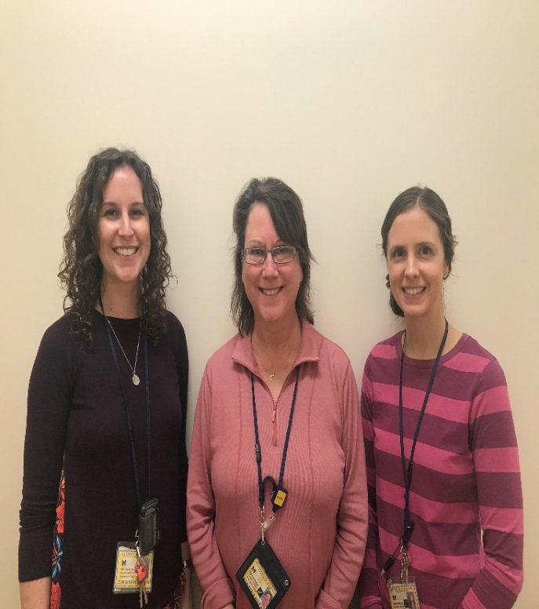
Role of the CF Center Nurse
Medications reconciliation & assessing parental/
patient knowledge of medications
Assess adherence to treatment
CF education: provide basic CF education
Medication education: on uses, risks, benefits, side effects & Proper use of inhaled medications
Throat culture, Nasal viral swab
School forms filled out: medication use in school
Other letters: ie travel letter, gym letter, smoke exposure letter,…

Slide 14
CF Center Nurses
Weekly Pre-clinic Huddle
Post-clinic review with CF Director/Associate Director, email team with concerns or recommendations
Case management/ follow up of hospitalized patients
Case management of outpatients and Sick calls
Follow up on laboratory results, relaying results to family

Slide 15
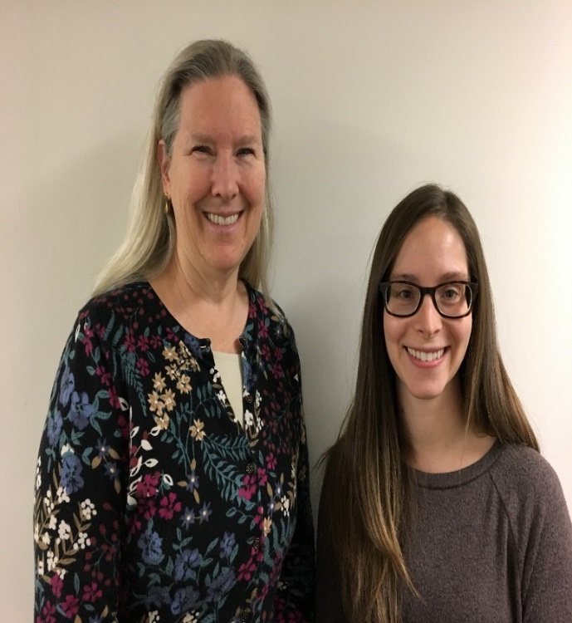
CF Center Dietitian
Provide nutrition therapy: In clinic and on phone:
  Evaluate intake/appetite/ Provide recommendations
    On high calorie, fat & protein, adequate salt
    On oral supplements and enteral nutrition
    On vitamin supplements
  Discuss stool output/abdominal pain
  Provide enzyme dosing recommendations
Administrative tasks:
  Prepare patient notes with updated information prior to clinic
  Attend weekly huddle prior to patients coming to clinic
  Make reminder calls to patients’ for OGTT yearly lab

Slide 16
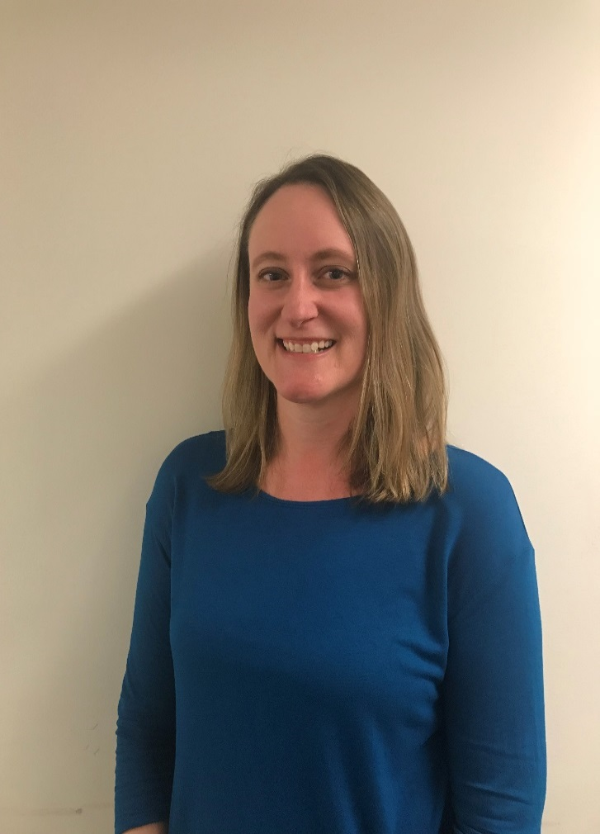
Role of the CF Center Social Worker
Provide education & support through life
changes / adjustments starting with diagnosis
Transition Process –Work with patients & families to prepare for a healthy transition to
the adult clinic using CF RISE & other tools
Assist with navigating systems/ Resources

Slide 17
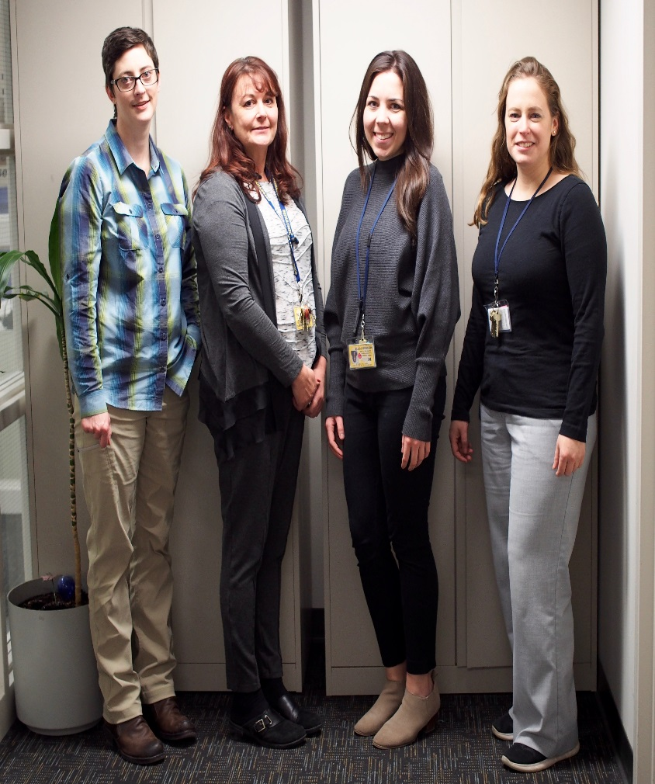
CF Center Research Coordinators
Completing Feasibility forms for new studies
Participating in the Investigators Meetings
Participating in the Study Initiation Visit
Submitting new study applications to the IRB
Study subject screening, study recruitment
& conducting study visits
Maintaining all regulatory documents,…

Slide 18
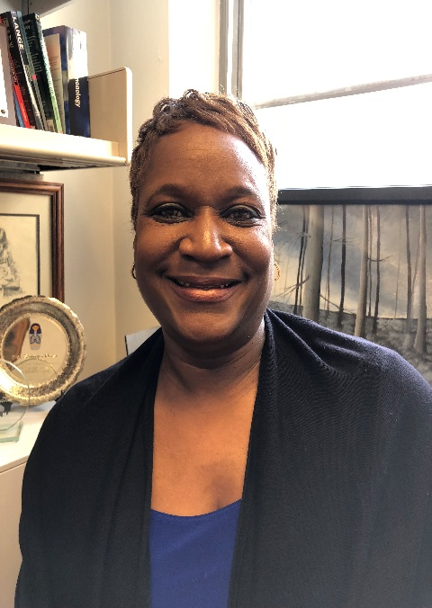
CF Center Administrator
1- Maintains good communications between
patients, families & the Center through
emails/ phone calls & mail
2- Event Coordinator for Family Education
Night & Family Advisory Board
3- Help with the CF Center Newsletter
4- Help with the CF Center Grant renewal
5- Email families with updates from CF Center
(drug recalls, new information, changes in clinic)

Slide 19
CFF Requirements for Accreditation
Three Missions:
Patient care and quality of care
Participating in Research; clinical (PI
initiated or Multi-Center) and basic science
Teaching: faculty, trainees and public

Slide 20
Establishing CF Center, Challenges
Having adequate personnel
Securing salary support from the hospital
Having adequate clinic space
Appropriate inpatient rooms / space
Infection control guidelines, Implementations & Challenges

Slide 21
Primary CF Microbiology
100
90
80
70
60
Percent
50
40
30
20
10
0
0-1
2-5
6-10
11-17
18-24
25-34
35-44
45+
Age in Years
P. aeruginosa
S. aureus
H. influenzae
S. maltophilia
B. cepacia
A. xylosoxidans
Cystic Fibrosis Foundation, Patient Registry 2015 Annual Report, Bethesda, Maryland.
Notes:
State the percentages for each organism.

Slide 22
Current Updates on Infection Prevention & Control (IP&C)
Recommendations for IP&C in CF
  Education of Healthcare personnel, patients & families. Adherence are monitored by CF care team.
  Minimizing transmission/acquisition: ALL CF patients should not be in contact or be separated by 6 feet (does not apply to members of the same household)
  Hand hygiene (includes all personnel)
  Immunizations: Healthcare personnel, CF patients & Families should be vaccinated (including influenza)

Slide 23
Current Updates- Continue
Recommendations for IP&C: CF Clinics
  Minimizing time in common waiting areas
  Any individual with Burkholderia spp should be scheduled on separate days
  CF patients should wear surgical masks in any healthcare facility to reduce risk of droplet precautions (includes public restrooms in such facilities)
  Healthcare personnel should implement Contact Precautions in the clinic and in PFT lab
  Disinfect stethoscopes before & after examining patients

Slide 24
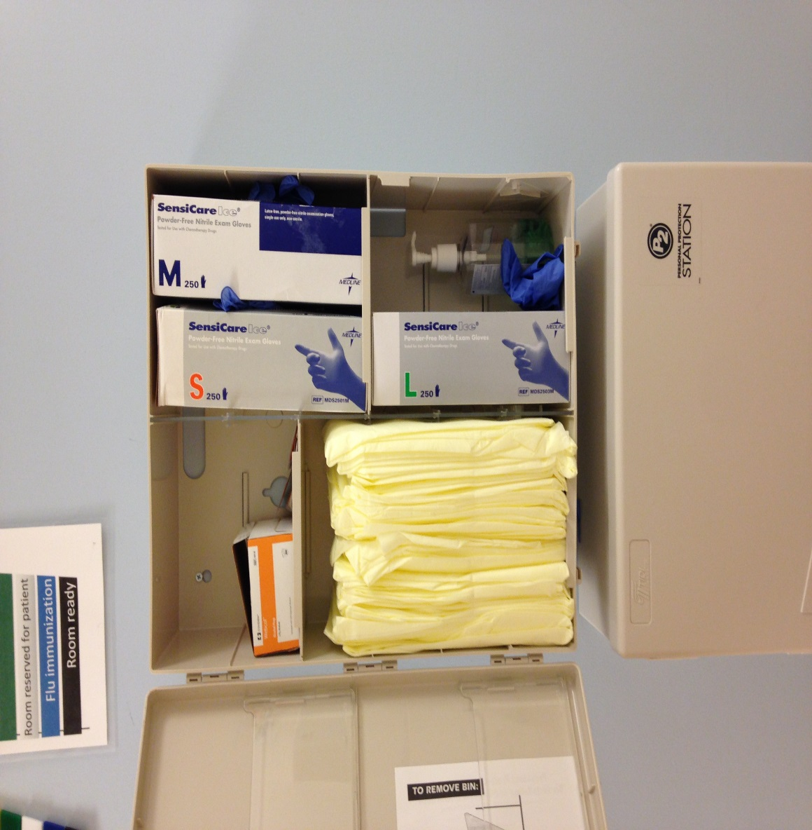
IC& P in Clinic

Slide 25
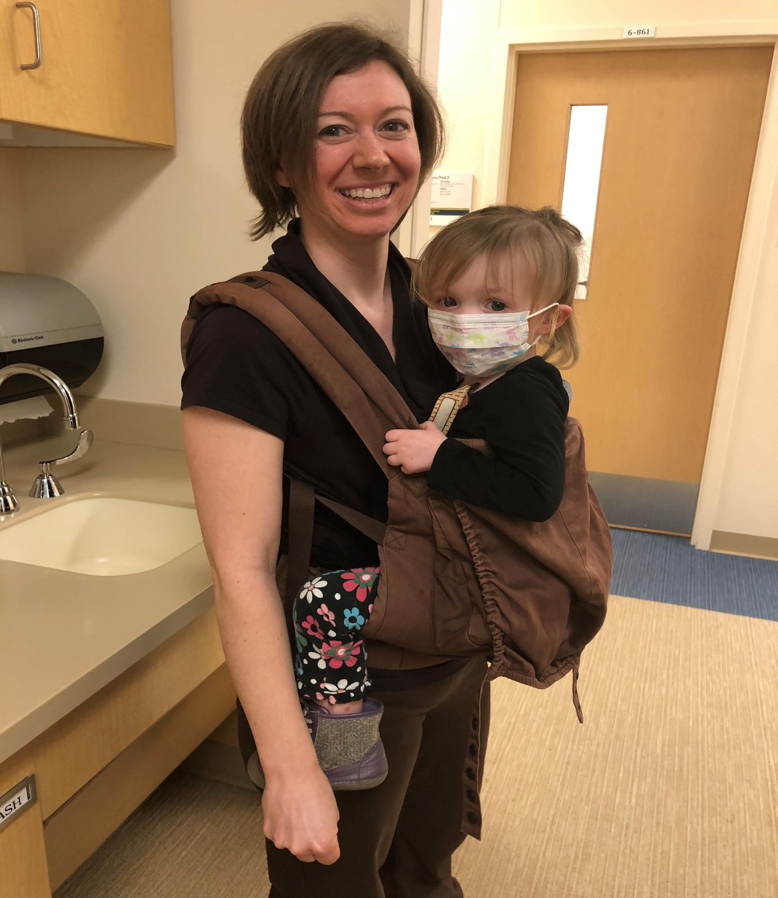

Slide 26
Current Updates- Continue
Recommendations for IP&C: Inpatient Settings
  Similar to outpatient setting
  Individuals visiting CF patients to follow local hospital IP&C policies for use of masks, gowns & gloves
  Healthcare personnel should use Contact
  Precautions for all CF patients (gown & gloves)

Slide 27
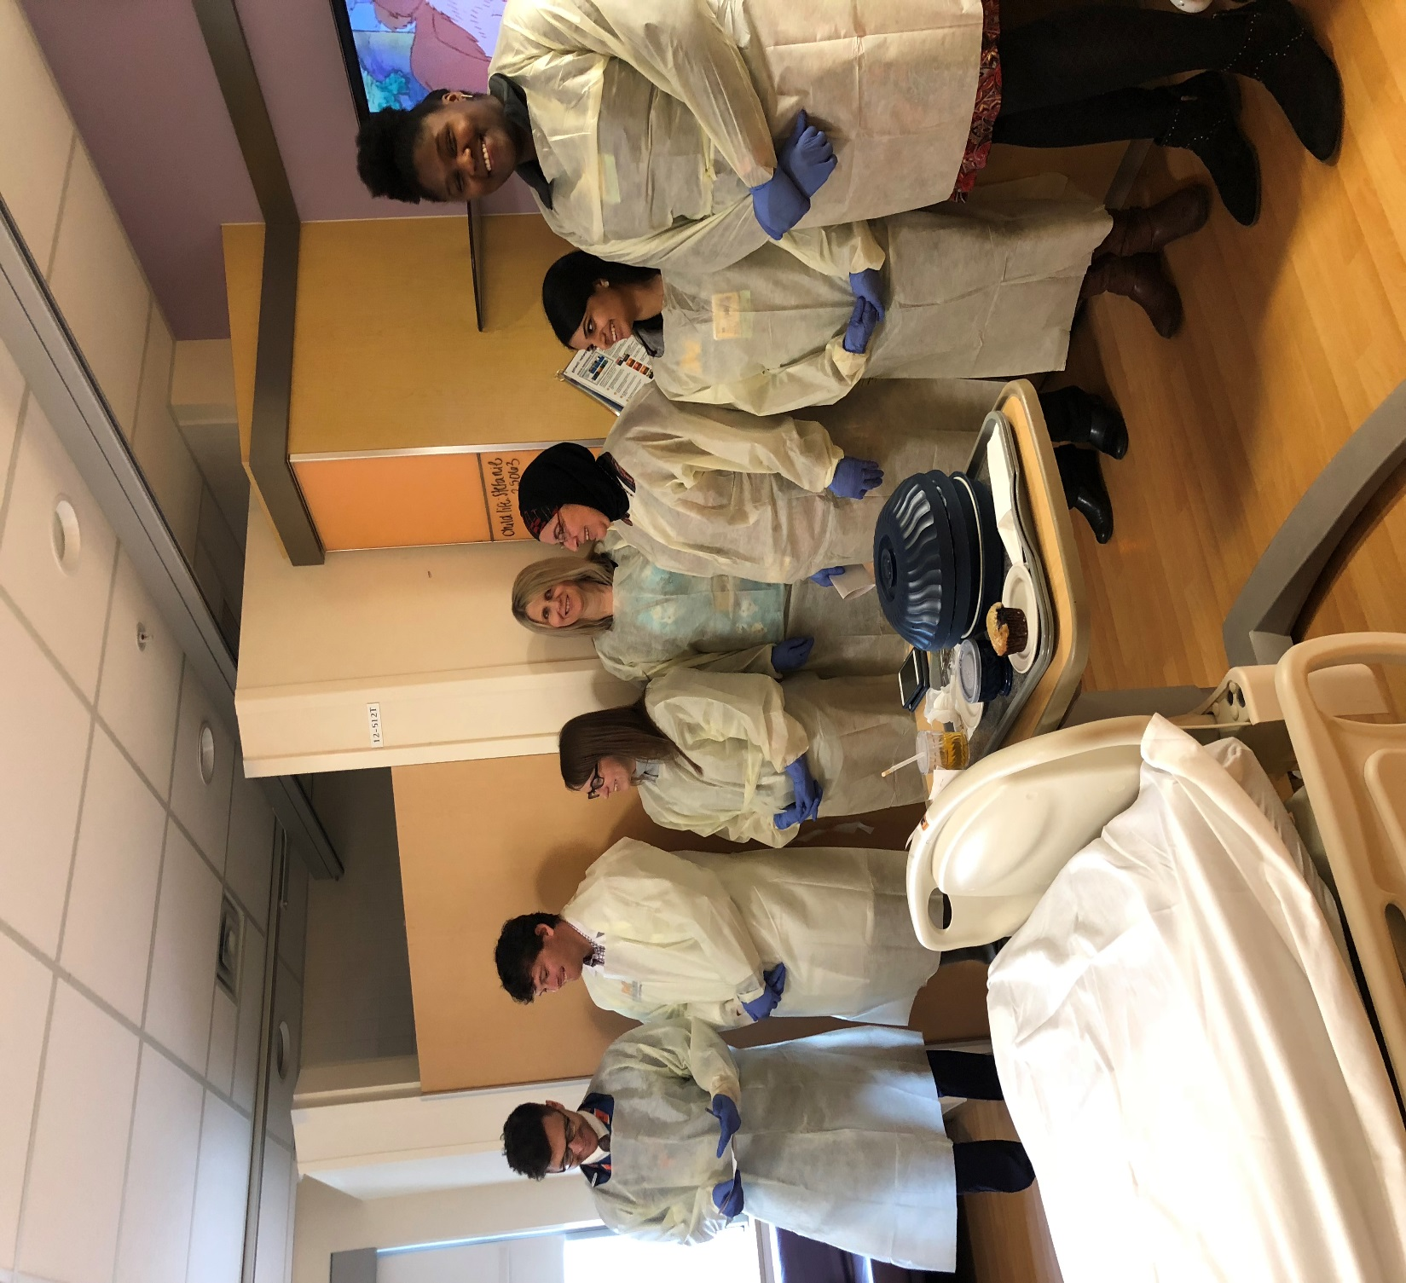

Slide 28
Current Updates- Continue
Recommendations for IP&C: Non-healthcare Settings
  Only 1 CF patient can attend CFF- or CF Center sponsored indoor events to reduce risk of person-to-person transmission
  CF patients can attend outdoor events, most remain 6 feet or 2 meters apart from others with CF.
  CF patients should avoid contact with individuals with MRSA skin/soft tissue infections, unless wounds are covered, hand hygiene is used & no personal items shared
  Avoid activities that generate dust from soil to decrease exposure to potential pathogens (ie Aspergillus)

Slide 29
Current Updates- Current
Recommendations for IP&C: CF Healthcare Personnel
  Should not provide care for other CF patients
  CF patients interested in healthcare career should seek counseling from their CF care team
  Healthcare personnel with CF should inform their employers’ Workforce Health & Safety Dept. about the diagnosis to minimize transmission/acquisition (disclosure is confidential)

Slide 30
What is the
CF Foundation
Patient Registry?

Slide 31


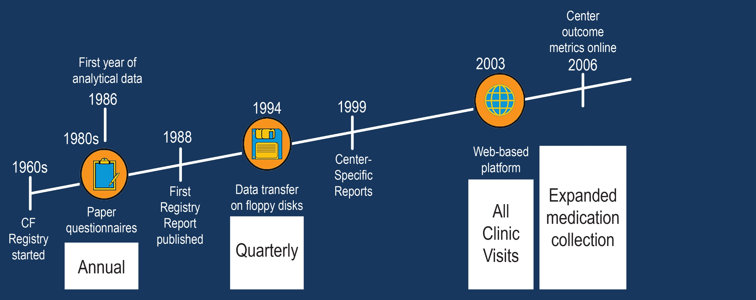
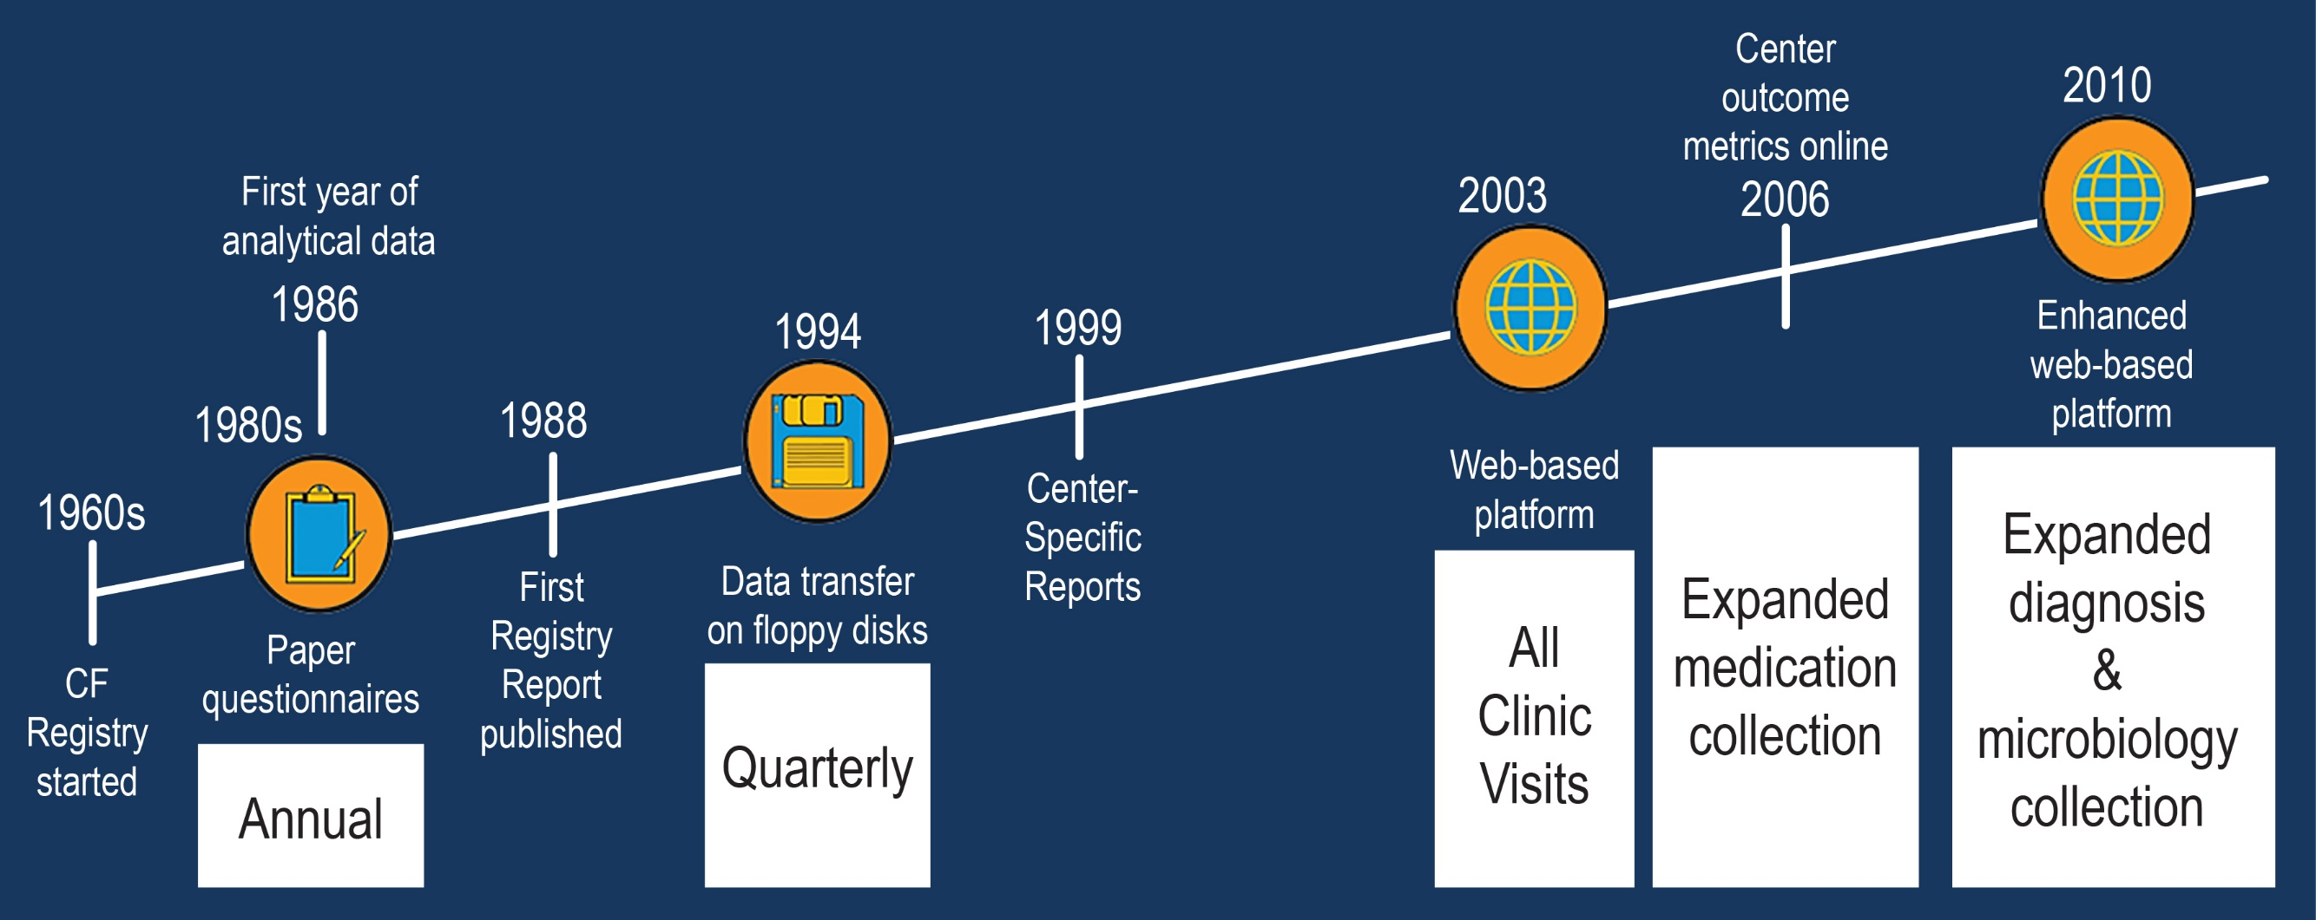
How has the CFF Registry grown?
Knapp et al. Ann Am Thorac Soc 13:1173-1179, 2016.
Notes:
The goal here is to briefly cover the CFF registry history and acknowledge Warren Warwick who played a seminal role in its beginning

Slide 32
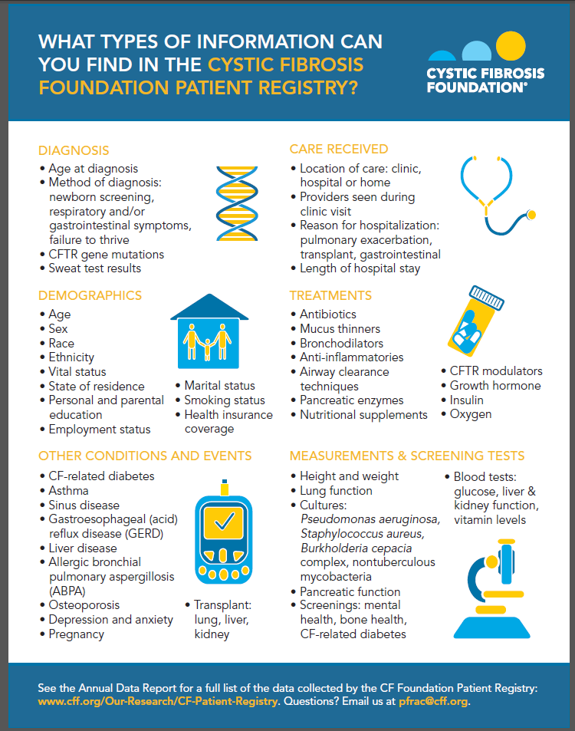
The CFF Registry Today
Inclusion criteria
Seen at CF care center
Consent to participate
Data collected at
Diagnosis
Clinic Visits
Hospitalizations / Home IV treatments
Annually
Download a copy at CFF.org/InsightCF.
Notes:
This will be available online
Detailed description of what’s in the Registry: excel spreadsheet can be downloaded from website, which provides info on when variables became available for analysis

Slide 33
Yearly CF Registry Report
Nutrition
Pulmonary Function
Pulmonary Exacerbation
Microbiology
Guidelines: Care, Screening and Prevention
Pulmonary Therapies
Modulator Therapies
Complications
Lung Function vs. Nutrition Status

Slide 34
Summary Medications

Slide 35
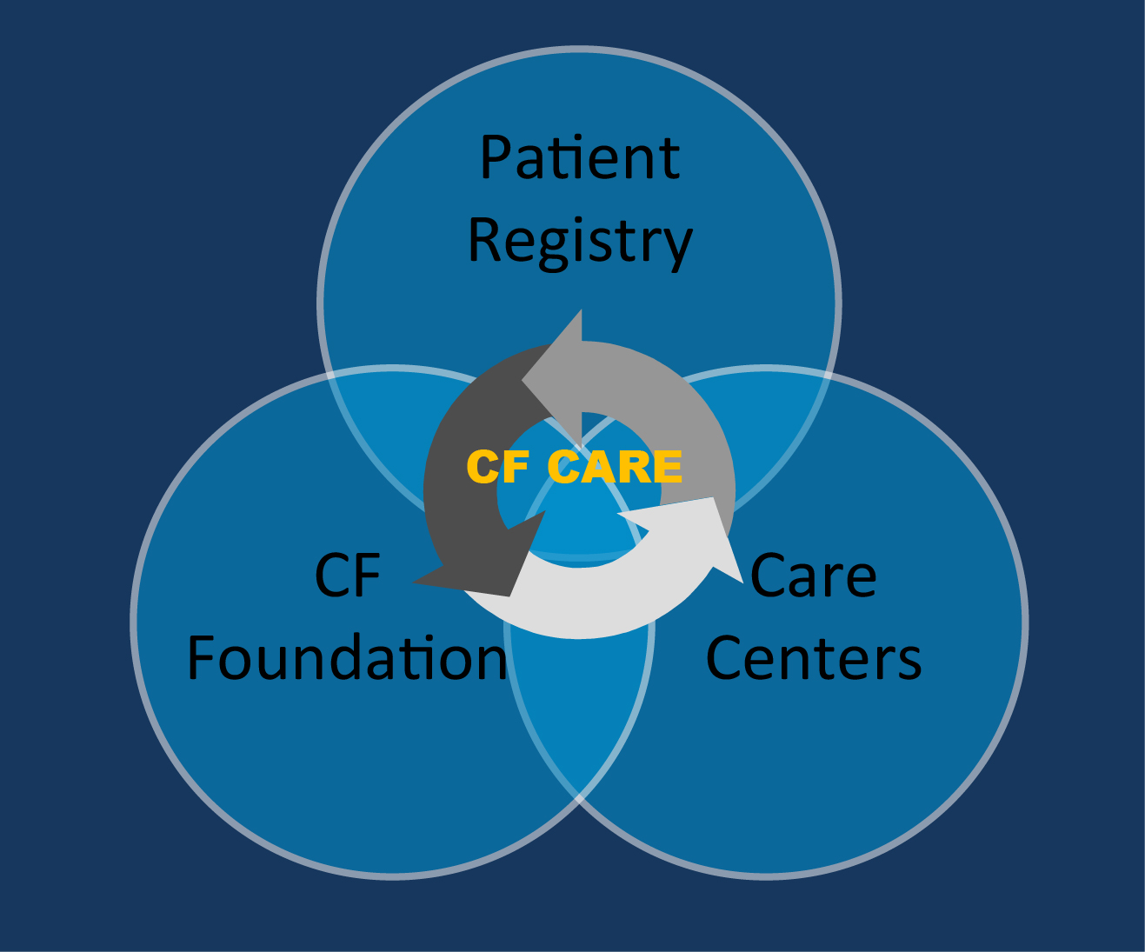
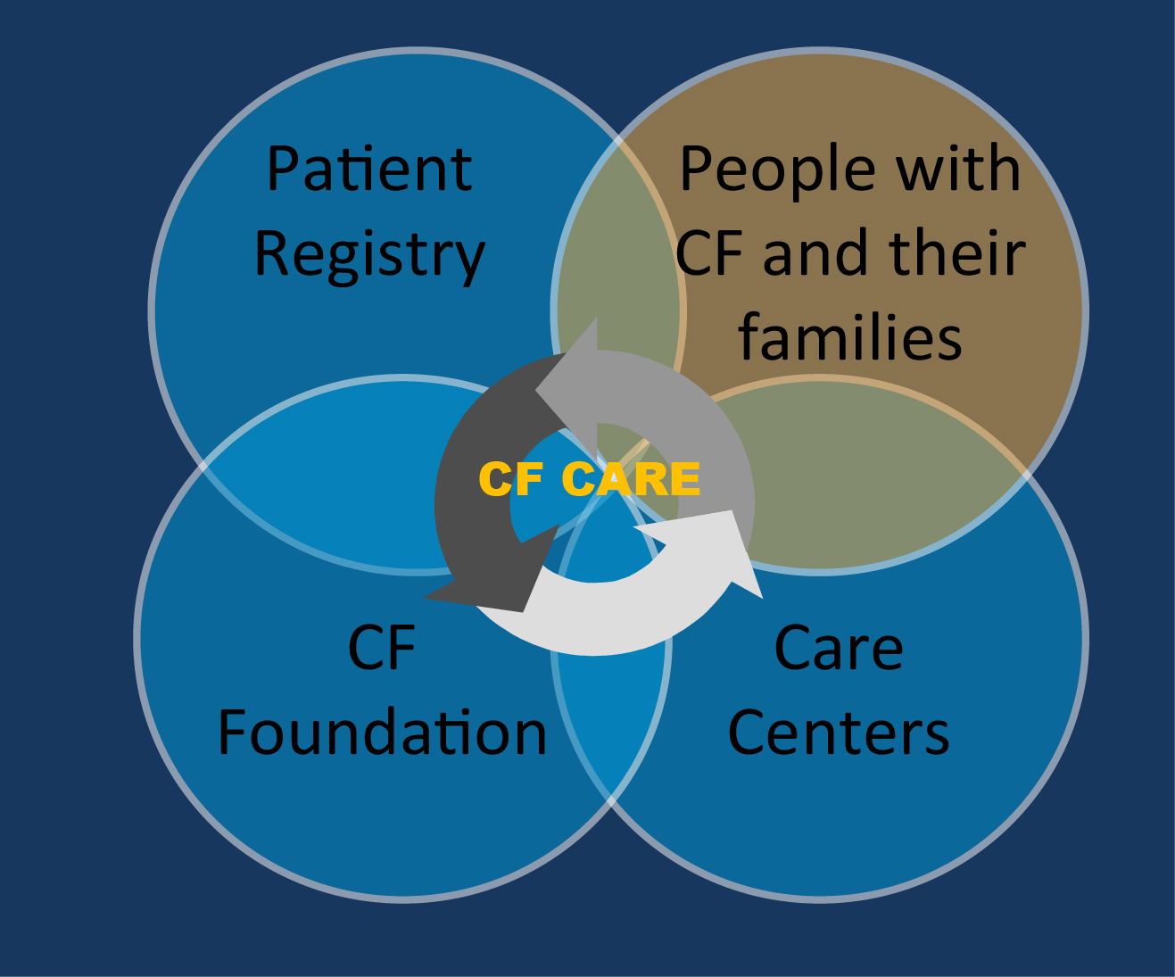
How have we partnered to create change?
Quality improvement and leadership development
Care center peer-review accreditation process
Evidence-based clinical practice guidelines
Benchmarking to learn from best practice
Engaging people with
CF and their families
Notes:
Quality improvement at national level, center level, personal data for patient (how to apply QI to each of these aspects of care) (overarching theme of talk: national level, center level, personal level plans—how the Registry impacts all of these levels)
QI training components:
Leadership development
Needs assessments
Measurement skills
Improved communication
During the reflection period of writing the BMJ special supplement of ten years of CF care improvement, the idea emerged to explore moving from pedi and or adult clinics and care to an integrated system of care that we titled “OneCF” care. This model was designed and tested as a pilot. The RFA resulted in eight CF Centers with 14 CF Quality Coaches in pairs for each Center to participate in a 15 month learning collaborative. New advanced improvement tools were introduced such as the “Oobeya Room” or the “Big Room”, workflow diagrams and Value Stream mapping to focus improvement on the lifespan of care from time of diagnoses through advanced care. Essential to this integrated care system of care for people with CF is the building and enhancing communications and relationships between the pediatric and adult care teams. We tested the validated relational coordination survey tool to increase awareness of communication and opportunities for improvement across the process of the hand of from pediatric to adult care. We learned a great deal in the first OneCF LLC pilot and have just started the OneCF LLC2 series with six CF Centers and six coaches.

Slide 36

Current challenges
Modulators
Azithromycin
Vitamins
High-calorie meals and snacks
Enzymes
School/work
Hypertonic
saline
Sports/play
Homework
Nebulized
antibiotics
Social life/friends
Albuterol
Family time
rhDNAse
Rest
Chest PT
Does one size fit all?

Slide 37

THANK YOU

