Slide 1
Pseudomonas Infection – Detection, Approach and Management

Slide 2
Samya Nasr, M.D., C.P.I.
Professor of Pediatrics
Director, Cystic Fibrosis Center
President, Michigan Thoracic Society
Coordinator, State of Michigan CF NBS Program
University of Michigan Medical School
Ann Arbor, Michigan, USA

Slide 3

Overview
Introduction
Microbiology
Detection
Approach
Management

Slide 4

Introduction- Our Dream
All patients with CF will live full, healthy lives.
Notes:
Everyone in this room holds the same dream that all patients with CF will live full, normal lives. Over the next hour, I hope to show you a path to that goal.

Slide 5
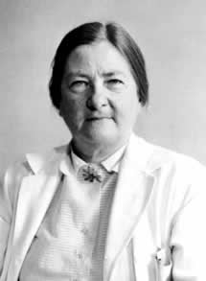
Where we started
1920
1930
1940
1950
1960
1970
1980
1990
2000
2010
1938
Dorothy Andersen
CF was with us long before 1938 and was identified according to our understanding of microbiology at that time
Cystic fibrosis of the pancreas

Slide 6
Where we are now: CF is Not One Genetic Disorder CFTR mutation classes
Cl ⁻
Cl ⁻
Cl ⁻
Cl ⁻
Cl ⁻
Cl ⁻
Cl ⁻
Cl ⁻
Cl ⁻
Cl ⁻
X
X
X
X
X
Normal
Class I
synthesis
Class II
maturation
Class III
regulation
Class IV
conductance
Class V
quantity
‘severe’ mutations
‘mild’ mutations
pancreatic insufficiency
decreased survival
pancreatic sufficiency
Adapted from http://www.umd.be/CFTR/W_CFTR/gene.html
Notes:
Normal CFTR protein is trafficked to the surface and activated as a Cl⁻ channel. We also know that there are over 1000 CF genetic mutations, most of which can be placed in functional classes shown here. The classes on the left (I, II, III) are associated with more severe disease, including pancreatic insufficiency and the right side (IV, V) with a milder disease. Every patient has 2 mutations and if one is mild, fortunately, it will dominate.

Slide 7
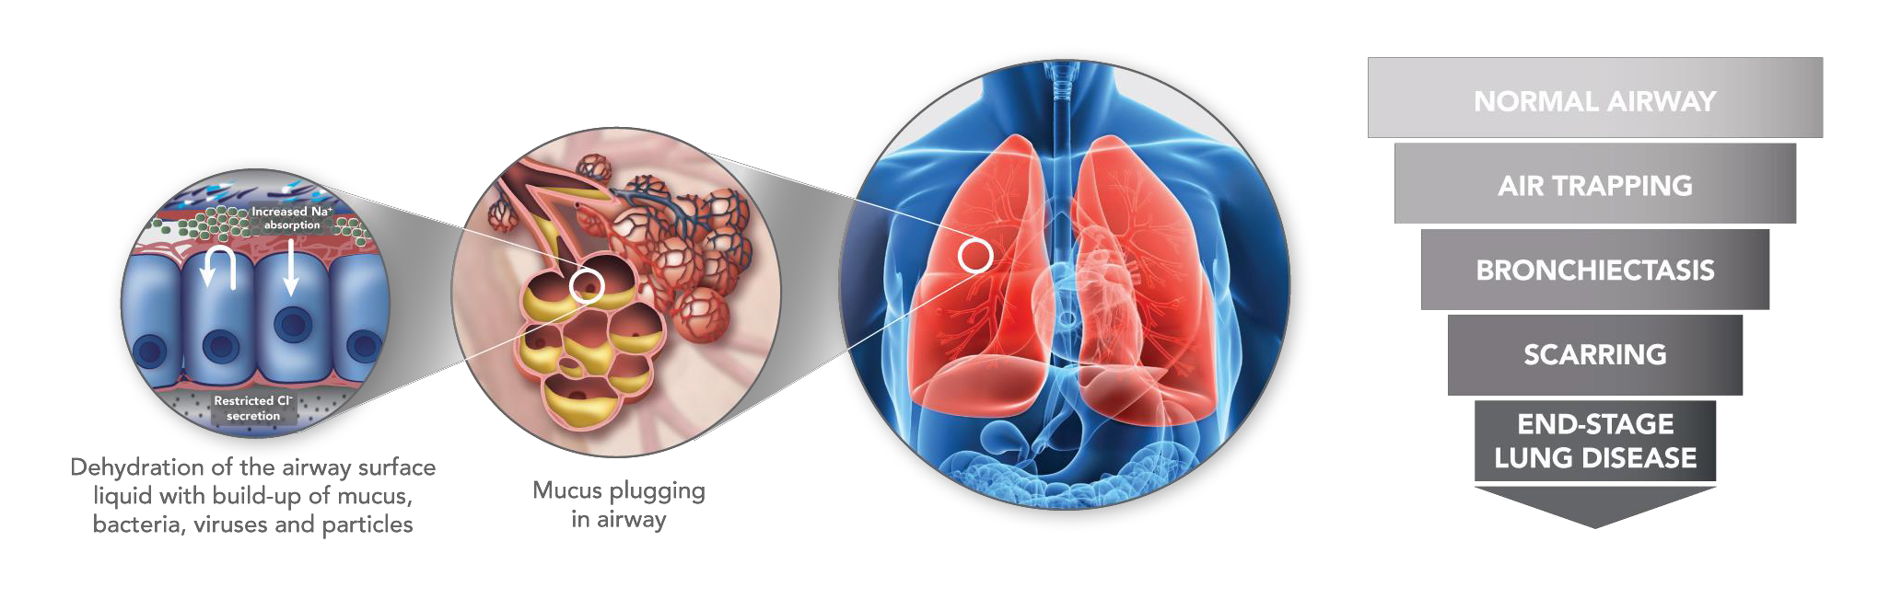
CF Pulmonary Disease Progression

Slide 8
“Microbiology”
Clinical microbiology
  detection & identification of microbes
  microbial taxonomy / nomenclature
  antimicrobial susceptibility testing
Infectious diseases
  diagnosis and treatment of infection
  pathophysiology of infection
  outcomes of infection

Slide 9
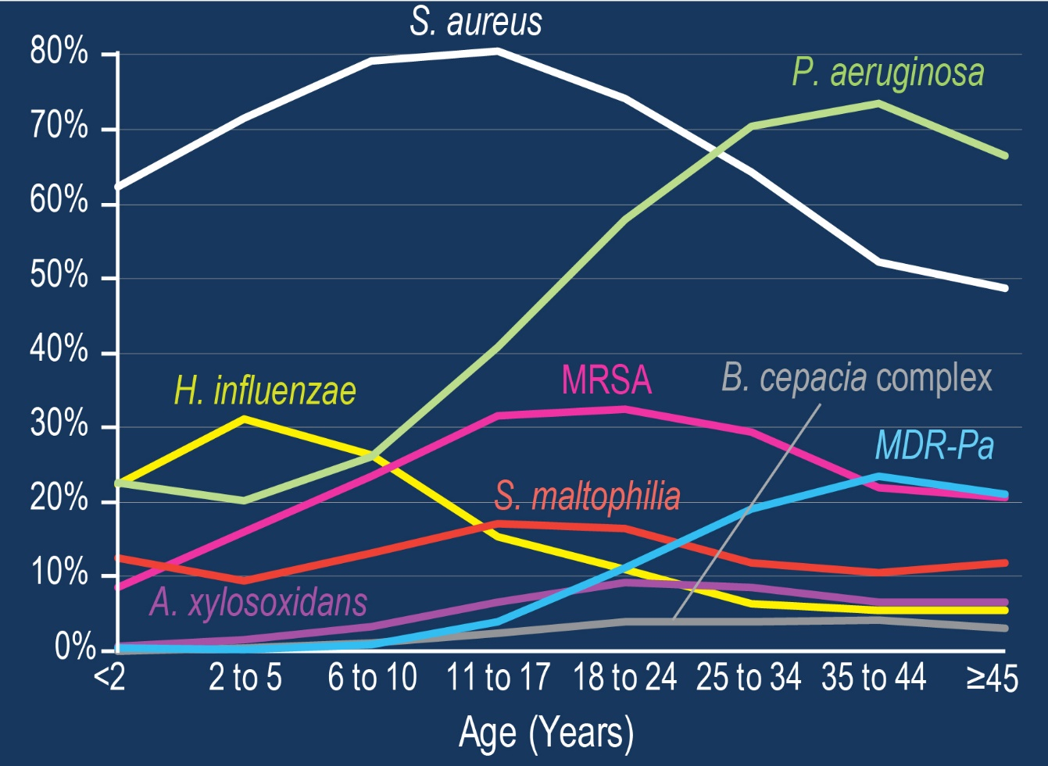
Infection Prevalence By Age
People
with
CF
Annual Data Report 2016, CF Foundation Patient Registry

Slide 10
DETECTION

Slide 11
“The Pre-Pseudomonas Era” milestones
1930
1940
1950
1960
1970
1980
1990
2000
2010
Identification of CF
CF is changed
  adolescent CF lung
Recognition of psychosocial needs: summer camps / social networks encouraged
Emerging concern about antibiotic resistance
Importance of infection
Development & use of antibiotics
Increased survival

Slide 12
The Pseudomonas Era (1975 – 2005)
1920
1930
1940
1950
1960
1970
1980
1990
2000
2010
Intense focus on P. aeruginosa
  epidemiology and outcomes
  biology and virulence
Antibiotic treatment strategies, based on P. aeruginosa
Awareness of inter-patient spread of some strains
  strict infection control (dismantling of social programs)
Decreasing concern about antibiotic resistance and less reliance of susceptibility testing to direct therapy

Slide 13
The Pseudomonas Era” milestones
1970
1980
1990
2000
2010
Intensified infection control
Less concern about antibiotic resistance
Current strategies for antibiotic therapy:
  eradication
  suppression
  episodic
Increased survival
Molecular biology
More antibiotics, P. aeruginosa therapy
P. aeruginosa epidemic clones
P. aeruginosa
basic biology & outcomes
Disconnect between susceptibility testing & outcomes

Slide 14
The Pseudomonas 2.0 Era (2005 – present)
1920
1930
1940
1950
1960
1970
1980
1990
2000
2010
Advances in taxonomy & identification of opportunists
Application of culture-independent methods
  appreciation of polymicrobial CF airway infection
Insight into the importance of microbial interactions
Beginnings of systems biology approach to understand the complexity of CF airway microbiology

Slide 15
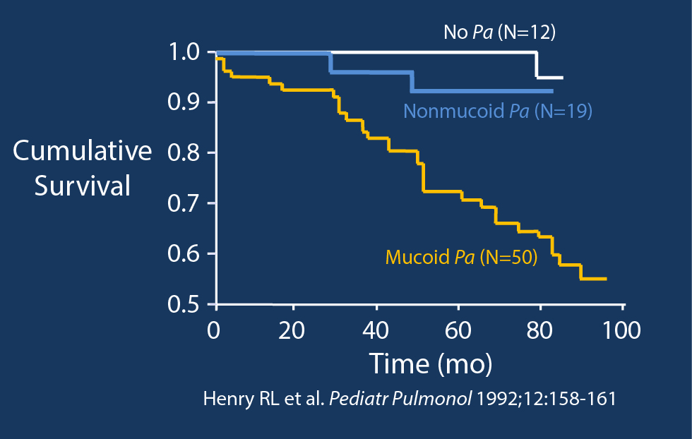
Impact Of Mucoid Phenotype

Slide 16
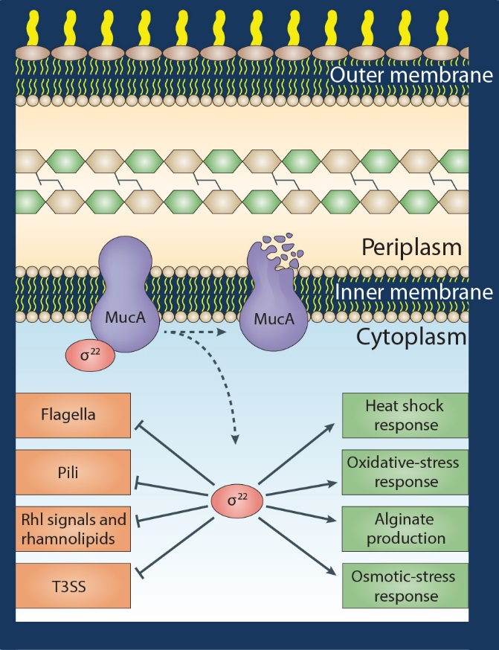
P. aeruginosa biology e.g., mucoidy / adaptation to CF airways
Stressful conditions (antibiotics, nutrient deprivation, oxidative stress, host inflammation)
Down regulation of metabolism, motility and virulence
Up regulation of alginate production and stress response systems
Folkesson et al. Nat Rev Microbiol 10:841. 2012

Slide 17
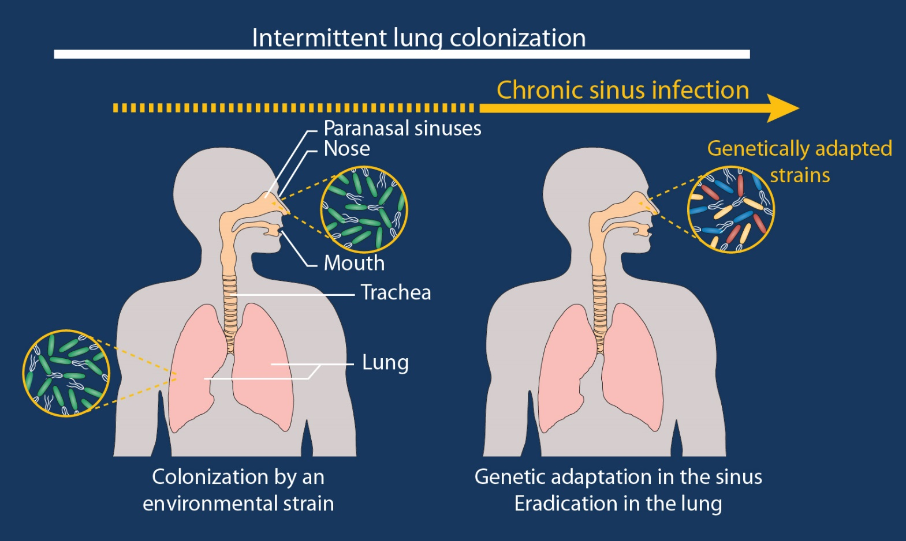
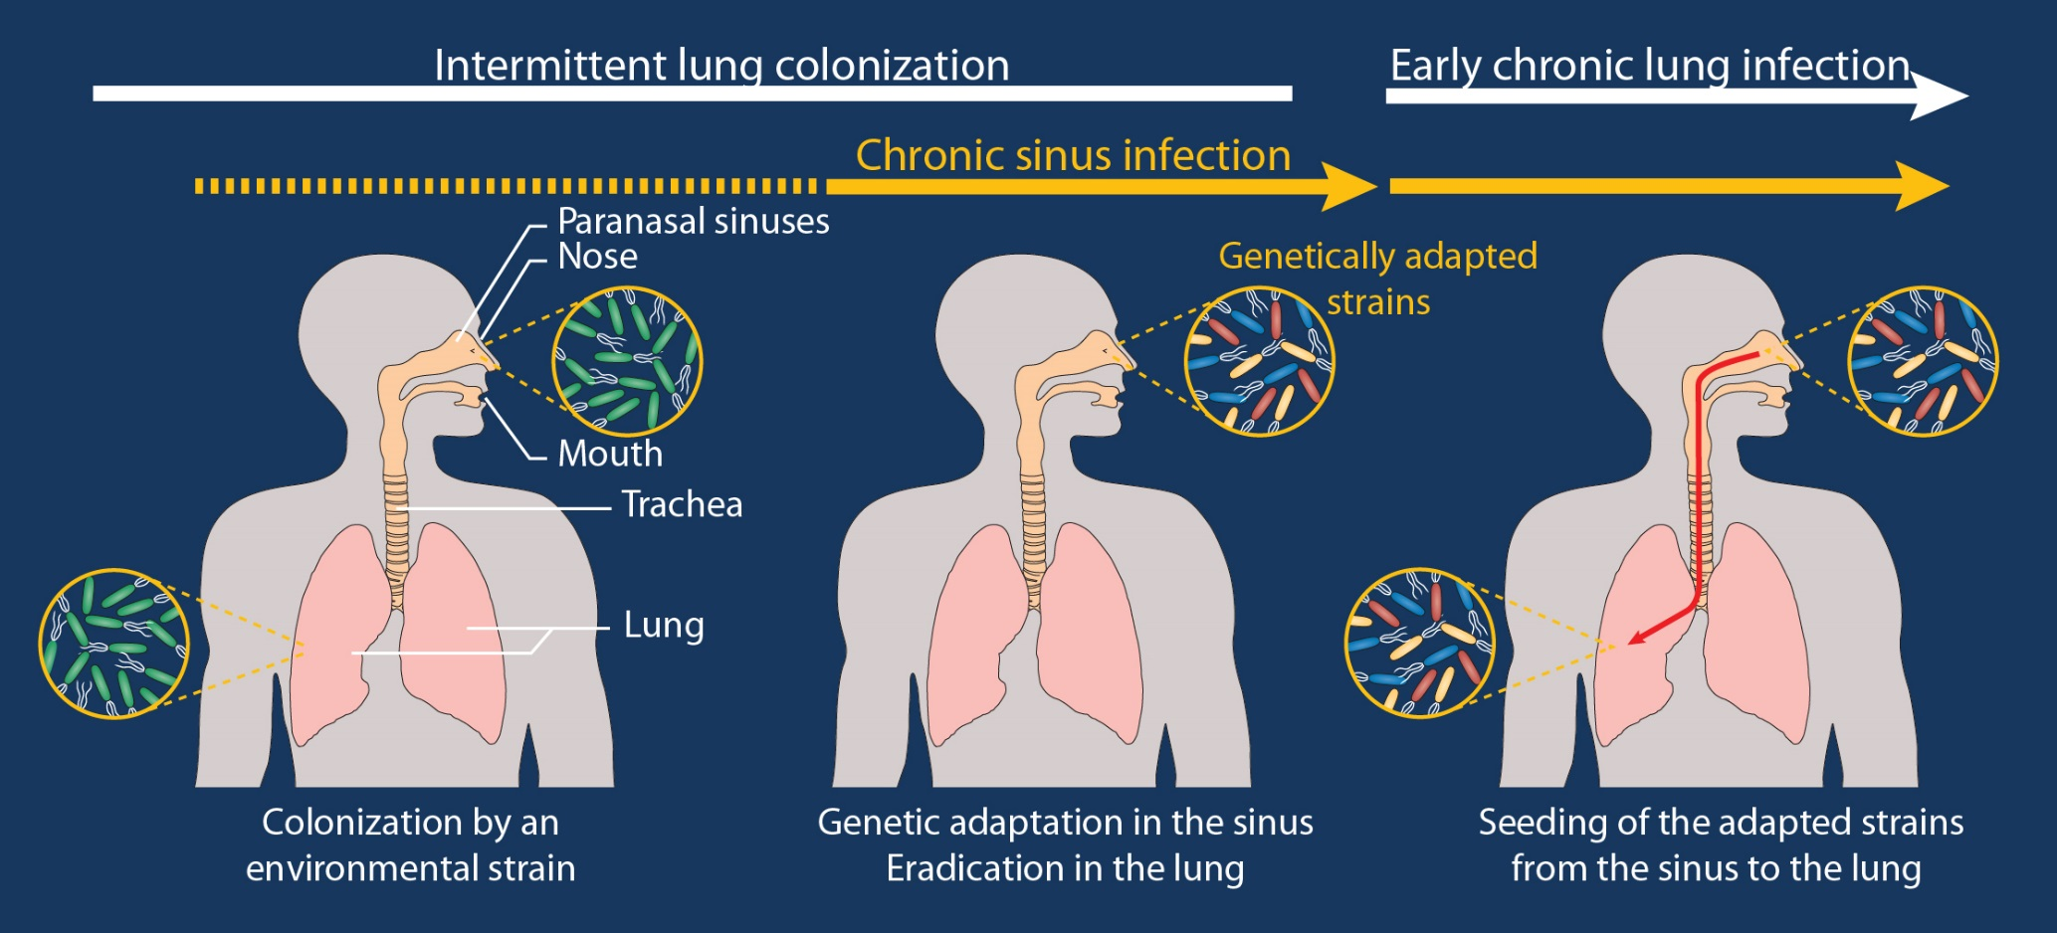
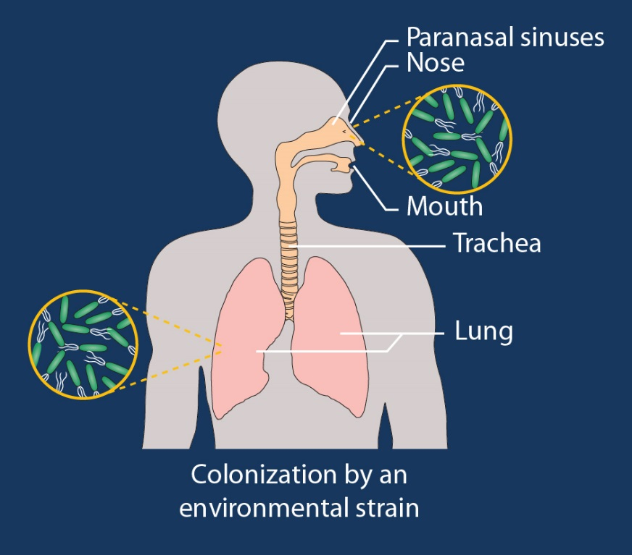
Pseudomonas adaptation to CF airways
Colonization of sinuses and lungs
Sinuses provide less hostile environment
Although lungs may clear bacteria, adaptation occurs in sinuses
Adapted bacteria are then better able to infect lungs
Folkesson et al. Nat Rev Microbiol 10:841. 2012
, Hansen et al. ISME J 6:831. 2012

Slide 18
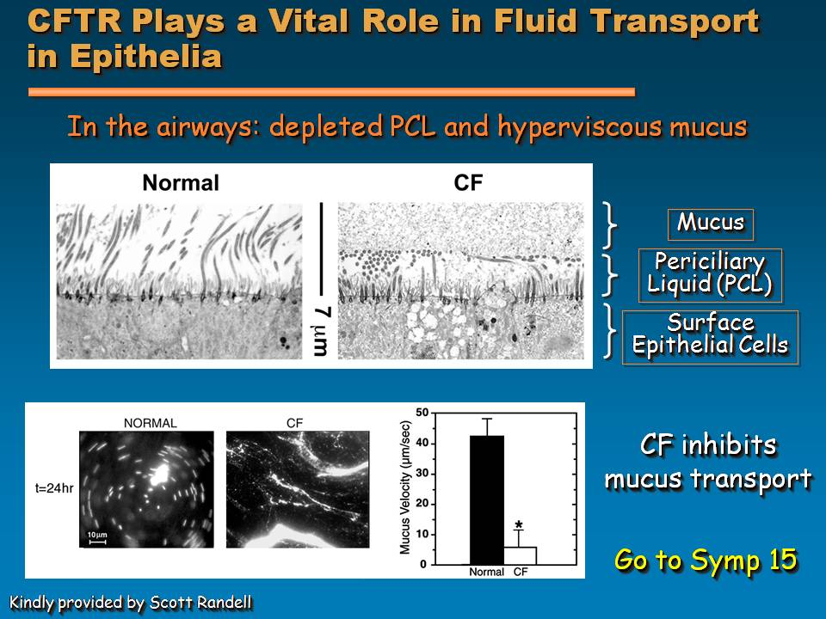
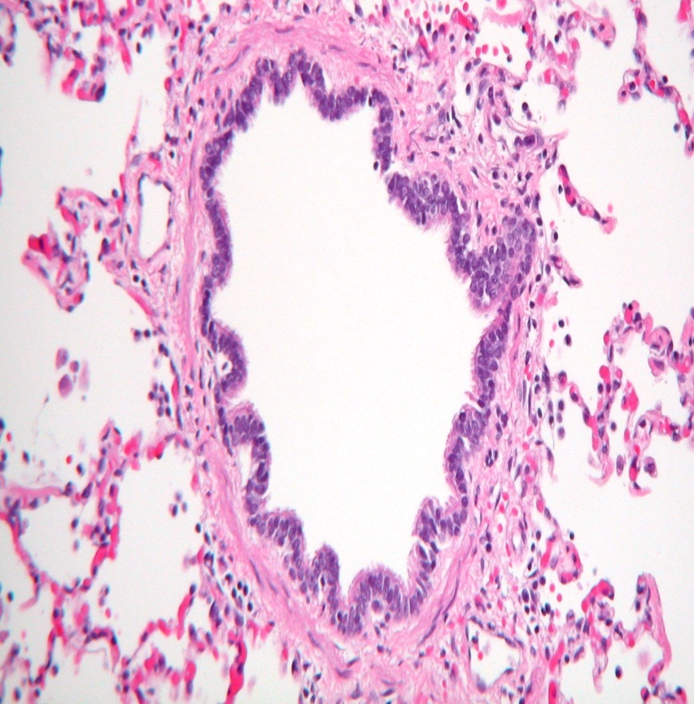
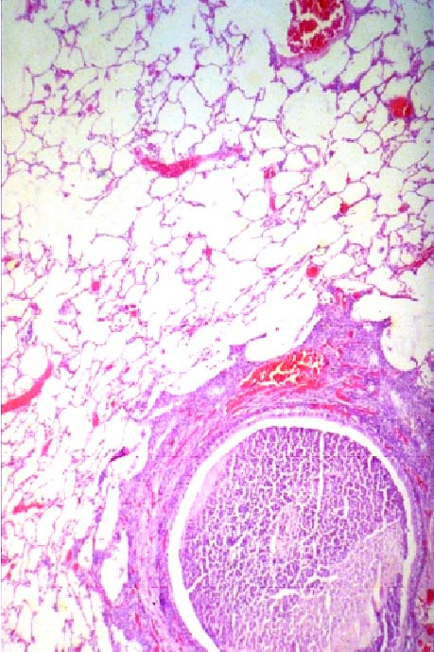
Mucociliary clearance and obstruction
Periciliary
Liquid
(PCL)
Surface
Epithelial
Cells
CFTR
normal
CF
Tenacious
Mucus
Notes:
To prevent the lung disease, we must correct the abnormal protein, CFTR, so that the salt and water content of the airway remains normal (as shown on the left) permitting normal mucociliary clearance and preventing airway obstruction and destruction (shown on right). I know that Scott Donaldson reviewed CFTR in detail during his excellent presentation yesterday.

Slide 19
Goals of Therapy for CF Airway Disease
Prevent or delay irreversible lung damage
Reduce airway infectious exacerbations (RTIs)
Improve lung function
Reduce use of parenteral antibiotics
Reduce days of school or work missed due to CF-related illness
Reduce respiratory symptoms
Improve patient well-being
CFF/FDA Consensus Conference. Bethesda, MD

Slide 20
Management
  Physiotherapy
    Airway clearance techniques
  Bronchodilators
  Mucolytic therapy
  Anti-inflammatory therapy
  Hypertonic saline
  Antibiotics
  Exercise
Therapies for CF. Cystic Fibrosis Foundation. Available at http://www.cff.org/treatments/Therapies/. Accessed August 22, 2007.
Boucher RC. Cystic Fibrosis. In: Kasper DL, Fauci AS, Longo DL, et al., eds. Harrison’s Principles of Internal Medicine. 16th ed.
New York: McGraw-Hill; 2005:1543-1546.
Notes:
The management of cystic fibrosis requires extensive time and commitment from the cystic fibrosis team, including the patient and his or her family.
To appropriately manage the pulmonary manifestations of cystic fibrosis, several interventions are required in order to maintain adequate lung function. Airway clearance techniques are administered in order to loosen mucus secretions and improve lung function. There are several airway clearance techniques that exist, with postural drainage and percussion being common techniques‡
Bronchodilators are commonly used prior to airway clearance techniques in order to help facilitate dilation of the airways for sputum mobilization.
Mucolytics are commonly administered in order to help decrease mucus viscosity. Mucolytics utilized include dornase alpha (Pulmozyme™) and acetylcysteine.
Anti-inflammatory agents are used for the anti-inflammatory management of cystic fibrosis. However, these agents which include corticosteroids and ibuprofen are limited by their toxicity.
Hypertonic saline is used in order to hydrate the airways and facilitate mucus clearance.
Once an individual with cystic fibrosis develops a pulmonary infection with a pathogenic organism, antibiotics with activity against the suspected organism is initiated orally, intravenously, or via inhalation.
For your reference:
‡ Other airway techniques include:
Oscillating Positive Expiratory Pressure (Oscillating PEP)
High-frequency Chest Wall Oscillation
Active Cycle of Breathing Technique (ACBT)
Autogenic Drainage (AD)

Slide 21
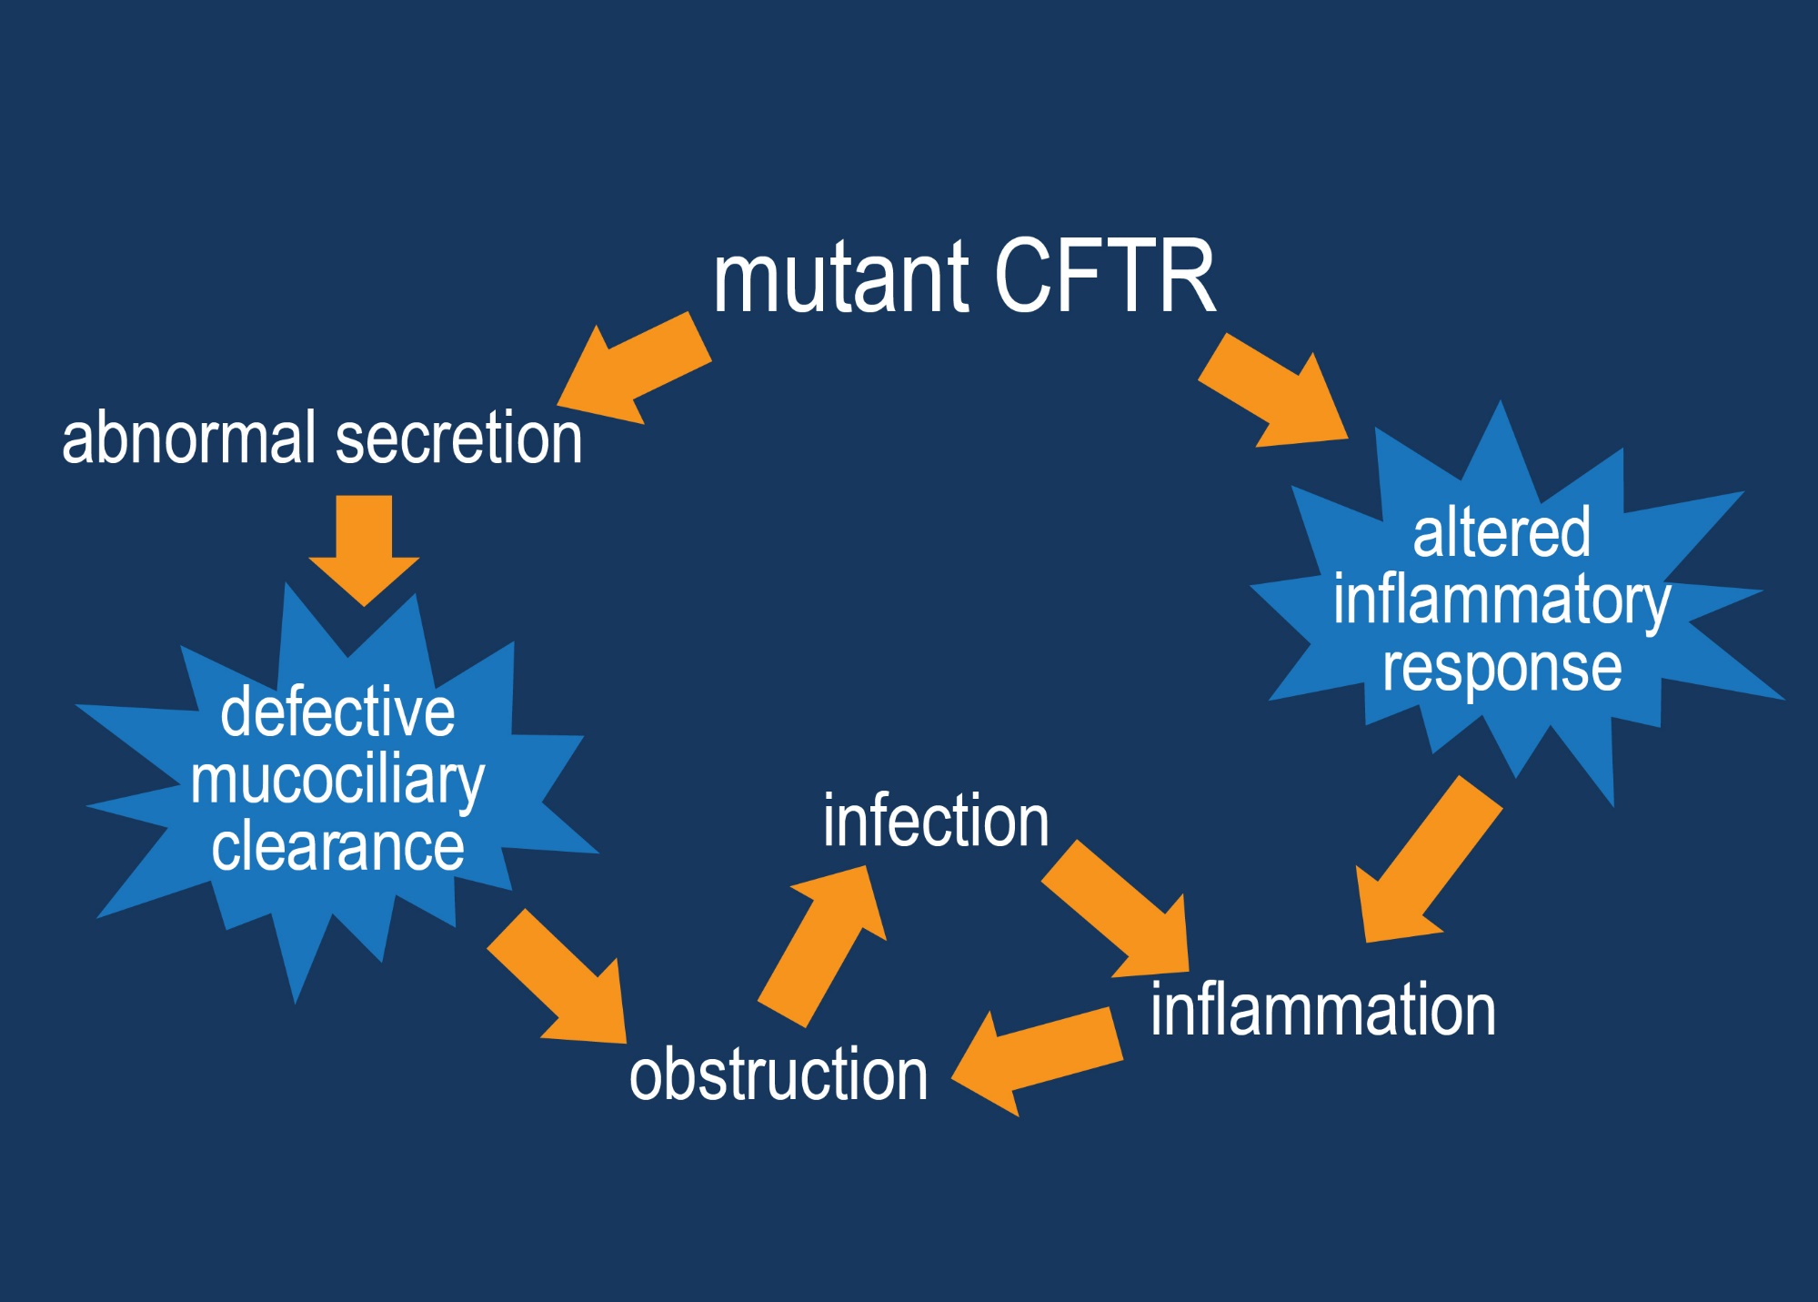
CF Respiratory Disease Pathways
Notes:
Here are the interventions we’ve been discussing so far (Advance)

Slide 22
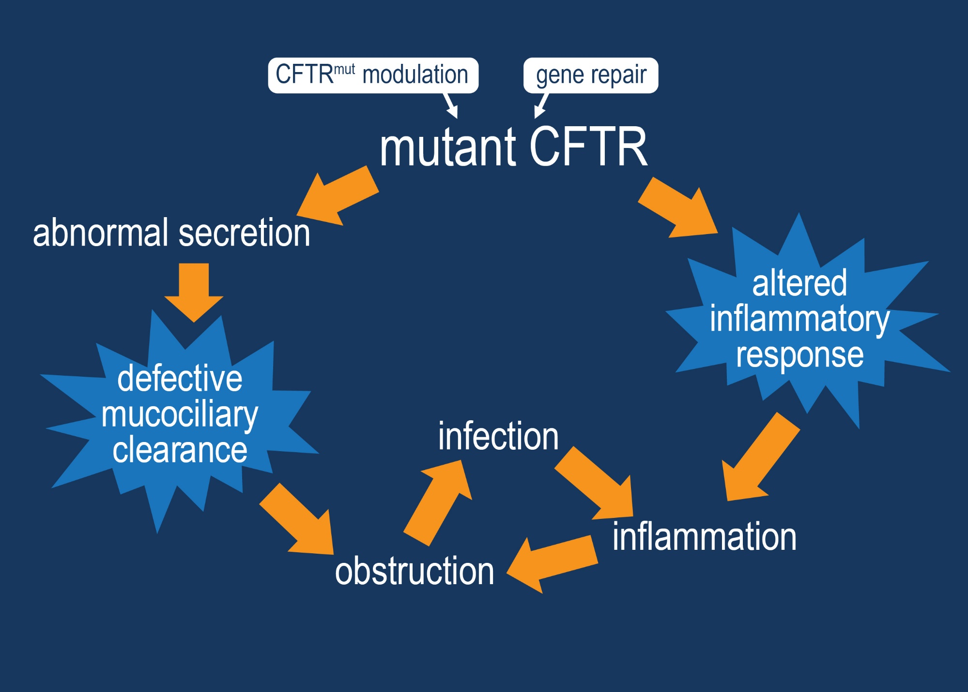
Therapies That Treat The Primary Defect
Notes:
. . . the growing number of robust modulator combinations (Point) and the exciting topic of CF gene repair (Point) will be discussed by Dr. Drumm shortly. (Advance)

Slide 23
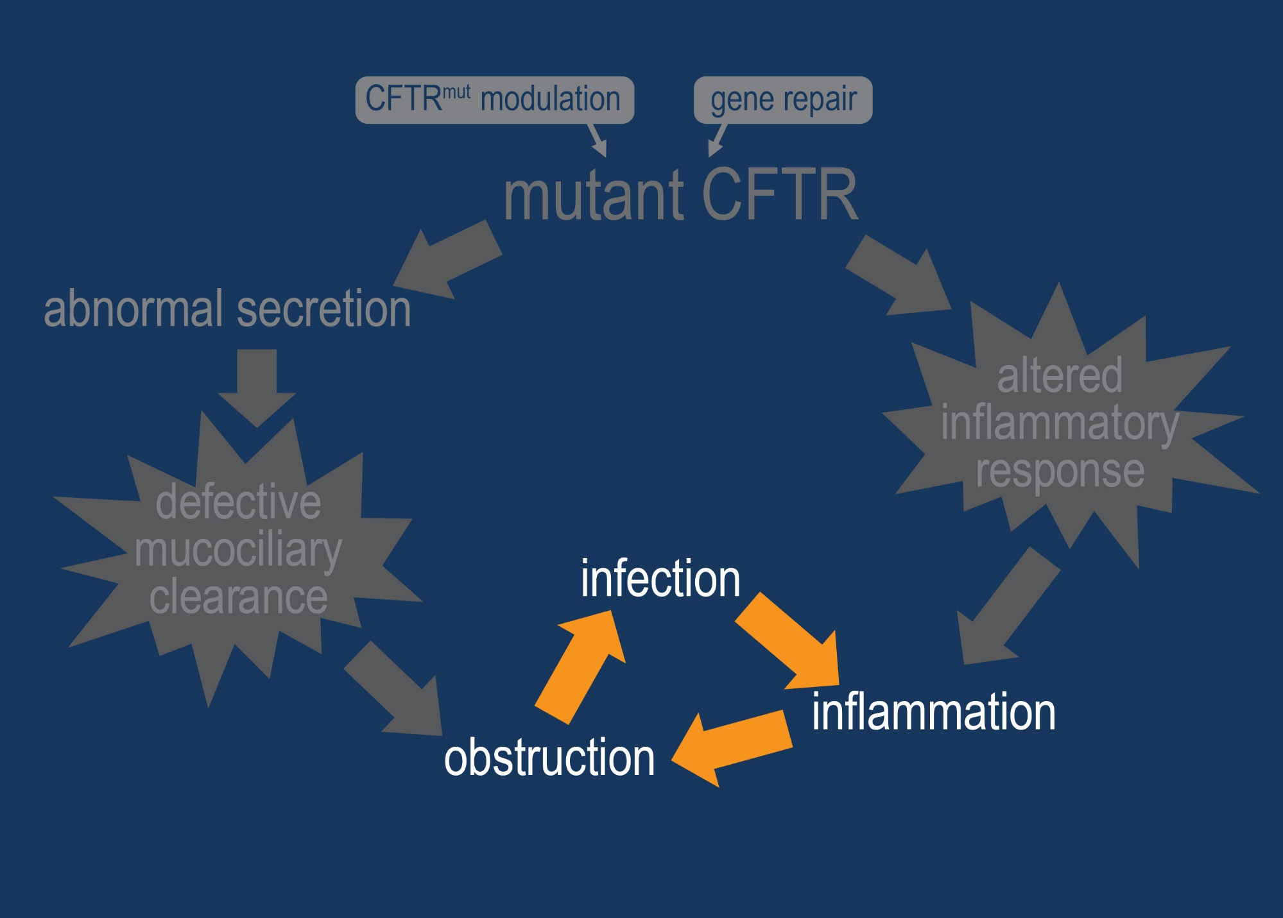
Therapies That Treat Downstream Effects
Notes:
But a substantial part of what goes wrong in CF – in lungs, pancreas, liver, intestines – can be quite independent of a specific mutation, and involves inflammation, clearing mucus obstruction, and infection.
For many patients, these aspects of the disease process are as vital as the advent of highly effective modulator treatments.
The science that underlies these processes is advancing rapidly – and it’s science that drives new therapies. The formation of mucus, the reasons for its obstructive properties, and the causes of infection and inflammation are not fully understood. But recent work in the CF pig model, as well as studies from the CF ferret, rat, mouse, and rabbit, are allowing us to ask questions we could never ask before – questions about how mucus is formed, when inflammation begins, and why infection gets started in the first place. So let’s now consider mucous obstruction, and (Advance twice)

Slide 24
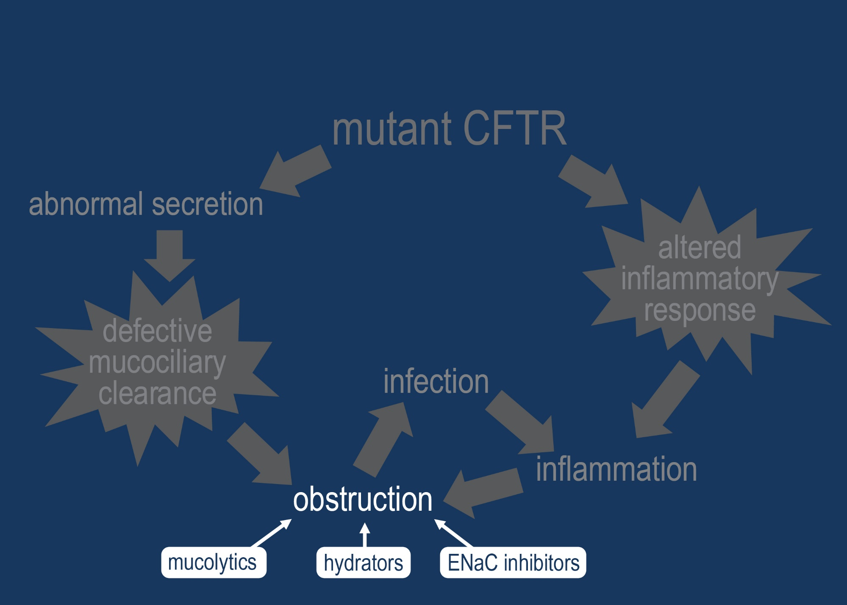
Targeting Mucociliary Clearance
Notes:
(. . . still advancing . . . )

Slide 25
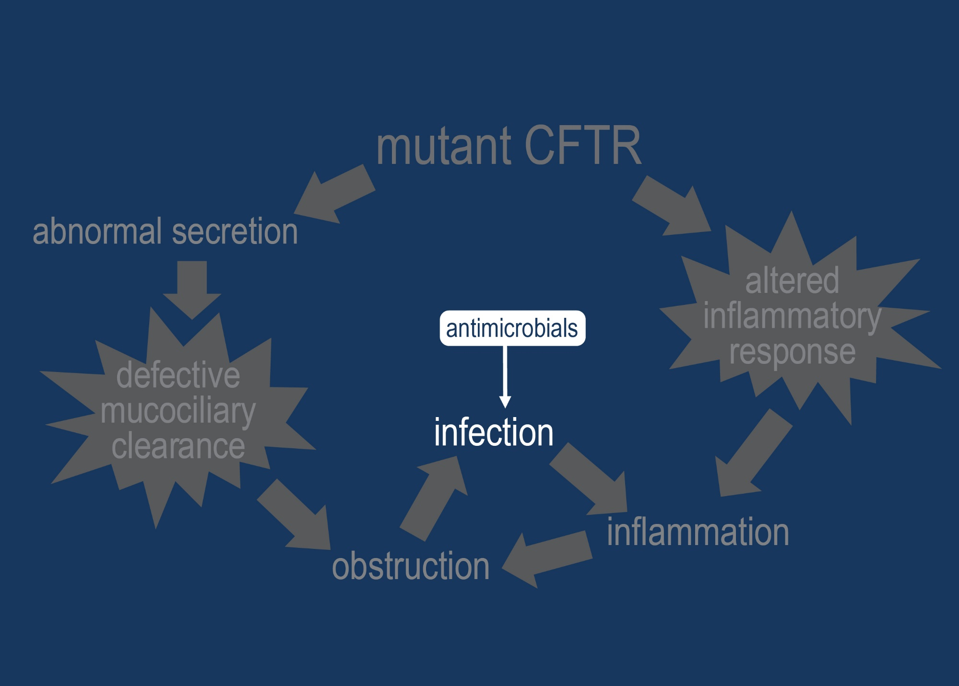
Targeting Infection
Notes:
Now, treating pulmonary infection has been a mainstay of CF therapy. A reason for better outlook among most patients with the disease has been availability of robust antimicrobials for treating respiratory pseudomonas or other bacteria.

Slide 26
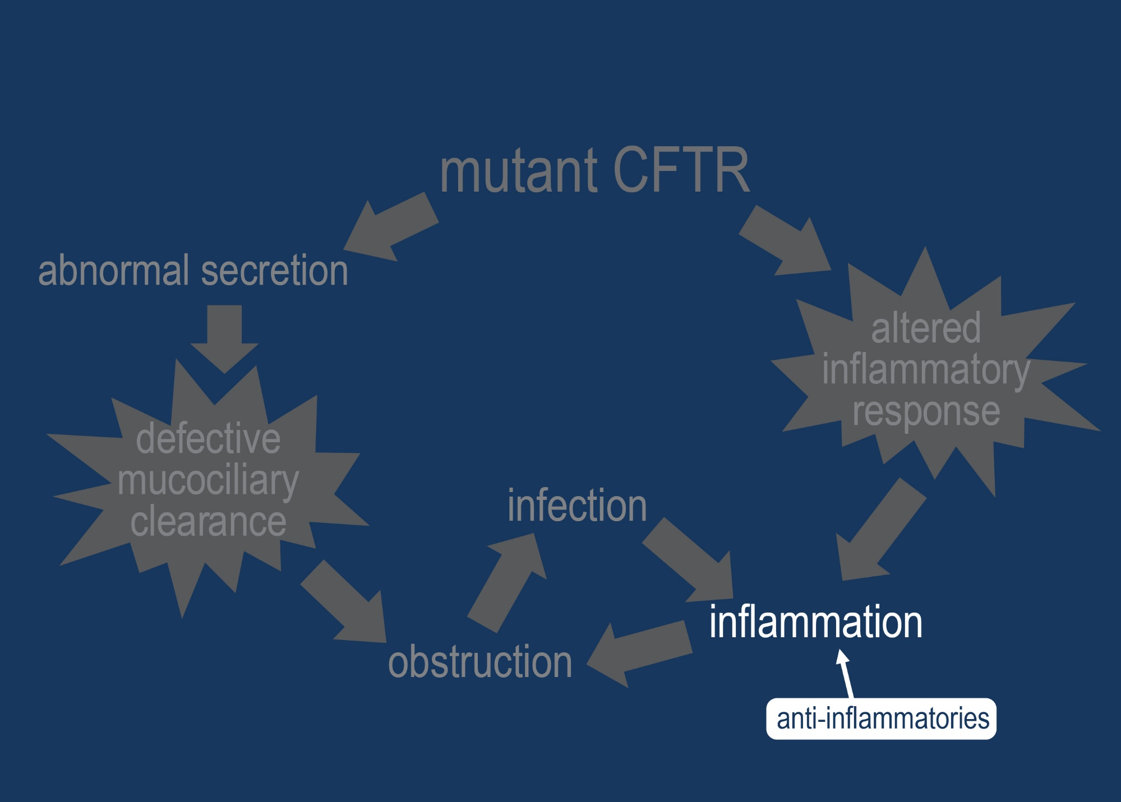
Targeting Inflammation
Notes:
Just as the mucociliary clearance and antibacterial pipelines are extensive, so are the prodigious efforts to treat CF lung inflammation. A simplified view of the process of lung inflammation is shown on the next slide.

Slide 27
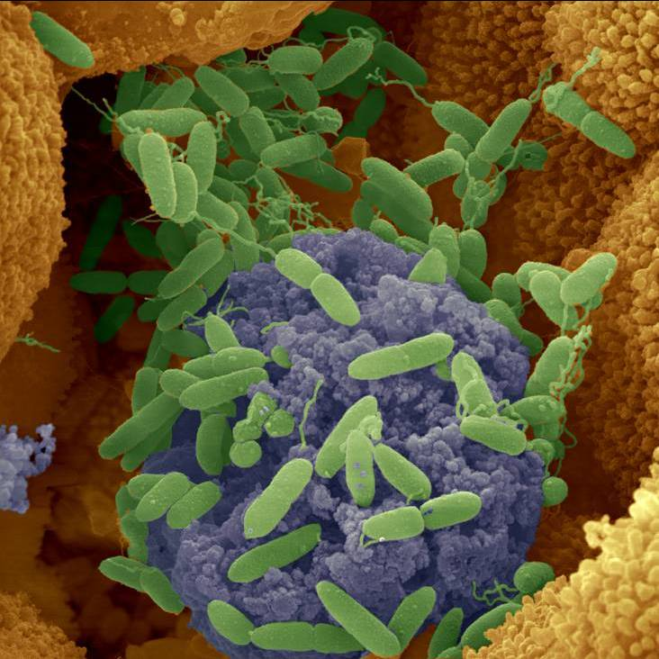
Advances in Anti-microbial Therapies
Pseudomonas aeruginosa
Notes:
Over the past 3 decades, most of the antimicrobial therapies have focused on eradicating or managing Pseudomonas aeruginosa (Pa) infections, the most common CF bacterial pathogen worldwide.

Slide 28
Treating CF Lung Infection
Antibiotic Era
1920
1930
1940
1950
1960
1970
1980
1990
2000
2010
penicillin
tetracycline
gentamicin
colistin
(polymyxin)
doxycycline
sulfonamides
streptomycin
cefalothin
vancomycin
methicillin
chloramphenicol
ampicillin
erythromycin
neomycin

Slide 29
Treating CF Lung Infection
Antibiotic Era
1920
1930
1940
1950
1960
1970
1980
1990
2000
2010
ampicillin
amikacin
penicillin
tetracycline
amoxicillin
sulfonamides
gentamicin
ticarcillin
neomycin
colistin
minocycline
cefalothin
cefalexin
tobramycin
streptomycin
vancomycin
doxycycline
chloramphenicol
methicillin
cefazolin
carbenicillin
erythromycin
clindamycin

Slide 30
Further Change CF
Antibiotic Era
1920
1930
1940
1950
1960
1970
1980
1990
2000
2010
Predicted
Median
Survival (US),
years
1965-1980: Doubling of predicted survival
Patrick Flume (various sources)

Slide 31
Inhaled antibiotics
Antibiotic Era
1920
1930
1940
1950
1960
1970
1980
1990
2000
2010
penicillin
ampicillin
piperacillin
azithromycin
streptomycin
cephalexin
sulfonamides
doxycycline
aztreonam
cefepime
neomycin
ticarcillin
clindamycin
cefuroxime
ciprofloxacin
chloramphenicol
gentamicin
carbenicillin
clarithromycin
tetracycline
fosfomycin
amikacin
imipenem
amoxicillin
pip/tazo
erythromycin
polymyxins
ceftriaxone
linezolid
tobramycin
meropenem
vancomycin
ceftazidime
levofloxacin
amoxicillin/clavulanate
ampicillin/sulbactam
Commercial inhalation formulations
TOBI®
Cayston®

Slide 32
Advances in Antibiotics to Treat Pseudomonas aeruginosa (Pa)
dry powder tobramycin approved
aztreonam for inhalation solution approved
tobramycin inhalation solution approved
dry powder colistimethate
approved (EMA)
US oral azithromycin study completed
Phase 3 study of inhaled levofloxacin completed
Phase 3 multi-cycle study of liposomal amikacin for inhalation (LAI) in 206 patients is ongoing
Inhaled aztreonam/tobramycin cycling study in process
Notes:
This timeline summarizes over 20 years’ work by investigators and clinicians worldwide to develop antibiotics to manage Pa infections. We have also been linked to wonderful industry partners to make this success possible.
2013 saw the worldwide release of dry powder tobramycin, TOBI Podhaler by Novartis
2 important Phase 3 trials have completed or are near completion, liposomal amikacin for inhalation developed by Insmed and inhaled levofloxacin developed by Rempex/Aptalis
Gilead is currently comparing the alternating inhaled aztreonam and tramytcin with alternate month tobramycin
I want to direct you to a presentation by Felix Ratjen at Symposium S11 where inhaled anti-Pa antibiots will be discussed in more detail.

Slide 33
CF Pulmonary Guidelines
Inhaled Tobramycin-Moderate to Severe disease A
Inhaled Tobramycin- Mild Disease B
Inhaled Aztreonam- Moderate to Severe Disease A
Inhaled Aztreonam- Mild Disease B
Dornase alfa- Moderate to Severe Disease A
Dornase alfa- Mild Disease B
Inhaled Hypertonic Saline B
Azithromycin with Pa A
Mogayzel, PJ, Naureckas2 Robinson,KA, el al:Cystic Fibrosis Pulmonary Guidelines. Am J Respir Crit Care Med Vol 187, Iss. 7, pp 680–689, 2013

Slide 34
Eradicative Approach to Early P aeruginosa CF Lung Infection
100
80
Treatment (n = 48)
60
Historical
control (n = 43)
% of patients without chronic infection
40
20
0
0
6
12
18
24
30
36
42
48
Months of observation
P <0.005 treatment vs control
Frederiksen B, et al. Pediatr Pulmonol. 1997.
Notes:
Eradicative Approach to Early P aeruginosa CF Lung Infection
In this cohort study by Frederiksen et al, 48 patients (median age 7.4 years) with positive Pa cultures enrolled in an intensive Pa eradication program between November 1989 and June 1993. Rates of chronic Pa infection were compared with those of a historical control group of 43 patients with Pa cultured between November 1983 and June 1987, before the initiation of the Pa eradication program.
Patients in the eradication program received aerosolized colistin (10⁶ IU 2-6 times daily) and oral ciprofloxacin (25-50 mg/kg/day divided into 2 doses) for 3 to 12 weeks depending on the number of prior Pa isolations.
This figure shows the cumulative proportion of patients free from chronic Pa infection over the 44-month study period.
Over 3.5 years, 16% of treated patients developed chronic Pa infection compared with 72% of 43 historical control subjects (P <.005). The efficacy of treatment was calculated to be 78%.
Significant improvements in FEV₁ and FVC were also observed after 1 and 2 years of treatment.
These data support an eradicative approach to Pa infection in CF patients.
Frederiksen B, Koch C, Hoiby N. Antibiotic treatment of initial colonization with Pseudomonas aeruginosa postpones chronic infection and prevents deterioration of pulmonary function in cystic fibrosis. Pediatr Pulmonol. 1997;23:330-335.

Slide 35
Beyond Pseudomonas: Developing Therapies For Other Emerging Pathogens
S. maltophilia
A. xylosoxidans
NTM
MRSA
B. cepacia complex
P. aeruginosa
Detection
Epidemiology
& Outcomes
Experimental
Intervention
Management
Change
Pathway from identification of “new” CF pathogen
to change in practice
LiPuma, Chronic Airways Infection 2007
Notes:
The CF community must look beyond Pa as our population ages. Over several decades we have successfully moved from detection, the multiple drug interventions to significantly impacting care for patients with Pa. Unfortunately for most other emerging pathogens such as S maltophilia and B cepacia we remain at the early stages of understanding these infections. Today I will discuss 2 examples where new therapies are being actively pursued: Methicillin Resistant Staph Aureus (MRSA) and non tuberculous mycobacteria (NTM).
When a ‘new’ bacterial species is identified in the CF lung, we know nothing about its natural history or role in disease progression.
A stepwise process of developing systematic detection of organisms is required before we can begin to collect information on epidemiology and association with outcomes. With information on association of the species and specific health outcomes, we can design interventions to see if we can affect outcomes. Only then can we rationally change management to address the presence of an organism
This figure first appeared in Commentaries on Chronic Airways Infection, Volume 1, Number 2, August 2007 in an article entitled “Beyond Pseudomonas: The expanding spectrum of CF microbiology” by John LiPuma

Slide 36
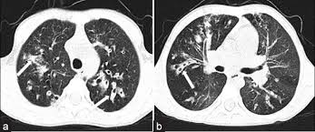
Summary of Current Treatment
CFTR to CF – numerous targets
Loss of CFTR
  Cl-, HCO3-, Na+
CFTR modulators
Gene transfer
Gene/RNA editing
Hydrators
Mucolytics
Airway
damage
Thick
mucus
Airway
infection
Persistent
inflammation
Anti-inflammatories
Antimicrobials

Slide 37
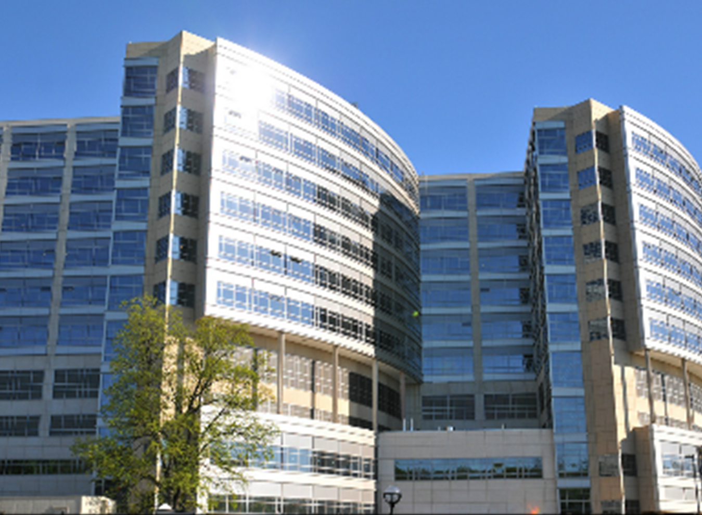
THANK YOU

