Slide 1
Cystic Fibrosis in Jordan
Samah Awad, MD
Assistant professor/ Pediatric department
Jordan University of Science & Technology
Irbid/ Jordan

Slide 2
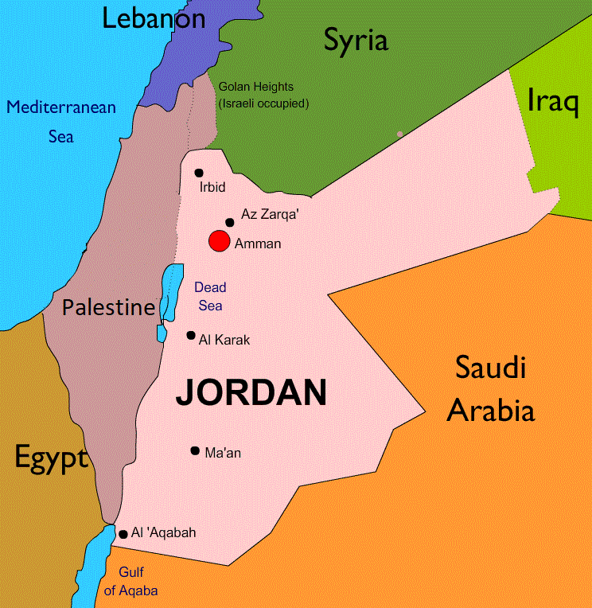
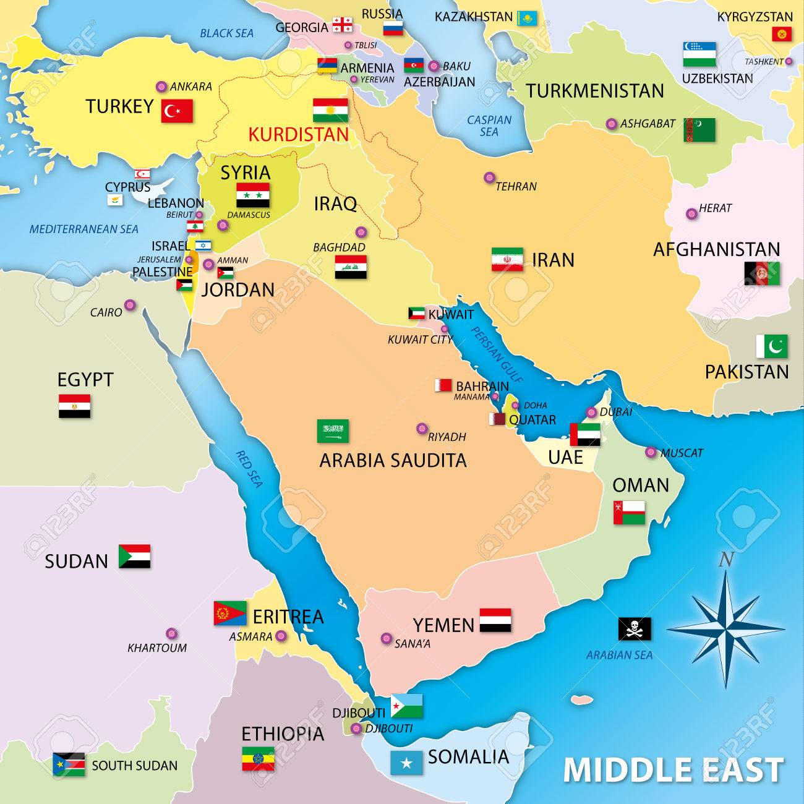
Jordan
Jordanian population 10,020,606 (2019)
Notes:
Jordan relatively a small country , almost landlocked with a population of 10 million as of 2019
Jordan has been referred to as oasis of stability in the turbulent region
Jordan is classified as a country of high human development , with an upper middle income economy
The country is a major tourist destination, it attracts medical tourism due to its well developed health sector.
The capital of Jordan is Amman, the second large city is Irbid with a population of 1, 800, 000

Slide 3
Health Sector in Jordan
Number one medical tourism provider in Arab region, top 5 in the world (World Bank)
In 2014, “Medical Destination of the Year”,
IMTJ Medical Travel Awards for attracting 250,000 international patients and generating more than
1 billion USD
Notes:
Jordan was ranked by the World Bank to be the number one medical tourism provider in the Arab region and among the top 5 in the world as well as being the top medical tourism destination in the Middle East and Africa.
highly skilled, educated and multilingual labor force, as well as internationally accredited hospitals equipped with the latest machinery and technologies
There are 78 hospitals in Jordan

Slide 4
Health Sector in Jordan
103 hospitals & 700 healthcare centers
Royal Medical Services (RMS)-Militay
Ministry of Health (MOH)
University Hospitals
Private sector hospitals
Distribution of beds in health sectors
University Hospitals
Ministry of Health
Private sector
Royal Medical Services
Notes:
Royal Medical Services 11 (RMS)
Ministry of Health 34
University Hospitals 2
Private sector hospitals 34

Slide 5
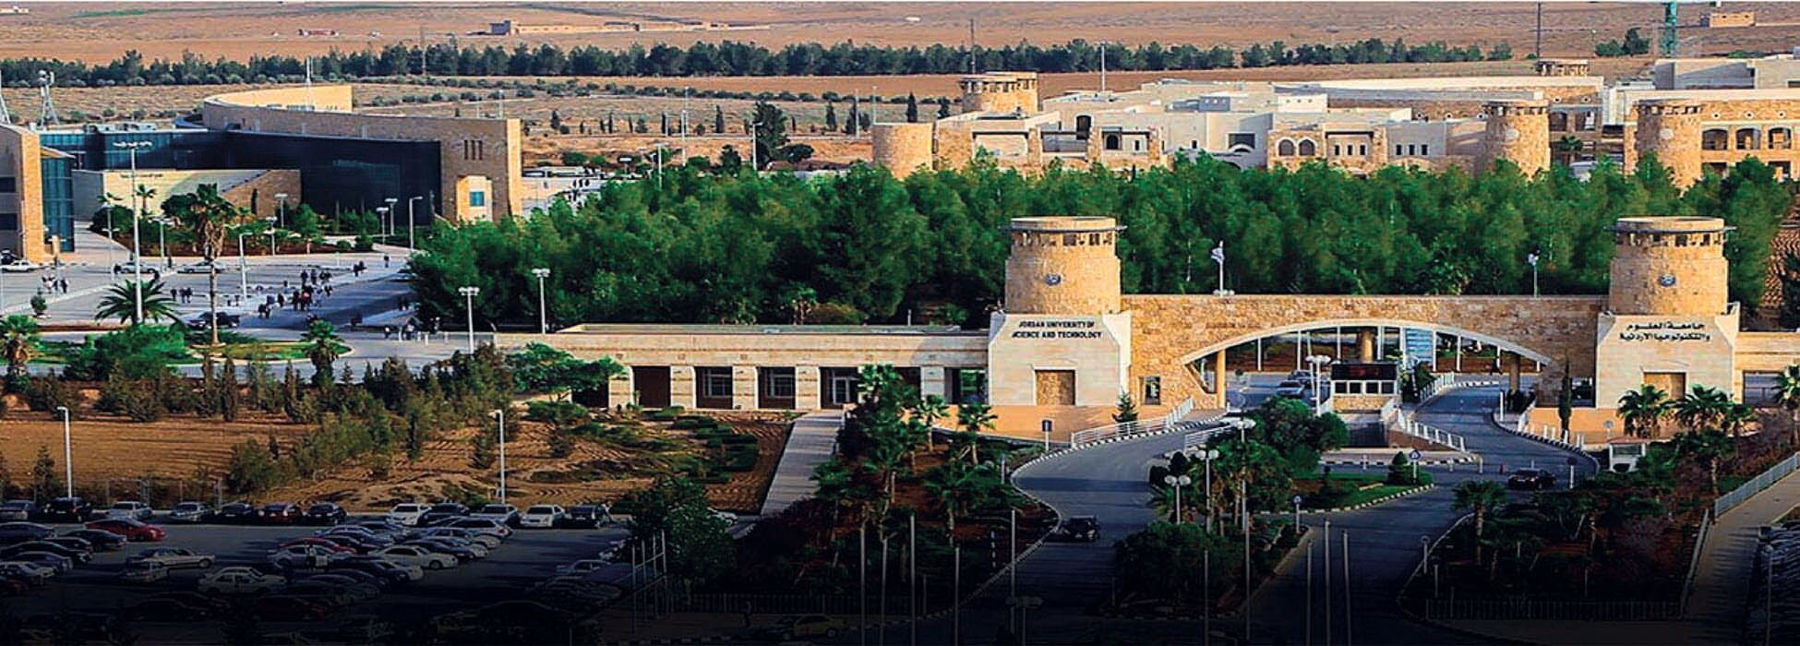
Jordan University of Science & Technology
1st rank in Jordan
14th in Arab world
QS University ranking ,
451-500 in Medicine

Slide 6
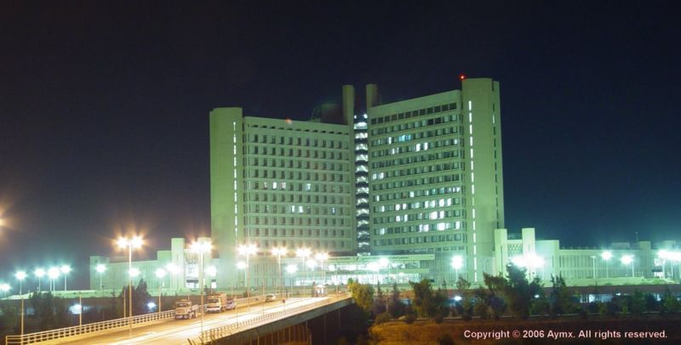
King Abdullah University Hospital
Largest referral hospital in Northern Jordan, 678 beds
Cost of 120 million USD

Slide 7
Cystic fibrosis in Jordan
Pediatric pulmonologists: total 11
Royal medical services 1
Ministry of health 1
- University hospitals 5
Private sector 4

Slide 8
Cystic fibrosis in Jordan
Cystic fibrosis national registry NA
Prevalence of the disease Unknown
Common genetic mutations Unknown
Patients’ life span Unknown
Average age of diagnosis Unknown
Notes:
Unfortunately CF gets little portion

Slide 9
Obstacles for CF care
Screening and diagnosis
Newborn screening NA
Sweat testing
quantitative pilocarpine iontophoresis, gauze or filter paper or sweat collected in a Macroduct® coil NA
Nanoduct system
Notes:
quantitative pilocarpine iontophoresis remains the standard test for diagnosing cystic fibrosis which is lacking in all the hospitals of the MOH and UH
If sweat is collected in a Macroduct®coil, the minimum sample volume is 15 microliters (µL).
Available methods include direct application of the chloride electrode to the skin

Slide 10
Medications
Inhaled antibiotics
Tobramycin, Aztreonam NA
Gentamycin, Amikacin (IV formulation for nebulization )
Mucolytics
Dornase alfa, Hypertonic saline 7% NA
Notes:
Eradication of pseudomonas and maintenance of lung health for colonized patient

Slide 11
Airway Clearance Techniques
High Frequency Chest Wall Oscillation (VEST) NA
Oscillating Positive Expiratory Pressure (PEP) Devices
NA in market
Chest Physical Therapy (CPT)
Notes:
CPT

Slide 12
Screening and Monitoring
Spirometry
Oropharyngeal cultures

Slide 13
Nutrition and GI Clinical Care
Pancreatic Enzyme Replacement Therapy
-CREON (pancrelipase) available in 10,000 lipase unit/capsule
-Other CREON strength NA
Fat-soluble vitamins NA

Slide 14
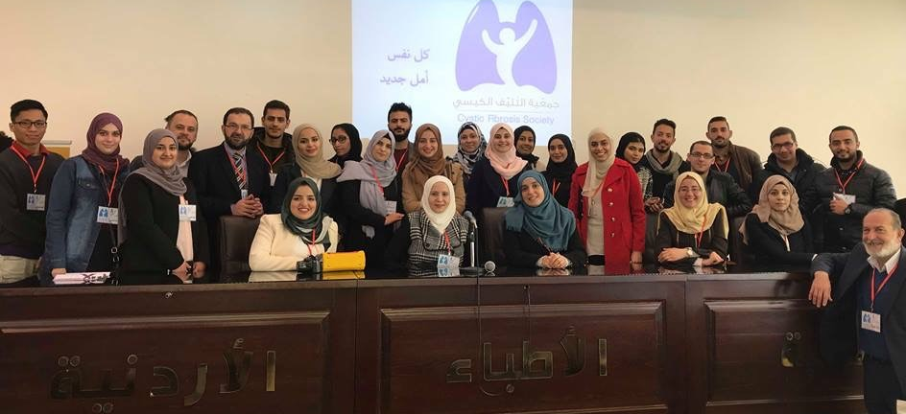
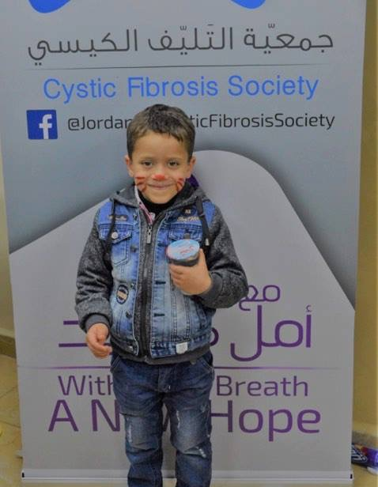
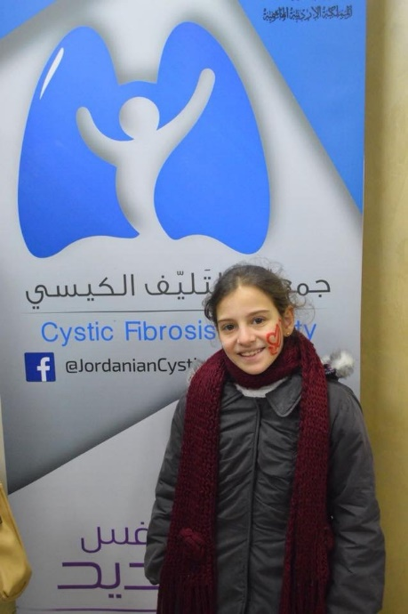
Notes:
We established an non prophit organization related to the ministry of health 14 months ago
With the aim of helping patients with CF

Slide 15
Objectives
Meet patients labelled to have CF in scheduled visits, demographic and clinical data collection
Educational sessions about CPT, CREON, nutritional intake, etc.
Influenza vaccine
Recognize challenges

Slide 16
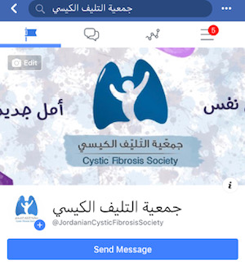

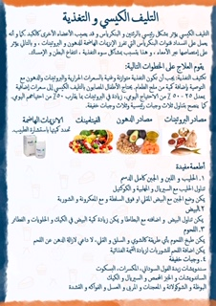
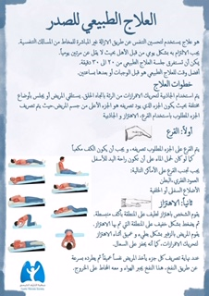
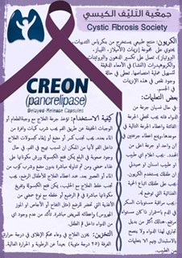

Slide 17
Notes:
Aimed to
Sequencing of the entire CFTR gene (including intron and promoter regions; MIM: 602421) in patients/cases with clinically diagnosed (or unconfirmed clinical diagnosis of cystic fibrosis (CF) in countries / regions where there is limited access to reliable sweat testing or newborn screening) in whom a CF-causing variants (henceforward mutations) were not detected in one or both CFTR alleles.

Slide 18
NM_000492.3 c.DNA | Legacy name
c.1521_1523delCTT/c.1521_1523delCTT | F508del/F508del
c.3196C>T/c.3196C>T | R1066C/R1066C
c.1545_1546delTA/c.1545_1546delTA | 1677delTA/1677delTA
c.650 A>G/N | E217G/N
CFTRdele2 homozygous | CFTRdele2/CFTRdele2
c.3909C>G/c.3909C>G | N1303K/N1303K
CFTRdele27 homozygous | CFTRdele27/CFTRdele27
c.254G>A/duplication of CFTR | G85E/gene duplication?
c.1521_1523delCTT/c.254G>A | F508del/G85E
c.3846G>A/c.3846G>A | W1282X/W1282X
c.1521_1523delCTT/c.2834C>T | F508del/S945L
c.254G>A/c.254G>A | G85E/G85E
CFTRdele17a-18 homozygous | CFTRdele17a-18 homozygous
Notes:
25 out of 88
5 homozygous for F508 del
3 heterozygous for F508 del

Slide 19
Novel CFTR Variants
NM_000492.3 c.DNA
c.650 A>G/N
c.2199G>C VUS?
c.3591C>T/N
c.3071T>A VUS? Homozygous
heterozygous deletion of whole gene

Slide 20
Case
A. Q. ,11 y, male, failure to thrive, greasy loose stool since birth, diagnosed cow’s milk allergy
Recurrent respiratory infections, Dx CF at age of 5 years, sweat test:70
He never received CPT, CREON 100-200 lipase units /kg/meal

Slide 21
First clinic visit
Clinical encounter @ 9 y
BMI: 13 @ 3rd percentile
ENT: severe polyposis
FEV1: 51
CT chest: bilateral diffuse bronchiectasis
Sputum culture: Pseudomonas aeruginosa, Methicillin-resistant Staphylococcus aureus
CFTR genotyping: cftrdele17a-18 homozygous
Notes:
3 admissions

Slide 22
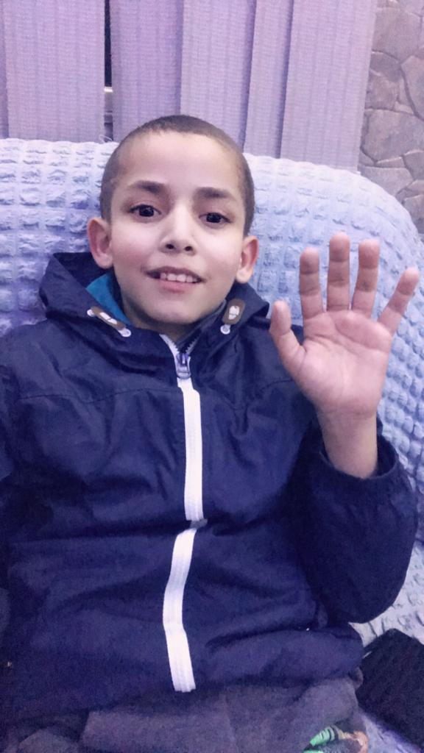
Follow up
Admissions with exacerbations:3
Polypectomy
CPT
Creon 2000 lipase units/kg/meal
BMI 15.8 @ 17th percentile
FEV1 = 68%
Notes:
IV antibiotics
Colonized with pseudomonas

Slide 23

Notes:
the road looks long for CF care in Jordan
Hopefully with the collaborations with CF foundations and dedicated people around the world we could make progress in the quality of care provided for cf patients Jordan
And reach the light at the end of the tunnel.

Slide 24
Thank you

