Slide 1
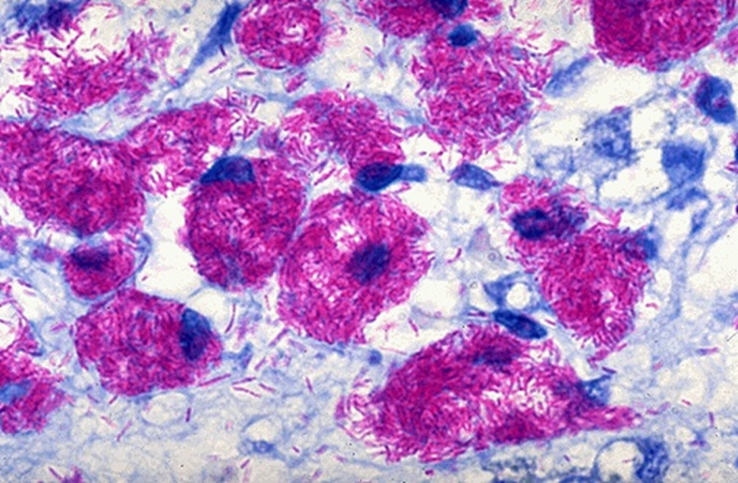
Non-Tuberculous Mycobacteria Not That Guilty !!
Yazan Said, ABP, ABAI
Jordan
Consultant, Allergy/Immunology and Pediatric Pulmonology
King Fahad Specialist Hospital-Dammam, Saudi Arabia

Slide 2
NTM Characteristics
NTM Responsible for opportunistic infections with a broad spectrum of virulence.
Ubiquitous organism: soil and water
Grow in drinking water
Grow at low oxygen (stagnant water)
Disinfectant-resistant and relatively heat-resistant
Adhere to pipe surfaces and form biofilms
Concentrated in aerosolized droplets
Notes:
Biofilm-grown 2 to 4-times more Cl-resistant

Slide 3
NTM Sources
NTM are normal inhabitants of:
Drinking water distribution systems/ plumbing
NTM recovered from:
Hot Water Heaters
Taps and Showerheads (70 % in US)
Bronchoscopes
Therapy Pools
Ice Machines
Refrigerator Taps and Ice
Humidifiers

Slide 4
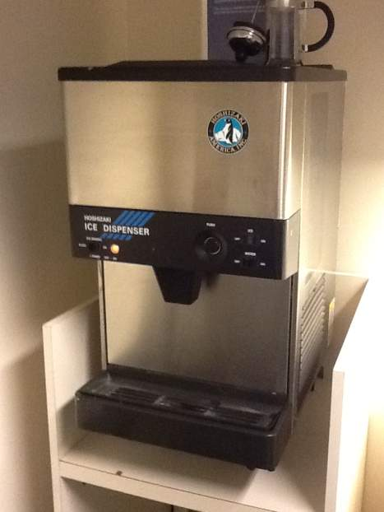
Sources of NTM Exposure
Aerosol Exposure
Ice machines
Waterborne microbes enter into the healthcare environment via:
Direct contact with water streams
Inadequately reprocessed medical devices
4
Notes:
Several sources of exposure to waterborne pathogens exist in the healthcare environment: direct contact with water streams, aerosols from showers and faucets, ice from ice machines, and rinsing of improperly processed medical devices.

Slide 5
NTM Concentration in Aerosols
Bacterium Aerosol Enrichment
_________________________________________
E. coli < 10
P. aeruginosa 9,000 - 27,000
L. pneumophila 1,200 - 2,500
M. avium 1,400 - 9,800
__________________________________________
Aerosol enrichment = concentration droplets/suspension
Am. Rev. Respir. Dis. 128: 652-656 (1983)

Slide 6
Now more than 125 identified NTM species
MAC (Mycobacterium avium complex) most common
Animal to human and human to human transmission not documented
Asymptomatic infections and symptomatic disease in humans possible

Slide 7
Estimates of the prevalence of NTM in the CF population have ranged from 1.3% in the earliest study reported in 1984 to 32.7% in a review of individuals with CF over the age of 40 years in Colorado
Rodman DM et al.. Am J Respir Crit Care Med 2005;171:621–6.
Analysis of CFF registry data has shown prevalence rates for NTM-positive culture in the USA of 12% but with considerable variation between individual states (0–28%)
Adjemian J, Olivier KN, Prevots DR. Nontuberculous mycobacteria among patients
with cystic fibrosis in the United States: screening practices and environmental risk.
Am J Respir Crit Care Med 2014;190:581–6.

Slide 8
NTM can transiently, intermittently or permanently reside within the
lungs of individuals with CF without causing NTM-PD, thus representing asymptomatic infection and creating considerable difficulties in deciding how best to screen for and diagnose NTM.3
Martiniano SL,et al. Clinical significance of a first positive NTM culture in cystic fibrosis. Ann Am Thorac Soc 2014;11:36–44.

Slide 9
Diagnosis
-For the diagnosis of NTM lung disease, patients suspected to have NTM lung disease are required to meet all clinical and microbiologic criteria
-Even after the identification of NTM species from respiratory specimens, clinicians should consider the clinical significance of such findings.
-Besides the limited options, treatment is lengthy and varies by species, and may be complicated by potential toxicity with discouraging outcomes.
Ryu Yon, et al.Tuberc Respir Dis 2016;79:74-84

Slide 10
Because NTM exists naturally in the environment, isolation of NTM from a nonsterile respiratory specimen does not mean they are causative organisms of lung disease
Diagnosis of NTM lung disease requires the clinician to integrate clinical,
radiographic, and microbiological data
van Ingen J. Microbiological diagnosis of NTM pulmonary disease. Clin Chest Med 2015;36:43-54.
Symptomatic patients with compatible radiographic findings should meet the microbiological criteria to establish a diagnosis of NTM lung disease
Griffith DE, et al. An official ATS/IDSA statement: diagnosis, treatment, and prevention of NTM diseases.
Am J Respir Crit Care Med 2007;175:367-416.

Slide 11
NTM lung disease
-Historically: not reportable disease –
-Increased prevalence not well characterized
-Disease duration for TB is 8 months and for pulmonary NTM 4-10yrs
-Burden of TB expected to steadily decline in industrialized countries with mature TB programs. By contrast, the prevalence of NTM disease may be expected to steadily increase
1979-80 : NTM 1/3 of all mycobact isolates
1990-91 : NTM 3/4 of all mycobact isolates
Notes:
Historically, case rate (MAC) estimated between 0.9 and 4.6 per 100,000
Ontario: ’97-’99 - 6.3/100k to ’01-’03 9.3/100k
( U.S. TB case rate 2004 4.9 / 100,000)

Slide 12
Nontuberculous Mycobacterial Lung Disease ATS Diagnostic Criteria
-Originally published in 1997; revised 2007
-Critical issue:
Since the NTM are widespread in the environment, a single isolation is usually NOT sufficient for diagnosis/initiation of therapy
-General guidelines for the typical NTMs (MAC., M.abscessus)
a) 2 or more (+) cultures
b) or a (+) smear and (+) culture
c) or (+) bronch wash culture
Am. J. Respir. Crit. Care Med. 175:367-416, 2007

Slide 13
Increasing Incidence of M. xenopi at Bellevue Hospital, NY
The dramatic increase in M.xenopi isolates noted in our hospital was due to a more sensitive laboratory isolation technique, rather than a true increase in clinical disease. Other hospitals utilizing MGIT systems for mycobacterial recovery should interpret positive M.xenopi cultures with caution
Vincent D et al, CHEST Volume 118, Issue 5, Pages 1365-1370 (Nov. 2000)
Notes:
he Bellevuemycobacteriology laboratory changed the culture medium from solidLowenstein-Jensen medium (used from 1975 to 1990) to the Septi-CheckAFB System (Becton-Dickinson; Glencoe, MD; used from 1991 to 1994), tothe Mycobacteria Growth Indication Tube (MGIT; Becton-Dickinson; usedfrom 1995 to 1998)
Werecovered 29 M xenopi isolates from 1975 to 1990, 12isolates from 1991 to 1994, and 381 isolates from 1995 to 1998. Wesubsequently identified and reviewed the medical records of all 81patients who were culture positive for M xenopi from1975 to 1994 (period 1), and 46 patients who had two or more isolatesculture positive for M xenopi from 1995 to 1998 (period2). For period 1, 75% of the subjects were male, 80% were minority,and at least 43% were HIV positive. Only one patient had clinicalM xenopi lung disease during this period. For period 2,79% of the subjects were male, 83% were minority, and at least 58%were HIV positive; two additional patients were identified who hadclinical M xenopi lung disease

Slide 14
Bystander?
-Positive culture may represent colonization of the lower respiratory tract
-Some organisms are unlikely pathogens, eg M.gordonae
-CF patients 13% positive culture
-M. xenopi frequently isolated from respiratory specimens from individuals infected with human immunodeficiency virus (HIV) and is often considered nonpathogenic
Jiva TM1 et al,, Clin Infect Dis. 1997 Feb;24(2):226-32.

Slide 15
Immunopathology
- Patients with pulm.NTM infection are taller and leaner, with high rates of scoliosis, pectus excavatum, mitral valve prolapse, and CFTR mutations, but without recognized immune defects
-Stimulated cytokine production was similar to that of healthy control subjects, including the IFN-γ / IL-12 pathway. CD4+, CD8+, B, and natural killer cell numbers were normal.
KIM R et al Am J Respir Crit Care Med Vol 178. pp 1066–1074, 2008
Notes:
Patients with PNTM infection are taller and leaner than control subjects, with high rates of scoliosis, pectus excavatum,mitral valve prolapse, and cystic fibrosis transmembrane conduc-tance regulator mutations, but without recognized immune defects

Slide 16
Thank You

Slide 17
Hospital Water Filters as M. avium Complex Source
Isolation of M. avium or M. intracellulare from 75 bronchoscopy samples (Dec 2007-Feb 2009)
Inconsistent with patient symptoms or conditions
Water and biofilm samples collected from bronchoscopy preparation laboratory
M. avium, M. intracellulare, M. malmoense isolated
M. avium and M. intracellulare isolates from laboratory matched rep-PCR fingerprint patterns from bronchoscopes
J. Med. Microbiol. 59: 1198-1202 (2010)

