Slide 1
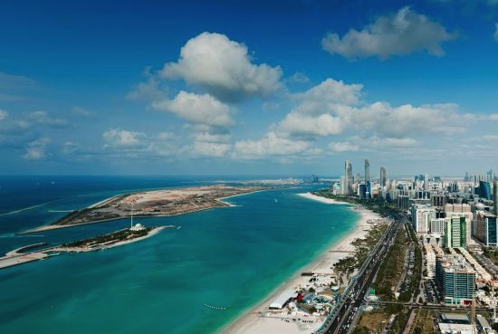
Cystic Fibrosis UAE experience
Asma Al Nuaimi
Consultant Pediatric Pulmonologist
UAE

Slide 2
Aim of the talk
Share our local experience
Learn from each other , our patients are unique to the region !
Understand the different dynamics of CF management in case oriented fashion
Illustrate how patients differ despite having the same genes

Slide 3
Cystic Fibrosis

Slide 4
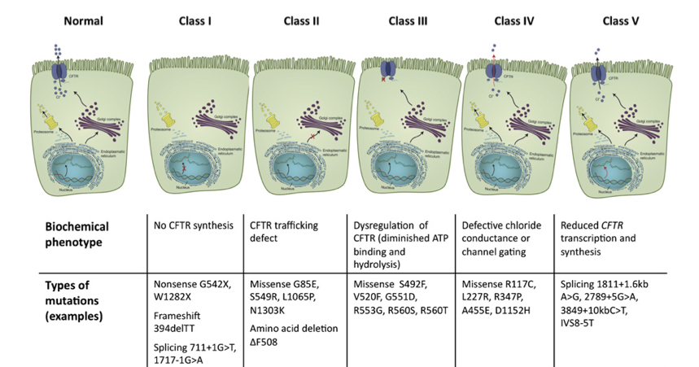
CFTR mutations
> 1800
Classes

Slide 5
UAE CF story
1994
S549R
1999
2007
CF clinic
2013
s549R 1/100,
1/15876
CF Foundation attempt ?
Ivacaftor
Δ508 1/200
Dr.Kheralla
Frossard
Frossard and Dawson
2015
Jay panicker
iva/lumcaftor
CF segreated clinic
CF family day

Slide 6
Diagnosis of CF
+Sweat chloride , conductive method
>60 -80
+Stool elastase
+Correlation with clinical symptoms and FHx
CF metabolic syndrome

Slide 7
CF in Arab American population
805 Arab Americans
7 carriers were identified
carrier frequency of 1 in 115.
The most common mutation identified was
W1282X (57% )
followed by DeltaF508 , R117H.
Three of 7 patients with a known or suspected diagnosis had two identifiable mutations, including :
1548delG, DeltaF508, W1282X, 2789 + 5G>A and R170H.
The addition of 1548delG, I1234V, H139L and 4010del4 as part of an extended screening panel would increase the detection rate to 66.3%
Cystic Fibrosis testing among Arab-Americans, Genet Med. 2006 Apr;8(4):255-8.

Slide 8
CF Mutations in the UAE Local Patients
*Frossard et al. HUMAN MUTATION . Mutation in Brief #133 (1997)
**SKMC Cystic Fibrosis Data 2009

Slide 9
CFTR mutation detection strategy
25 mutation middle eastern panel
2 mutation detection
99 commonest mutation

Slide 10
CF potentiators/
correctors

Slide 11
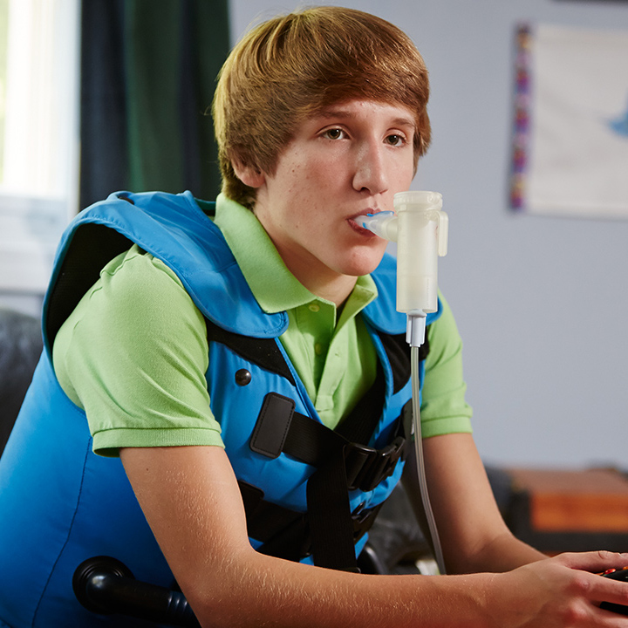
3 inhalation medications twice a day +VEST , lasting 2 hours /day
25-50 tablets /day + 3-4 insulin injections

Slide 12
Minnesota protocol for HFCC
Thought to be beneficial by altering volumes and flow rates during therapy
More interactive therapy ( getting away from just sitting & shaking)
6 cycles of 5 minutes
Settings range from:
Hz 6,8,10 at pressure of 10 ( or highest the patient can tolerate )
Hz 16,18,20 at pressure of 6
VEST hoses are detatched after each 5 minutes to allow the patient to huff and cough

Slide 13
Pulmonary exacerbation
25 % of patients do not improve back to their baseline
Goal should be to prevent exacerbation
Plan Scheduled admissions for IV antibiotics and concentrated airway clearance therapy with any signs of deviation

Slide 14
General Aim
Improve life expectancy
Improve everyday living activities
Overall Wellbeing

Slide 15
Specific goals with CF patients
Normal lung function
No FTT
Eradication of bugs
CFRDM early screening
Positive feedback on improvement

Slide 16
Attempt multi-displinary settings
Segregation of patients in CF according to bugs
Pulmonary /Nutrition /physio/pharmacy +/-GI

Slide 17
CF turning points
Diagnosis
Toddlerhood “ NO I wont do that “
First bad bug culture
First hospitalization
Going to school
Adolescent
“No I wont do that and you cant make me “
Self care
Transition to adults
Adulthood
Relationship
Family
Work
Declining health
Transplant vs end of life

Slide 19
2007- 2017
62 patients
Age range : 2m( S549R) -42years(D 508)
9 deaths : (S549R x4)
3120 1G>A x1
Unidentified x2
Dleta 508 X2
Co morbidity of depression in 5
B.Cepacia in 4

Slide 20
Local CFTR mutations

Slide 21
Demography
No of Children | 40
Gender | M: F=22:18
Mean Age | 10.2 yr.
Ethnicity | Arab= 38 Caucasian= 2
National: Non National | 30:10

Slide 22
Genotype
S549R | 12
S549N | 1
DF 508 Homozygous | 8
1548delG | 3
3120+1G>A | 3
3670delA | 2
406-2A-->G | 2
3849+10KBC->T | 2

Slide 23
Genotype
C.212G>T | 2
C.80G>Tp.Gly27Val exon2 | 2
1525-1G>A | 1
2789+5G->A | 1
1898+3A>G | 1
N1303K | 1
l1234V | 1
DF508/- | 1

Slide 24
BACTERIOLOGY
Bacteriology | No: of children
Pseudomonas aeruginosa | 13 (33%)
No growth | 12 (30%)
MRSA | 7 (18%)
Staph A | 5
H Influenza | 2
AX/Strep/SM | 1each
NTM/BC | 1each
B.Cepacia 2 patients passed away
New protocol for eradication of MRSA & priority for infection control

Slide 25
BMI
No: of children | 40
Data analyzed | 33
Mean BMI | 16.97
Mean BMI- Centile | 30.6
Mean BMI-Z score | -.73
BMI is LOW in our CF Population.

Slide 26
complications
No: of children | 40
CF Related Diabetes | 8
CF Liver disease | 5

Slide 27
Genotype-phenotype
Genotype | Mean FEV1 | Mean BMI-Z Score
S549R/S549R(n=12) | 70% | -.89
F508/F508(n=8) | 58% | -1.54
1548 delG/1548 delG(n=3) | 28% | -1.62
3120+1G>A/3120+1G>A(n=3) | 71% | -0.08

Slide 28
YuH,et al,Ivacaftor potentiatior of multiple chanels with gatting mutaions ,J CF (2012)

Slide 29
YuH,et al,Ivacaftor potentiatior of multiple chanels with gatting mutaions ,J CF (2012)

Slide 30
SKMC Patients’ Response to 30 Days of Ivacaftor Therapy
Mutation | Age in years | Sweat Cl |  | Weight Kg |  | BMI |  | FEV1 (%)
 |  | Pre | Post | Pre | Post | Pre | Post | Pre | Post
S549N | 18 | 105 | 49 | 64.7 | 72 | 21.9 | 24.6 | 3.15 (80) | 3.63 (89)
S549N | 11 | 113 | 40 | 31.7 | 36 | 15.5 | 17.6 | 2.0 (100) | 2,22 (111)
S549N | 11 | 116 | 60 | 33.4 | 37.3 | 16.1 | 17.7 | 2.09 (103) | 2.46 (119)
S549R | 13 | 111 | 56 | 45.5 | 49.5 | 18.5 | 20 | 2.71 (109) | 3.5 (117)
S549R | 10 | 130 | 50 | 23.8 | 31.4 | 24.8 | 78.7 |  | 0.42 (24)
G551D | 11 | 120 | 61 | 43.2 | 45.4 | 77.7 | 79.7 | 1.21 (48) | 1.41 (56)

Slide 31
Tribal Association
S549N
S549R
1548delG
delta F 508
Consanguinity
Families with more than one child with CF
Social stigma

Slide 32
Ivacaftor clinical experience
2017
18 patients including adults

Slide 33
The star
12 years
S549R
Severe FTT , < 3rd centile 26 kg , referred for GT
B.Cepacia
FEV1 30s
Required admission for initiation
FEV1 in 6 month 56 % ---64 %
Weight gain 12 kg , 3 kg in 19 days
Now he is 16 years old and recently admitted with hemptysis and B.Cepacia
Lung function improved post hospitalization

Slide 34
Ivacaftor family
S549R
29 yrs
CFRDM
Porta Cath
B.Cepacia/Psudomonas
FEV1
29-62
Depression
Weight gain
23yrs
Lymphectasia
FEV1 105%
No exacerbation
26 yrs
CFRDM
Porta cath
Psudomonas
FEV1 42%-65%
No admission for 19 m
Pregnency counselling , weight gain
11 yrs
IDDM
Hypoglycemia
Seizure
No admissions

Slide 35
Monozygotic Identical twins S549N
14 years
Ivacaftor for one year
FEV1 100 % pre 111% 1 m 101% 1 year | FEV1 103% pre 119% 1 m 95% 1 year
WT 36 41 42 Pancreatitis mass ? Sever gastritis, Stenting common bile duct | WT 37 44.2 44
20 yrs M
FEV1 %65
No weight gain
CFRDM
LFT
Poor compliance

Slide 36
Severe case
11 years , 2 siblings died of CF
S549R homozygote
FEV1 25 % , On O2 ,NIPP
Multi drug resistance , desensitization with each admission
B.Cepacia
Ivacaftor !
End of life discussion
Death 2016

Slide 37
Ivacaftor granules
2 years
Excellent compliance
Good weigh gain
Hospitalization frequency is less
3 years
Poor compliance
Weight gain fluctuating
Hospitalization q4-6 weeks

Slide 38
Ivacadtor /lumucaftor △508
15 years
B.Capcia
CFRDM
Non compliant
?depression
Lives in rural area
FEV1 25-29
Used for 4 months
B,Cepacia worsening lung status
Worsening FTT
Inhopsital management
Death 2017
32 years
B.Cepacia
CFRDM
Compliant
Lives adjacent to CF center
FEV1 30-55
PE /hemorrhage
Pregnancy
Conceived naturally
Tried it for 3 months , dyspnea associated with it so stopped it

Slide 39
3120+1G>A 22
Ivacaftor
Feels good
Wellbeing
Weight gain
No change in FEV1( 50-60 )
ABPA
No change in sweat chloride
Ivacaftor /lumucaftor
Feels good
Wellbeing
No change in FEV1 (75-78 )
ABPA
sweat chloride
117 -87-74
Tested +organoids
promissing

Slide 41
Lung transplant
2 cases
Done in USA
Major psychosocial challenge/adjustments
Financial burden
Normal lungs post transplant
Average 6-10 daily medications

Slide 42
CF management justification

Slide 43
5 major clinical challenges
Multi disciplinary setting of assessment
Adult transition clinic
Fertility counselling
Pre marital counselling
Sustaining compliance with chest toilet
Multiple siblings with CF
Pseudomonas colonization /cepacia
Growth and nutrition
Local diet strategies vs. western diet
Co morbidity of depression
Social stigma
Families feel alone
Divorce rate in families caring for CF

Slide 44
Long term Challenges
End point definition for success or response to treatment ! FEV1 ? Or weight gain !
Can we sustain financial Insurance coverage !
How can we improve Compliance ?
Pessimistic view of the Other CF children that are not legiable for new drugs
The old generation CF vs. the new CF promise

Slide 45
Social media effect
Not isolated any more
Support groups
Need of education
Family days

Slide 46
Social workers and psychosocial concerns in CF
New diagnosis
First hospitalization
Beginning school
Adherence
Siblings and parenting
Adulthood
Transplant
End stage
Mental health/substance a use
Depression and anxiety

Slide 47
Depression and anxiety
Depression 15 %
Depression and anxiety 8 %
Anxiety 5 %
Mothers and fathers 2-3 X the community
We tend to forgot this ??

Slide 48
Adult transition
For the first time adults > 18 yrs outnumber children in the registry
In 2014 USA registry adults were 50.7%
Introduction of adult team prior to transition significantly reduced concern , 86 % felt transition should occur by age 21
Caregivers concern overestimate parent and patient concerns !
Suggestion:
Transition meetings
Pediatric team needs to terminate (bring closure ) their relationship in a therapeutic manner to facilitate the transition

Slide 49
Issues related to getting older that we may forget to deal with !
Education
Family planning
Age appropriate health screening

Slide 50
CF counseling
Life expectancy will it be prolonged !
Severity of local cases vary even among siblings
Earlier treatment !
Can we justify trial of Ivacaftor or lumacaftor Ivacaftor/ in rare CF mutations ?
Patients who are considering to get pregnant ? Counseling

Slide 51
Conclusion/recommendation
Re evaluate our multidisplinary setting
RT roles emphasized , main reason for referral abroad
Psychiatry role
Policies need to be updated
Second Family awareness day
Connect our patient via social media

Slide 52
Thank you
The year of Zayed

