Slide 1

The European Cystic Fibrosis Society
Isabelle Fajac
Paris, France
MECF Conference, Izmir, 23 March 2018

Slide 2
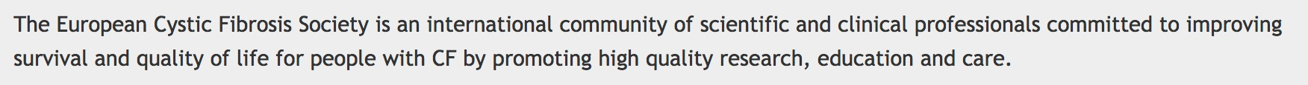
ECFS: Mission Statement & History
1969: European Working Group for Cystic Fibrosis, Chairman: Prof. E. Rossi (IT), annual forum
1997: European Cystic Fibrosis Society, 1st President: Prof. N. Høiby (NL)
2000-: Regular consensus meetings and reports: Prof. G. Döring (DE) & Prof. S. Elborn (UK)
2002: Journal of Cystic Fibrosis, 1st Editor-in-Chief: Dr. H. Heijerman (NL)
2004: Annual conference on basic science
2008: ECFS-CTN, Prof. K. De Boeck (BE), and the ECFS Registry
2011: Standards of Care project, Dr C. Castellani (IT)
2017: Education platform, Prof. D. Peckham (UK)
https://www.ecfs.eu

Slide 3
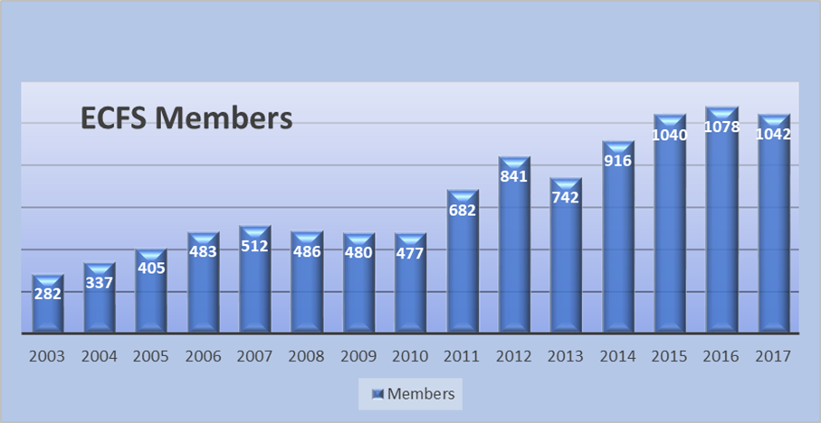
ECFS Structure
Annual General Meeting
ECFS
Board
Notes:
Changes in working groups (exercise and AMR) – Central Office – Conferences (under Education)

Slide 4
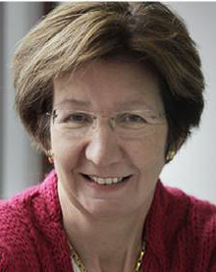
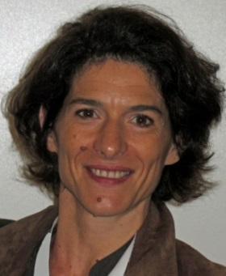
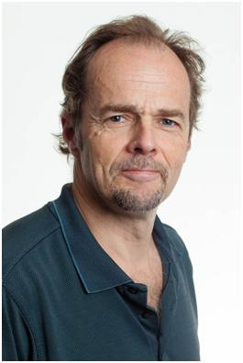
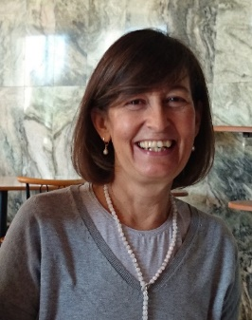
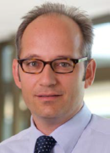
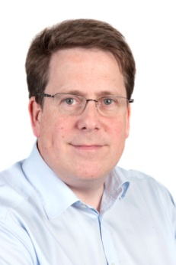
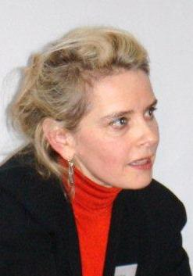
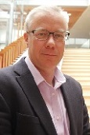

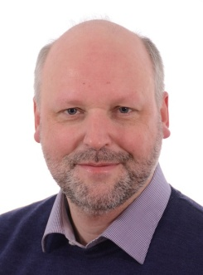
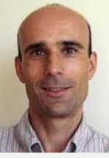
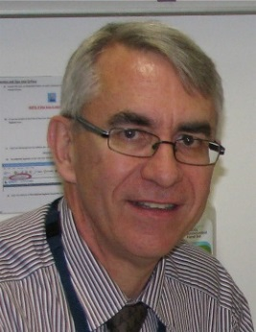
ECFS Board
Kris De Boeck
President
Isabelle Fajac
President Elect
Harm Tiddens (NL) Margarida Amaral (PT) Marcus Mall (DE) Daniel Peckham (UK) Isabelle Sermet (FR) Kevin Southern (UK)
Silke van Koningsbruggen (DE) Lutz Naehrlich (DE) Pavel Drevinek (CZ) Scott Bell (AU)

Slide 5
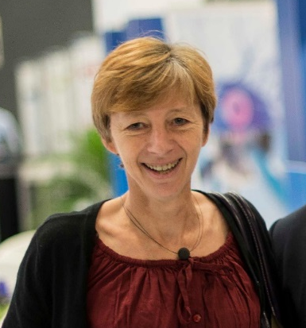
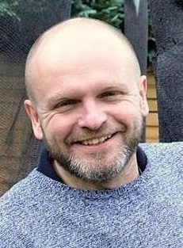
ECFS Structure
Annual General Meeting
ECFS
Board
ECFS Central Office
- Christine Dubois, Executive Director
- David Debisschop, Project Manager
Education
European CF Conference
Basic Science Conference
Online education platform
Clinical Trials Network
Silke van Koningsbruggen (DE)
CTN Director
Patient Registry
Lutz Naehrlich (DE)
Registry Director
Standards of Care
Pavel Drevinek (CZ) SoC Director
Journal of Cystic Fibrosis
Scott Bell (AU) Editor-in-Chief
Working Groups
Diagnostic Network
Neonatal Screeing
Basic Science
Exercise
Mental Health
Fungal pathogens
Antimicrobial Resistance
Notes:
Changes in working groups (exercise and AMR) – Central Office – Conferences (under Education)
Membership: JCF sent and participation to working groups

Slide 6

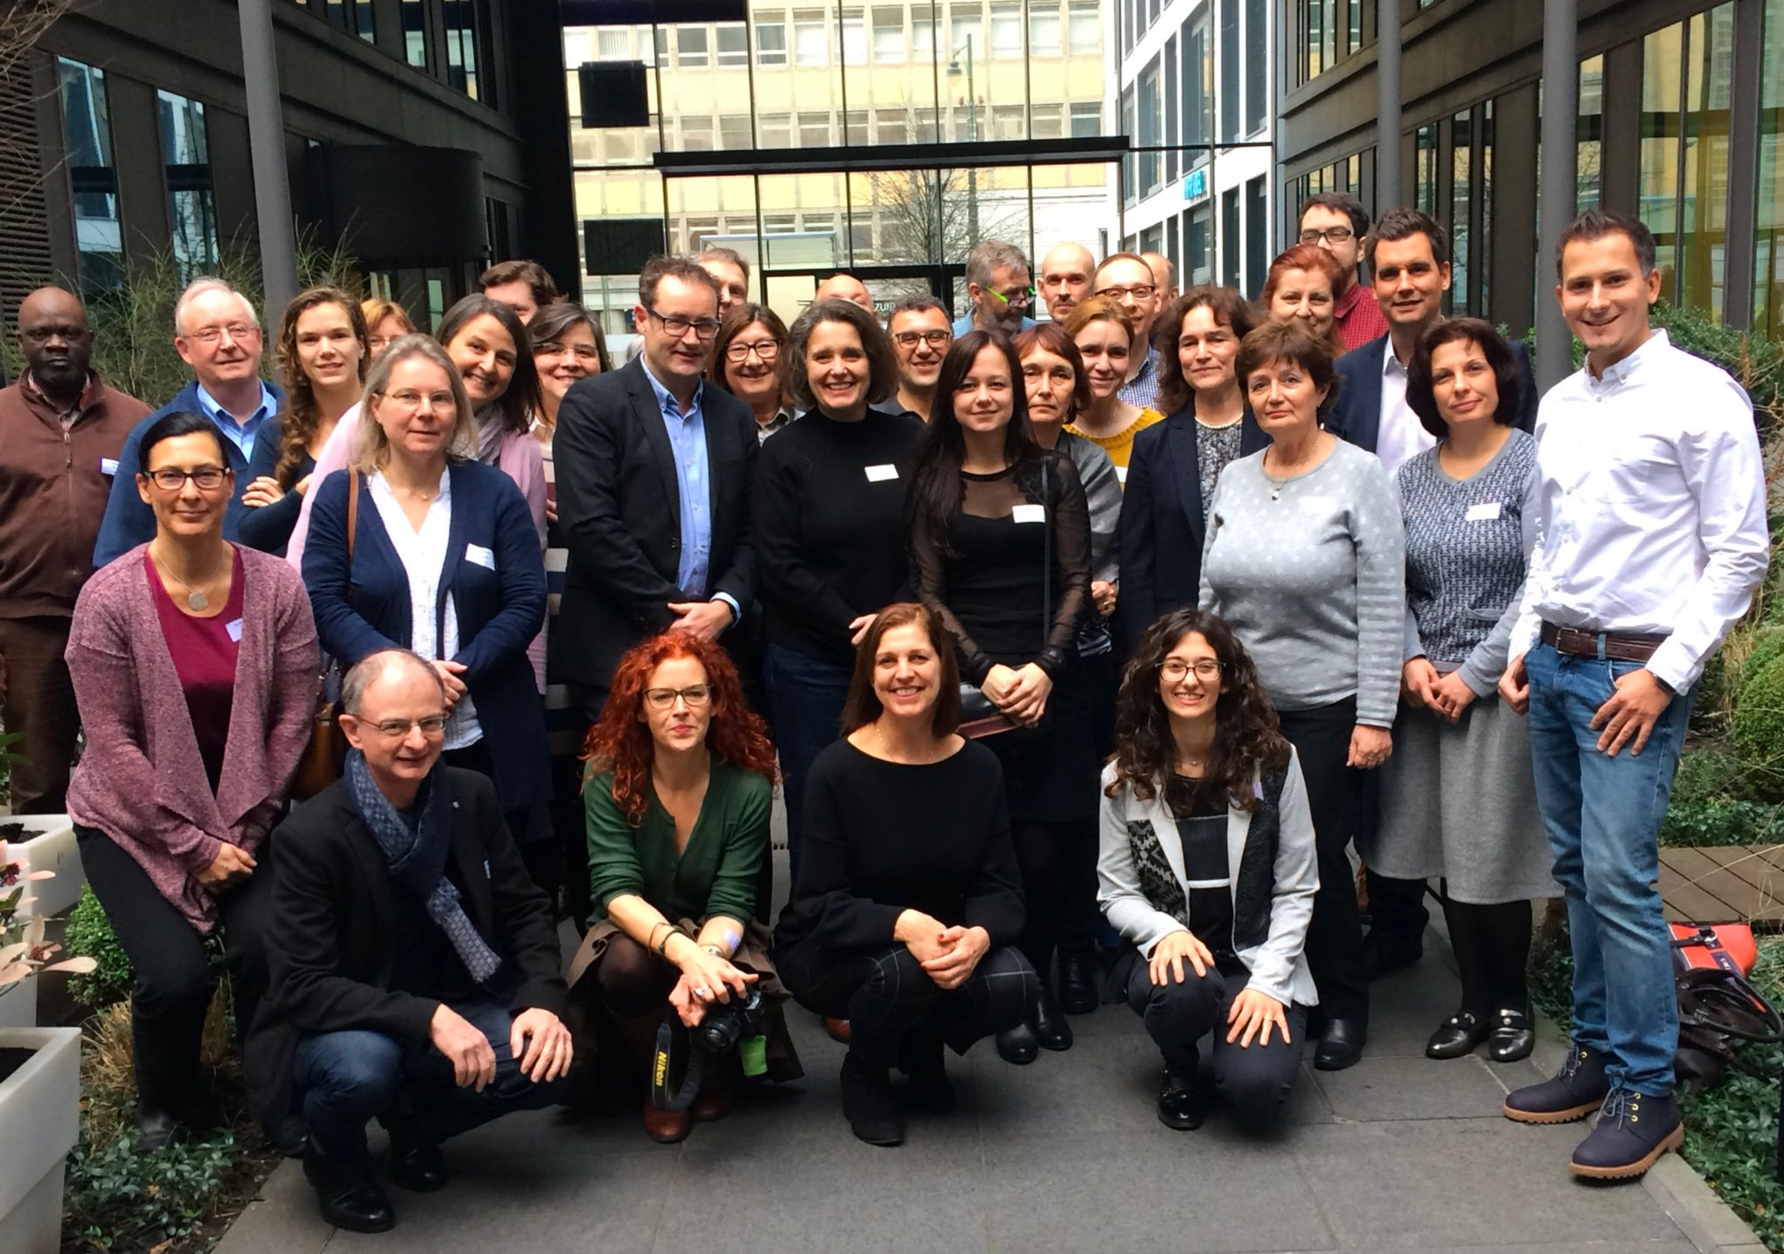
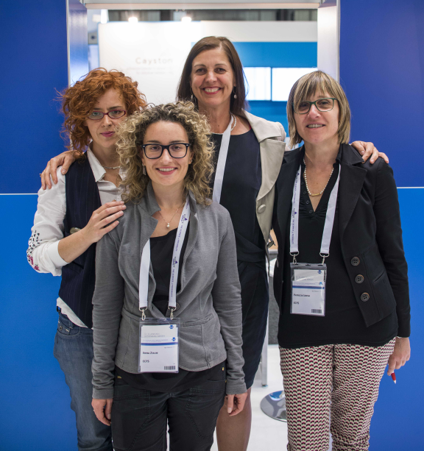

ECFS-Patient Registry
Lutz Nährlich (DE)
Registry Director
Registry Steering Committee
Meeting in Brussels, 2018
Registry Team

Slide 7
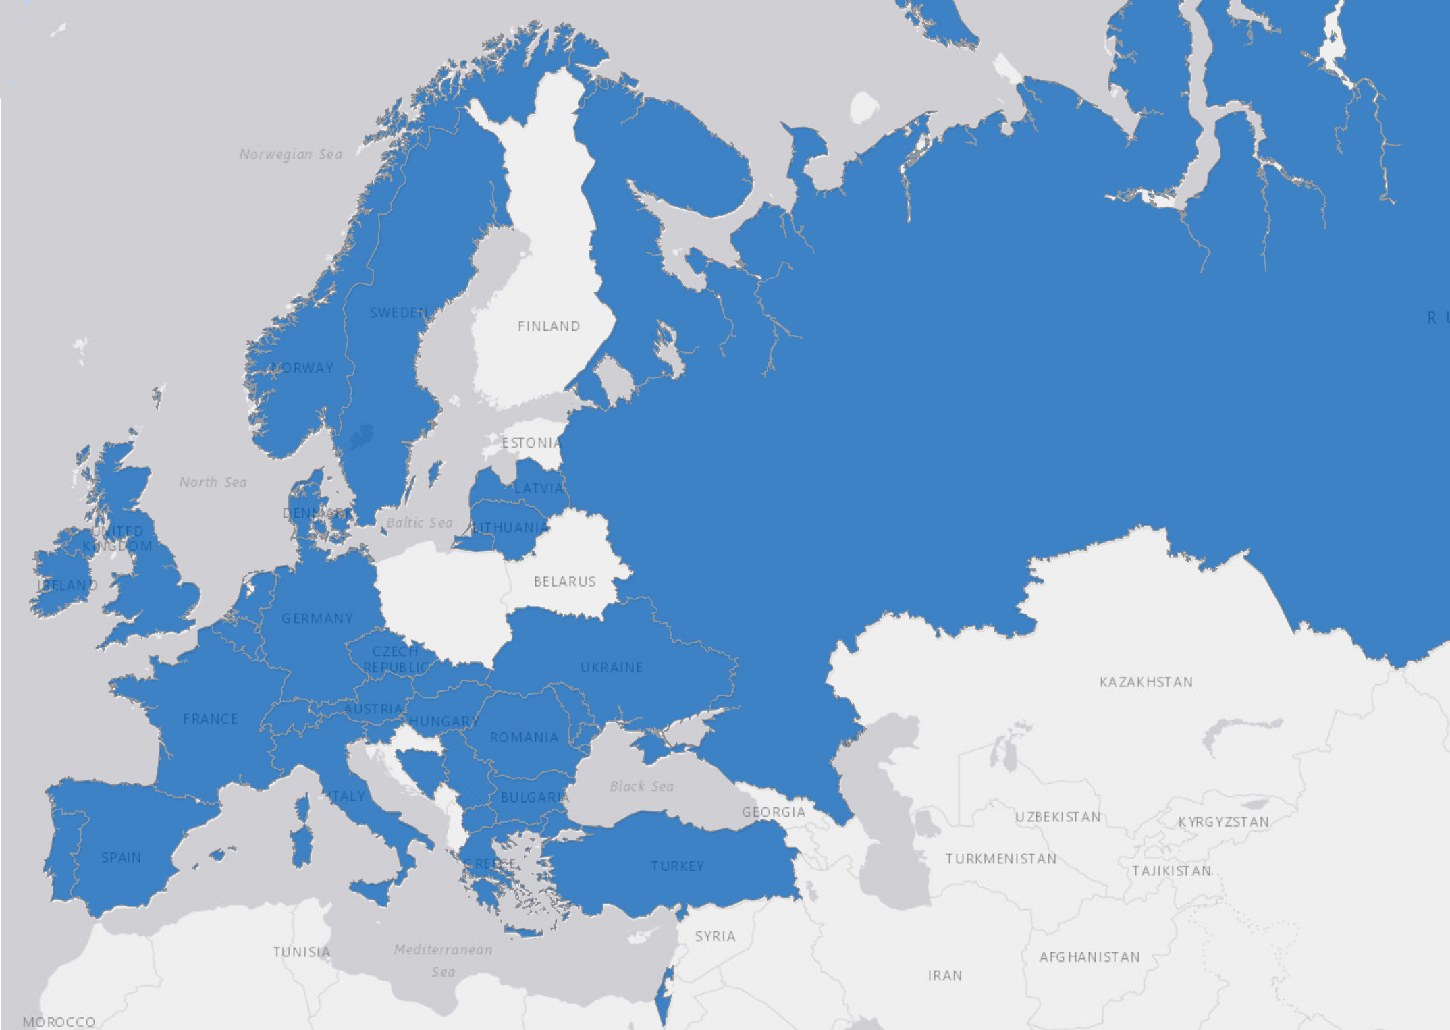
ECFS-Patient Registry
31 participating countries, > 42,000 patients
Longitudinal data 2011-2015
Notes:
ME Registry: input from our team

Slide 8
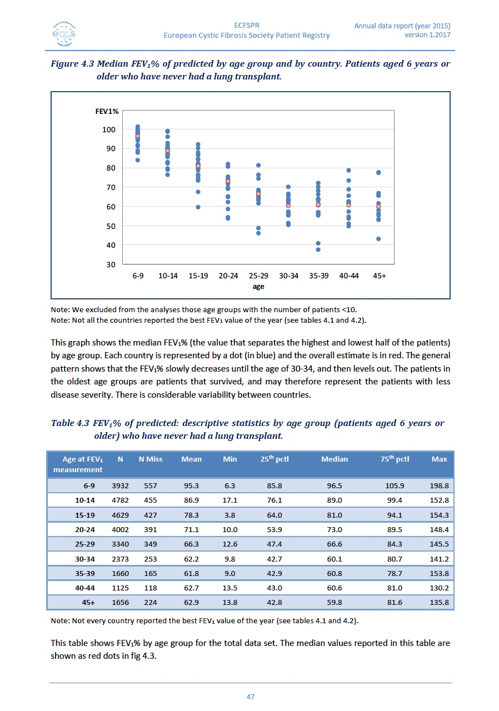
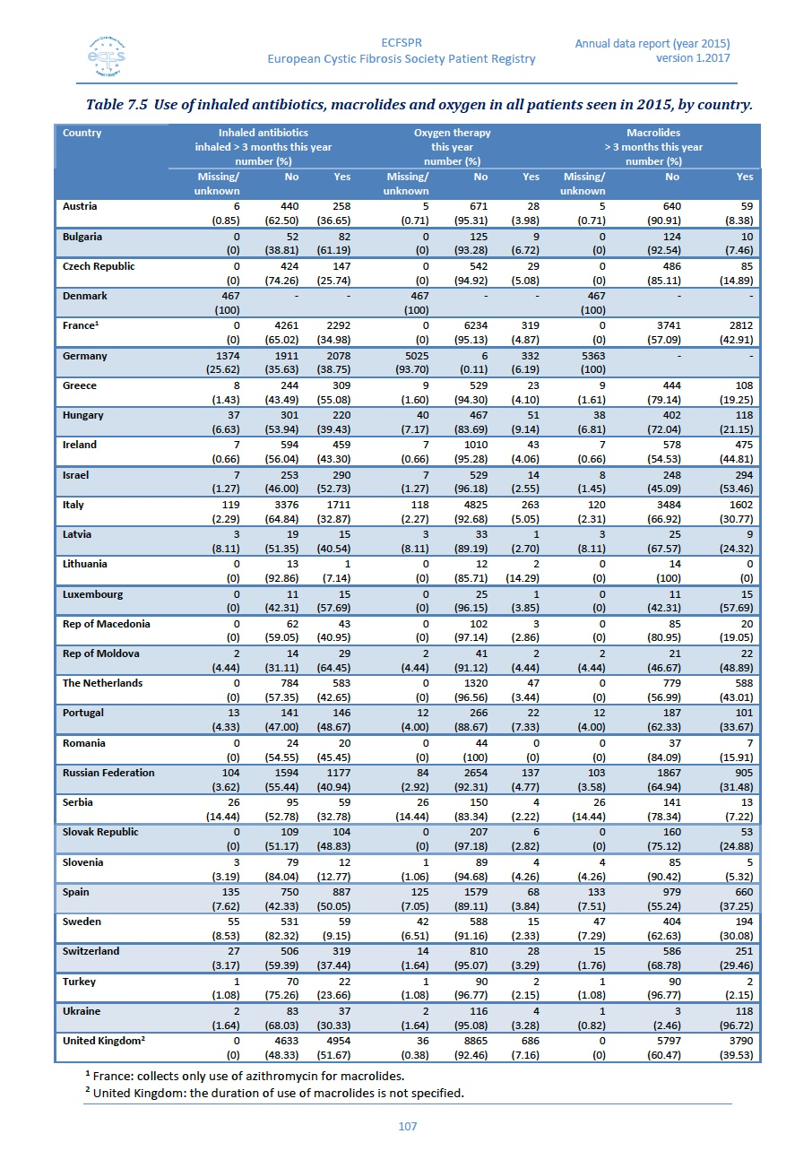
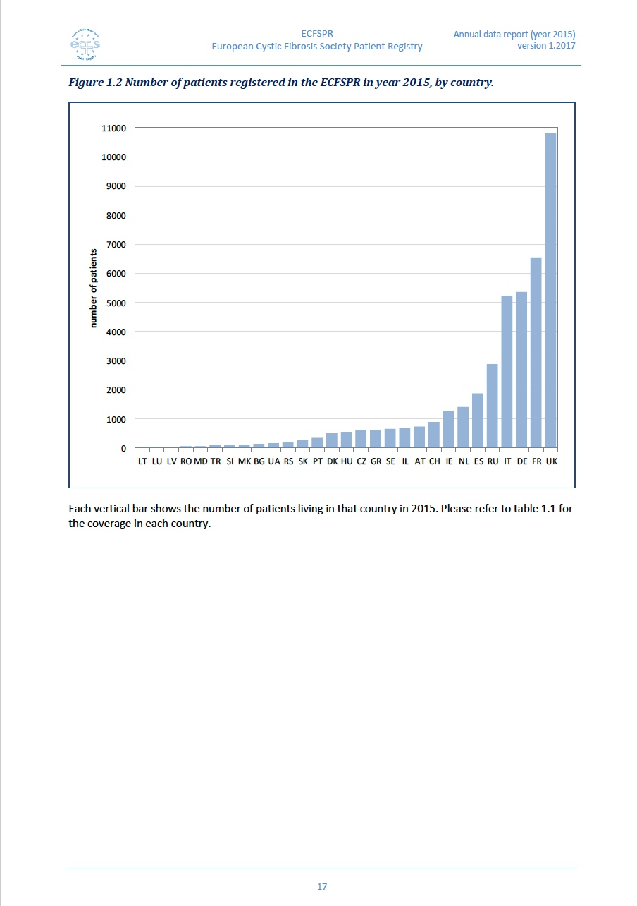
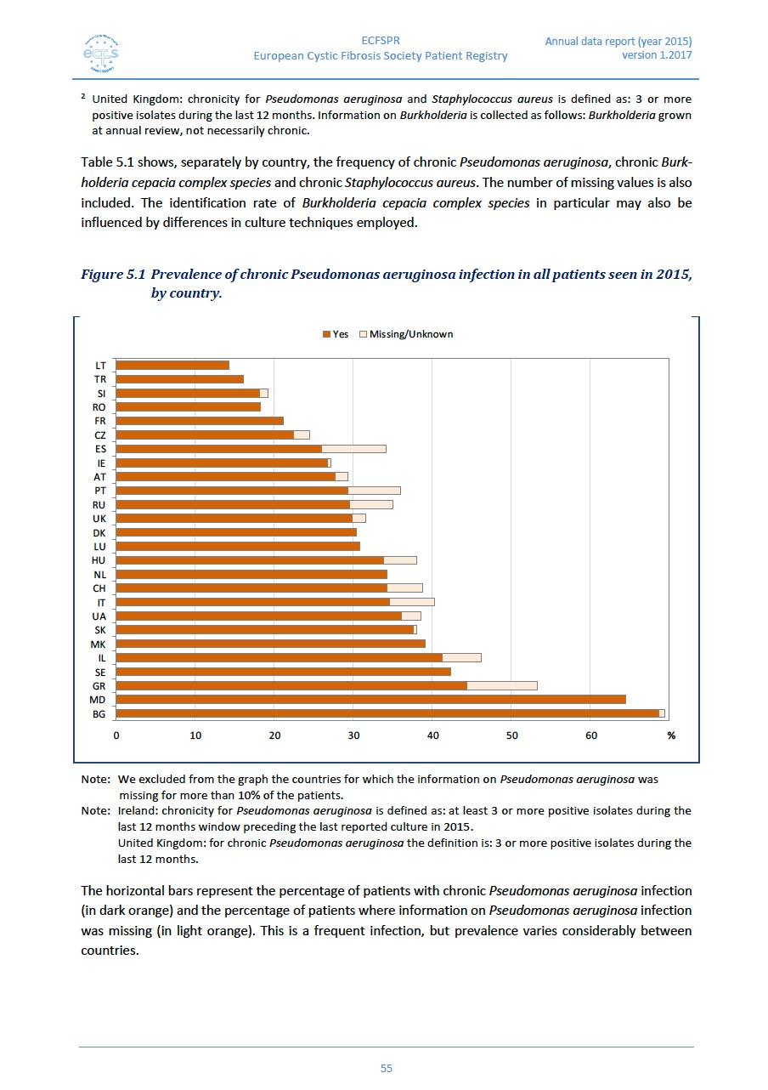
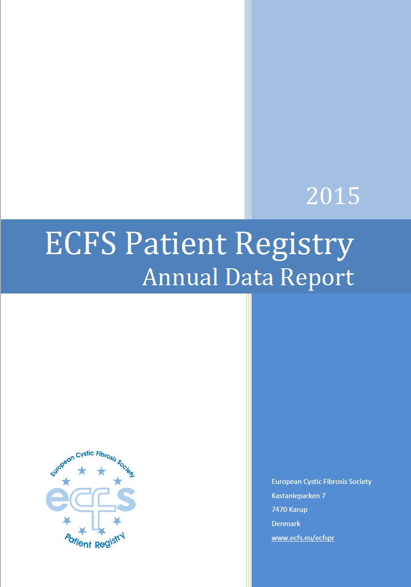
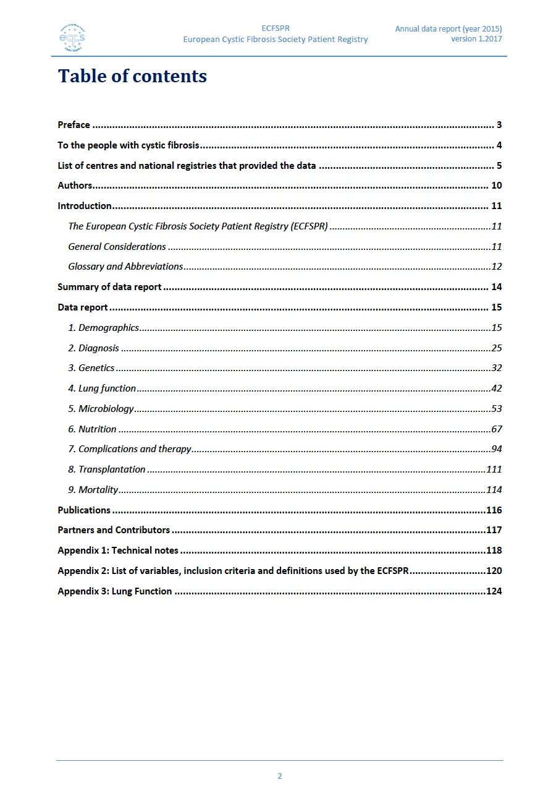
Patient Registry: Annual Data Report
https://www.ecfs.eu/ecfspr

Slide 9
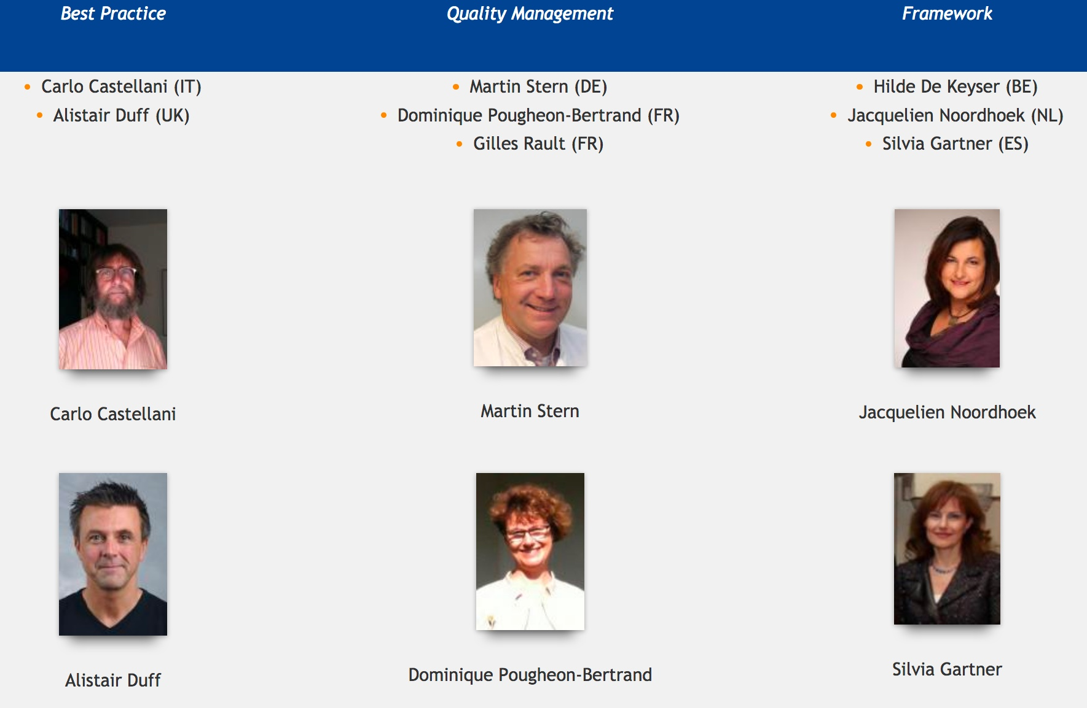
ECFS Standards of Care
Pavel Drevinek (CZ)
Project Leader

Slide 10
Standards of Care – Best Practice
2018: Update of the document in Journal of Cystic Fibrosis 2014
Each chapter revised – in press – Open access
Kevin Southern | Newborn screening and access to specialist care from early life
Isabelle Sermet-Gaudelus | Diagnosis
Felix Ratjen | Prevention of progression of lung disease by ensuring all patients have access to therapies of proven effectiveness
Anne Munck | Optimal nutrition and management of metabolic complications
Harry Heijerman | Treatment of the complications in a timely and effective way
Scott Bell | Transplantation and appropriate management of end of life issues
Alistair Duff | Psychological support
https://www.ecfs.eu/news/ecfs-standards-care-available-open-access
Notes:
Cooperation: work on ME SoC with some input from our team

Slide 11
ECFS-Clinical Trials Network
43 sites
15 countries
17,500 patients
https://www.ecfs.eu/ctn
ECFS-CTN@uzleuven.be

Slide 12

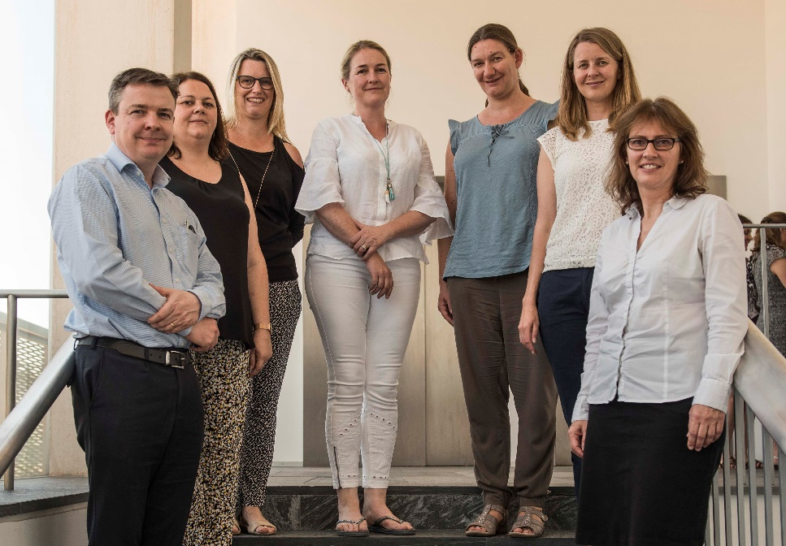
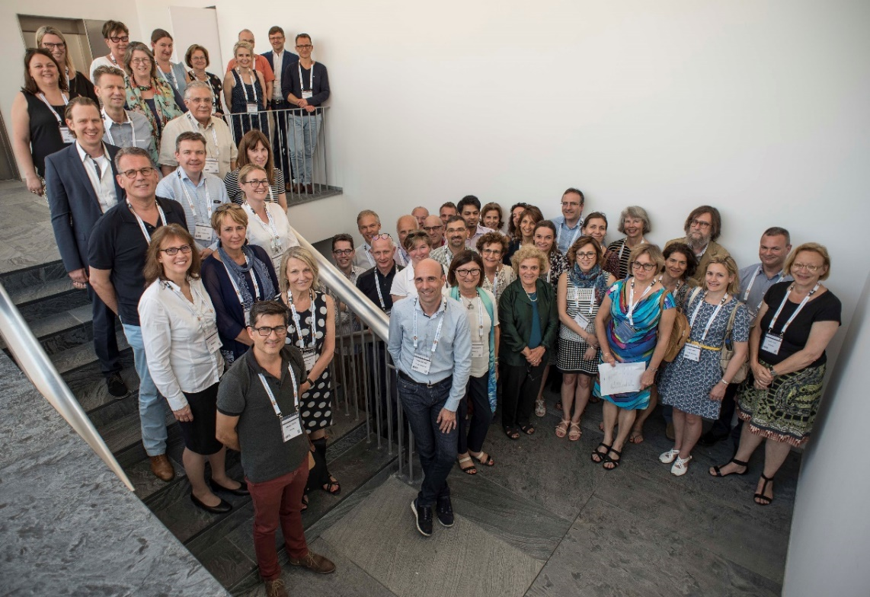
ECFS-Clinical Trials Network
Steering Committee Meeting
2017 Seville
CTN Team

Slide 13
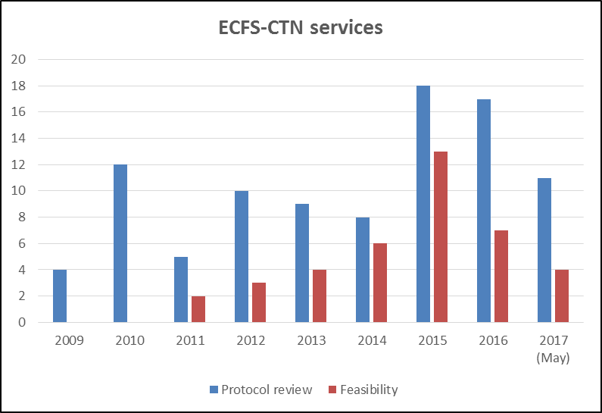
2009-2017: ECFS-CTN Services

Slide 14
2009-2017: Active ECFS-CTN Studies/Month
2009
2011
2013
2015
2017

Slide 15
ECFS-CTN Studies in 2017

Slide 16
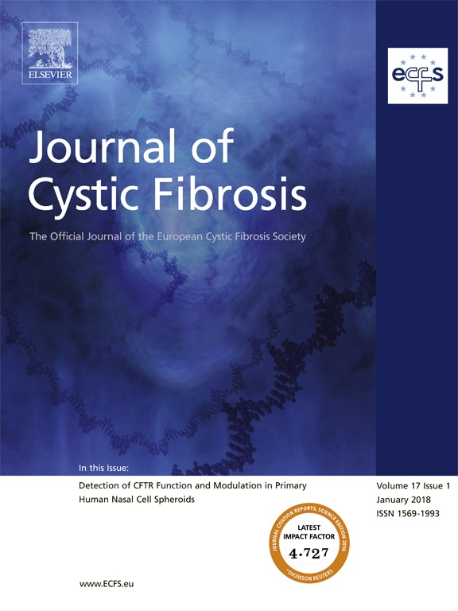
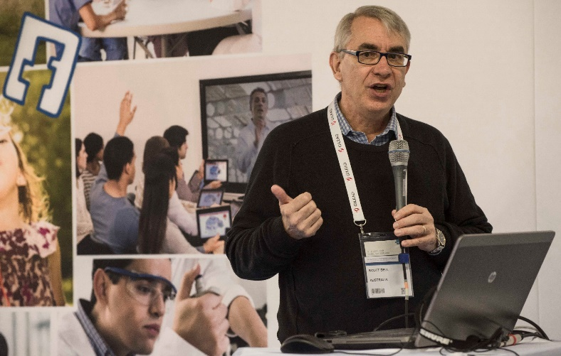
Journal of Cystic Fibrosis
Editor-in-Chief: Scott Bell (AU)

Slide 17
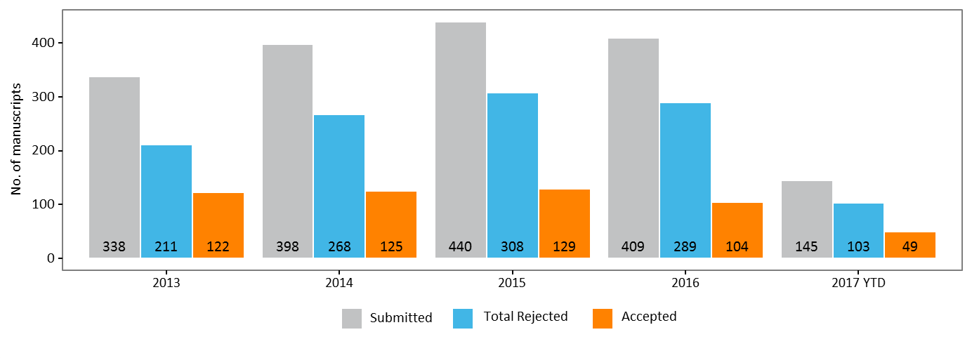
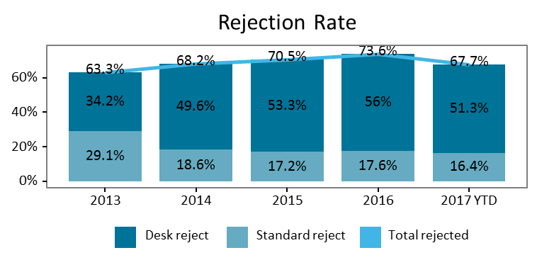
Submitted Manuscripts and Decisions
Updated last 2017-05-01

Slide 18
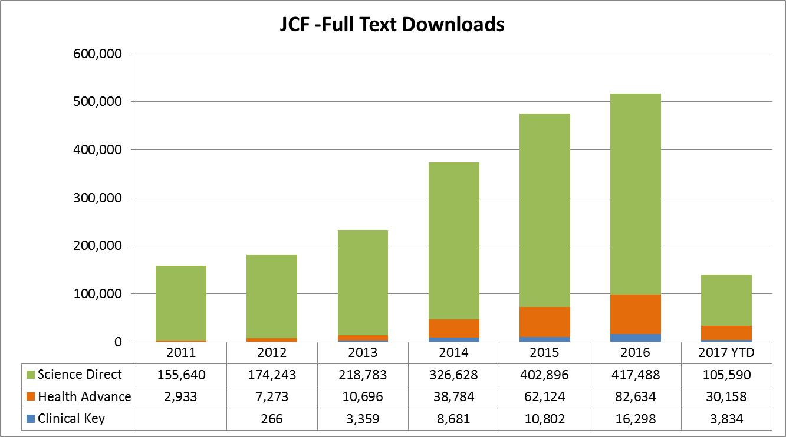
Journal of Cystic Fibrosis

Slide 19
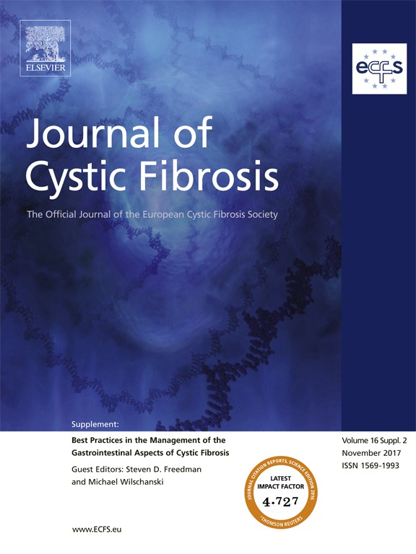
Publications on Best Practices

Slide 20
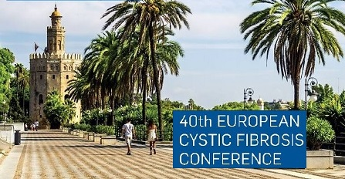
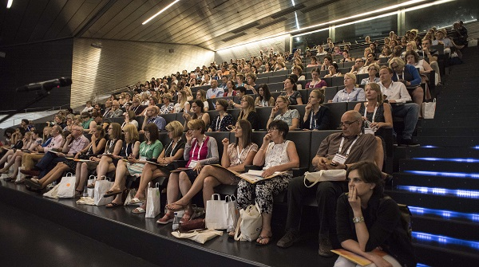
Annual European CF Conference
7–10 June 2017: Seville, Spain
Top 10 Countries
2,345 participants
from 54 countries

Slide 21
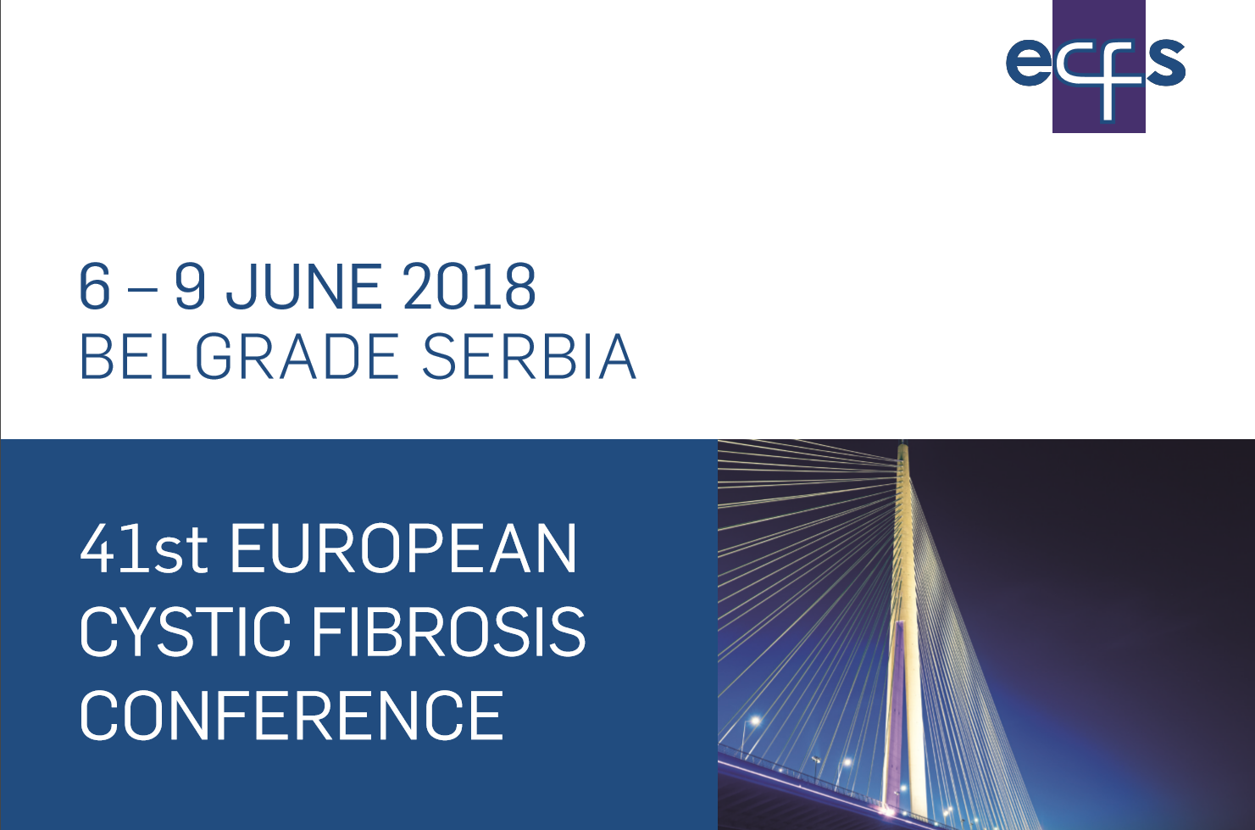
Annual European CF Conference
Conference President:
Prof. Predrag Minic

Slide 22
Belgrade 2018 – Pre-Conference Courses
https://www.ecfs.eu/belgrade2018

Slide 23
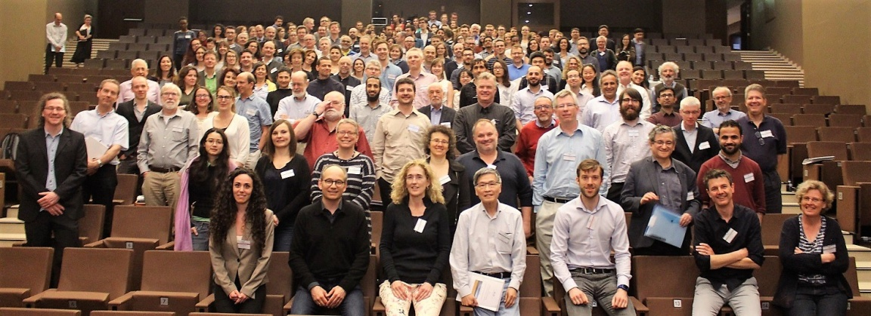

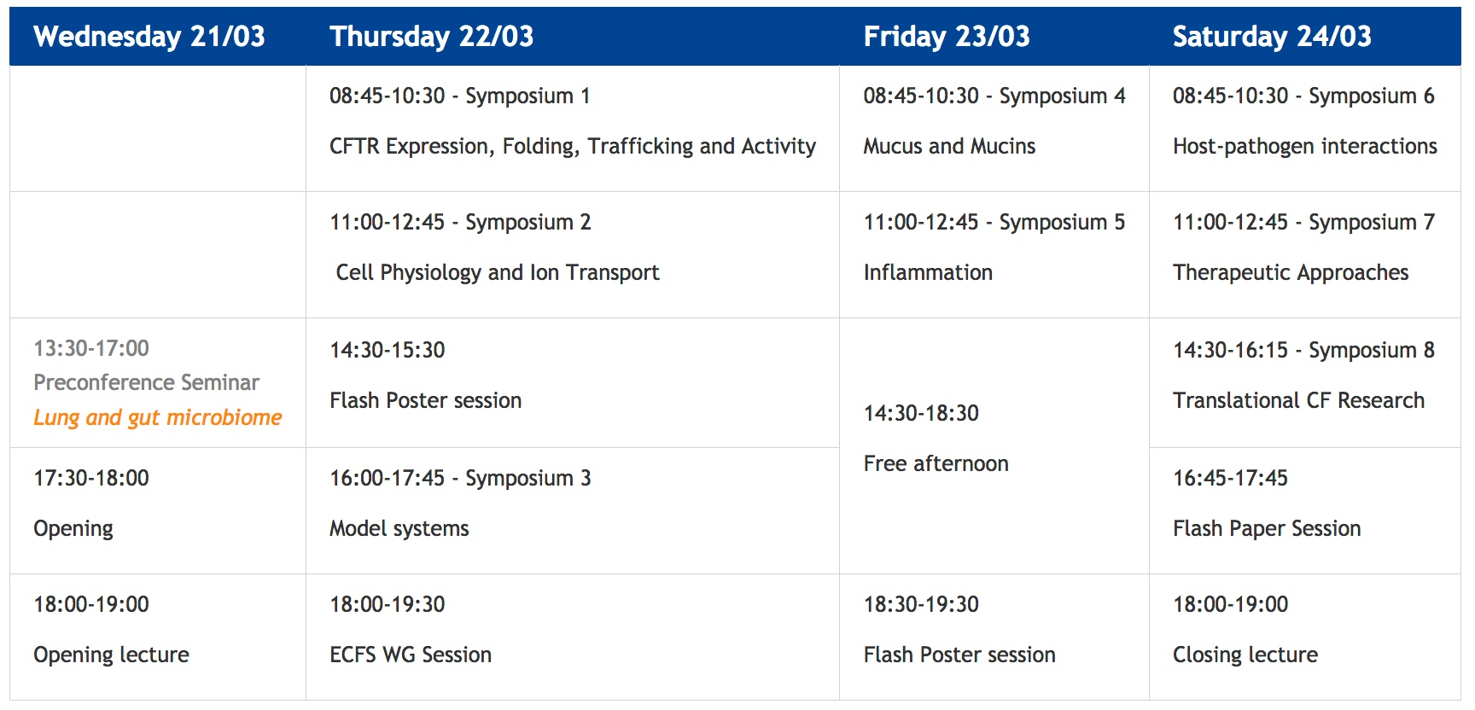
Annual Basic Science Conference
29 Mars - 01 April 2017
Albufeira, Portugal

Slide 24
New Activities: Education Platform
The ECFS Education committee:
  Chair: Daniel Peckham, ECFS Board Member
  One representative of ECFS Working groups, Special Interest Groups and projects (standards of care, CTN, Registry)
Goals:
  Support development of a clear curriculum appropriate to each sub-speciality
  Interactive online programmes from some of the leading experts in cystic fibrosis
Remit:
  assess unmet educational needs
  support the development of educational modules

Slide 25
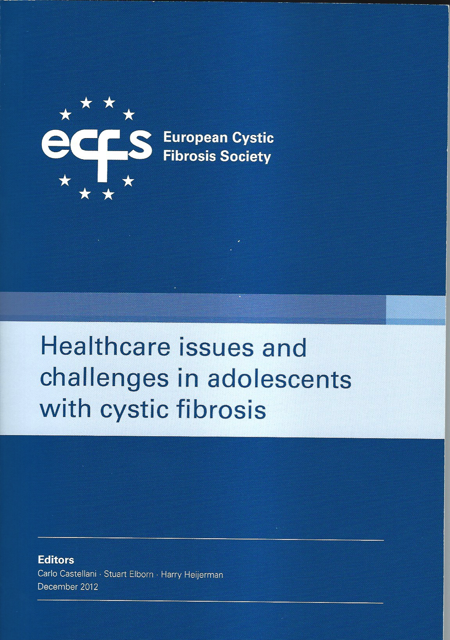
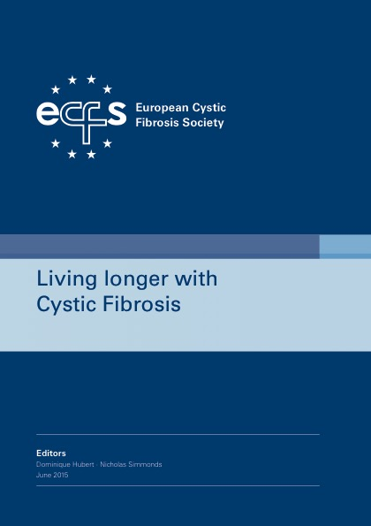
Education : ECFS Books
Coming soon: The Early CF Years
Editors: K. De Boeck (BE) and K. Southern (UK)

Slide 26
Education: Support from ECFS
ECFS Preceptorship programme
Partnered with the course ‘Managing the care of children and adults with cystic fibrosis’ held twice a year in London, UK
Clinical placement for 2 weeks at the Royal Brompton Hospital, London, UK
https://www.ecfs.eu/content/ecfs-preceptorship
ECFS Short Term fellowship
Travel/accommodation support to visit a CF Centre or CF laboratory in Europe to learn a specific technique
https://www.ecfs.eu/society-details/short-term-fellowships
Notes:
The ECFS has partnered with the course ‘Managing the care of children and adults with cystic fibrosis’ held twice a year in London (March & September), UK or on-line to offer clinical placements to members of the CF multidisciplinary team. The clinical placement will typically be for two weeks in either the paediatric or adult centre at the Royal Brompton Hospital, London, UK (additional CF Centres will be available at a later date).
ECFS offers Travel/accommodation support to visit a CF Centre or CF laboratory in Europe to learn a specific technique. These fellowships are not applicable for attendance at ECFS conferences, meetings or sponsored courses where different terms apply.

Slide 27
