Slide 1


Middle East Cystic Fibrosis Association – 2018
Case Report
Dr. Sanem ERYILMAZ
​
Department of Pediatrics, Division of Pediatric Pulmonology
Hacettepe University Faculty of Medicine

Slide 2
Case, F.B.
17-years-old male patient
PMH: CF (delTA/delTA) diagnosed at 2 months.
He has chronic colonization with Pseudomonas aeruginosa since 1-years-old.
He hospitalized many times because of pulmonary exacerbations and Pseudomonas aeruginosa infections.

Slide 3
At age of 4, unilateral pleural effusion was detected and he hospitalized, at this time sputum and pleural fluid tuberculosis cultures were negative, PPD was 17 mm (BCG vaccineted). There was no history of tuberculosis.
Sputum culture: Pseudomonas aeruginosa
Thoracic CT: Mediastinal lymph nodes (max. diameter 9 mm), consolidation at right lung middle lobe and left lung lower lobe, bronchiectasis at bilateral upper lobes.

Slide 4
He treated for pulmonary infection and discharge with tuberculosis prophylaxis.
Prophylaxis was continued for 6 months.

Slide 5
When he was 8-years-old, he applied with pulmonary complaints (the increase of sputum and cough) and hospitalized for pulmonary exacerbation.
Chest x-ray: nonspecific consolidation at the right lung
Sputum culture: Pseudomonas aeruginosa
Thoracic CT: Consolidations and bronchiectasis at bilateral upper lobes.
PFT: FVC: 49(L), FEV1:45, FEV1%:85, FEF25-75:28(L/s), VC:46(L)
Tx: ceftazidime and amikacin

Slide 6
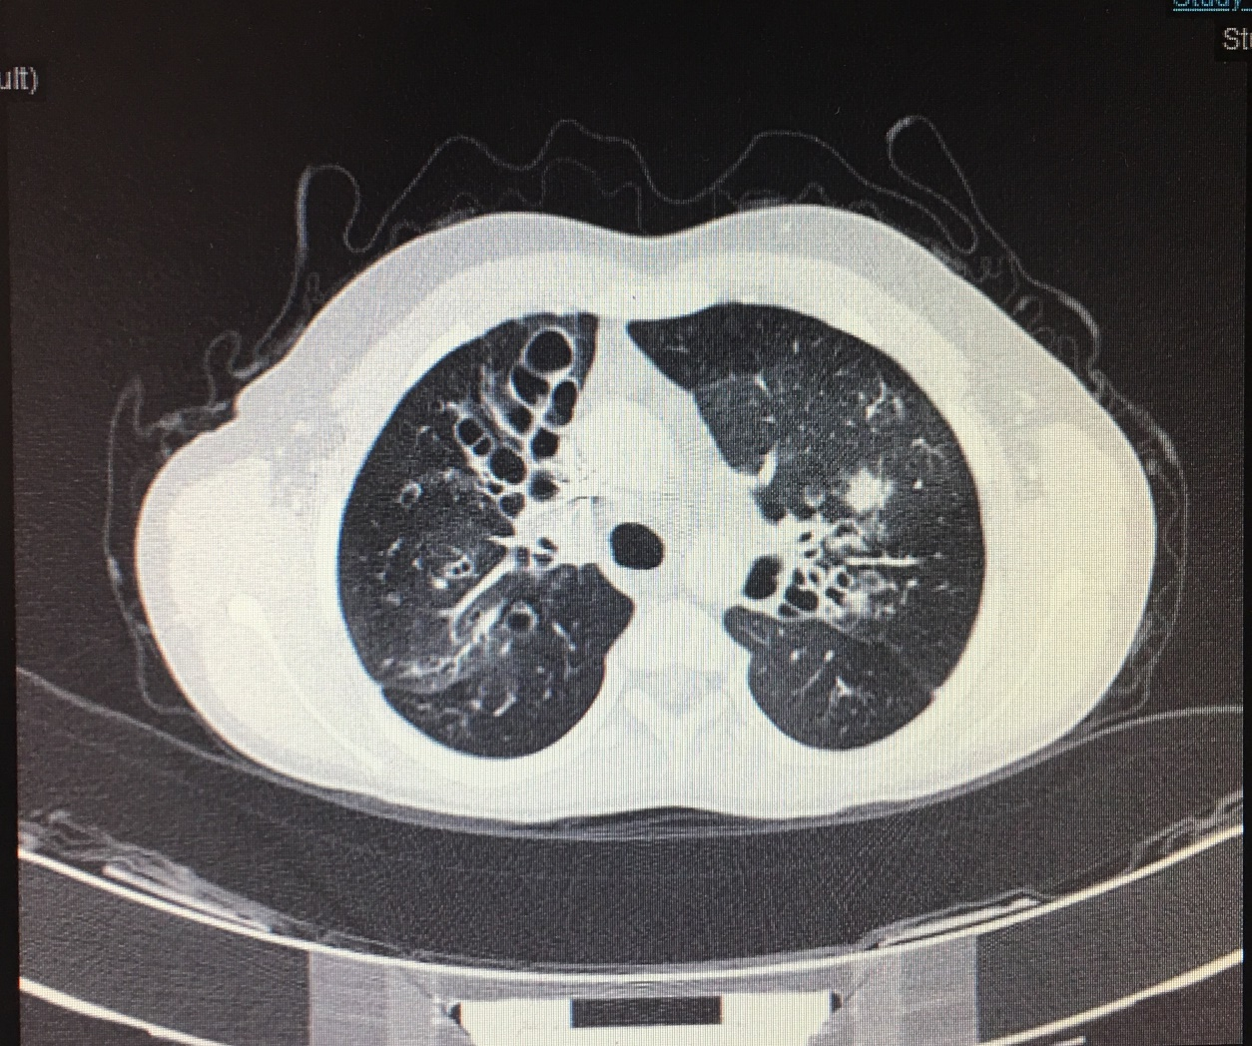
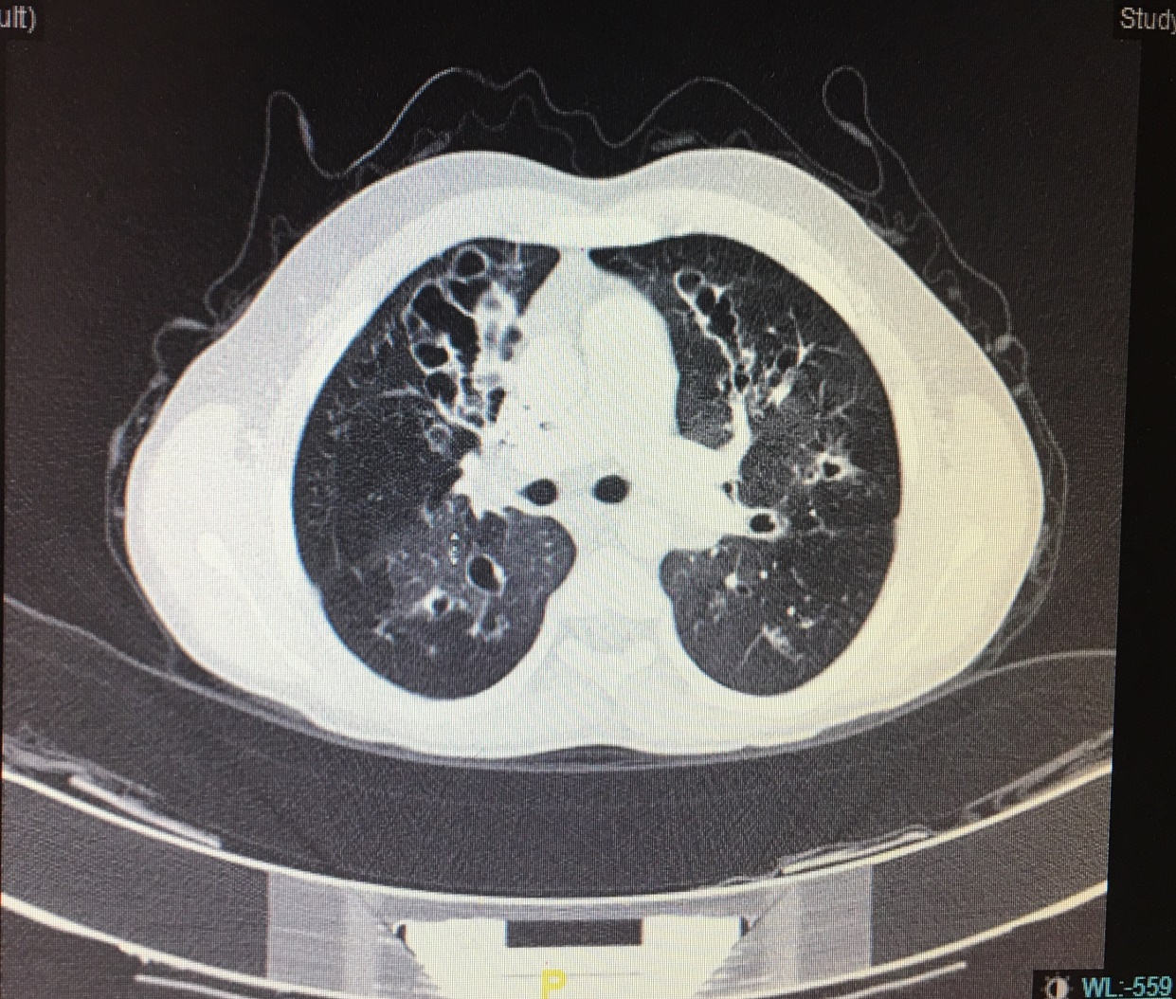

Slide 7
Tuberculosis culture (sputum): Mycobacterium abscessus
AFB positive
PCR negative
PPD: 14 mm
Antimicrobial susceptibility testing:
Isoniazid (Resistant), rifampicin (Resistant), ethambutol (Resistant), streptomycin (Resistant), Amikacin (Sensitive), clarithromycin (Sensitive)

Slide 8
Initial induction treatment (4 weeks): cefoxitin, amikacin, clarithromycin
After induction treatment, he recieved inhaled amikacin and clarithromycin.
At 2. months of treatment, AFB result was negative and TB culture was positive for Mycobacterium abscessus.
He continued inhaled amikacin and oral clarithromycin for 18 months and at this period, all sputum TB cultures were positive for Mycobacterium abscessus without AFR positiveness.

Slide 9
After 2. years of TB treatment, the patient has evaluated again and there was no clinical and radiological deterioration but culture positiveness kept going for Mycobacterium abscessus.
The treatment was continued for another 18 months.
Thoracic CT: Mediastinal lymph nodes (max. diameter 13 mm), cystic bronchiectasis at bilateral all lobes.
PFT:
FEV1: 40(L), FVC:41(L), FEV1%:96, FEF25-75(L/s), VC:48(L)

Slide 10
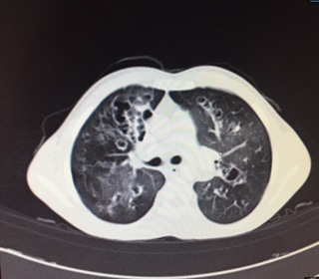
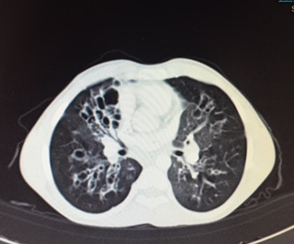

Slide 11
Tb treatment was ended after 3 years because the patient was thought to be colonized with Mycobacterium abscessus.
When the patient was 14-years-old, at one of his routine outpatient controls, AFB was detected positive for Mycobacterium abscessus.
PFT:
FVC: 47(L), FEV1: 46(L), FEV1%: 75, FEF25-75: 31(L/s), VC:50(L)
Thoracic CT: Mediastinal lymph nodes (no difference between others), cystic bronchiectasis at bilateral all lobes.

Slide 12
Antimicrobial susceptibility testing:
Isoniazid (R), rifampicin (R), ethambutol (R), streptomycin (R)
Amikacin (S), clarithromycin (S)
He admitted to hospital for treatment with amikacin, teicoplanin, imipenem and clarithromycin for 2 weeks and after discharge he had inhaled amikacin and oral clarithromycin treatment.

Slide 13
Inhaled amikacin and clarithromycin treatment were given for 3 years again.
At this period, his all sputum cultures were positive for Mycobacterium abscessus and AFR positiveness was continued intermittently.
PFT results were in compliance with the restriction and obstruction.
Radiographic findings were similar to previous ones: mediastinal lymph nodes and cystic bronchiectasis at bilateral all lobes. There was no enlargement at lymph nodes.

Slide 14
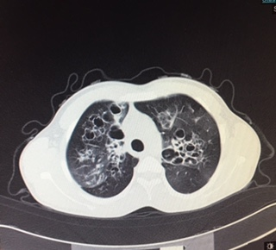
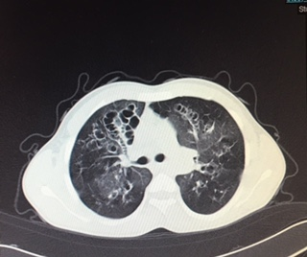

Slide 15
The treatment was ended at the end of 6 years, considering the duration of treatment, persistence of culture positivity, cost of treatment and patient compliance.
Lung function decline stabilized in the year after therapy initiation even though the organism was not eradicated.

Slide 16
Discussion
Nontuberculous mycobacteria are increasingly implicated as a clinically important infection in CF.
Positive cultures for NTM have been reported in 6 to 22% of patients with CF from various CF Centers worldwide.
Determining which patients are at risk for active NTM disease is clinically valuable.
“indolent infection” Patients with CF with recurrent positive cultures for NTM but no clinical evidence of disease.

Slide 17
The capacity of NTM to accelerate progression of CF lung disease has been uncertain, and in some reports no clinical impact was detected.
(Torrens JK, Dawkins P, Conway SP, Moya E. Non-tuberculous mycobacteria in cystic fibrosis. Thorax 1998;53:182–185).
In longitudinal analysis of patients identified with NTM from the prospective US multicenter prevalence study, only 22 cases of NTM disease were identified, and the trend toward worsening lung function did not reach significance over the 15 months of follow-up.
(Olivier KN, Weber DJ, Lee JH, Handler A, Tudor G, Molina PL, Tomashefski J, Knowles MR; Nontuberculous Mycobacteria in Cystic Fibrosis Study Group. Nontuberculous mycobacteria: II. Nested-cohort study of impact on cystic fibrosis lung disease. Am J Respir Crit Care Med 2003;167:835–840).

Slide 18
At the Martiniano and friends’ study, the majority of patients with CF with a first positive NTM culture did not require treatment, and one fourth of subjects cleared their sputum spontaneously. Among these subjects was a group of patients who persistently grew NTM from their sputum but did not progress to active NTM disease. Baseline FEV1 and rate of decline in the year before culturing NTM may help distinguish which patients progress to active NTM disease requiring treatment.
(Stacey L. Martiniano1 , Marci K. Sontag2 , Charles L. Daley3 , Jerry A. Nick3 , and Scott D. Sagel. Clinical Significance of a First Positive Nontuberculous Mycobacteria Culture in Cystic Fibrosis. Ann Am Thorac Soc 2014 Jan;11(1):36-44).

Slide 19
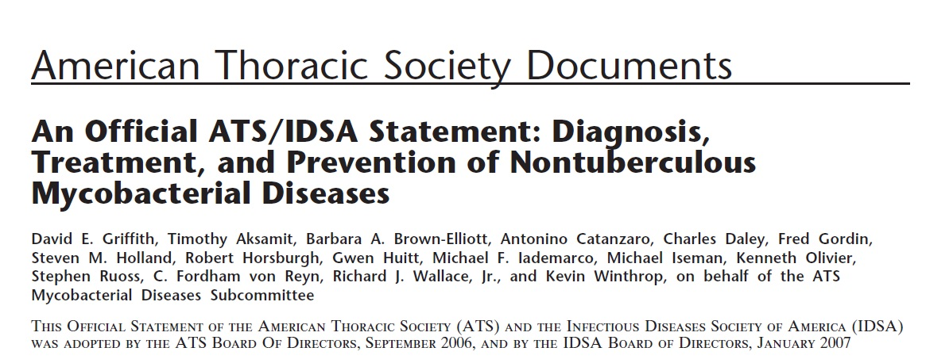

Slide 20
Chronic pulmonary disease is the most common clinical manifestation of NTM.
most common NTM pathogen > M. avium complex (MAC)
most common RGM pathogen > M. abscessus

Slide 21
Treatment of M. abscessus pulmonary disease
There are no drug regimens of proven or predictable efficacy for treatment of M. abscessus lung disease.
Multidrug regimens that include clarithromycin 1,000 mg/day may cause symptomatic improvement and disease regression.
Surgical resection of localized disease combined with multidrug clarithromycin-based therapy offers the best chance for cure of this disease.

Slide 22
The chest radiograph from patients with M. abscessus lung disease usually shows multilobar, patchy, reticulonodular, or mixed interstitial–alveolar opacities with an upper lobe predominance.
Cavitation occurs in only approximately 15% of cases.
HRCT of the lung frequently shows associated cylindrical bronchiectasis and multiple small ( 5 mm) nodules.

Slide 23
M. abscessus isolates are uniformly resistant to the standard antituberculous agents.
No antibiotic regimens based on in vitro susceptibilities has been shown to produce long-term sputum conversion for patients with M. abscessus lung disease.
The goal of 12 months of negative sputum cultures while on therapy may be reasonable, but there is no medication strategy to reliably achieve this goal.
Alternative goals of therapy, such as symptomatic improvement, radiographic regression of infiltrates, or improvement in sputum culture positivity, short of conversion to negative culture, are more realistic for M. abscessus lung disease.

Slide 24
Combination therapy with amikacin plus cefoxitin or imipenem for 2 to 4 months usually produces clinical and microbiologic improvement, but cost and morbidity are significant impediments to a curative course of therapy.
Suppressive therapy, including periodic parenteral antibiotic or oral macrolide therapy, may be all that can be realistically administered to control the symptoms and progression of M. abscessus lung disease.

Slide 25
Initial therapy should be followed by an oral macrolide (clarithromycin or azithromycin) plus at least one other agent to which the organism is susceptible to complete a 6 to 12 month course.
Duration of therapy: for patients with pulmonary disease, the duration should include at least twelve months of therapy once sputum cultures become negative.
Griffith DE, Wallace RJ Jr. Rapidly growing mycobacterial infections in HIV-negative patients. Uptodate 2011

Slide 26
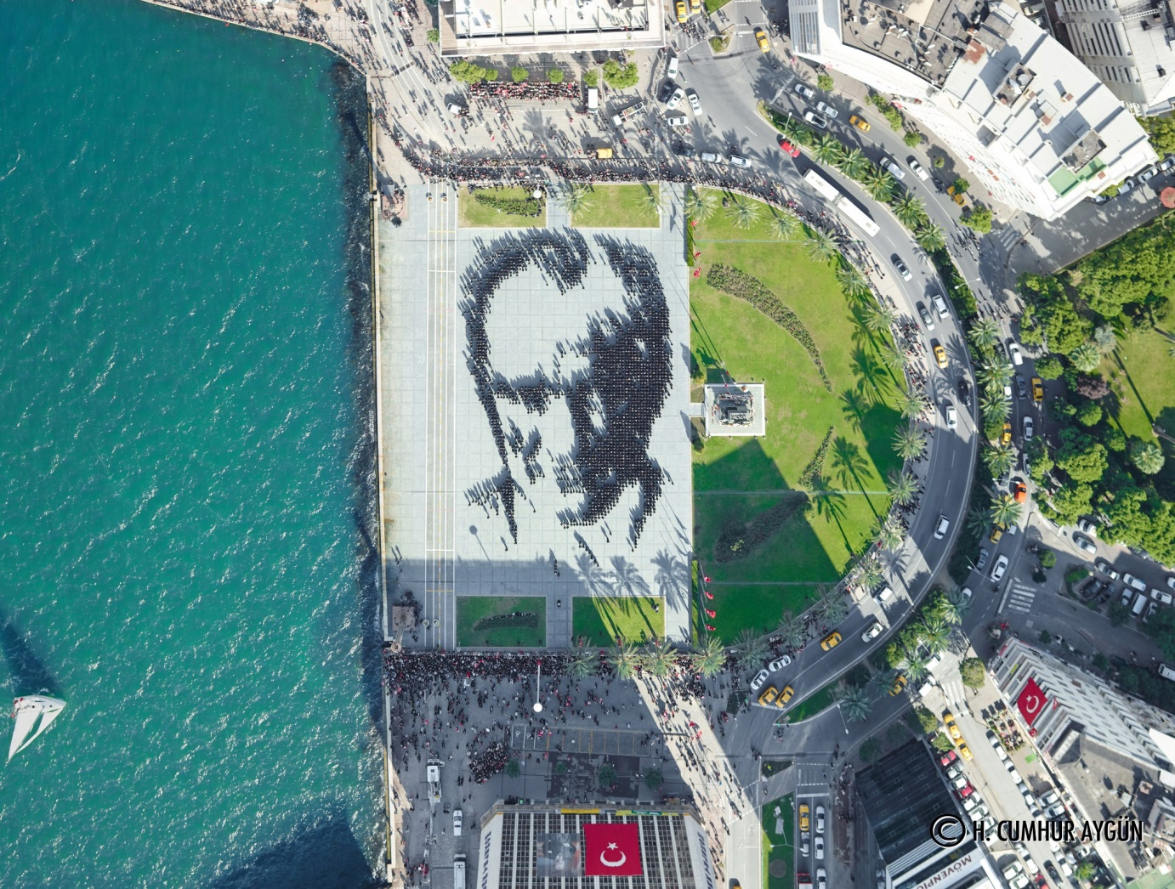
Thank you..

