Slide 1
CF adult Care ,challenges in Qatar
Dr.Mona Allangawi, MD,FCCP,ABIM
Sr.Consultant ,adult pulmonologist
director of adult CF service , HMC
Ass.Professor of Medicine ,WCMC/Q

Slide 2
Declaration of Conflict of Interest
I have no Actual or Potential conflict of interest in relation to this presentation

Slide 3
Objectives:
Successful transition of CF patient from pediatric to adult service
Family planning
Fertility issue in men with CF
Fertility issue in women with CF
The impact of pregnancy on women with cystic fibrosis

Slide 4
Successful transition of CF patient from pediatric to adult service

Slide 5
Successful transition of CF patient from pediatric to adult service
Transition OR Transfer

Slide 6
National Museum of Qatar 1975
Notes:
inaugurated on 23 June, 1975

Slide 7
National Museum of Qatar New National Museum of Qatar 1975 March 2019
Notes:
inaugurated on 23 June, 1975

Slide 8
Advances in cystic fibrosis (CF) treatment have changed CF from a disease lethal in early childhood to a chronic illness with a median survival of 40 years.
More than 48% of CF patients in the USA are age 18 years or older, and this number is increasing.
Cystic Fibrosis Foundation Program Specific Patient Registry Report. 2011
Hodson ME, et al. An international/multicentre report on patients with cystic fibrosis (CF) over the age of 40 years. J Cyst Fibros 2008;7:537–42..

Slide 9
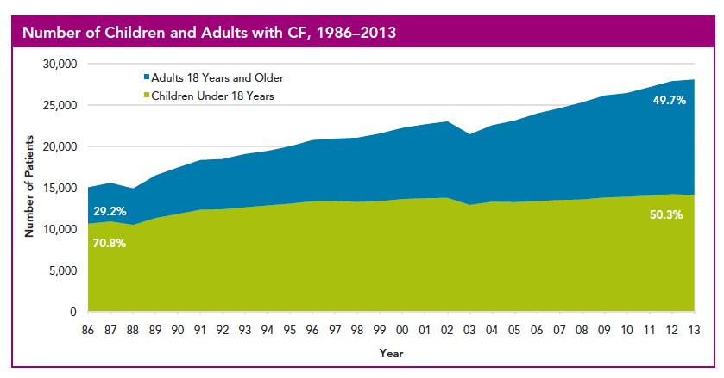
Advances in cystic fibrosis (CF) treatment have changed CF from a disease lethal in early childhood to a chronic illness with a median survival of 40 years.
More than 48% of CF patients in the USA are age 18 years or older, and this number is increasing.
Cystic Fibrosis Foundation Program Specific Patient Registry Report. 2011
Hodson ME, Simmonds NJ, Warwick WJ, et al. An international/multicentre report on patients with cystic fibrosis (CF) over the age of 40 years. J Cyst Fibros 2008;7:537–42..

Slide 10
Patients are living long enough to require transition from pediatric CF centers to adult CF centers.
Notes:
Therefore, patients are living long enough to require transition from pediatric CF centers to adult CF centers.
Unfortunately, this transfer process from the pediatric to the adult CF center is met with a variety of challenges.

Slide 11
Patients are living long enough to require transition from pediatric CF centers to adult CF centers.
This transfer met with a variety of challenges.
Cystic Fibrosis Foundation Program Specific Patient Registry Report. 2011.
Notes:
Unfortunately, this transfer process from the pediatric to the adult CF center is met with a variety of challenges.

Slide 12
Studies showed that Patients with CF remained clinically stable during transition
Other studies reported that time of transfer has been associated with morbidities such as
Loss of pulmonary function
Decrease in body mass index (BMI) and
Hospitalizations
Dugueperoux I, , et al. Clinical changes of patients with cystic fibrosis during transition from pediatric to adult care. J Adolesc Health 2008;43:459–65.
Champion. Comparison of clinical changes before and after transition to adult care in patients with cystic fibrosis., American Thoracic Society, 2011.
Notes:
PURPOSE:
To evaluate the clinical changes of adults with cystic fibrosis (CF) during transition from a pediatric to adult CF center.
METHODS:
Data were collected at the time of transfer, 1 year earlier and 1 year later, for all patients in our adult CF center arriving from one of the three pediatric CF centers in Paris between January 2001 and June 2004.
RESULTS:
Sixty-three of the 68 patients (transferred at a median age of 21.0 years) were regularly attending this adult CF center after 1 year and one had died. The mean number of outpatient visits increased in the year after transfer (5.7 vs. 3.8 in the year before, p < .001). The occurrence of clinical events and the rate of bronchial colonization did not change. Pseudomonas aeruginosa was found in about 60% of patients at any time. Pulmonary function declined regularly with no statistically significant difference in the rate of decline between the 2 years of follow-up (FEV 1 was 54.7% predicted at transfer). Nutritional status remained stable (mean body mass index was 19.1 kg/m2). The number and duration of oral and i.v. antibiotic courses did not change, but more patients received them at home (p < .001) and self-administered physiotherapy after transfer (p = .001). The proportion of students decreased from 79.3% to 48.1% (p = .02) and the proportion in the workforce increased from 12.7% to 20.4% after transfer.
CONCLUSIONS:
Patients with CF remained clinically stable during transition and progressively acquired autonomy.

Slide 13
There are no generally accepted guidelines to assure smooth transfer from pediatric to adult centers.
Notes:
While multiple reports endorse the standard that pediatric providers should prepare their patients for transfer to adult care

Slide 14
Pediatric

Slide 15
Pediatric Adult

Slide 16
Pediatric Adult

Slide 17
Pediatric Adult

Slide 18
The goal of transition
Transfer of care from child-oriented to adult-oriented services with uninterrupted services
For the young adult to be engaged in the adult health care system in ways that
Optimize health
Maximize potential
Increase quality of life
Promote autonomy
Self-care
Self-determination

Slide 19
Infancy
Childhood
Adolescence
Adulthood

Slide 20
Infancy
Childhood
Adolescence
Adulthood
Nutritional Assessment
Pulmonary Function Assessment
Monitoring for Complications
Prevention of Disease Progression
Education About CF
Assessment of Family Functioning and Social Supports

Slide 21
Infancy
Childhood
Adolescence
Adulthood
Transition
Self-Management
Shared Decision-Making

Slide 22
Complexity of CF treatment
Daily medical treatment
Chest physiotherapy
Dietary & vitamin supplements
Pancreatic enzyme replacement
Respiratory medications
Bregnballe, et al. Patient Prefer Adherence. 2011;5:507-15. Sawicki, et al. Pediatr Pulmonol.
2012;47(6):523-33.

Slide 23
Complexity of CF treatment
Daily medical treatment
Chest physiotherapy
Dietary & vitamin supplements
Pancreatic enzyme replacement
Respiratory medications
Bregnballe, et al. Patient Prefer Adherence. 2011;5:507-15. Sawicki, et al. Pediatr Pulmonol.
2012;47(6):523-33.

Slide 24
National Survey of US CF Centers
Transfer of care occurs at age of 19, but initial discussion begins at age of 17
Fewer than half of CF programs perform readiness assessments
Half of programs never or rarely prepare medical summaries
Improving transition from pediatric to adult cystic fibrosis care: lessons from a national survey of current practices.
McLaughlin, S. E. et al. Pediatrics 2008;121:e1160-e1166
Notes:
OBJECTIVES:
More than 500,000 adolescents with special health care needs age into adulthood each year in the United States, and there is growing recognition of the need for support of their transition to adult-oriented health care. Because of improved survival, cystic fibrosis has experienced this increasing transition need, and cystic fibrosis policy leaders responded by mandating the transition of adults with cystic fibrosis to adult-focused cystic fibrosis care programs by 2000. The primary objective of this study was to characterize in detail recent transition practices at US cystic fibrosis programs, to identify areas for improvement and to serve as a model for other diseases. A secondary objective of this study was to develop and validate a survey for formal assessment of transition practices.
METHODS:
A 105-question survey on key aspects of transition was administered to cystic fibrosis care team members from all 195 US Cystic Fibrosis Care programs. Rates of adherence to recommended components of transition care were measured.
RESULTS:
A total of 448 surveys were obtained from 170 (87%) of 195 cystic fibrosis programs. Although transfer of care occurs at a median age of 19 years, initial discussion of transition does not occur until a median age of 17 years, limiting time to foster self-care skills. Only half of programs consistently perform a transition readiness assessment, 28% of centers offer visits focused on transition, and <10% have a written list of desirable self-management skills.
CONCLUSIONS:
There is significant variability in transition support provided to young adults with cystic fibrosis, but there are simple steps that may lead to more consistent delivery of transition services. Methods of assessment and lessons learned from transitioning young adults at US cystic fibrosis programs may serve to improve transition for individuals with other childhood diseases.

Slide 25
University of California, San Francisco Cystic Fibrosis Center (UCSF-CFC) pediatric and adult teams recognized poor coordination in the transfer of pediatric patients to adult care.
Transfer to adult care by
Choice
Being over the age limit
Marriage
Pregnancy
Incarceration

Slide 26
University of California, San Francisco Cystic Fibrosis Center (UCSF-CFC) pediatric and adult teams recognized poor coordination in the transfer of pediatric patients to adult care.
Transfer to adult care by
Choice
Being over the age limit
Marriage
Pregnancy
Incarceration
Often these transfers were unplanned and occurred during hospitalisation for acute illness, raising a concern for later morbidities.

Slide 27
BMJ Qual Saf 2014;23:i64-i72
Notes:
Objective and methods The objective of this quality improvement (QI) project was to develop, implement and evaluate a theory-based programme for transition from paediatric to adult CF care. In a multi-phase process, the paediatric and adult programmes developed a transition curriculum, addressed care standards and standardised patient transfer protocols. We evaluated the impact of this process through staff surveys, review of field notes from QI meetings, tracking transfers and responses of patients to the Transition Readiness Assessment Questionnaire (TRAQ) at the start of the programme and 18 months after initiation.
Results The collaboration between the paediatric and adult teams continued through quarterly meetings over the past 4 years. This has provided a forum that sustained our transition programme, harmonised care across CF centres and addressed other needs of our CF centre. Discussion of transition with families in the paediatric centre increased twofold (35% to 73% p<0.001), and resulted in a trend towards improved patient TRAQ self-advocacy scores and decreased in-hospital transfer.
Conclusions We successfully created a curriculum and process for transition from paediatric to adult CF care at our centres. This collaboration shapes the communication between our paediatric and adult CF care teams and enables ongoing feedback among patients, families and providers. The impact of our transition programme on long-term patient morbidity will require future evaluation.

Slide 28
1. Transition is a responsibility shared by the pediatric and adult CF teams.
2. Patient introduction to transition in a framework of developmental milestones would promote sufficient knowledge of CF and skills in self-care to maintain their health and access therapies.
Notes:
Conclusion
We successfully developed and implemented a transition programme, which created a culture of shared responsibility between adult and paediatric programmes.
The transition programme created mechanisms to identify and address barriers within our transfer process impacting our hospital and clinics, adult and paediatric providers, and patients and families. Working with behavioural theories to improve care delivery, we improved communication and improved the transfer process for families, staff and providers. The collaborative effort between our adult and paediatric programmes continues in regular communication and efforts have expanded to standardise CF care protocols. A change in culture has occurred with paediatric and adult programmes respecting our common interest and acknowledging a shared responsibility of transition. This process of shared responsibility and QI can be implemented in any clinic or service that requires a coordinated transition and eventual transfer of care from paediatric to adult services.

Slide 29
1. Transition is a responsibility shared by the pediatric and adult CF teams.
2. Patient introduction to transition in a framework of developmental milestones would promote sufficient knowledge of CF and skills in self-care to maintain their health and access therapies.
Notes:
Conclusion
We successfully developed and implemented a transition programme, which created a culture of shared responsibility between adult and paediatric programmes.
The transition programme created mechanisms to identify and address barriers within our transfer process impacting our hospital and clinics, adult and paediatric providers, and patients and families. Working with behavioural theories to improve care delivery, we improved communication and improved the transfer process for families, staff and providers. The collaborative effort between our adult and paediatric programmes continues in regular communication and efforts have expanded to standardise CF care protocols. A change in culture has occurred with paediatric and adult programmes respecting our common interest and acknowledging a shared responsibility of transition. This process of shared responsibility and QI can be implemented in any clinic or service that requires a coordinated transition and eventual transfer of care from paediatric to adult services.

Slide 30
Cystic Fibrosis Trust.2010
The transition from pediatric to adult care should be a planned, collaborative process involving professional caregivers, the young person and family.

Slide 31
How patient be prepared as he/she get older
- Pediatrician should start talking more to the patient about treatment
- Patient should have the opportunity to talk to the doctor by himself
- Patient should have the opportunity to know members of the adult team and become familiar with the adult’s center before moving
- Patient should be able to take part in a joint transition clinic
Cystic Fibrosis Trust.2010
Notes:
As patient get older
Pediatrician should start talking more to the patient, rather than to the parents, about CF and treatment .
Patient should have the opportunity to talk to the doctor by himself as the time for transfer approaches, but this should be discussed so that both patients and parents feel comfortable with the new arrangement.

Slide 32
The topic of transition should be introduced at least a year before transfer
The actual timing of transfer should then be flexible, in accordance with individual needs.
Notes:
The topic of transition should be introduced at least a year before transfer , allowing time to explore feelings and resolve concerns which the young person and/or parent may have.
The actual timing of transfer should then be flexible, in accordance with individual needs. Between 14 and 18 years.

Slide 33
Patient Checklist for transition
Early discussion about moving
Time to talk and ask questions
Full involvement in plans for transfer
Meet the adult team
Visit the adult centre
Joint transition clinic
Key person
Information booklet
Reassurance about in-patient care
Cystic Fibrosis Trust.2010

Slide 34
Transfer should ideally occur during stable medical conditions
provider should receive transfer documentation prior to the first visit ( medical summary & plan of care)
Pediatric provider should confirm successful transfer following the last pediatric appointment

Slide 35
Recommendation for Successful smooth Transition

Slide 36
a. Effective communication between pediatric and adult care teams is required

Slide 37
b. Adolescents should gradually be given more responsibility for
Self-care and decision-making
Health education and training

Slide 38
c. Formal transfer of care should be individualized considering psychological aspect for the patient

Slide 39
e. Inviting parents to the first visit in adult care
f. Transfer during the period were the patient condition is stable
g. Full medical Summary and plan of care should be prepared by pediatrician

Slide 40
Notes:
Museum of Islamic Art 2008

Slide 41
Family Planning

Slide 42
Fertility issues in men and women
Fertility treatments
The impact of pregnancy on women with cystic fibrosis

Slide 44
Issues of sexuality and reproduction will become increasingly relevant as the average life expectancy for people with CF continues to improve
Fertility issues are a strong focus among both men and women with CF.
Adults with Cystic Fibrosis and (In)fertility: How Has the Health Care System Responded? J.androl 2000,nov-dec,809-813

Slide 45
When you should start discussing this issue with your CF patient

Slide 52
Counseling
Genetic tests have to be performed in the patient and partner
Prenatal or pre-implantation genetic diagnosis could be recommended
Notes:
Genetic tests have to be performed in the patient (if not already done) and in the partner in order to define the risk of generating an affected child
Prenatal or pre-implantation genetic diagnosis could also be recommended for those who missed or has incomplete genetic assessment

Slide 53
Male fertility

Slide 54
Approximately 98% of men with CF are infertile
Abnormal development of vas deferens, epididymis, and seminal vesicles.
Thick secretions in vas deferens
Abnormal morphology
Lemke A. Reproductive issues in adults with cystic fibrosis: implications for genetic counseling. J Genet Counseling. 1992;1:211–218

Slide 55
Reproductive options
Not to have children
Adoption
In vitro fertilization with donor sperm
Hamberger L, Sjogren A, Lundin K, Soderlund B, Nilsson L, Bergh C, Wennerholm UB, Wikland M, Svalander P, Jakobsson AH, Forsberg AS. Microfertilization techniques—the Swedish experience. Reprod Fertil Dev. 1995;7:263–268
Notes:
Reproductive options for the majority of men with CF who are infertile include
No. 12 – “First Baby Born Healthy After Pre-Implantation Genetic Diagnosis for CF in Ireland”
Efforts continue to be made in the science community to detect and avoid CF in utero — a controversial subject that the Cystic Fibrosis community typically follows with interest. Baby Bridget, born on June 27th, became the first baby conceived in Ireland using pre-implantation genetic diagnosis (PGD), a technique used to screen embryos for genetic mutations such as cystic fibrosis (CF).

Slide 56
Reproductive options
Not to have children
Adoption
In vitro fertilization with donor sperm
Hamberger L, Sjogren A, Lundin K, Soderlund B, Nilsson L, Bergh C, Wennerholm UB, Wikland M, Svalander P, Jakobsson AH, Forsberg AS. Microfertilization techniques—the Swedish experience. Reprod Fertil Dev. 1995;7:263–268
Notes:
Reproductive options for the majority of men with CF who are infertile include

Slide 57
Biological father
Microsurgical Epididymal Sperm Aspiration (MESA)
Percutaneous Epididymal Sperm Aspiration (PESA)
Testicular Sperm Aspiration (TESA)
Hamberger L, Sjogren A, Lundin K, Soderlund B, Nilsson L, Bergh C, Wennerholm UB, Wikland M, Svalander P, Jakobsson AH, Forsberg AS. Microfertilization techniques—the Swedish experience. Reprod Fertil Dev. 1995;7:263–268

Slide 58
A step-by-step guide to office-based sperm retrieval for obstructive azoospermia Robert M. Coward ^{1,} Transl Androl Urol., 2017 Aug; 6(4): 730–744

Slide 59
A step-by-step guide to office-based sperm retrieval for obstructive azoospermia Robert M. Coward ^{1,} Transl Androl Urol., 2017 Aug; 6(4): 730–744

Slide 60
A step-by-step guide to office-based sperm retrieval for obstructive azoospermia Robert M. Coward ^{1,} Transl Androl Urol., 2017 Aug; 6(4): 730–744

Slide 61
A step-by-step guide to office-based sperm retrieval for obstructive azoospermia Robert M. Coward ^{1,} Transl Androl Urol., 2017 Aug; 6(4): 730–744

Slide 62
Success rates of sperm retrieval is 100%
Fertilization rates 37 - 48 %
Pregnancy rates 30 % per attempt
A step-by-step guide to office-based sperm retrieval for obstructive azoospermia Robert M. Coward ^{1,} Transl Androl Urol., 2017 Aug; 6(4): 730–744
Notes:
Success rates of sperm retrieval in cases of OA should be almost 100% if the surgeon is well trained and the patient is well prepared
Fertilization rates 37 - 48 %
Pregnancy rates 30 % per attempt, very similar to the success of a single natural conception cycle.

Slide 63
Retrospective study included 25 men with CF between 1994 and 2004 (Cochin Saint Vincent de Paul Hospital, Paris, France)

Slide 67
Notes:
ICSI has been performed in 19 couples and is planned in three other couples.
Fertilization rate was 61%.
16 clinical pregnancies (40% per cycle) occurred as a result of ICSI in 12 of the 19 couples (63%)
Four pregnancies : 2 early miscarriages and 2 ectopic pregnancies.
One therapeutic abortion was performed for an early ultrasonographic diagnosis of major malformation
11 pregnancies led to single-term deliveries

Slide 68
Female Infertility

Slide 69
Delayed puberty and reduced fertility
Exact fertility rates and potential causes of lowered fertility are unknown
Not significantly different from general population
Mechanical barrier of the cervical mucus plug
Notes:
Delayed puberty and somewhat reduced fertility are characteristic in women with CF.
The exact fertility rates and potential causes of lowered fertility are unknown
Some have even suggested that fertility rates May not be significantly different among CF compared with the general population , although this remains controversial.
There appears to be little evidence that fertility is reduced in healthy women with CF, except by the mechanical barrier of the cervical mucus plug

Slide 70
Pregnancy

Slide 71
Pregnancy
1960 , First pregnancy in female CF

Slide 72
Pregnancy
In mild disease
Pregnancy is tolerated well
Prognosis for mother and child is good
Poor pulmonary function
Inadequate nutrition
Pulmonary hypertension
Risk for maternal and fetal morbidity and mortality
Siegel B, Siegel S. Pregnancy and delivery in a patient with cystic fibrosis of the pancreas. Obstet Gynecol 1960;16:438– 40.
Notes:
Pregnancy is tolerated well
As management of all aspects of CF has improved
So the prognosis for mother and child has also improved
CF women
- In mild disease, pregnancy is tolerated well
In contrast, women with
Poor pulmonary function
Inadequate nutrition
Pulmonary hypertension
are at greater risk for maternal and fetal morbidity and mortality

Slide 73
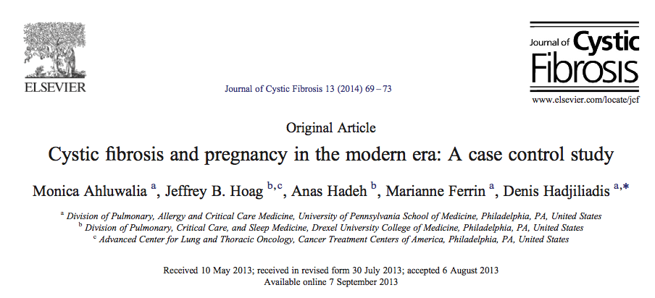

Slide 74
2 adult CF centers ,University of Pennsylvania and Drexel University College of Medicine
Case control study of pregnant CF women including 22 matched pairs with an average follow-up of 4.5 years.
Nutritional outcomes
Changes in lung function
Exacerbation rate
were compared

Slide 75
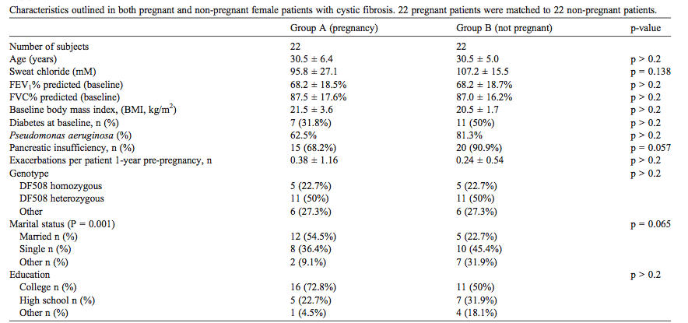

Slide 76
2001 - 2008
18 -38 years of age were included
Notes:
To examine the outcomes of pregnant cystic fibrosis patients who carried fetuses beyond second trimester (Group A) compared to non-pregnant CF patients (Group B)
2001 - 2008.
Women between 18 and 38 years of age were included.

Slide 78
The study demonstrates that women with CF who become pregnant do not have worse outcomes compared to non-pregnant women

Slide 79
Rev Bras Ginecol Obstet. 2019 Mar 7. doi: 10.1055/s-0039-1678613.
Notes:
Most of the literature on pregnancy in CF is in the form of case reports, individual centre reports of their experience, a few national centre based reviews and some database derived series. There are a few case based discussions of complex clinical problems in pregnancy in CF including diabetes, respiratory failure, nutritional failure etc and fewer still of obstetric and therapeutic interventions. There have been no trials of any aspect of pregnancy management in CF.

Slide 80
Perinatal , maternal and fetal outcomes of pregnant CF women with severe lung impairment FEV1 < 50%
(2003-2016)
Fetus : Prematurity, fetal growth retardation or fetal death rate were not increase
Mother : Multiple respiratory exacerbation requiring antibiotic therapy (4 events)

Slide 82
- Pregnancy should be planned in advance.
- Preconception genetic counselling
- Psychological readiness for pregnancy and future child
- Optimisation of nutrition, lung function and physical fitness
- Attention to CF associated complications (CFRD, liver disease, vitamins deficiencies …etc)
- Review of medications
- Termination for psychosocial or medical reasons
Notes:
Ideally pregnancy should be planned in advance. Preconceptional genetic counselling and assessment of the practical and psychological preparedness of the woman for pregnancy and the care of a potential future child is essential. This should occur in parallel with optimisation of nutrition, lung function and physical fitness, the three principle aspects of preconceptional health that will impact on success or otherwise of the pregnancy. Attention to detail of CF associated complications (CFRD, liver disease, vitamin deficiencies etc) and review of medications are likely to further improve chances of success.
Accidental pregnancy is not uncommon and may occur unexpectedly in those even with the most impaired lung function. Spontaneous miscarriage, termination for psychosocial reasons or for medical reasons related to maternal health can be fraught for patient and carers particularly in the latter case where a much wanted, potentially healthy infant may be lost to save the mother. Grief and sadness may be prolonged and anger directed at the CF team in these circumstances or if the team advises against a pregnancy when consulted due to maternal health.
When pregnancy continues, regular review of lung function and nutrition is essential and may require aggressive intervention. The biggest single risk to the infant is likely to be the mother's failing health and her treatment is paramount. Flexibility of treatment regimens to accommodate the physiological changes of pregnancy is necessary but should not imply any relaxation of therapy. Early meetings with the obstetrician and anaesthetist, perhaps including visiting the delivery area and SCBU and meeting the midwives, and careful planning of the type of anaesthesia and mode of delivery is advisable.
The outcome for the infant is likely to be good with the greatest risk being from prematurity, itself a result of the mother's health whether pre- or post-transplant. The outcome for the mother is dependent primarily on her lung health and may be predictable from her pre-pregnant status, though some women fare unexpectedly badly in pregnancy. Sadly the reality is that any child is likely to lose their mother at a relatively young age. Despite the pressures of a young family women must be encouraged to manage their treatment after pregnancy just as thoroughly, if not more so, than before pregnancy. The CF team will thus continue to play an active role in the mothers care and may be privileged to share joys of watching the children from such a pregnancy growing up.

Slide 83
Qatar

Slide 84
Qatar
Challenges

Slide 85
Qatar and Challenges of Transition
2006-2017:
Joint transition clinic ,attended by pediatric and adult pulmonologist and CF nurses for both team
Total number of patient transferred to adult service between 2006 and 2017 were more than 30

Slide 86
Qatar and Challenges of Transition
Oct 2017 , 2 different hospital ,10km distance
Number of transfer
1 Transfer by routine referral
3 received during hospitalization for acute exacerbation

Slide 88
Bacterial colonization | Total 32 patient
PSA | 24 (75%)
S.Aureus | 26 (81%)
MOTT | 8 (25%)

Slide 89
Bacterial colonization | Total 32 patient
PSA | 24 (75%)
S.Aureus | 26 (81%)
MOTT | 8 (25%)

Slide 90
Pancreatic Insuficensy | Pancreatic Enzyme replacement (Creon)
13/32 (40% ) | 9/13 (69%)

Slide 93
Numer of children | Married CF male petients
1 | Patient 1
2 | Patient 2
1 | Patient 3
3 | Patient 4
2 | Patient 5
 | Patient 6

Slide 94
4th pregnancy (mode , number of children ) | 3rd pregnancy (mode , number of children ) | 2nd pregnancy (mode , number of children ) | First pregnancy (mode , number of children ) | Married CF female patients
 |  |  | IVF, 1 child | patient 1
 |  | IVF, 1 child | IVF 1 child | patient 2
spont.1 child | AR, triplet | AR,1 child | Assisted reproduction (AR) 1 child | patient 3
 |  |  | Spont,1child | Patient 4
 |  |  | IVF, no pregnancy | Patient 5
 |  |  | ---------- | Patient 6

Slide 95
Summary:
No generally accepted guidelines to assure smooth transfer from pediatric to adult centers
Effective communication between pediatric and adult care teams and gradual involvement of adolescent in management plan are required for successful smooth transition
Formal transfer of care should be individualized and during stable condition
Full medical Summary should be prepared by pediatrician
Biological father is an option for infertility since IVF started
In mild disease prognosis of pregnancy on the mother and fetus is good, however increase risk of maternal and fetal morbidity and mortality are expected in advance cases

Slide 96
Acknowledgment
Adult CF team :
Merline Thomas
Yasmin Hussain

Slide 97
Thank You
World cub 2022

