Slide 1
Staph Aureus infection: do we need prophylaxis? The case For
Dr Basil Elnazir
PhD, FRCPI, FRCPCH, DCH.
Consultant Paediatric Pulmonologist

Slide 2
Declaration
Received Honoraria
(CF) from Vertex, Novartis, Pharmaxis
(Asthma) GSK, AZ, MSD
Travel Grant ( Aerogen)

Slide 3
Objectives:
Evidence for staph aureus prophylaxis in CF
Consequences of staph aureus colonization
Guidelines review

Slide 7
Cystic Fibrosis
“Woe to the child which when kissed on the forehead tastes salty. He is bewitched and soon will die” - old proverb
lethal (life shortening) autosomal recessive disease
incidence: 1 in 2000-3000; predominantly Caucasian populations
32000 USA
>70000 Worldwide
1000 cases diagnosed every year
(carrier frequency 1 in 22-28) -disease gene CFTR (cystic fibrosis transmembrane conductance regulator)
is a regulated epithelial Cl- channel
influences other ion channels
Abnormal CFTR alters chloride secretion and leads to abnormal hydration of secretion
Notes:
This adage, from northern European folklore,
German Children’s Songs and Games of Switzerland,

Slide 8
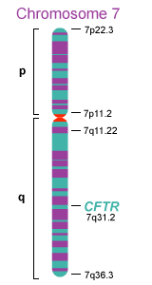
Locus: 7q31.2 - The CFTR gene is found in region q31.2 on the long (q) arm of human chromosome 7.
Gene Structure: The normal allelic variant for this gene is about 250,000 bp long and contains 27 exons.
mRNA: The intron-free mRNA transcript for the CFTR gene is 6129 bp long.
Coding Sequence (CDS): 4443 bp within the mRNA code for the amino acid sequence of the gene's protein product.
Protein Size: The CFTR protein is 1480 amino acids long and has a molecular weight of 168,173 Da.
Protein Function: The normal CFTR protein product is a chloride channel protein found in membranes of cells that line passageways of the lungs, liver, pancreas, intestines, reproductive tract, and skin. CFTR is also involved in the regulation of other transport pathways.
Associated Disorders: Defective versions of this protein, caused by CFTR gene mutations, can lead to the development of cystic fibrosis (CF) and congenital bilateral aplasia of the vas deferens (CBAVD).

Slide 9
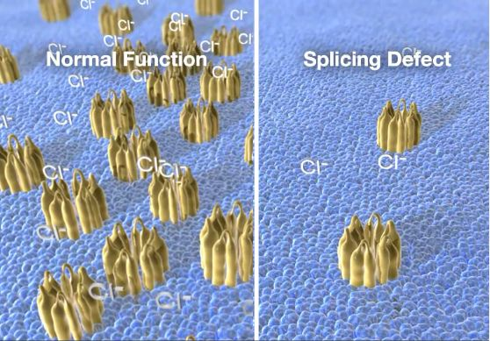

Slide 11
Notes:
Although CF impacts many organs lung disease accounts for most of the morbidity and mortality

Slide 12
The vicious cycle of CF lung disease
Obstruction
Infection
Inflammation
Notes:
Relieving obstruction with mucolytics and airway clearance,controlling infections with antibiotics and reducing inflammation with anti inf drugs has been the cornerstone of a comprehensive pulmonary treatment programe.

Slide 13
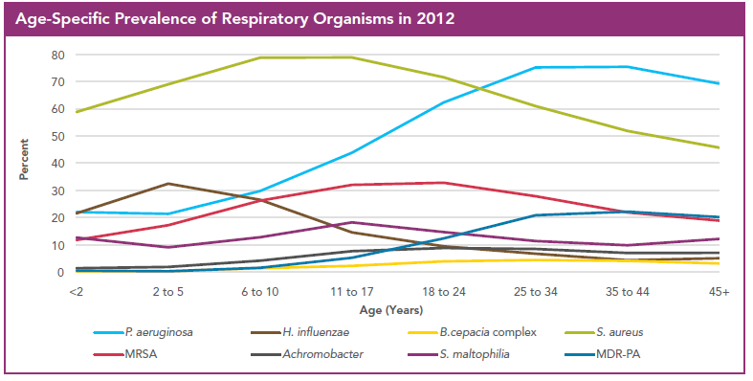
Prevalence of CF Pathogens
US CF Foundation Patient Registry, 2012

Slide 14
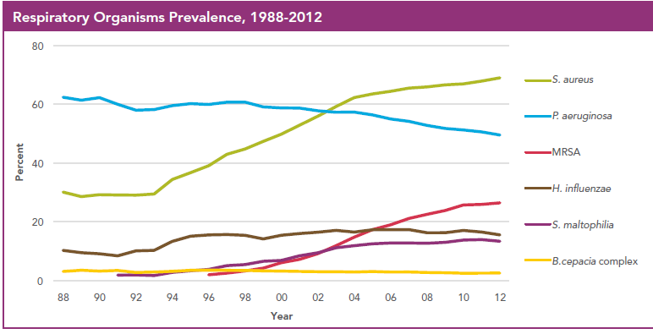
Changing Prevalence of CF Pathogens
US CF Foundation Patient Registry, 2012

Slide 15
BALANCING antistaph prophylaxisWITH CONSEQUENCES

Slide 16
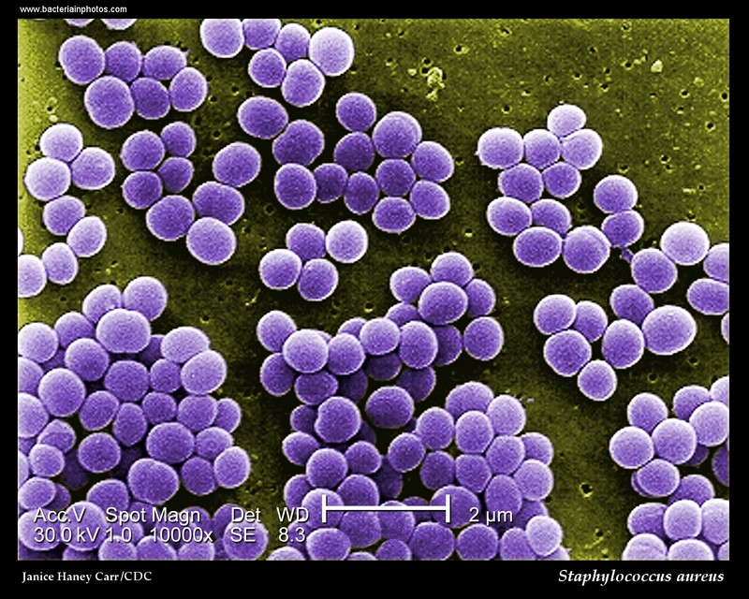
Etymology Edit. Staphylococcus aureus:; staphylo: "bunch of grapes" (from greekσταϕυλή, meaning "bunch of grapes") coccos: "berry" (from greek κόκκος, meaning"berry") aureus: "golden" (from latin aureus, meaning "golden")
Notes:
The aureus ( pl. aurei — "golden") was a gold coin of ancient Rome originally valued at 25 pure silver denarii. The aureus was regularly issued from the 1st century BC to the beginning of the 4th century AD

Slide 17
Staph Aureus :
Staphylococcus aureus (SA) is a significant pathogen in CF and may be present in respiratory cultures without causing symptoms.
S. aureus is one of the first microbes and also one of the commonest to infect patients with cystic fibrosis.
The use of prophylactic anti-staphylococcal antibiotics has been shown to reduce clinical symptoms, and the need for additional antibiotics in the first two years of life
Notes:
Despite this it may initiate an immunological response, and cause significant lung damage

Slide 18
So, why the worry?

Slide 19
Pseudomonas aeruginosa

Slide 20
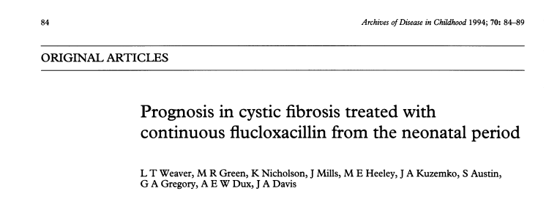
38 CF infants (mean 1-14 months) randomized continuous treatment (P n= 18) or episodic antimicrobials as indicated (E n = 20).
no significant differences in the neonatal characteristics ( social, domestic of the two groups
Progress monitored from birth for 24 months.
Infants in group E had more frequent cough and a greater number of Staphylococcus aureus isolates than infants in group P
More infants of group E were admitted to hospital, had higher admission rates during the second year (19 v 5), for longer periods (6.4 v 2 .2 days), despite receiving more than double the number of courses of antibiotics than group P infants
Notes:
250 mg/ day of oral flucloxacillin

Slide 21
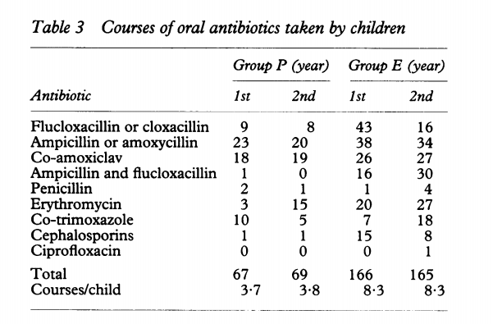
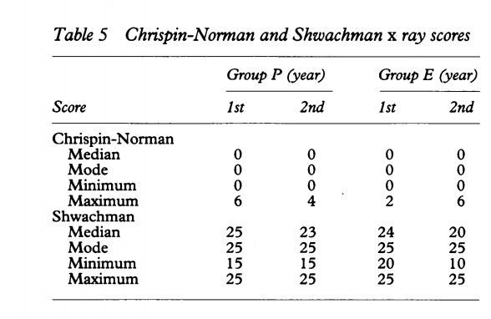
(Arch Dis Child 1994; 70: 84-89)
Continuous prophylactic flucloxacillin from early diagnosis of cystic fibrosis is associated with improved clinical progress during the first two years of life.

Slide 22
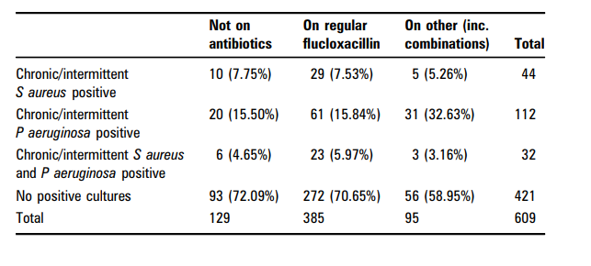
UK CF registry search to include <3 yrs at 2009 dataset
Info about antibiotic prophylaxis and bacterial status
Identified 609 children ( Augsut2006 and Dec 2009)
480 children (78.8%) were on prophylaxis (385= 80.2%) were on flucloxacillin alone.
Notes:
he UK antibiotic guidelines for cystic fibrosis (CF) recommend that all infants should be prescribed a prophylactic narrow spectrum antibiotic, such as flucloxacillin, from diagnosis until 3 years of age. We wished to evaluate the prevalence of prophylactic antibiotic use in the UK and the effect this had on the microbiological outcome of children with CF.
Methods A registry search was conducted on the UK CF registry to include all children <3 years at the time of the 2009 dataset (UK CF registry. Cystic Fibrosis Trust, 2011). Information on antibiotic prophylaxis (“chronicoral antibiotic not prescribed to treat an exacerbation”) and bacterial status (no growth, intermittent or chronic) are entered at the time of annual assessment and refer to the previous year.

Slide 23
Conclusion
We did not detect any significant differences in microbiological outcome between those on regular Flucloxacillin to those on no antibiotics
Prophylactic use of antibiotics other than Flucloxacillin (mostly cephalosporins; n= 36 out of 95) appear associated with increased prevalence of P. aeruginosa.
RCT needed to establish effects of prophylaxis on progression of CF lung disease
Notes:
Prevalence of Chronic intermittent staph & Ps Auerginosa were similar between those not on antibiotics to those on flucloxacillin alone.
The use of other antibiotics was significantly associated with an increased prevalence of Ps A.

Slide 24
Giving antibiotics regularly to people with cystic fibrosis to prevent infection with a germ called Staphylococcus aureus Smyth AR, Rosenfeld M 18 April 2017
Reviewed the evidence about the benefits and adverse effects of giving regular antibiotics to people with cystic fibrosis to prevent infection with a germ called Staphylococcus aureus.
The review includes four studies with 401 children ( no adult )
The children were put into groups at random and received either an oral antibiotic continuously as a prevention for at least one year or no antibiotic treatment to prevent infection with Staphylococcus aureus.
All children could be given additional antibiotics if their doctor thought they needed them, based on symptoms and germs grown in their respiratory secretions.
Studies lasted for a maximum of six years.

Slide 25
Giving antibiotics regularly to people with cystic fibrosis to prevent infection with a germ called Staphylococcus aureus Smyth AR, Rosenfeld M 18 April 2017
Anti-staphylococcal antibiotic prophylaxis leads to fewer children having isolates of Staphylococcus aureus, when commenced early in infancy and continued up to six years of age.
Further research may establish whether the trend towards more children with CF with Pseudomonas aeruginosa, after four to six years of prophylaxis, is a chance finding and whether choice of antibiotic or duration of treatment might influence this.

Slide 27
To evaluate whether anti staphylococcal prophylaxis in infants and young children with cystic fibrosis (CF) would suppress the acquisition of Staphylococcus aureus and delay the onset of the manifestations of bronchopulmonary disease.
7-year, multicenter, DBPC of continuous anti staphylococcal therapy
CF children <2 years of age randomly assigned to be treated with daily cephalexin (80-100 mg/kg/day) or placebo.
Clinical, microbiologic, laboratory, radiographic, and anthropometric outcomes were evaluated.
209 children enrolled, 119 completed a 5- to 7-year course of therapy. ( mean 14.1-15.6)
Notes:
Otherwise healthy children <2 years of age with CF were randomly assigned to be treated with daily cephalexin (80-100 mg/kg/day) or placebo. Clinical, microbiologic, laboratory, radiographic, and anthropometric outcomes were evaluated

Slide 28
Respiratory cultures from children treated with cephalexin were significantly less likely to be positive for S aureus (6.0% vs 30.4%; P < .001).
They were, however, much more likely to be positive for Pseudomonas aeruginosa (25.6% vs 13.5%; P < .009).
In contrast to these microbiologic differences, there were no differences in clinical outcome measures, including radiographic (Brasfield score, 23.4 vs 23.2) or anthropometric scores or pulmonary function.
Conclusions: Although long-term prophylaxis with cephalexin successfully delayed the acquisition of S aureus, it enhanced colonization with P aeruginosa and did not lead to clinically significant improvement in major health outcomes.
These data do not support routine anti staphylococcal prophylaxis in otherwise healthy infants and young children with CF.
Thus the safety of prophylactic, broad spectrum, oral cephalosporins must be questioned
Notes:
Otherwise healthy children <2 years of age with CF were randomly assigned to be treated with daily cephalexin (80-100 mg/kg/day) or placebo. Clinical, microbiologic, laboratory, radiographic, and anthropometric outcomes were evaluated

Slide 30
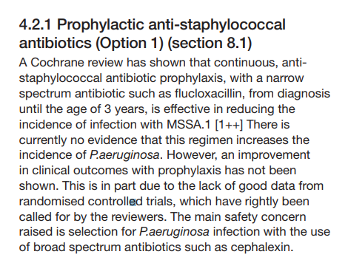
ddddd

Slide 32
Conclusion:
Staphylococcus aureus (SA) is a significant pathogen in CF and may be present in respiratory cultures without causing symptoms.
Emerging evidence suggests early lower airway infection with this organism in young children with CF results in the deterioration of lung function, poorer nutrition parameters and heightens the airway inflammatory response
There is currently no evidence that this regimen increases the incidence of P.aeruginosa.
Broad spectrum cephalosporins should not be used as treatment for MSSA
Randomised controlled trials with long term follow-up, using clinically relevant outcomes, are warranted in order to better understand the effect antistaphylococcal prophylaxis has on the progression of CF lung disease
Notes:
250 mg/ day of oral flucloxacillin

Slide 34
Thank you
belnazir@ajch.ae

Slide 35
References
Weaver LT, Green MR, Nicholson K, Mills J, Heeley ME, Kuzemko JA, Austin S, Gregory GA, Dux AE, Davis JA.Prognosis in cystic fibrosis treated with continuous flucloxacillin from the neonatal period. Arch Dis Child. 1994 Feb;70(2):84-9.
Smyth AR¹, Rosenfeld M².Cochrane Database Syst Rev. 2017 Apr 18;4:CD001912. Prophylactic anti-staphylococcal antibiotics for cystic fibrosis.
Das RR, Kabra SK, Singh M.Treatment of pseudomonas and Staphylococcus bronchopulmonary infection in patients with cystic fibrosis. ScientificWorldJournal. 2013 Dec 30;2013:645653.
McCaffery K, Olver RE, Franklin M, Mukhopadhyay S. Systematic review of antistaphylococcal antibiotic therapy in cystic fibrosis. Thorax. 1999 May;54(5):380-3.

Slide 38
A US CF Foundation multicenter controlled trial of long-term cephalexin included 209 children less than 2 years old with mild chest involvement.
Only 119 children finished the study. After 5 years, although the treated children failed to demonstrate any significant clinical advantage, they had fewer respiratory cultures positive for S.aureus (6% in the cephalexin group versus 30% of controls) but more were positive for P.aeruginosa (26% of the cephalexin group versus 14% of controls).
Thus the safety of prophylactic, broad spectrum, oral cephalosporins must be questioned although there is currently no evidence to suggest that a narrow spectrum antibiotic, such as flucloxacillin (widely used in the UK) poses such a risk.

Slide 39
Recommendations for treatment of MSSA in CF
 Continuous, anti-staphylococcal antibiotic prophylaxis, with a narrow spectrum antibiotic such as flucloxacillin, may be used, from diagnosis until the age of 3 years, to reduce the incidence of infection with MSSA. The prophylactic dose used in previous clinical trials is 125 mg twice daily [A].
 if MSSA grows while the patient is receiving flucloxacillin, consider patient adherence and increase the flucloxacillin to 100 mg/kg/day and add a second oral anti-staphylococcal antibiotic for two to four weeks (sodium fusidate, or rifampicin)
Check cultures after treatment. If clear, continue long-term prophylactic flucloxacillin [D]. For patients who are allergic or intolerant to penicillins then an alternative antibiotic should be used. The choice is determined by the antibiotic sensitivity pattern of the organism and the age of the patient
 If cultures are still positive after 2 weeks of 2 antibiotics to which the organism is sensitive continue treatment for another 4 weeks. Culture every week if possible. If the patient is unwell and still growing MSSA, give a course of intravenous antibiotics
Two antibiotics, to which the organism is sensitive, should be used but in practice it may be easier to give one of these orally (e.g. fusidic acid or rifampicin) [D].  If MSSA remains even after a course of IV antibiotics continue with long-term flucloxacillin (100 mg/kg/ day) and also check patient’s adherence to treatment. Treat with an additional anti- staphylococcal antibiotic whenever there is any increase in the symptoms and signs and always try to include an anti-staphylococcal antibiotic with any subsequent IV courses of treatment [C]. 
Broad spectrum cephalosporins should not be used as treatment for MSSA [B].  Macrolides cannot be assumed to provide effective empirical treatment for MSSA because macrolide resistance is increasingly common.
 Whatever regular regimen is chosen, any upper or lower airway isolate of MSSA is treated with a course a new anti-staphylococcal regimen for two to four weeks and a further respiratory specimen obtained at the end of treatment to ensure the organism has been eradicated

Slide 41
A Cochrane review has shown that continuous, antistaphylococcal antibiotic prophylaxis, with a narrow spectrum antibiotic such as flucloxacillin, from diagnosis until the age of 3 years, is effective in reducing the incidence of infection with MSSA.
There is currently no evidence that this regimen increases the incidence of P.aeruginosa.
However, an improvement in clinical outcomes with prophylaxis has not been shown. This is in part due to the lack of good data from randomised controlled trials.
The main safety concern raised is selection for P.aeruginosa infection with the use of broad spectrum antibiotics such as cephalexin.

Slide 42
S. aureus is one of the first microbes & one of the commonest to infect patients with cystic fibrosis.
There has been an increase in the prevalence of colonization/infection with both (MSSA) & (MRSA) S. aureus over the past decade .
Colonization of the anterior nares with S. aureus represents an important risk factor for subsequent infection in both healthy and diseased population, but only few studies have investigated colonization in with CF. In one study, the authors reported a significantly increased prevalence among patients with CF who had not received anti-staphylococcal prophylaxis prior to taking the cultures [74].
Another study using nasal lavage found the presence of identical genotypes in upper and lower airways, which suggests that upper airways play a role as a reservoir of S. aureus (like P. aeruginosa) in CF [75].
In a 2-year cohort study of 100 children with CF, small-colony variants (SCVs) of S. aureus were detected among 24% of participants and were significantly associated with a greater drop in lung function during the study [76]. Other studies have also found SCVs to be associated with higher rates of antimicrobial resistance and more advanced lung disease [77].
Notes:
Staphylococcus aureus. S. aureus is one of the first microbes and also one of the commonest to infect patients with cystic fibrosis. There has been an increase in the prevalence of colonization/infection with both methicillinsusceptible (MSSA) and methicillin resistant (MRSA) S. aureus over the past decade [73]. Colonization of the anterior nares with S. aureus represents an important risk factor for subsequent infection in both healthy and diseased population, but only few studies have investigated colonization in with CF. In one study, the authors reported a significantly increased prevalence among patients with CF who had not received anti-staphylococcal prophylaxis prior to taking the cultures [74]. Another study using nasal lavage found the presence of identical genotypes in upper and lower airways, which suggests that upper airways play a role as a reservoir of S. aureus (like P. aeruginosa) in CF [75]. In a 2-year cohort study of 100 children with CF, small-colony variants (SCVs) of S. aureus were detected among 24% of participants and were significantly associated with a greater drop in lung function during the study [76]. Other studies have also found SCVs to be associated with higher rates of antimicrobial resistance and more advanced lung disease [77]. We will discuss below the treatment (prophylactic and eradication) strategy for S. aureus.

Slide 44
infection and inflammation in the CF lung. CF lung disease is essentially an endobronchial/peribronchial process.
The alveoli do not become involved until late in the disease course.
In CF, the gene defect leads to an abnormal airway surface environment and then to airway obstruction with mucus (represented as an amorphous gray area in the center of the airway), chronic bacterial infection, and persistent inflammation.
Although there are several different types of bacteria that infect the CF airway, S. aureus predominates early in life but typically yields to P. aeruginosa.
However, most patients have polymicrobic infections, thus making selection of appropriate antibiotics for treatment of a pulmonary exacerbation difficult.
The bacterial infection is associated with a vigorous inflammatory response that is characterized by a large neutrophilic infiltration. Other inflammatory cells are also involved in the inflammatory response including epithelial cells, macrophages, dendritic cells, B lymphocytes, and T lymphocytes. These cells release many inflammatory cytokines and mediators that further promote the inflammatory response. The inflammatory response is ineffectual in eliminating bacteria from the airway, but the excess inflammatory mediators released into the endobronchial and peribronchial spaces damage the airway wall architecture and ultimately lead to bronchiectasis. This figure focuses on the proinflammatory aspects of CF airway inflammation. The abnormalities in the counter-regulatory mechanisms in CF are not depicted.

