Slide 1
MECFC 2019 Towards Optimal CF Care in the Middle East Istanbul, March 20-22 2019
CRMS/CFSPID
Carlo Castellani
Cystic Fibrosis Centre
Istituto Giannina Gaslini, Genoa

Slide 2
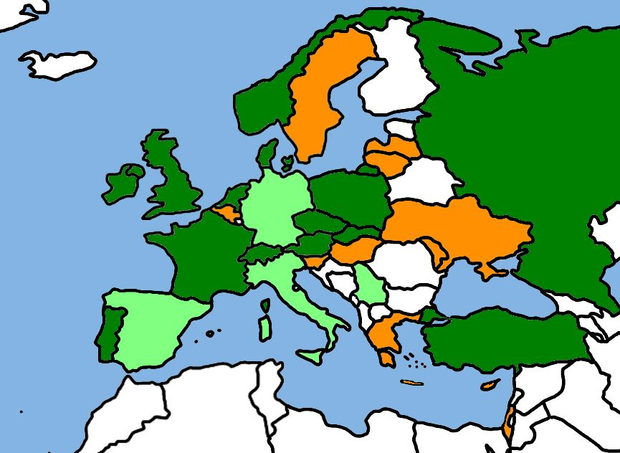
CF NBS 2016 – Europe – National Programmes (Dark Green)
Norway
Russia
Denmark
Ireland
UK
NL
Poland
Czech Rep
Slovakia
France
CH
Austria
Portugal
Turkey
Key
National - Green
Regional - Light Green.
Under Consideration - Amber
None or unknown - White

Slide 3
Possible algorithms:
IRT→ IRT
IRT→ CFTR mutation analysis
IRT→ CFTR mutation analysis + very high IRT
IRT→ CFTR mutation analysis → IRT
IRT→ CFTR mutation analysis→ DNA scanning
IRT→ IRT→ CFTR mutation analysis
IRT/PAP → CFTR mutation analysis→ DNA scanning
false positives
sweat test
screening
diagnosis
NBS positives
CF affected
neonatal population
Note: the outline does not represent real proportions.
Notes:
It may sound obvious, but it is important always keeping in mind that screening and diagnosis are two very different steps.
Screening works on large numbers of individuals, in this case newborns, and selects a small subpopulation at risk for having the condition, but it does not make the diagnosis, with some exceptions.
In order to move from the whole neonatal population to the small number of NBS-positives, many strategies may be used.
…..
The small subset of newborns identified by screening enter the diagnostic process, in our case usually represented by the sweat test, and in the end those with CF and the false positves are, or should be, told apart.

Slide 4
IRT AT BIRTH
> CUT
-
OFF
< CUT
-
OFF
NBS NEGATIVE
INTERMEDIATE
TIERS
NBS POSITIVE
NBS NEGATIVE
SWEAT TEST
Cl > 60 mmol/L
Cl 30
-
59 mmol/L
Cl < 30 mmol/L
CF
INCONCLUSIVE
FALSE NBS
DIAGNOSIS
DIAGNOSIS
POSITIVE
REFERRAL TO CF CENTRE
REFERRAL TO CF CENTRE FOR
FOR CLINICAL EVALUATION
FURTHER INVESTIGATIONS
AND FOLLOW
-
UP
(AND FOLLOW
-
UP)

Slide 5
Farrell et al. in press
Suspicion of CF:
Positive NBS¹
Clinical signs/symptoms²
Family History³
Sweat Chloride Testing
≥60mmol/L⁴
30-59 mmol/L
≤29mmol/L⁵
CFTR Genetic Analysis⁶
2 CF-causing⁷ CFTR mutations
CFTR genotype undefined or known MVCC⁸
No CFTR mutations⁹
CFTR Physiologic Testing
NPD/ICM
CFTR dysfunction
Testing Unavailable, Equivocal
CFTR function preserved
CF Diagnosis
CF Diagnosis Not Resolved¹⁰
CF Unlikely

Slide 6
CF clinical manifestations AND sweat chloride > 59 mmol/L
and/or and/or
positive NBS two CF-causing mutations
and/or and/or
CF sib consistent electrophysiology tests
Rosenstein BJ, Cutting GR.
J Pediatr. 1998 Apr;132(4):589-95.
CFSPID high IRT at birth plus an equivocal sweat chloride
concentration and fewer than two mutations of the
CFTR gene that are known to be associated with cystic fibrosis.
Some infants might have two CFTR mutations, with 0-1 CF- causing mutations and a sweat chloride concentration <30 mmol/L.
Munck A
J Cyst Fibros. 2015 Nov;14(6):706-13

Slide 7
CFSPID / CRMS The harmonised definition
A positive NBS result for CF
AND EITHER
A sweat chloride value < 30 mmol/L and 2 CFTR variants* (mutations), at least one of which has unclear phenotypic consequences
OR
An intermediate sweat chloride value (30-59 mmol/L) and 1 or 0 CF causing variants** (mutations)

Slide 8
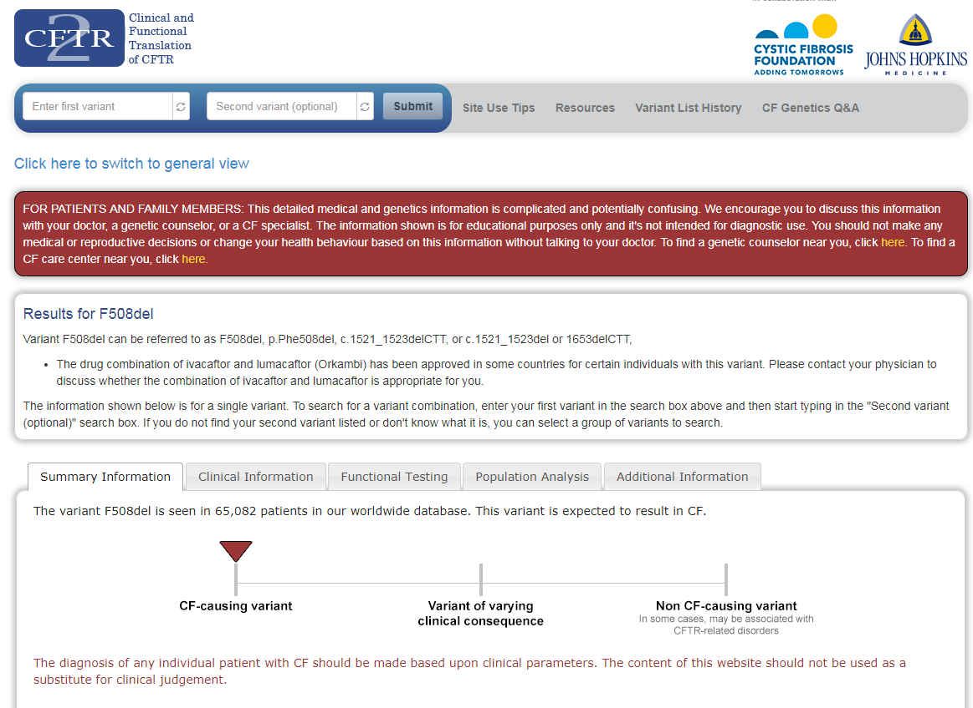

Slide 9
Key points
second sweat test to measure sweat chloride in a laboratory with a high level of experience. Infants with only one CFTR variant recognised and a normal repeat sweat chloride (<30 mmol/L) should be reported as carriers and no further testing undertaken
regular clinical review by physicians with an interest in CF, possible evolution to clinical disease
essential that families have clear and precise information at all stages of this process, including the longer term risks
submitted to JCF

Slide 10
A web survey 256 respondents from 45 countries (114 CF specialists and 104 general respiratory paediatricians)
What is the most appropriate diagnosis/designation of this infant?
Cystic Fibrosis
Carrier of CF-causing variant (mutation)
CFTR-related disorder
Atypical CF
CF Screen Positive, Inconclusive Diagnosis (CFSPID)*
*For this survey CFSPID was used for CRMS/CFSPID
submitted to JCF

Slide 11
A web survey
A four week infant is assessed by the CF team after a positive NBS result (raised IRT value on day 3 of life and one CF-causing variant identified (c.1521_1523 delCTT (legacy name, F508del))
The infant is well, gaining weight and there is no family history of CF.
A sweat test is organised and a good volume of sweat collected. The sweat chloride concentration is 35 mmol/L.
submitted to JCF

Slide 12
A web survey
A four week infant is assessed by the CF team after a positive NBS result (raised IRT value on day 3 of life and one CF-causing variant identified (c.1521_1523 delCTT (legacy name, F508del))
The infant is well, gaining weight and there is no family history of CF.
A sweat test is organised and a good volume of sweat collected. The sweat chloride concentration is 35 mmol/L.
Answer: CFSPID (76% answered correctly)
Rationale: Only one CF causing variant is recognised but the sweat chloride is intermediate (30-59).
submitted to JCF

Slide 13
A web survey
A 4 week old infant is assessed by the CF team after a positive NBS result (raised IRT on day 2 of life, one CF-causing variant recognised on first DNA panel (c.1521_1523delCTT,(legacy: F508del)) and second variant recognised on more extended testing (c.3454G>C (legacy: D1152H)).
The genetics laboratory report D1152H as a variant of varying clinical consequence.
The infant is well, clinical examination is reassuring and she is gaining weight appropriately.
A sweat test is undertaken, a good sample obtained, and the sweat chloride value is 18 mmol/L.
submitted to JCF

Slide 14
A web survey
A 4 week old infant is assessed by the CF team after a positive NBS result (raised IRT on day 2 of life, one CF-causing variant recognised on first DNA panel (c.1521_1523delCTT,(legacy: F508del)) and second variant recognised on more extended testing (c.3454G>C (legacy: D1152H)).
The genetics laboratory report this as a variant of varying clinical consequence.
The infant is well, clinical examination is reassuring and she is gaining weight appropriately.
A sweat test is undertaken, a good sample obtained, and the sweat chloride value is 18 mmol/L.
Answer: CFSPID (67% answered correctly)
Rationale: The infant has two variants, one CF causing and one of varying clinical consequence. Although the sweat chloride value is low, the designation is CFSPID..
submitted to JCF

Slide 15
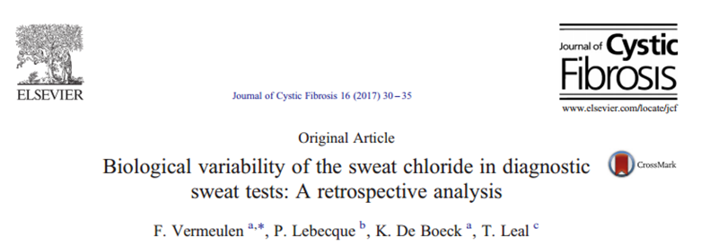
WHEN DOES CFSPID END AND CF BEGIN?
CFSPID positive NBS AND sweat chloride 30-59 mmol/L
and/or
two CFTR mutations (non both CF-causing)
CF clinical manifestations AND sweat chloride > 59 mmol/L
and/or and/or
positive NBS (= raised IRT) two CF-causing mutations
and/or and/or
CF sib consistent electrophysiology tests

Slide 16
LATE ONSET OF WHAT?

Slide 17
LATE ONSET OF WHAT?
-ive to borderline

Slide 18
CFSPID high IRT at birth plus an equivocal sweat chloride
concentration and fewer than two mutations of the
CFTR gene that are known to be associated with cystic fibrosis.
Some infants might have two CFTR mutations, with 0-1 CF- causing mutations and a sweat chloride concentration <30 mmol/L.
Munck A
J Cyst Fibros. 2015 Nov;14(6):706-13
CFTR-RD a clinical entity associated with CFTR dysfunction
that does not fulfil the diagnostic criteria for CF
Bombieri C et al
J Cyst Fibros. 2011 Jun;10 Suppl 2:S86-102

Slide 19
https://www.cftr2.org/resources

Slide 20
CFSPID high IRT at birth plus an equivocal sweat chloride
concentration and fewer than two mutations of the
CFTR gene that are known to be associated with cystic fibrosis.
Some infants might have two CFTR mutations, with 0-1 CF- causing mutations and a sweat chloride concentration <30 mmol/L.
Munck A
J Cyst Fibros. 2015 Nov;14(6):706-13
CFTR-RD a clinical entity associated with CFTR dysfunction
that does not fulfil the diagnostic criteria for CF
Bombieri C et al
J Cyst Fibros. 2011 Jun;10 Suppl 2:S86-102

Slide 23
PEDIATRICS Volume 135, number 6, June 2015

Slide 24
CFSPID
CFTR-RD

Slide 26
CFSPID
CFTR-RD

Slide 27
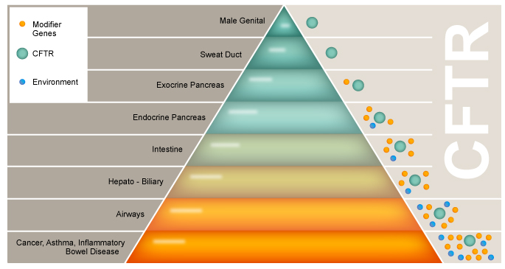
What’s the most probable CFTR-RD
for CFSPID?
CBAVD
chronic / acute recurrent
pancreatitis
bronchiectasis
CF
CFTR-RD

Slide 28
Take home messages CFSPID infants are often misdiagnosed It is important to include them in a follow-up program It is unclear for how long we need to follow them Some will evolve into CFTR related disorders or CF

