Slide 1


Middle East Cystic Fibrosis Association
Case Presentation
Dr.Gökçen Kartal Öztürk
Division of Pediatric Pulmonology, Ege University Faculty of Medicine
İzmir/Turkey
Notes:
Dear session moderators and masters, Dear colleaques and all participants.
First of all, I thank to organization committee for giving me a chance for speaking in such a good congress.
I am Gökçen Kartal Öztürk from division of pediatric pulmonology, Ege University Faculty of Medicine, İzmir.

Slide 2
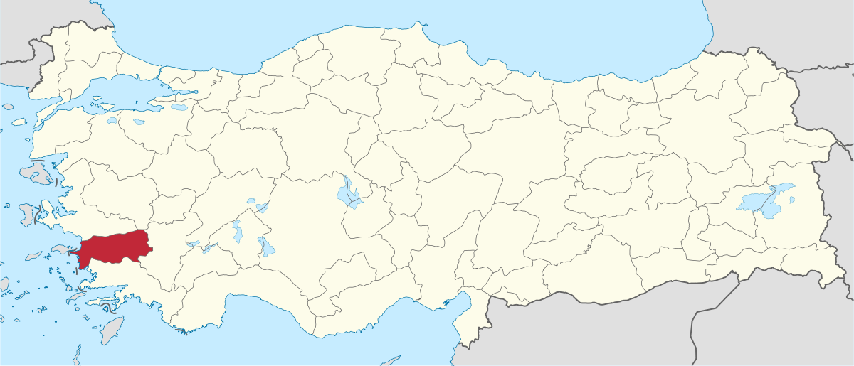
Case
6 month old girl
Aydın/Turkey
Notes:
I will present you a six-month-old girl from Aydın/Turkey.

Slide 3
Complaints
Growth retardation Weigth<3 percentiles
Heigth<3 percentiles
Meconium ileus
Notes:
She applied to our hospital with the complaint of growth retardation. She had underwent three operations due to meconium ileus at newborn period.

Slide 4
Medical History
Mother: 30 years old,
Second pregnancy (in vitro fertilization), twin
37 weeks, C/S, 2400 grams
First day Jaundice
Third day Meconium ileus
Notes:
*She was born as two thousand four hundred grams with cesarean section with a twin sister. It was her mother’s second pregnancy with in vitro fertilization.
On the first day of her life, phototherapy was given to her due to jaundice.
She had surgery because she had not have fecal output in the seventy second hour of her life.

Slide 5



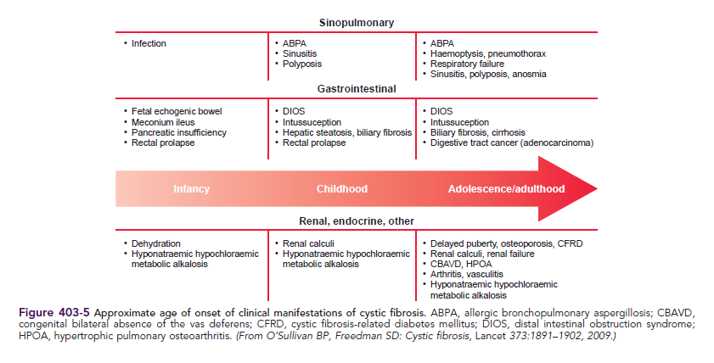
ABPA
Hemoptysis
Pneumothorax
Shortness of breath
Sinusitis, nasal polyp, anosmia
Respiratory System
Sinusitis
Nasal polyp
ABPA
Infections
Bronchial Obstruction
Gastrointestinal system
Dehydration
Meconium ileus
Pancreatic insufficiency
Rectal prolapse
DIOS
Intussusception
Hepatosteatosis
Biliary cirrhosis
Hepatocellular carcinoma
DIOS
Intussusception
Hepatosteatosis
Biliary cirrhosis
Rectal prolapse
Others
Delayed pubety, Renal failure, and kidney stones, Osteoporosis, Congenital absence of the vas deferens, hyponatremic hypochloremic metabolic alkalosis
Dehydration
Hyponatremic, hypochloremic metabolic alkalosis
Hyponatremic, hypochloremic metabolic alcalosis
Kidney stones
Notes:
*Cystic fibrosis is a disease that can cause different clinical symptoms and findings in different age groups.
It is one of the diagnoses that should be kept in mind in children with meconium ileus during infancy. For this reason, we searched for cystic fibrosis in our patient.

Slide 6
Diagnostic Criteria For Cystic Fibrosis
Meconium ileus
Presence of typical clinical features (respiratory, gastrointestinal, or genitourinary)
Or
A history of CF in a sibling
Or
A positive newborn screening test
+
Laboratory evidence for CFTR (CF transmembrane regulator)
dysfunction:
Two elevated sweat chloride concentrations obtained on
separate days
Or
Identification of two CF mutations
Or
An abnormal nasal potential difference measurement
Sweat tests:
146 / 134 mmol/lt
ΔF508del/ ΔF508del
Notes:
* There was a meconium ileus history in our patient.Her sweat tests were one hundred and forty- six and one hundred thiry-four milimol liter. She had ΔF508 homozygous mutation. She was diagnosed as cystic fibrosis with these criteria

Slide 7
Case Follow-up
Malnutrition
(weight<3percentiles)
Fecal elastase (+)
Stool oil +3 (+)
Formula
Multivitamin
2/6 pansystolic murmur
Pancreatic enzyme replacement therapy
Ventricular septal defect
Echocardiography
Notes:
In the patient, weight was under third percentiles. Fecal elastase and stool oil were positive. Formula, pancreatic enzyme replacement therapy and multivitamin were given to her.
* She had a second degree pansystolic murmur. Echocardiography was performed and ventricular septal defect was found. She has been followed by cardiology department.

Slide 8
Brasfield score: 20/25
Dornaz alpha therapy
Atelectasis in right lung,
Left lower lobe retrocardiac consolidation,
Peribronchial thickening
Notes:
In her chest X-ray, there were atelectasis in right lung, consolidation in left lower lobe and diffuse peribronchial thickening. Brasfield score was calculated as twenty. Dornaz alpha therapy was started

Slide 9
Follow-up
Pulmonology
Endocrinology
Cardiology
Gastroenterology/ Nutritionist
Physiotheraphy
Notes:
Patient’s follow-up by pediatric pulmonology, endocrinology, cardiology, gastroenterology and physical therapy and rehabilitation departments will continue.

Slide 10
Family History
Mother
Father
30 years old
Hypothyroidism
Sweat test : 55mmol/lt
Mutation : ΔF508 Heterozygous
31 years old
İnfertility (azoospermia) (+)
Sweat test: 48 mmol/lt
Mutations:p.F508del/p.T1220I
Parental consanguinity (+)
Notes:
In family history, her mother was thirty years old. She had hypothyroidism. Her sweat test was fifty five milimol liter. She had ΔF508 heterozygous mutation.
Her father was thiry one years old. He was infertile due to azoospermia. His sweat test was forty eight milimol liter. He had ΔF508 heterozygous mutation and pi point ti twelve twenty ay heterozygous mutation.
There was parental consanguinity.

Slide 11
CF
+
Infertility
+
Epilepsi
F
Same-village
CF
?
?
Notes:
You see the pedigree of patient’s family. There was paternal consanguinity and there was a lot of marriages in the same village. Her father and three uncles of father were infertile. Both pregnancies of the mother were done by in vitro fertilization method. There was also a cousin with CF.

Slide 12
Family History
Sister: SK, 5 year old girl
2 years = recurrent bronchitis
3 years = constipation + rectal prolapse
Chronic cough
Malnutrition (weight<3percentiles)
Fatty stool (+)
A history of Cystic fibrosis in a sibling
Sweat tests:
124/128 mmol/lt
ΔF508del/ ΔF508del
Notes:
Patient’s elder sister was five years old. She had a history of receiving treatment for recurrent bronchitis when she was two years old. She had rectal prolapse due to constipation when she was three years old. She had chronic cough. She had fatty stool and her weight was below three percentiles. She was evaluated in terms of CF.
She had a history of CF in a sibling. Her sweat tests were one hundred twenty four and one hundred twenty eight milimol liter. She had ΔF508 homozygous mutation. She was diagnosed as cystic fibrosis.

Slide 13
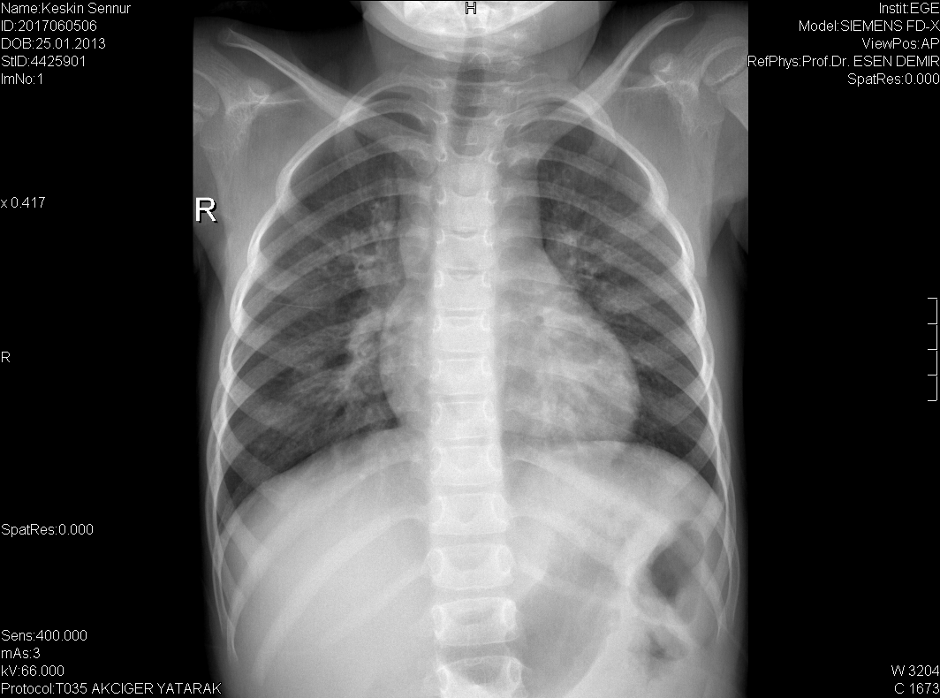
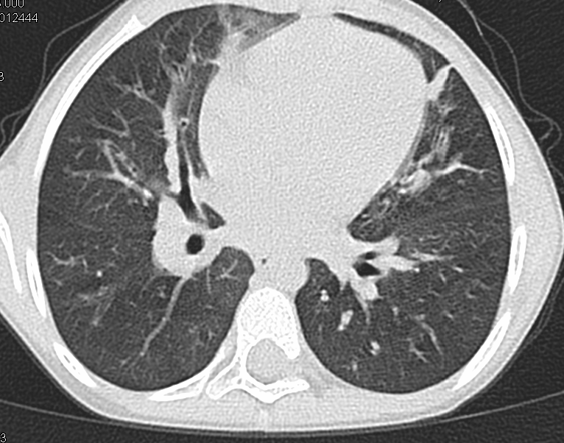
X-ray = Peribronchial thickening
(especially in the right upper lobe
(Brasfield score: 19/25)
Tomography=
Peribronchial thickening in bilateral all lobes,
dilatation in bronchi and bronchioles,
mosaic attenuation
(Brody score: 30/180)
Dornaz alpha therapy
Notes:
In her chest X-ray, there was peribronchial thickening especially in the upper lobe of the right lung. Brasfield score was calculated as nineteen.
In high resolution computerized tomography, there were peribronchial thickening, dilatation in bronchi/bronchioles and mosaic attenuation in all lobes. Brody score was calculated as thirty.
* Dornaz alpha therapy was started

Slide 14
Malnutrition
(Body mass index 13)
Stool oil (+)
Fecal elastase (+)
Recurrent bronchitis
Echocardiography: normal
(Mean pulmonary
artery pressure: 16
mmHg)
Formula
Pancreatic enzyme replacement therapy
Multivitamin
Notes:
Echocardiography was normal. Mean pulmonary artery pressure was sixteen milimeter mercury.
Her body mass index was calculated as thirteen. Stool oil and fecal elastase were found to be positive. Formula, pancreatic enzyme replacement therapy and multivitamin were given to her.

Slide 15
Family History
Sister: NK, twin (6 month old, girl)
A positive newborn screaning
Jaundice
Meconium ileus
Recurrent pulmonary infection/ bronchitis
Stool oil
A history of Cystic fibrosis in siblings
Sweat tests:
77/102 mmol/lt
ΔF508del/ p.T1220I
Notes:
In family history, patient’s twin sister was six months old. Her newborn screening test was not positive. There was no jaundice, meconium ileus, recurrent pulmonary infections/bronchitis and fatty stools in the history of her. But she had history of cystic fibrosis in siblings. Her sweat tests were seventy seven and one hundred and two. She had ΔF508 heterozygous mutation and pi point ti twelve twenty one ay heterozygous mutation, like her father. She was diagnosed as CF.

Slide 16
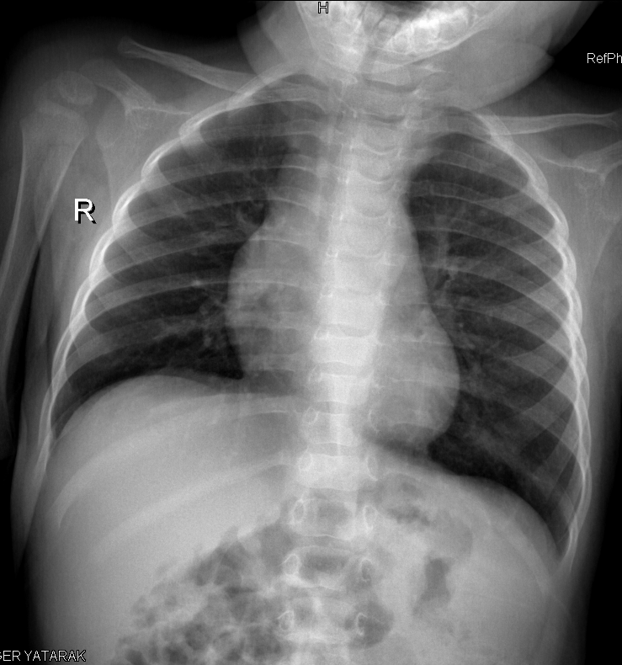
Dornaz alpha therapy
Air trapping (+)
Brasfield score: 23/25
Notes:
In her chest X-ray, there was air trapping. Brasfield score was calculated as twenty three. Dornaz alpha therapy was started.

Slide 17
CF
+
Infertility
+
Epilepsi
F
Same-village
CF
CF
CF
Notes:
When we review the patients pedigree again. All children born with in vitro fertilization method had a diagnosis of cystic fibrosis.

Slide 18
ABPA
Hemoptysis
Pneumothorax
Shortness of breath
Sinusitis, nasal polyp, anosmia
Respiratory System
Sinusitis
Nasal polyp
ABPA
Infections
Bronchial Obstruction
Gastrointestinal system
Dehydration
Meconium ileus
Pancreatic insufficiency
Rectal prolapse
DIOS
Intussusception
Hepatosteatosis
Biliary cirrhosis
Hepatocellular carcinoma
DIOS
Intussusception
Hepatosteatosis
Biliary cirrhosis
Rectal prolapse
Others
Delayed pubety,
Renal failure, and kidney stones,
Osteoporosis,
Congenital absence of the vas deferens,
Hyponatremic hypochloremic metabolic alkalosis
Dehydration
Hyponatremic, hypochloremic metabolic alkalosis
Hyponatremic, hypochloremic metabolic alcalosis
Kidney stones
Notes:
Cf is the most common cause of congenital absence of the vas deferens with azoospermia.

Slide 19
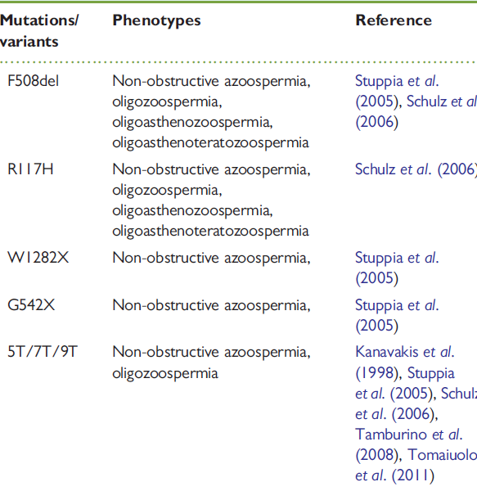
Azoospermia
Obstructive %40
Nonobstructive %60
CF ?
Notes:
Of the known CFTR mutations, some may cause classic CF, while other cause only infertility and do not exhibit any other signs seen in classic CF. Congenital bilateral absence of the vas deferens has been noted to have a strong association with delta F508 mutation of CFTR. In adults with infertility due to the absence of congenital vas deferens which occurs in %1-2 of infertile men, CF should be one of the diagnoses that should be considered.

Slide 20
Male infertility with Azoospermia
Genetic counseling
Perform Mutation analysis for CFTR
Preimplatation genetic + IVF
.
Notes:
Assisted fertilization in patients with CBAVD increases the risk of transmitting mutations in the CF gene, like our patients. For this reason, This adults should be directed to the department of genetic. Couples found to be carriers of CF mutations can also choose to undergo preimplantation genetic diagnosis of their embryos.

Slide 21
Take Home Messages
Assisted fertilization increases the risk of transmitting mutations in the CF gene.
Genetic counseling !!!
Male Infertility
(1-2 %, bilateral absense of the vas deferens)
ΔF508 ***
R117H mutation
The birth of children with CF can be prevented
Notes:
In this way, the birth of children with CF can be prevented.

Slide 22

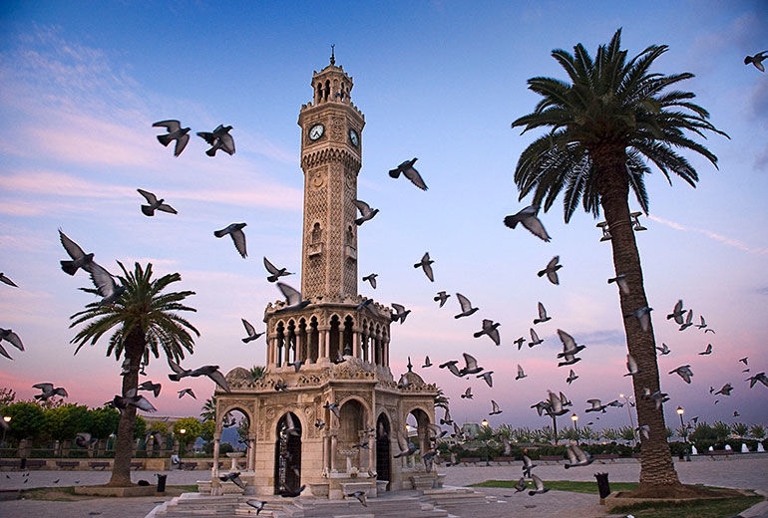
Teşekkürler…
Notes:
Thanks for your attandence

