Slide 1
CLINICAL AND GENETIC OVERVIEW OF CYSTIC FIBROSIS PATIENTS
Aykut Eşki, Gökçen Kartal Öztürk, Esra Işık, Sanem Eren Akarcan, Ferda Özkınay, Figen Gülen, Esen Demir
AYKUT EŞKİ, MD
Department of Pediatric Pulmonology, Ege University Faculty of Medicine

Slide 2
INTRODUCTION
Mostly affects Caucasians, 1/2000-3500 live birth
Autosomal recessive, 7th chromosome q22-31 region
Cystic Fibrosis Transmembrane Regulator (CFTR) Protein consists of 1480 aminoacids
CFTR gene mutations divide into 6 classes due to chloride channel activity
Most seen mutation is F508del
Respiratory system, gastrointestinal system, pancreas, genitourinary system, endocrine system and sweat glands are affected.

Slide 3
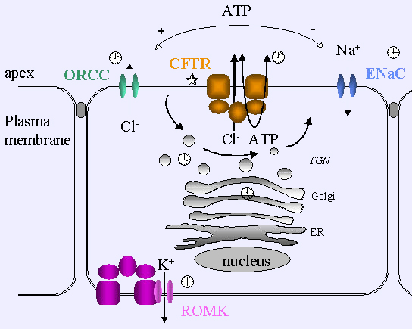
INTRODUCTION
CFTR, cAMP regulated chloride channel;
  Stimulation of other chloride (Cl) channels
  Inhibition of epithelial sodium (Na) channel

Slide 4
INTRODUCTION
MECONIUM ILEUS
DISTAL INTESTINAL OBSTRUCTION SYNDROME (DIOS)
Excessive absorption of Cl, Na and water causes
  Increased absorption of intestinal fluid,
  Dehydration of biliary tract,
  Dehydration of airways, mucous plaque, chronic infections and inflammation,
  Dehydration of pancreatic ducts
  Excessive loss of Cl, Na and water from sweat glands
  Sticky mucous production of urogenital system
PROLONGED JAUNDICE
FOCAL BILIARY CIRRHOSIS
RECURRENT LUNG INFECTIONS
BRONCHIECTASIS
ACUTE/RECURRENT PANCREATITIS
PANCREATIC INSUFFICIENCY
DEHYDRATION
PSEUDOBARTTER
INFERTILITY
NEPHROLITHIASIS

Slide 5
INTRODUCTION
Gold standart for diagnosis is sweat test ;
  Measures function of CFTR protein
  Cl, Na and other ion levels secreted from sweat glands
  Quantitative Cl level measurement is recommended
  Increased level Cystic Fibrosis
  Intermediate level CFTR related disease(CFTR-RDs)
  Intermediate level or normal CFTR related metabolic syndrome (CFMS)

Slide 6
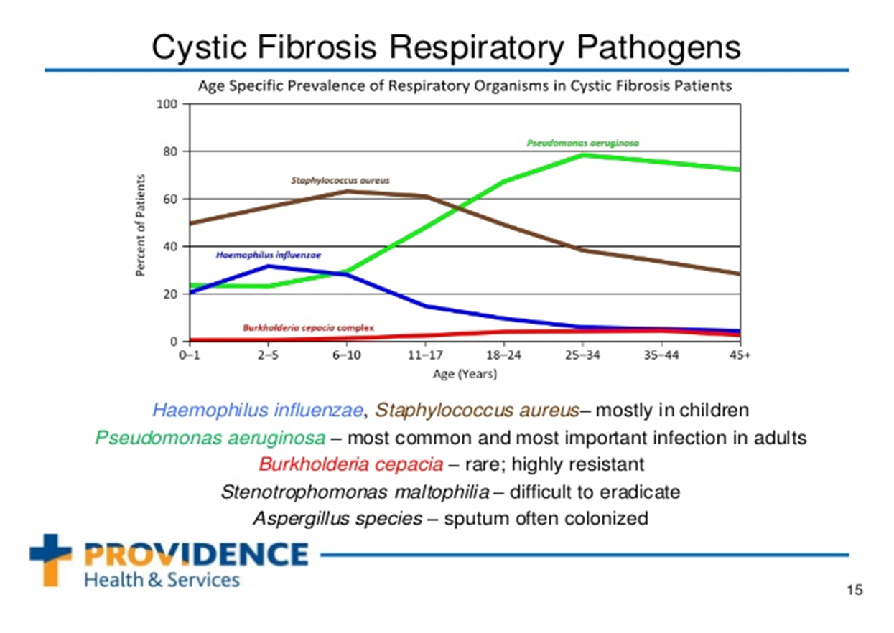
INTRODUCTION
Most frequently respiratory tract pathogens in CF;
  Staphylococcus aureus
  Haemophilius influenzae
  Pseudomonas aeruginosa
  Burkholderia cepacia complex
  Stenetrophomonas maltophilia
  Acromobacter xylosoxidans
  Nontuberculous mycobacteria
  Fungi
  Respiratory viruses

Slide 7
METHODS
  Ege University Faculty of Medicine, Pediatric Pulmonology Department
  Age, sex, sweat test result (conductivity/macroduct), age at diagnosis, clinical manifestations, consanguinity,
  Mutations and sequence analysis, homozygous and compound heterozygous variants of the mutations, respiratory pathogens, radiologic findings and respiratory function test results.

Slide 8
RESULTS
Table 1- Demographic data
 | CF (n:117) | CFTR-RDs (n:17) | CFMS (n:1) | Total (n: 135)
Age* (months) | 96 (7-456) | 156 (9-288) | 9 | 96 (7-456)
Sex, M/F | 52/65 | 10/7 | 0/1 | 62/73
Sweat test*¹ | 108 (32-150) | 70 (23-94) | 54 | 105 (23-150)
Age at diagnosis* (months) | 4 (0-384) | 10 (2-216) | 2 | 4 (0-384)
Consanguinity | 39 (33.3%) | 6 (35.3%) | 0 | 45 (33.3%)
36 mutations | 6 patients are diagnosed by sweat test , no mutation analysis; N:129
2 alleles 1 allel Negative | 56 (43.4%) | 2 (1.5%) | 0 | 58 (44.9%)
 | 28 (21.8%) | 9 (6.9%) | 1 (0.8%) | 38 (29.5%)
 | 27 (20.9%) | 6 (4.7%) | 0 | 33 (25.6%)
*Median (min-max)
¹Sweat test cannot be obtained of 4 patients with CF

Slide 9
RESULTS
Table 2.1- Respiratory pathogens, frequency and first isolation age of microorganisms
 | n (%) | Age (years)*
S. aureus | 31 (22.9) | 9 (0-36)
MRSA | 5 (3.7) | 11 (1-19)
H. influenzae non type b | 33 (24.4) | 9 (6-17)
M. catarrhalis | 3 (2.2) | 12 (6-17)
P. aeruginosa | 51 (37.7) | 9 (1-32)
Chronic colonisation of P. aeruginosa | 36 (26.6) | 9.5 (3-32)
*Median (min-max)

Slide 10
RESULTS
Table 2.2- Respiratory pathogens, frequency and first isolation age of microorganisms
 | n (%) | Age (years)*
S. maltophilia | 6 (4.4) | 6.5 (1-22)
A. xylosoxidans | 4 (2.9) | 7.5 (3-22)
A. baumanii | 2 (5.7) | 1 (1-1)
Enterobacteracea | 1 (0.7) | 11 (11-11)
*Median (min-max)

Slide 11
RESULTS
Table 2.3- Respiratory pathogens, frequency and first isolation age of microorganisms
 | n (%) | Age (years)*
Mycology | 37 (27.4) | 11 (3-34)
C. albicans C. parapsilosis C. dublinensis A. flavus A. fumigatus A. niger A. terreus | 14 (37.8)
 | 4 (10.8)
 | 1 (2.7)
 | 1 (2.7)
 | 11 (29.8)
 | 3 (8.1)
 | 3 (8.1)
Mycobacteriology | 3 (2.2) | 18 (13-18)
TB Non-Tb | 0 (0)
 | 3 (100)**
*Median (min-max)
**M. simiae

Slide 12
RESULTS
Table 3- Mutations and sequence analysis
 | n: 129 | %
Homozygous | 50 | 38.8
Compound heterozygous, 2 alleles | 59 | 45.7
Heterozygous, 1 allele | 20 | 15.5
*6 patients are diagnosed by sweat test , no mutation analysis.

Slide 13
RESULTS
Table 4.1- Frequency of homozygous mutations
Mutation | N | % | Mutation | n | %
F508del | 18 | 13.9 | G178R | 1 | 0.8
E92K | 5 | 3.8 | I234V | 1 | 0.8
2183AA>G | 4 | 3.1 | W1282* | 1 | 0.8
N1303K | 3 | 2.3 | R334W | 1 | 0.8
G542* | 3 | 2.3 | W1098L | 1 | 0.8
A46D | 1 | 0.8 | R347P | 1 | 0.8
D1152H | 1 | 0.8 | Q1411* | 1 | 0.8
D110H | 1 | 0.8 | W401* | 1 | 0.8
E1044G | 1 | 0.8 | R1158* | 1 | 0.8
2184delAA | 1 | 0.8 | c.2988+1G>A | 1 | 0.8
Y515* | 1 | 0.8 | c.1393-1G>A | 1 | 0.8

Slide 14
RESULTS
Table 4.2- Mutation frequencies of all alleles
Mutation | n | % | Mutation | n | %
F508del | 76 | 29.4 | I148T | 3 | 1.1
E92K | 14 | 5.4 | L467F | 3 | 1.1
2183AA>G | 14 | 5.4 | G178R | 3 | 1.1
N1303K | 13 | 5 | c.1393-1G>A | 3 | 1.1
G542* | 11 | 4.2 | W1098L | 2 | 0.7
c.489+1G>T | 7 | 2.7 | S945L | 2 | 0.7
D1152H | 6 | 2.2 | E1044G | 2 | 0.7
W1282* | 5 | 1.9 | R334W | 2 | 0.7
Y515* | 5 | 1.9 | G85E | 2 | 0.7
D110H | 4 | 1.5 | c.2657+5G>A | 2 | 0.7
c.2789+5G>A | 4 | 1.5 | c.2988+1G>A | 2 | 0.7
R347P | 4 | 1.5 | R1158* | 2 | 0.7
W401* | 3 | 1.1 | M470V | 2 | 0.7
2184delAA | 3 | 1.1 | A46D | 2 | 0.7
R1066C | 3 | 1.1 | I1234V | 2 | 0.7

Slide 15
RESULTS
Table 4.3- Mutation frequencies of all alleles
Mutation | n | % | Mutation | n | %
T1036N | 2 | 0.7 | L732* | 1 | 0.3
R1162* | 2 | 0.7 | c.489+3A>G | 1 | 0.3
Q1411* | 2 | 0.7 | T788Qfs*15 | 1 | 0.3
K174* | 2 | 0.7 | D1154Y | 1 | 0.3
c.3041-15T>G | 1 | 0.3 | H1054D | 1 | 0.3
E379* | 1 | 0.3 | R117C | 1 | 0.3
G1244E | 1 | 0.3 | R117H | 1 | 0.3
G1249W | 1 | 0.3 | C524* | 1 | 0.3
G551D | 1 | 0.3 | R347H | 1 | 0.3
Del ekz. 4-11 | 1 | 0.3 | 3199del6 | 1 | 0.3
I506V | 1 | 0.3 | R75Q | 1 | 0.3
D58E | 1 | 0.3 | R75* | 1 | 0.3
L68E | 1 | 0.3 | S1196* | 1 | 0.3

Slide 16
RESULTS
Table 4.4- Mutation frequencies of all alleles
Mutation | n | %
S1455* | 1 | 0.3
S459L | 1 | 0.3
S466* | 1 | 0.3
S737F | 1 | 0.3
F992L | 1 | 0.3
Tn7T/9T | 1 | 0.3
E92* | 1 | 0.3
E831* | 1 | 0.3
c.2657+5G>A | 1 | 0.3
* 6 patients are diagnosed by sweat test , no mutation analysis

Slide 17
RESULTS
Table 5- Clinical properties at the time of admission

Slide 18
RESULTS
Table 6- High Resolution Computerized Tomography findings

Slide 19
RESULTS

Slide 20
CONCLUSION
135 patients are diagnosed as CF
  6 of the patients have no genetic analysis and 4 of them do not have sweat test.
 | Our study (%) | CFF 2016 report (%)
CF | 86.6 | 85.6
CFTR-RDs | 12.5 | 6.1
CFMS | 0.9 | 8.3
M/F | 45.9/44.1 | 51.5/48.5
Mean/meadian age at diagnosed | 2.6 years/4 months | 3.9 years/4 months
CF diagnosed < 1 age | 74.8 | 74.1
Sweet tests, median | 105 | 99
Similar to our study.

Slide 21
CONCLUSION
 | Our study % | Hacettepe 2012 % | CFF 2016 report %
Respiratory abnormalities | 39.3 | 31.7 | 37.3
Pseudobartter | 30.4 | 18.3 | 3.1
Malnutrition | 18.5 | 17 | 29.1
Sibling with CF | 5.9 | 7 | 14.8
Steatorhea/Malabsorption | 13.5 |  | 22.4
Newborn screning | 6 |  | 23.6
Our study is also similar to Hacettepe University’s and CFF’s reports, it’s thought that frequency of pseudobartter is high due to climate of Aegean region.
1 patient is diagnosed prenatally.
NBS in Turkey, is used since january 2015 so the frequency of diagnosed patients are lower than CFF 2016 report.

Slide 22
CONCLUSION
 | Our study (%/years) | CFF 2016 report (%/years)
P. Aerouginosa/median age | 37.7/9 | 46.4/6
Chronic P. Aeruginosa/median age | 26.6/9.5 | 29.1
MSSA/median age | 22.9/9 | 55/10
MRSA/median age | 3.7/11 | 26/12
Nontuberculous Mycobacteria/median age | 2.2/18 | 12.6/22

Slide 23
CONCLUSION
 | Our study (%) | CFF 2016 report (%)
FVC, mean | 66.1 | 88.7
FEV1, mean | 69.7 | 77.4
FEV1/FVC, mean | 103.9 | 74.3
The respiratory function tests of our patients are lower due to irregular follow-up, unable to reach the treatment opportunities and some of the medical equipments in our country are not covered by health insurance.
This situation can be overcome with founding the CF centers in our country and increasing support for CF patients.

Slide 24
CONCLUSION
 | Our study (%) | CFF 2016 report (%) | Bobadilla et al (%)
F508del | 29.4 | 86.4 | 24.5
E92K | 5.4 | <0.5 | 2.6
2183AA>G | 5.4 | <0.5 | 2.5
N1303K | 5 | 2.4 | 2.9
G542* | 4.2 | 4.7 | 2.6
Mutations of our patients correlate with Bobadilla et al’s study.
Differences of mutation percentages can be obtained due to regional changes.

Slide 25

THANK YOU FOR YOUR PATIENCE…

