Slide 1

Case Presentation
Tuğba RAMASLI GÜRSOY, MD¹
Tuğba ŞİŞMANLAR EYÜBOĞLU, MD²
Ayşe Tana ASLAN, MD¹
1. Division of Pediatric Pulmonology, Gazi University Hospital, Ankara, Turkey
2. Dr. Sami Ulus Obstetrics and Gynecology, Children’s Health and Disease Training and Research Hospital, Division of Pediatric Pulmonology, Ankara, Turkey
2nd Middle East CF Conference 2018, 22-24 March, İzmir
Notes:
Good morning ladies and gentlemen. It is an honor for me to make a presentation in such a
distinguished organization. My name is Tuğba Ramaslı Gürsoy and I’m pediatric pulmonology fellow in Gazi University Hospital

Slide 2
ERG, 8-year-old
Past Medical History
Prenatal: No features
Natal: Born at term, 3600 gr, C/S
Postnatal: ▪ Breast-fed: 2 years
▪ Immunizations: Up to date
▪ Normal development
Family History
Mother:
38-year-old, healthy
Father:
38-year-old, healthy
G1: 19-year-old, girl, healthy
G2: Triplets
16-year-old, boy, healthy
16-year-old, boy, healthy
16-year-old, boy, healthy
G3: D/C
G4: D/C
G5: Our patient
Notes:
I am going to start with our patient he is eight years old. There weren’t any features in his past medical and family history

Slide 3
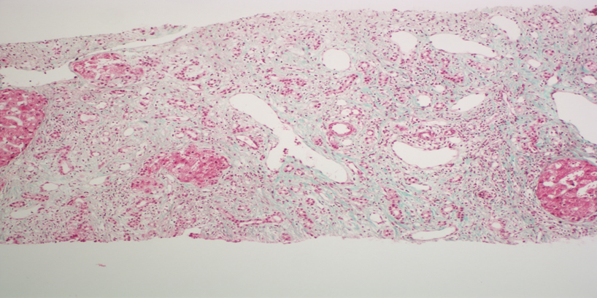
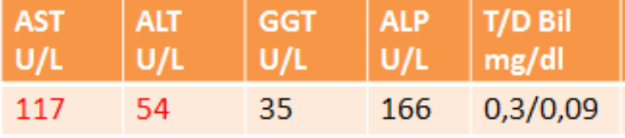
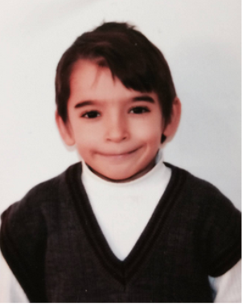
α-1 antitrypsin: 217
Celiac antibodies: negative
Immunoglobulins: normal
αFP: normal
TORCH: negative
Viral hepatitis markers: negative
Seruloplasmin: normal
Urine copper: normal
Chitotriosidase: normal
Amino Acids in Blood Plasma and Urine: normal
Lipid profile: nomal
Autoimmune markers: normal
ANA, ASMA, Anti LKM: negative
Doppler USG: normal
Endoscopy: normal
Duodenal biopsy: normal
Eye examination: normal
Bone marrow aspiration: normal
Hb g/dl | Htc % | MCV fL | Plt X10³ | WBC X10³
11,5 | 34.3 | 77,1 | 196600 | 7670
11. 2012
*Admission to hospital with abdominal distention
* Hepatosplenomegaly detected
Microscopy
Liver biopsy involves subcapsular changes and is suboptimal for evaluating fibrotic activity with trichrome. No accumulation was observed with D-PAS and alpha antitrypsin. Copper binding protein with orsein accumulation has not been seen.
Diagnosis
Liver biopsy characterized by active signs of cholangitis
Chronic liver disease
Notes:
In 2012 he admitted to hospital with abdominal distention. Hepatosplenomegaly was detected on the physical examination.
His laboratory results were normal except AST and ALT. He was our patient. The tests for hepatosplenomegaly etiology were normal. His liver biopsy was characterized by active signs of cholangitis. Chronic liver disease was diagnosed

Slide 4
02-09/2013
11. 2012
24.09.2013
Chronic productive cough
*Admission to hospital with abdominal distention
* Hepatosplenomegaly detected
*Diagnosis as chronic liver disease
*Recurrent upper respiratory tract infections
*Lower respiratory tract infections
*Chronic cough
Hepatopulmonary Syndrome?
Pediatric pulmonology consultation
Notes:
He was diagnosed as chronic liver disease, He had recurrent upper and lower respiratory tract infections and chronic cough. Had he Hepatopulmonary Syndrome? He was consulted to our division.

Slide 5
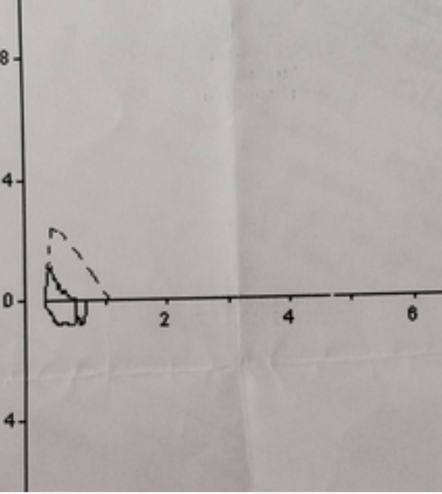
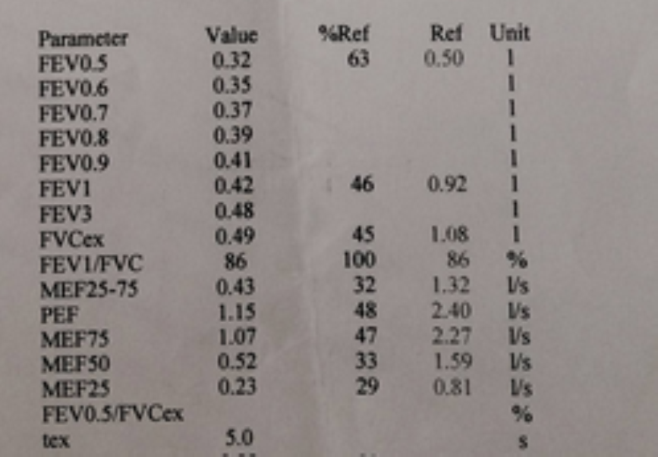
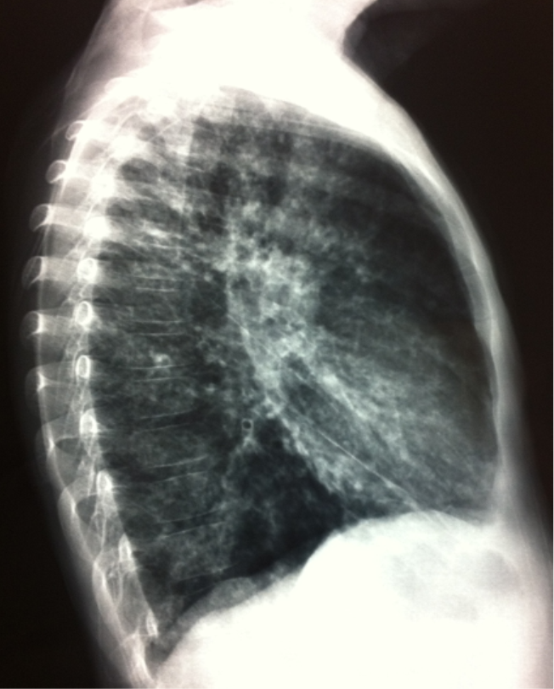
Weight: 14,9 kg (<3p) Height: 105 cm (<3p)
Temperature : 37,1 °C Heart rate: 125/min
Respiratory rate : 24/min Sat O2: 95%
Head-Neck: Tonsils-oropharynx normal
RS: Both hemithorax equates to breathing
Subcostal, intercostal retractions
Chest anterior-posterior diameter increased
Crepitan rales were common in the right lung and left lower lobes
CVS: S1+S2 + rhythmic, no murmur
GIS: Abdominal distention (+)
liver 6 cm, spleen 8-9 cm palpable
GUS : Normal
NE: Normal
EXT: clubbing+
RADIOLOGY: There are reticulonoduler infiltrative changes in both lungs
Both obstructive and restrictive pattern
Notes:
His weight and height were under three percentil. In physical examination: He had subcostal and intercostal retractions. Chest anterior-posterior diameter was increased. Crepitan rales were common in the right lung and left lower lobes. Liver six centimeters, spleen 8-9 centimeters were palpable, I’d like to show you his abdominal distention and clubbing. These graphs shows there are reticulonoduler infiltrative changes in both lungs. Here we can see both obstructive and restrictive pattern in spirometry

Slide 6
Laboratuary
Hb g/dl | Htc % | MCV fL | Plt X10³ | WBC X10³
11,5 | 36,4 | 81 | 79000 | 5800
AST U/L | ALT U/L | GGT U/L | ALP U/L | T/D Bil mg/dl | BUN mg/dl | Creatin mg/dl | uric acid mg/dl | Glucose mg/dl
30 | 27 | 60 | 180 | 0,7/,015 | 6,4 | 0,28 | 3,02 | 106
Na mmol/L | K mmol/L | Cl mmol/L | Ca mg/dl | P mmol/L | Alb g/dl | Prot g/dl | Ldh U/L
135 | 4,1 | 104 | 8,9 | 4,8 | 3,4 | 6,1 | 181
Notes:
He had thrombocytopenia due to hypersplenism, ggt level was elevated minimal. Other laboratuary tests were normal

Slide 7
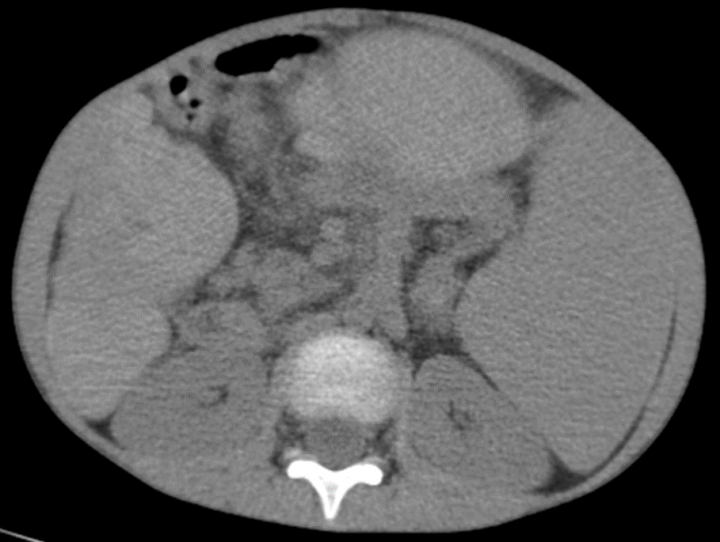
Thorax CT: There are common bronchiectasis in all lobes. Mucous plugs were observed in accordance with full appearance. Pulmonary vasculary structures are visible in peripheral areas. Liver is small and it’s contour is irregular. Spleen is large than normal. These findings support the hepatopulmonary syndrome.
Notes:
I’d like to show you his thorax CT There are common bronchiectasis in all lobes. Mucous plugs were observed in accordance with full appearance. Pulmonary vasculary structures are visible in peripheral areas. Liver is small and it’s contour is irregular. Spleen is large than normal. These findings support the hepatopulmonary syndrome.

Slide 8
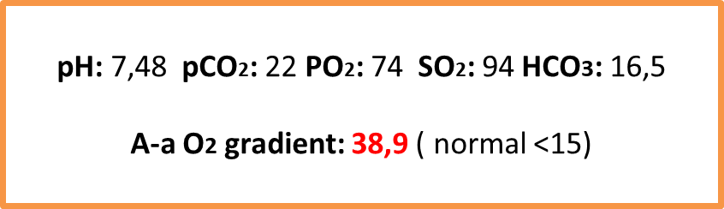

Contrast echocardiography++ (intrapulmonary shunt+)
HPS?
ABG,
Contrast echocardiography,
V/P scintigraphy
V/P scintigraphy: The distribution of radioactivity in both lungs was heterogeneous and bilateral segmenter/subsegmental perfusion defects were observed.
Notes:
Alveolar-arterial oxygen gradient was high and contrast echocardiography was shown intrapulmonary shunt. the distribution of radioactivity in both lungs was heterogeneous and bilateral segmenter/subsegmental perfusion defects were observed in the ventilation/perfusion scintigraphy

Slide 9
24.09.2013
27.09.2013
Chronic respiratory complaints
Gastrointestinal system findings
CF?
Sweat chloride test: 103 mmol/L
Sweat conductivity: 106 meq/L
Steatocrit: negative
Sputum cx: normal flora
HPS?
ABG,
Contrast echocardiography, V/P scintigraphy
Fever, cough
increased AFR
Oxygen requirement
Infiltration on chest x-ray +
IV antibiotic
Sputum cx: normal flora
Notes:
In september 2013 He admitted to hospital with fever and cough. AFR were increased. There was infiltration on his chest x-ray. He had oxygen requirement and treated with iv antibiotic. Sputum cx was normal. He had chronic respiratory complaints and gastrointestinal system findings. Had he Cystic fibrosis disease? Sweat chloride test: 103 mmol/L . Sweat conductivity: 106 meq/L. Steatocrit was negative. Sputum culture was normal

Slide 10
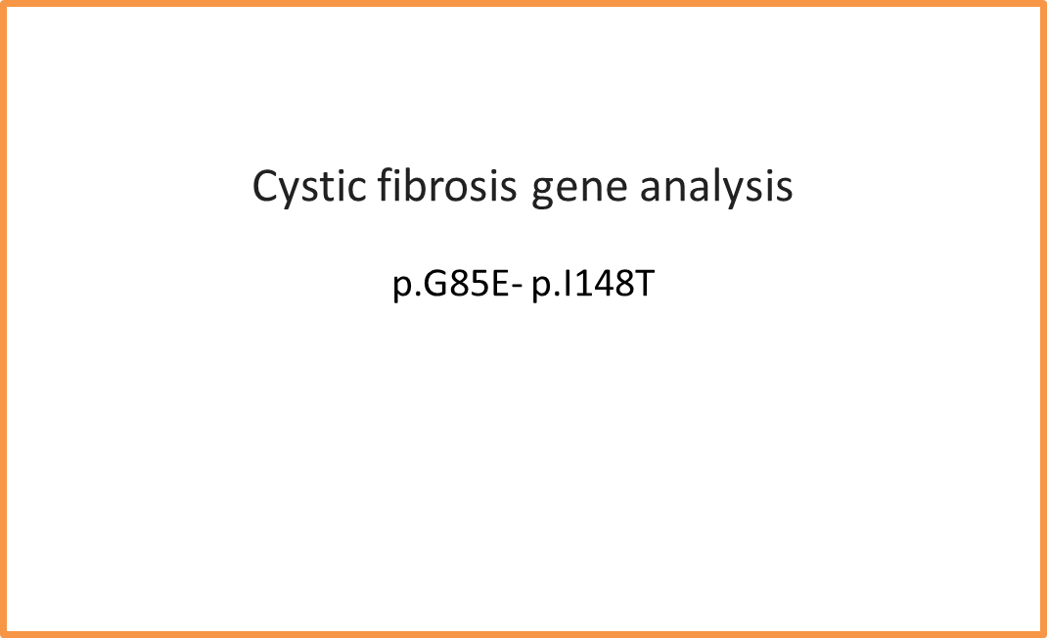
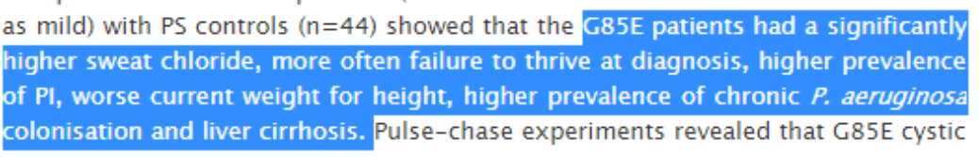

Diagnosis: Cystic fibrosis
Notes:
G85E mutation was detected in cystic fibrosis gene analysis. Researchs shows that these patients had a significantly higher sweat chloride, more often failure to thrive at diagnosis, higher prevalence of pancreatic failure, worse current weight for height prevelance of chronic P. Aeruginosa colonization and liver cirrhosis. He was diagnosed as cystic fibrosis

Slide 11
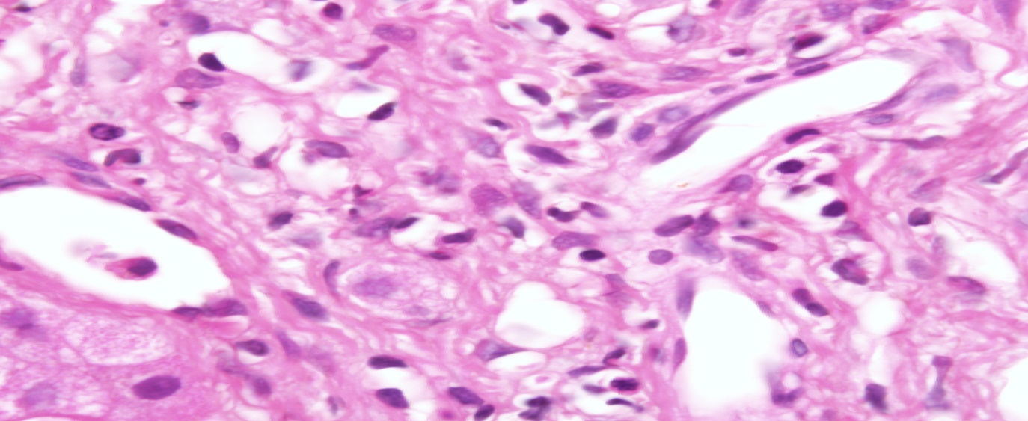
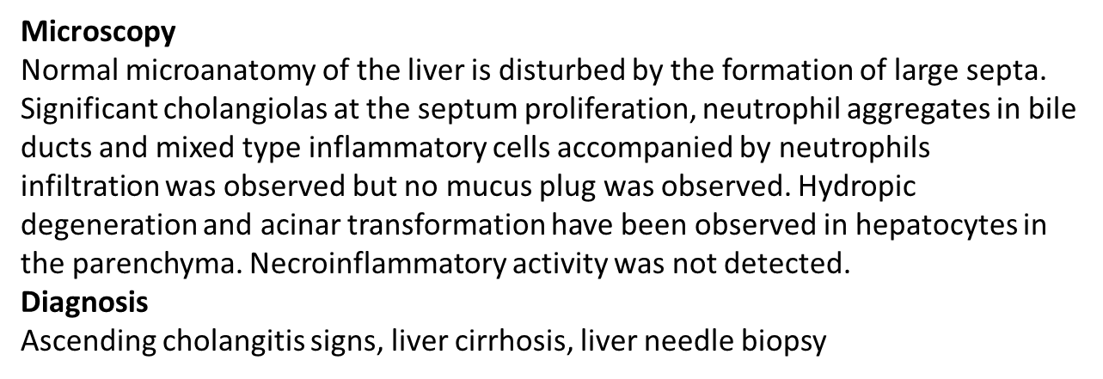
LIVER NEEDLE BIOPSY
DIAGNOSES
Cystic fibrosis
Chronic liver disease
Cirrhosis
Ascending cholangitis
Hepatopulmonary syndrome
TREATMENT
Inhaled Dornase Alfa
Ursodeoxycholic acid
A, D, E, K vitamins
Chest Physiotherapy
Notes:
liver needle biopsy was done. It was shown that ascending cholangitis signs, liver cirrhosis. He was diagnosed as cystic fibrosis, chronic liver disease, cirrhosis, ascending cholangitis, hepatopulmonary syndrome. Inhaled dornase alfa, ursodeoxycholic acid, A, D, E, K vitamins, chest physiotherapy were started for treatment

Slide 12
24.09.2013
27.09.2013
20.10.2013
pH: 7,47 pCO2: 35 PO2: 84 SO2: 96 HCO3: 25
A-a O2 gradient: 12,7 ( normal <15)
HPS?
ABG,
Contrast echocardiography, V/P scintigraphy
Fever, cough, tachycardia
increased AFR
Oxygen requirement
Infiltration on chest x-ray +
IV antibiotic
Sputum cx: normal flora
CF, cirrhosis
HPS?
ABG
Contrast echocardiography
Contrast echocardiography
normal
Notes:
Alveolar-arterial oxygen gradient and contrast echocardiography were normal after treatment.

Slide 13
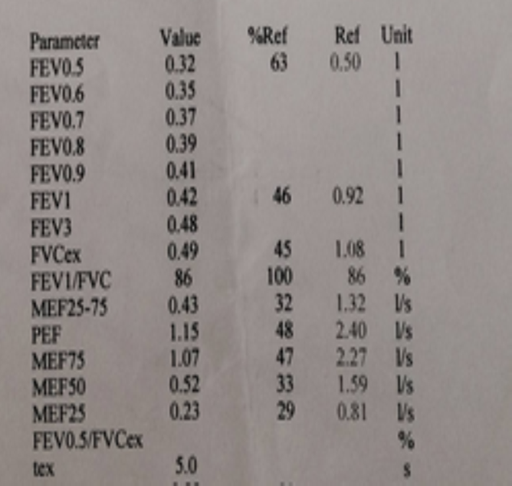

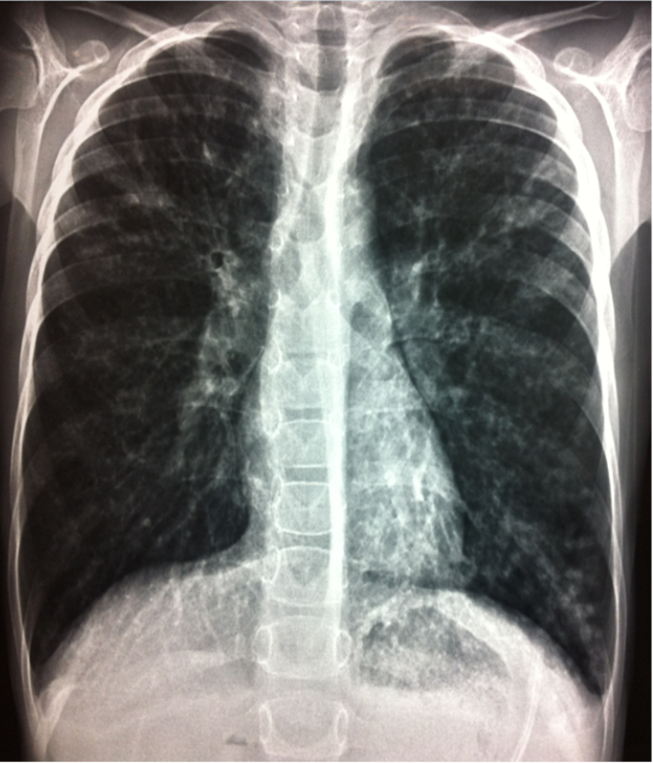
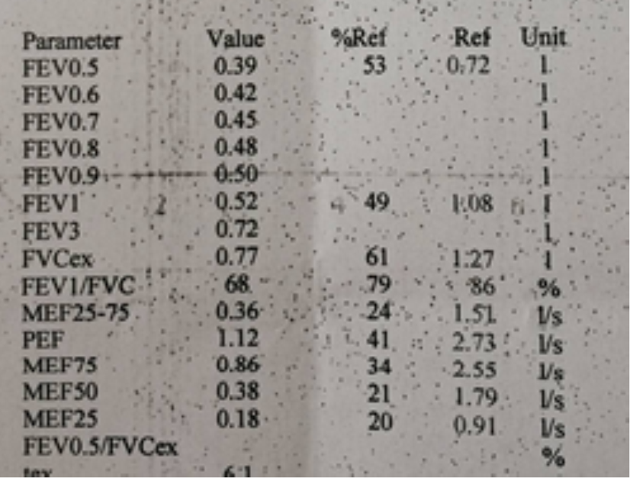
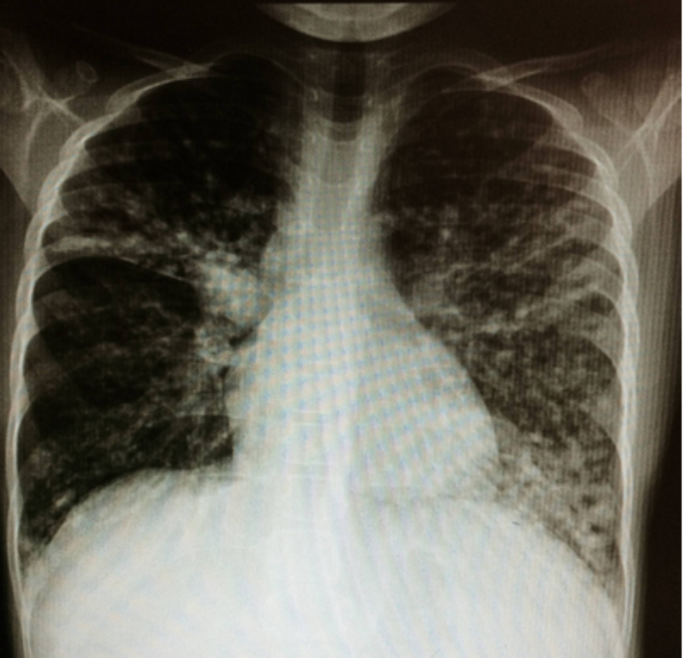
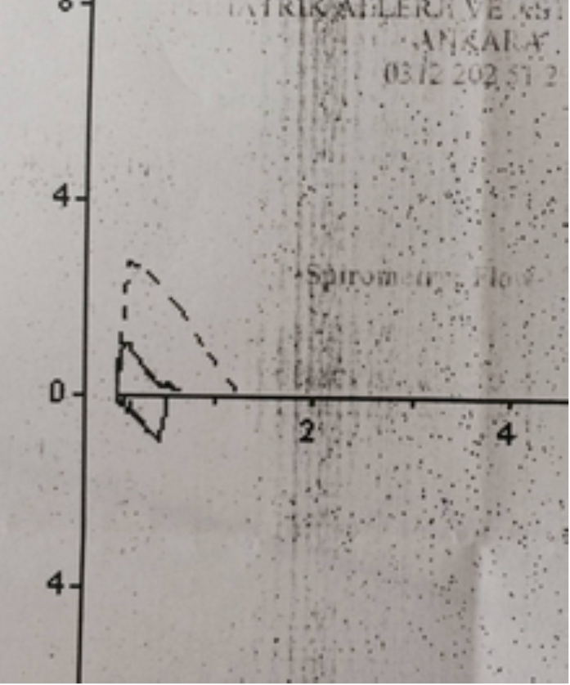
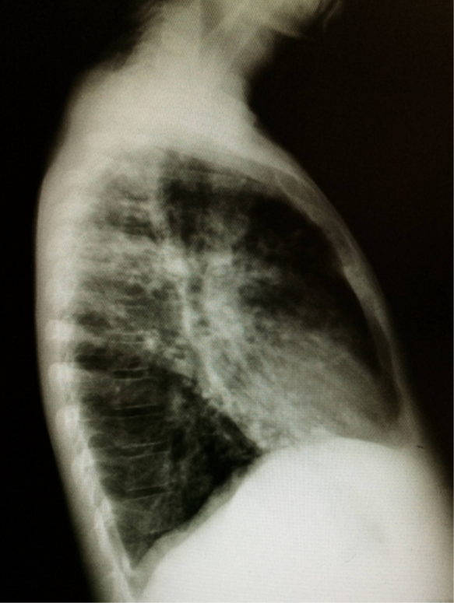
24.09.2013
27.09.2013
15.04.2015
Steatocrit (+) → pancreatic enzyme replacement
Pneumonia 3 times → hospitalization
Chronic Pseudomonas colonization → inhaled tobramycin
Esophageal varices, portal hypertension → Propranolol
HPS?
ABG,
Contrast echocardiography, V/P scintigraphy
Fever, cough, tachycardia
AFR increase
Oxygen requirement
Infiltration of chest x-ray +
IV antibiotic
Sputum cx: normal flora
Weight: 19,4 kg (<3p)
Height: 115 cm (<3p)
SatO₂:94%
No auscultation signs
Liver 6 cm,
Spleen 12 cm palpable
clubbing+
Notes:
2 years later his weight and height were under three percentil. In physical examination: There weren’t any auscultation signs. Liver 6 cm, Spleen 12 cm were palpable. clubbing+. Pancreatic enzyme replacement treatment was given for pancreatic failure. He was hospitalizated 3 times because of pneumonia. Inhaled tobramycin was started for chronic Pseudomonas colonization. Propranolol was started for esophageal varices and portal hypertension. I’d like to show you chronic changes in chest X-ray. Here we can see small airway obstruction in the pulmonary function test

Slide 14
28.10.2015
Pediatric Pulmonology Consultation : At this stage the patient does not need a lung transplant. However, he is frequently infected and pulmonary functions may gradually decrease in this process. This may be a problem for isolated liver transplantation. Azithromycin 250 mg / day was started 3 days a week.
Pediatric Gastroenterology and Hepatology Consultation : The patient is a candidate for liver transplantation because of cirrhosis, acid and portal hypertension. However, post-op lung complications will be more. Lung-liver transplantation will be more appropriate.
Pre-op preparation for lung-liver transplant was done. The patient was referred to a transplant center.
Two hospitals were contacted for lung transplantation in Istanbul. However, transplantation was not possible due to lack of licenses.
Notes:
He was evaluated with other divisions. For the pediatric pulmonology division…… For the Pediatric Gastroenterology and Hepatology division……

Slide 15
24.11.2015
14.03.2017
22.05.2017
Pseudomonas colonization
Cirrhosis
Portal hypertension
Hepatopulmonary syndrome
Bronchiectasis
Recurrent lung infections
Recurrent hospitalization
Esophageal variceal bleeding, desaturation, respiratory distress
Hospitalization
Cardiac arrest
Intubation
Circulatory support
14 days in intensive care unit
Died in 02.06.2017
Notes:
Between 2015-2017 . He had recurrent hospitalization because of pseudomonas colonization, cirrhosis, portal hypertension, hepatopulmonary syndrome, bronchiectasis and recurrent lung infections. In may 2017 he admitted to hospital with esophageal variceal bleeding, desaturation and respiratory distress. After 14 days in intensive care unit, he died.

Slide 16
Notes:
This is our patient’s Picture.

Slide 17
Cystic Fibrosis and Liver
CFLD is seen in 30% of patients
Prz Gastroenterol.2014;9:136-41
J Cyst Fibros. 2011;2:529-36
Notes:
CF-associated liver disease is seen in 30% of patients.

Slide 18
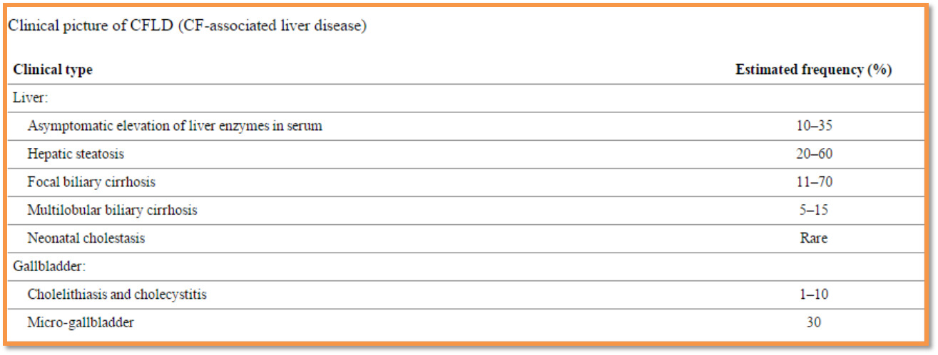

Cystic Fibrosis and Liver
Multilobular cirrhosis occurs in the first decade of life in 5-15% of CF patients
Prz Gastroenterol.2014;9:136-41
J Cyst Fibros. 2011;2:529-36

Slide 19

Hepatopulmonary syndrome is the third cause of death after lung disease and transplant complications
Hepatic failure is late onset; usually seen after the pediatric age group
J Cyst Fibros. 2015;14:120-6
J Hepatol. 1999;31:77-83

Slide 20

HEPATOPULMONARY SYNDROME

Slide 21
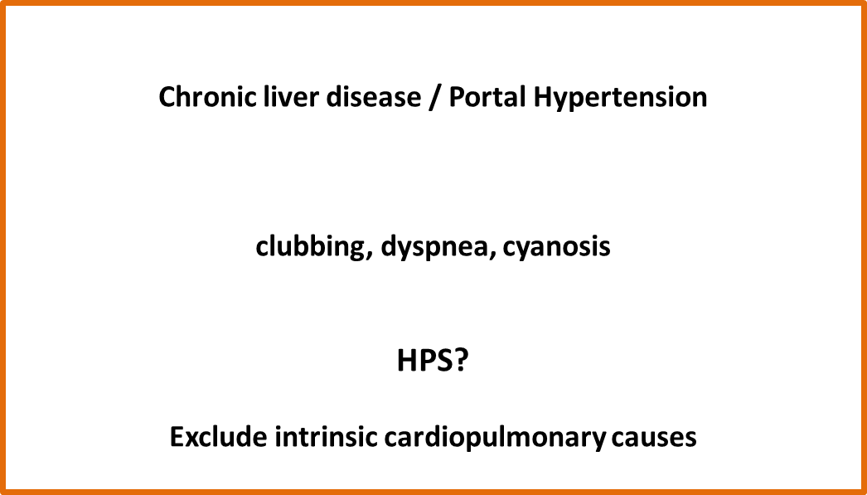



Best Pract Res Clin Gastroenterol. 2013;27:497-512
Notes:
Here I’d like to show you HPS management algorithm. If we summarize the algorithm Clinical suspicion of HPS (dyspnea, cyanosis, clubbing in the setting of liver disease+/- portal hypertension). exclude any intrinsic cardiorespiratory causes and other chronic liver diseases causing.

Slide 22
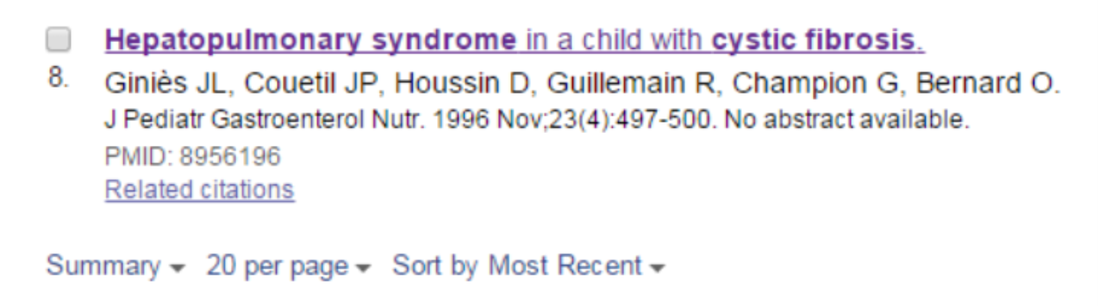
Cystic Fibrosis and Hepatopulmonary Syndrome
No data on HPS frequency
Notes:
There isn’t any data on HPS frequency in a child with CF

Slide 23
Cystic Fibrosis and Liver Transplantation
INDICATIONS
CONTRAINDICATIONS
Liver failure
If portal hypertension has life-threatening complications
(especially in patients with prolonged life expectancy and PFT preserved)
PFT has been severely decreased for a long time, patients with frequent exacerbations
Patients with Burkholderia cepacia or other multi-drug resistant organisms colonization
Common lung fibrosis in CT, increased PCO₂
Severe pulmonary hypertension (right ventricular dysfunction)
FEV1 <50 Tx
WHEN?
Without severe pulmonary deterioration
Keep the threshold low!!!
Pediatr Transplant. 2013;17:271-7
Transplant Int. 2006;19:726-31
Am J Transplant. 2012;12:954-64
Curr Opin Pulm Med. 2001;7:441-7
J Pediatr Gastroenterol Nutr. 2006;43:519-55
Notes:
Indications of liver transplantation in CF patients are Liver failure, If portal hypertension has life-threatening complications (especially in patients with prolonged life expectancy and PFT preserved) If forced expiratory volume in 1 second under fifty Transplantation indicated. Contraindications are PFT has been severely decreased for a long time, patients with frequent exacerbations, Patients with Burkholderia cepacia or other multi-drug resistant organisms colonization, Common lung fibrosis in CT, increased PCO₂ . Severe pulmonary hypertension (right ventricular dysfunction) when can we do? Without severe pulmonary deterioration. Keep the threshold low!!!

Slide 24

What did we learn?
Cirrhosis may be early finding
Patients may present with gastrointestinal system symptoms without any respiratory symptoms.
Hepatopulmonary syndrome should be evaluated when the patients are clinically stable.
Patients with severe cirrhosis may die with massive esophageal variceal hemorrhage.
Notes:
So what did we learn?

Slide 25
The Division of Pediatric Gastroenterology and Hepatology
The Division of Pediatric Genetics and Metabolism
The Division of Pediatric Cardiology
The Division of Pediatric Infectious Diseases
The Department of Radiology
Thank you…
Notes:
Well, that ends the last part of my talk. Thanks for listening.

