Slide 1
The Role of Registries in CF Care
Deniz Doğru Ersöz, MD
Professor of Pediatrics
Hacettepe University,
Pediatric Pulmonary Medicine Department,
Ankara, Turkey

Slide 2
Today, healthcare providers have access to extensive patient medical information at their fingertips with the use of computers
When the microscope was invented four centuries ago, people could see and measure things at the cellular level
“Big data” is our modern microscope
Patient registries use this big data for research and disease management

Slide 3
Patient registries
Allow clinicians, researchers, and policymakers
to examine data for trends and clinical outcomes within patients
to practice sites for quality improvement efforts
to investigate the natural history of a disease for patients
provide insight into standard practice
can facilitate collaboration between patients, families and clinicians

Slide 4
Purposes for registries
Describe the natural history of the disease
Determine clinical effectiveness of treatments
Assess safety or harm of treatments
Measure or improve quality of care
Gliklich R, Dreyer N, Leavy M. Registries for Evaluating Patient Outcomes: A User's Guide. 3rd ed. Rockville, MD: AHRQ Publication No. 13(14)-EHC111; 2014.

Slide 5
Patient registries
People living with rare diseases today face particular challenges:
treatment availability
a lack of resources
disease severity
Special efforts are required to undertake research for better treatments and possible cures

Slide 6
Patient registries
Rare disease registries are critical
They combine standardized individual data across clinics and countries
Allow for larger, more statistically meaningful studies and more efficient use of resources

Slide 7
Patient registries
Cystic fibrosis
Cancer
Organ transplantation
Products: specific drugs, therapies
….

Slide 8
Cystic Fibrosis Patient Registries
CF registries work by bringing patient data together from specialist CF centres
Accumulate data on a relatively rare condition over patients' lifetimes
The strength of CF registry studies originates from
the large number of subjects
high rates of coverage by the patient registries
long term patient follow-up

Slide 9
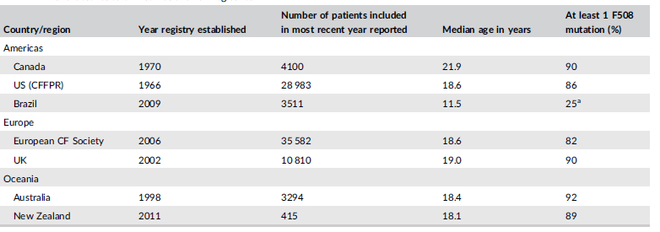
Cystic Fibrosis Patient Registries
First CF registry was started in the United States in 1966

Slide 10
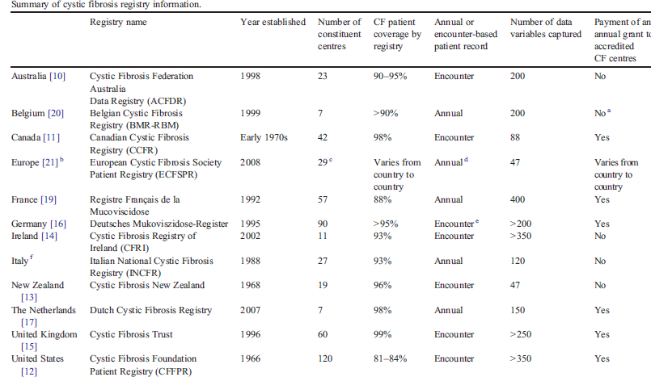

Slide 11
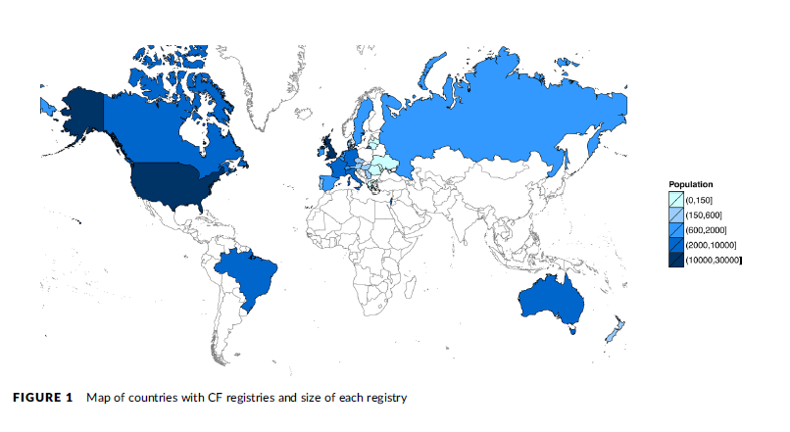
Cystic Fibrosis Patient Registries
Registry-derived population estimates suggest that
72,000 people are living with CF worldwide

Slide 12
Cystic Fibrosis Patient Registries (CFPR)
Most CFPR are developed from national patient organisations
Aim to better understand the demographics of CF in each country
Aim to determine clinical outcomes in those patients when followed longitudinally

Slide 13
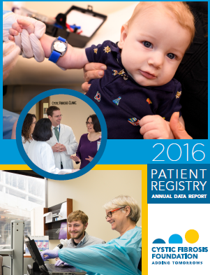

Slide 14
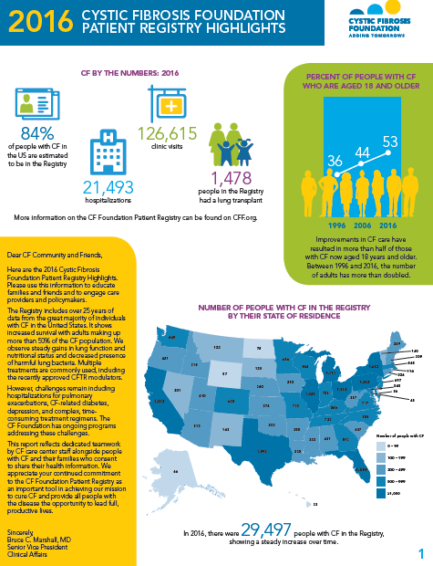

Slide 15
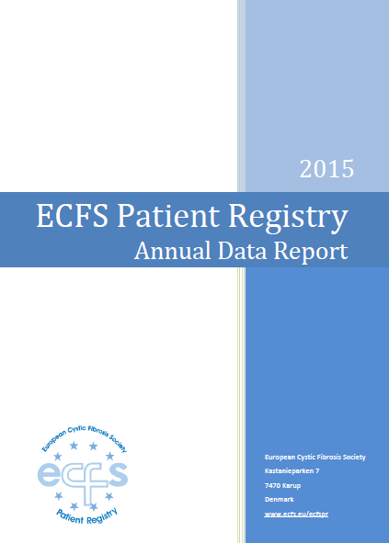

Slide 16
Demographic and clinical data of 42,054 CF patients
29 countries
The epidemiological data is provided by
national cystic fibrosis registries, and
individual CF centres

Slide 17
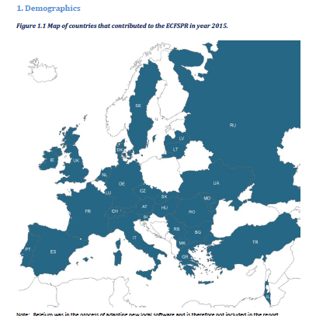

Slide 18
Cystic Fibrosis Patient Registries (CFPR)
To participate in a CF registry, informed consent must be obtained from patients/families
Legislation exists in each nation to safeguard the disclosure and use of personal health
Without obtaining patient/family's participation, personal health information could not be gathered and national registries would not exist

Slide 19
Cystic Fibrosis Patient Registries (CFPR)
In the analyses, data completeness is a challenge for most registries
CF registries either
high coverage of the CF population and gathered small numbers of highly accurate demographic data fields,
many clinically relevant variables which tended to be poorly completed
CF registries should gather a core set of demographic and clinical variables with high rates of data completion to avoid data bias
Mehta G, Macek Jr M, Mehta A. Cystic fibrosis across Europe: EuroCareCF analysis of demographic data from 35 countries. J Cyst Fibros 2010;9(Suppl. 2):S5–s21.

Slide 20
Cystic Fibrosis Patient Registries (CFPR)
The majority of registries collect data from CF specialty adult and pediatric clinics
They collect data at least annually including
Age
Gender
Genotype
Lung function
Nutritional status
Complications
Medication usage
Transplantation status
Sputum microbiology
Some registries (US CFPR) now collects data at every patient encounter and includes over 350 variables

Slide 21
Longitudinal analysis of registry data
Patient registries also have data through time on individual CF patients
This longitudinal data markedly increases the ability to describe what is happening on a patient level and a population level through time
Longitudinal studies can
establish sequences of events
provide information about cause-and-effect relationships

Slide 22
Longitudinal analysis
Numerous clinical aspects
Impact of therapies
New therapies like novel CFTR modulators
Survival estimation
Clinical implications of sputum microbiology
Complications like CF related diabetes
Implication of being pregnant
Referral timing for lung transplantation

Slide 23
Cystic Fibrosis Patient Registries (CFPR)
Advanced knowledge about
changing demographics
improvements in health outcomes
Valuable source of information describing CF epidemiology at a single point in time is the registry annual data report
It provides a snapshot of the burden of disease nationally

Slide 24
Changing Demographics
National registry's annual data
increases in population size
median participant age
proportion of participants living into adulthood
earlier age at diagnosis: CF patients diagnosed as a result of neonatal screening
median age of survival

Slide 25
Improvements in survival
Reported as a “median age of survival”
Most people born with CF today can expect to survive into their forties or fifties
Estimated median age of survival:
1989: 27 years in USA, 32 years in Canada
2009 - 2013: 40.6 years in the USA, 50.9 years in Canada
2015: 45.1 years in the United Kingdom
Median age at death and birth cohort survival are alternative/additional measure of life expectancy that can be derived using registry data

Slide 26
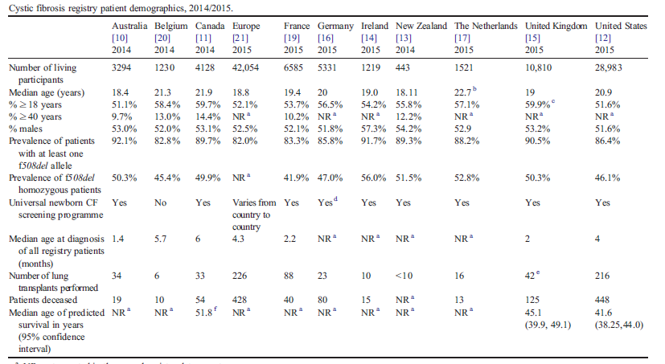

Slide 27
Improvements in Health Outcomes
Annual change in lung function
Assessment of post-lung transplantation outcomes
The changing epidemiology of CF pathogens
Complications: cystic fibrosis related diabetes

Slide 28
National and International Registry Collaboration
Variation in practice and patient outcomes can be identified by comparing practices and outcomes:
At a national level, centre-to-centre
At an international level
It enables clinicians and researchers to
look beyond local approaches
evaluate and identify best practices internationally
It provides opportunities to enhance outcomes for all CF patients

Slide 29
National and International Registry Collaboration
Each registry collects data differently
Data elements are not always similarly defined
Extensive work is required to harmonize data
Harmonisation of
registry data definitions
data collection procedures
analysis is essential

Slide 30
National and International Registry Collaboration
Challenges
Key indicators are not collected by all contributors
Completeness of patient records are poor in some cases
Definitions applied to the same variable differ by country
Data cleaning is undertaken to varying degrees at national levels
Different reference ranges are used for lung function and growth (zscores, percentiles)
Selection of lung function and growth measurements vary (best in the year, average annual value, annual assessment measurement)

Slide 31
National and International Registry Collaboration
Challenges
Missing data: can be associated with patient or clinic characteristics
Despite data entry guidelines, there is often no standardization of definitions:
“pulmonary exacerbations” are defined by treatment with IV antibiotics,
there is variability between providers regarding when to initiate this treatment

Slide 32
International Registry Collaboration
Successful collaborative partnership
Achieved harmonized data collection
29 national registries (or participating centres)
>42.000 patients
Use of a shared electronic platform for data collection,
automated derivation of required variables
data quality checks

Slide 33
International Registry Collaboration
The CFTR2 project
(Clinical and Functional Translation of CFTR project)
by Johns Hopkins University
Aim: to gain a better understanding of the relationships between specific mutations and symptoms of CF
CF centers share mutation and specific clinical outcome data
40,000 people with CF
Identification of approximately 1900 mutations in the CF gene, and their evaluation for clinical severity and functional consequence

Slide 34
Sustainability of Registries
The biggest challenges to maintain a CF patient registry
time for data entry
the cost associated with data entry
Without committed resources and time, registries may not be sustainable

Slide 35
Sustainability of Registries
In the US
CF Foundation accredited sites are provided an annual grant to support data entry personal and time
Completeness of data is one factor used to determine the annual grant
In the UK
Cystic Fibrosis Trust data is used to determine the amount that CF clinics get to support the care of their CF patients

Slide 36
Turkish National CF Registry
Developed by “Turkish Pediatric Respiratory Diseases and Cystic Fibrosis Society”
The purpose is better understanding the demographics of CF in Turkey and their clinical outcomes longitudinally
First studies started in 2008

Slide 37
Turkish National CF Registry
Data-entry software system developed for the registry
Accessed from the internet
Easy to use
It has a simple, user-friendly interface
Additional modules can be added in the future
Free
The software program doesn’t need to be installed
Updates of the software can be done remotely

Slide 38
Turkish National CF Registry
Each authorised operator is able to enter the data for their centre
Informed consent must be obtained from patients/families
Participating centres input patient information once a year
Longitudinal data from individual patient visits can be obtained

Slide 39
Turkish National CF Registry
Collected data
55 variables
Final age
Age of diagnosis
Neonatal screening
Mutations
Weight, height
Pulmonary function tests
Number of annual acute pulmonary exacerbations
Complications
Treatments
Cause of death

Slide 40
Turkish National CF Registry
Annual Summary of Turkey with anonymised data is extracted from the system
Each center can also analyse their annual summary
Tables can be downloaded and printed or visualised online both nationally and centre level
Participation to ECFS Patient registry started in 2016

Slide 41
Turkish National CF Registry
Executive Committee: 7 members
Steering Group
Center representatives
Selections in every 4 years
Annual summary is presented in every 2 years in National CF Symposium

Slide 42
Turkish National CF Registry
Total 1657 CF patients registered
In 2017
940 patients from 21 centers
433 (% 46) girls, 507 (% 54) boys
Median age of diagnosis: 1.66 years
186 (% 19 ) patients were diagnosed with neonatal screening
48 (% 5) patients had meconium ileus
32 (% 3.4) pateints are older than 18 years

Slide 43
Turkish National CF Registry
PFT: 306 patients:
FEV1%
≤%40: 18 patients
%41-59: 26 patients
%60-79: 46 patients
>%80: 129 patients
Mutation analysis: 1080 alleles
The most common : deltaF508 in 266 (% 27)
Followed by: N1303K, G542X, 1677delTA, G85E, 2183AA->G

Slide 44
Turkish National CF Registry
Microbiology
Chronic P. aeruginosa 160 (%17,04)
Chronic S. aureus: 136 (%14,4)
S. maltophilia: 16 (%1.7)
Chronic Burkholderia cepacia complex: 7 (%0.7)
Nontuberculous mycobacteria: 4 (%0.4) patients
^{Complications:}
Pseudobartter syndrome 284 (% 30)
^{Sinusitis 93 (% 9),}
Chronic liver disease 42 (%4.4)
^{Gastroesophageal reflux} ^{42 (%4.4)}
^{Diabetes: 18 (%1,92)}

Slide 45
Turkish National CF Registry
698 (% 74): rhDNase
105 (% 11): inhaled antibiotics
53 (% 5) hipertonic saline
38 (%4): inhaled mannitol
22 (%2.3): noninvazive mechanical ventilation
774 (% 82): Pancreatic enzyme,
116 (%12) ursodeoxycholic acid
449 (% 47) Enteral feeding
4 (%0.4): Gastrostomy
Follow up:
6 (%0.6): in lung transplantation list
9 (%0.9): died

Slide 46
Conclusion
Registries have been central to the core mission of CF care
Overall CF registries need to be complete and cover a vast majority of the patients with CF in each country
Registries are essential in describing the demographics of the population and the longitudinal changes through time
CF registries have now evolved to encompass international comparisons
The registries need to ensure sustainability
CF registries are clearly going to become more integrated into both patient care, patient interactions and research

