Slide 1
Nontuberculous Mycobacteria: pathogens not innocent bystanders?
Dr. Hussein AlKindy
Senior Consultant Pediatric Pulmonologist
Sultan Qaboos University Hospital
Saltant of Oman

Slide 3
Nontuberculous Mycobacteria (NTM)
Environmental mycobacteria, atypical mycobacteria and mycobacteria other than tuberculosis (MOTT)
soil and water organisms
Thought : benign environmental bacteria associated with random colonization and only rarely with genuine infection of the airway
NTM can cause progressive inflammatory lung damage, a condition termed ‘NTM pulmonary disease’ (NTM-PD)
the prevalence of NTM-PD has increased dramatically over the past 3 decades
NTM have been found in the sputum of CF since the 1990s.

Slide 4
Nontuberculous Mycobacteria (NTM)
The American Thoracic Society (ATS)’s and the Infectious Disease Society of America (IDSA)’s statement on NTM disease in 2007
The principle guide of management
NTM-PD diagnostic criteria are the same for patients with or without CF
2013 ECF Conference :Announced NTM as the most important emerging threat to CF patients

Slide 5
Table 1. ATS/IDSA clinical and microbiologic criteria for diagnosis of NTM pulmonary disease
Clinical criteria (both required):
1. Pulmonary symptoms, nodular or cavitary opacities on chest radiograph, or a high-resolution computed tomography scan that shows multifocal bronchiectasis with multiple small nodules.
2. Appropriate exclusion of other diagnoses.
Microbiologic criteria (one of the following required):
1. Positive culture results from at least two separate expectorated sputum samples.
2. Positive culture result from at least one bronchial wash or lavage.
3. Transbronchial or other lung biopsy with mycobacterial histopathologic features (granulomatous inflammation or AFB) and positive culture for NTM or biopsy showing mycobacterial histopathologic features (granulomatous inflammation or AFB) and one or more sputum or bronchial washings that are culture positive for NTM.

Slide 7
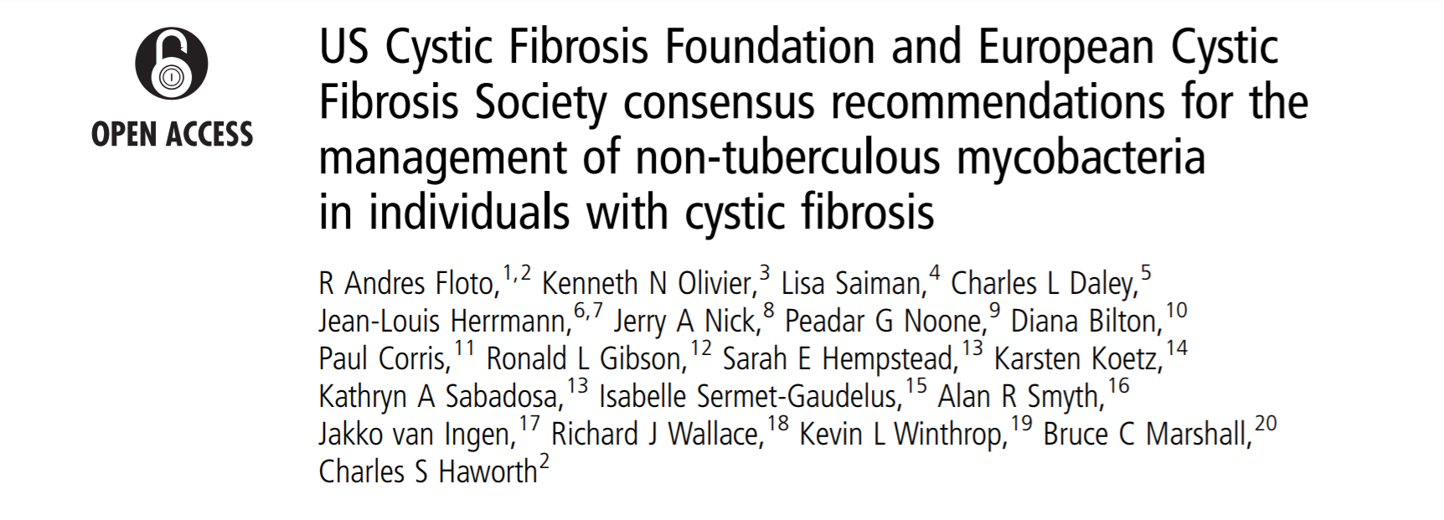
in 2016, CFF/ECFS published consensus recommendations for the management of NTM in CF.

Slide 8
NTM and CF
CFTR dysfunction alone may predispose patients to NTM infection
unknown mechanisms,
rates of CF-carrier status are high (30-50%) within the non-CF pulmonary NTM disease population
Mycobacterium abscessus Complex (MABSC) and Mycobacterium avium Complex (MAC) are now recognized as insidious opportunists that can seriously affect morbidity and mortality in CF.

Slide 9
NTM and CF
CF have the highest prevalence of pulmonary NTM
True rate is unknown ( 6-13%)
Longitudinal data from US : 19 % (2011-2015)
prevalence increas from 10% in children aged 10 years, to over 30% in adults over the age of 40 years
Possible causes:
Impaired mucocilliary clearance
Altered host defense innate in cf lung
Overlap of clinical symptoms with other bacterial CF lung infection

Slide 10
NTM and CF
MABSC :
Three subspecies:M. abscessus subsp. abscessus, M. abscessus subsp. massiliense, and M. abscessus subsp. bolletii.
Younger patients ,
may include children,
relatively more severe lung disease
and more frequent intravenous antimicrobial treatment
MAC :
M. avium, Mycobacterium intracellulare, and Mycobacterium chimaera
is more commonly in older patients,
adult-diagnosed CF patients with a less severe phenotype,
Patients with residual function CFTR mutation
Catherinot E, Roux AL, Vibet MA, et al. J Cyst Fibros. 2013; 12: 74–80.

Slide 11
NTM and CF
NTM disease is associated with worse clinical outcomes
CF patients infected with MABSC have more rapid decline in lung function compared to those uninfected (2.52% / year vs 1.64% / year) Esther et al
In a retrospective study in Colorado: patients with NTM disease, a increased rate in decline in PFT occurs in the year prior to the first isolation of NTM
NTM culture positivity is often a later sign of disease.
Presence of MABSC results in exclusion from lung transplant candidacy if not eradicated

Slide 12
Risk factors
increases in environmental exposure to NTM through more permissive temperature settings of home water heaters
more contact with shower aerosols,
increased antibiotic usage creating more NTM favorable lung niches
greater chronic use of medications that might impair host immunity to NTM,
spread of NTM through person-to-person transmission.

Slide 14
Even with guidance from ATS/IDSA and the CF Foundation and European CF Society (CFF/ECFS) consensus statements,
the diagnostic criteria are still somewhat subjective and variably interpreted by providers.
The CFF has sponsoring the PRospective Evaluation of nontuberculous mycobacterial Disease In CysTic Fibrosis (PREDICT) trial.

Slide 15
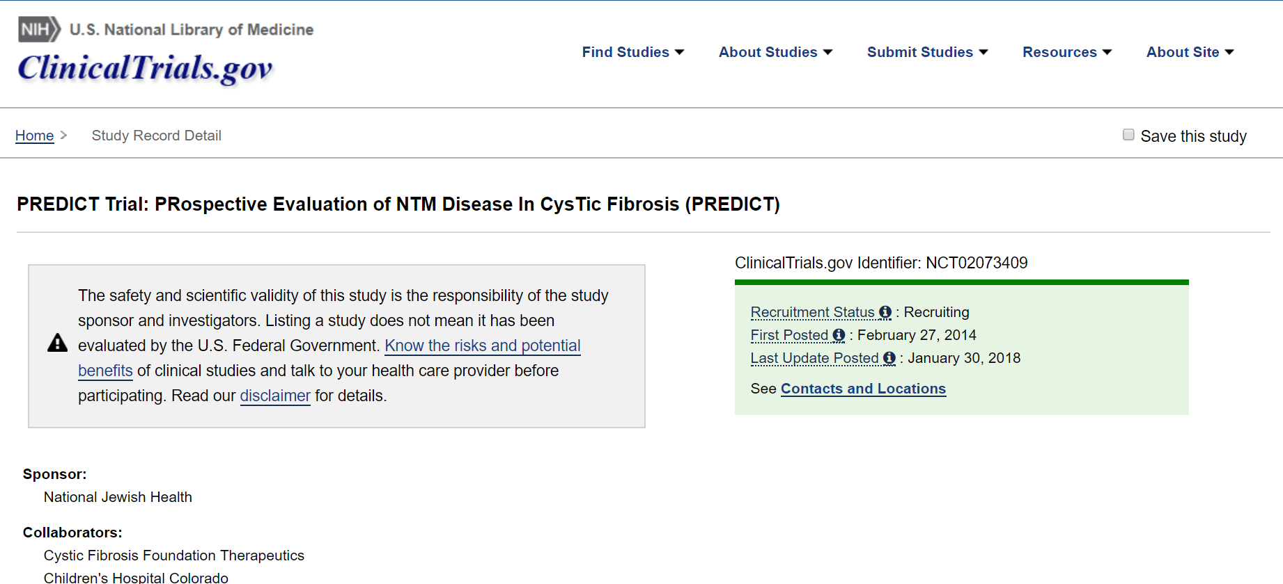

Slide 16
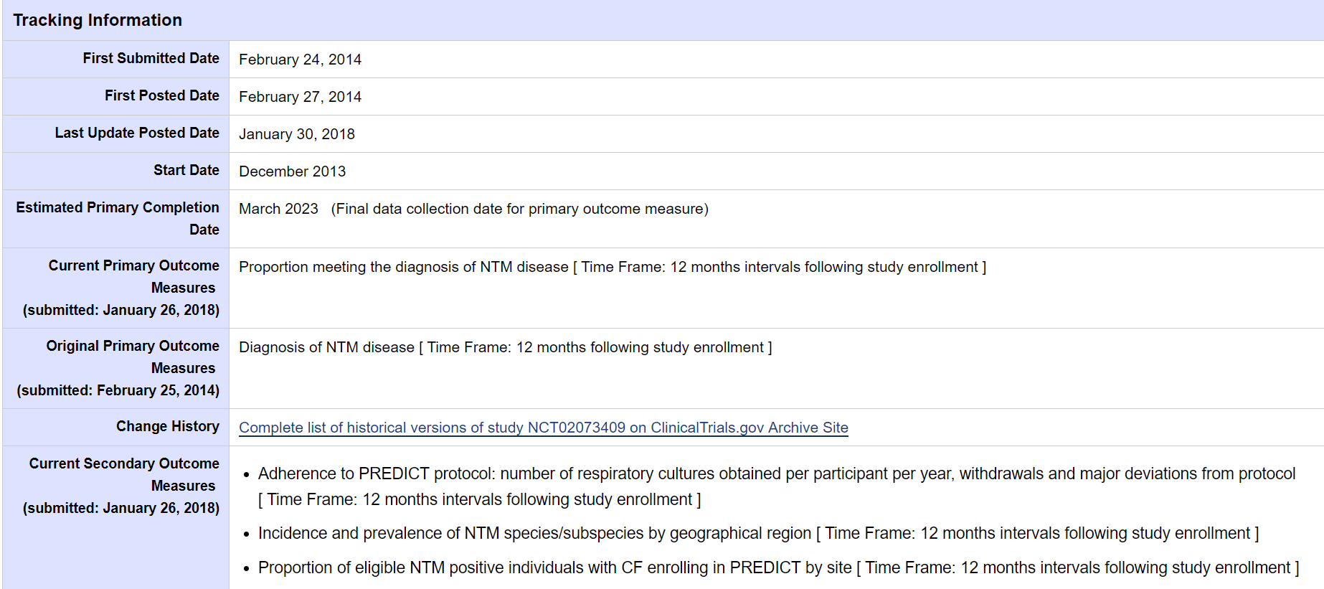

Slide 17
In conclusion
NTM is a pathogen that can worsen the clinical outcomes of CF
the diagnostic criteria are still subjective and variably interpreted
CF patients infected with MABSC have more rapid decline in PFT
(PREDICT) trial will probably improve our understanding and hence care for CF with NTM

Slide 18
Thank you

