Slide 1
Evaluation of Subclinical Atherosclerosis Development in Children with Cystic Fibrosis
Seçil Conkar, Gökçen Kartal Öztürk, Aykut Eşki, İ.Özgür Koska, Figen Gülen, Ahmet Keskinoğlu, Esen Demir
Dr.Gökçen Kartal ÖZTÜRK
Division of Pediatric Pulmonology, Ege University Faculty of Medicine
Notes:
I am gökçen Kartal Öztürk from the division of pediatric pulmonology, Ege university faculty of medicine izmir
I will present you a study “ Evaluation of subclinical atherosclerosis development in children with CF” that we have carried out with the department of pediatric nephrology.

Slide 2
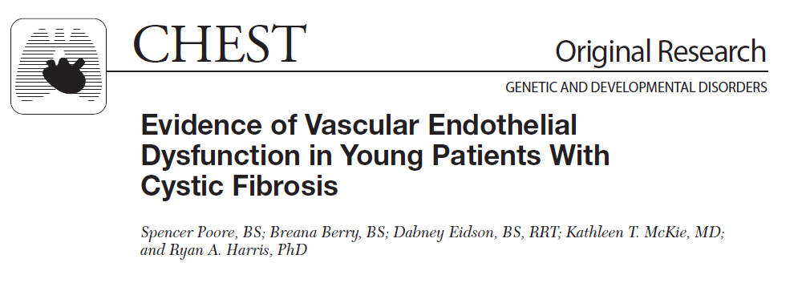
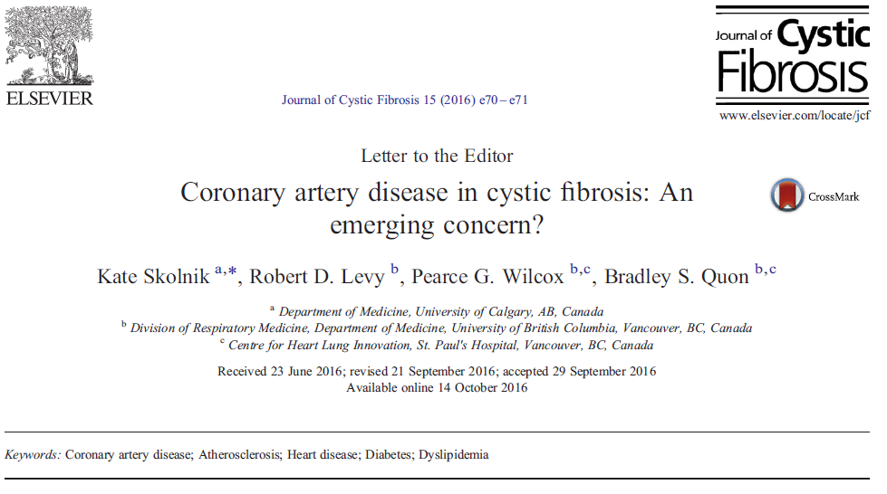
Life expectancy
Extra- pulmonary complications
Notes:
*Good management and new treatment methods prolonged survival time of CF patients
*In recent years, extra-pulmonary complications especially cardiovascular complications are more prevalent.

Slide 3
Notes:
*Cardiovascular complications (especially atherosclerosis) increase the risk of morbidity and mortality in chronic diseases (such as celiac disease, chronic obstructive pulmonary disease, rheumatoid athritis, cystic fibrosis and end-stage renal disease) associated with systemic inflammation.

Slide 4
MIA Syndrome =
Malnutrition
Inflammation
Atherosclerosis
End-stage chronic kidney disease
Increased proinflammatory cytokines
Malnutrition
Chronic inflammation
Atherosclerosis
Increased risk of morbidity and mortality !!!
Notes:
*One of the cardiovascular complications is mia syndrome, which is defined in end-stage renal failure. This syndrome is characterized by malnutrition, chronic inflammation and atherosclerosis due to increased proinflammatory cytokines. Syndrome (especially atherosclerosis) increases the risk of morbidity and mortality in the chronic diseases.

Slide 5
Introduction
CF Atherosclerosis ???
Inflammation
Oxidative stress
High dietary fat
Low HDL
Endothelial dysfunction
Diabetes
Decreased physical activity
Cystic fibrosis (CF)
Chronic inflammation
in lung
+
Malabsorption
+
Malnutrition
Notes:
*Cystic fibrosis (CF) is a disease that causes chronic inflammation in the lungs, malabsorption and malnutrition. *Chronic inflammation, oxidative stress, high dietary fat, low HDL, endothelial dysfunction, CF-associated diabetes, and reduced physical activity are possible risk factors for atherosclerosis in patients. We aimed to evaluate our patients in terms of malnutrition-inflammation and atherosclerosis syndrome.

Slide 6
Materials and Methods
1 January-20 July 2017
Division of Pediatric Pulmonology, Ege University Faculty of Medicine
37 CF patients and 37 healthy controls
Infection
Obesity
Hypertension
Early coronary artery disease in the family
exclusion criteria
Notes:
*This study was conducted at the Division of Pediatric Pulmonology, Ege University Faculty of Medicine between one january and twenty july in two thousand seventeen. There were thirty-seven CF and thirty-seven healty children in the study. Exclusion criteria were active infection, obesity, hypertension, and premature coronary artery disease in the family.

Slide 7
Age, Weight, Height, Body mass index, Weight SDS, Height SDS, Systolic and diastolic blood pressure (Weight SDS <-2 malnutrition, >2 SDS obesity)
Inflammation, Malnutrition, Atherosclerosis markers: Blood count, sedimentation, CRP, procalcitonin, SAA, Fasting blood sugar, insulin, HbA1C, T.protein, albumin, prealbumin, transferrin, ferritin, iron and 25 (OH) vitamin D, Igs, total IgE, specific IgE, T. cholesterol, triglyceride, HDL, LDL and homocysteine
CF Patient : Mutations, Sweat test, Shwachman-Kulczycki Score, Vasoactive drug, Enteral nutrition, Colonization, Pulmonary hypertantion, Radiological scoring
Notes:
* Demographic parameters and markers of inflammation, malnutrition, atherosclerosis were recorded from patients files. Blood pressure of the patient group and the control group were measured under similar conditions.

Slide 8
Atherosclerosis
Carotid intima media thickness(cIMT)
Arterial stiffness:
-Pulse wave velocity (PWV)
-Augmentation index (Aix)
Flow mediated vasodilatation (FMD)
Early marker for atherosclerosis !!!
PWV = Peripheral and central arterial pulse waveform averages from radial and carotid arteries
Aix = The difference between the first and second systolic peaks of the central aortic waveform
Notes:
* Early diagnosis of preclinical atherosclerosis can be made by measurement of carotid artery intima-media thickness (cIMT), flow-mediated vasodilatation and arterial stiffness. We also measured cIMT, pWV and aix for the evaluation of atherosclerosis in our study.

Slide 9
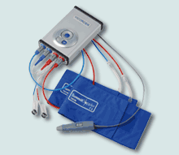
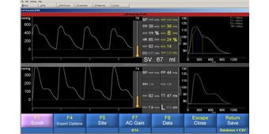
PWV =
Vicorder device
Peripheral and central arterial pulse waveform averages from radial and carotid arteries
Aix =
The difference between the first and second systolic peaks of the central aortic waveform
Vicorder device and pulse wave measurement
Notes:
*Carotid-femoral pulse wave velocity(PWV) and augmentation index(Aix) were measured by vicorder device.

Slide 10
cIMT =
Radiologist
Siemens Acuson Antares device and VFX-7-13 MhZ prob
Random selection 3 measurements from right or left carotid arteries
Three measurement averages
Notes:
*Carotid intima media thickness(cIMT) was measured with ultrasonography by the same radiologist.

Slide 11
 | Patient | Control | p
Age(month) | 138.64 ± 66.75 | 136.27 ± 55.8 | 0.86
Height(cm) | 134.16 ± 25.91 | 130.32 ± 22.44 | 0.49
Weight(kg) | 32.17±18.17 | 35.21±10.48 | 0.01
BMI(kg/m²) | 16.62±3.7 | 18.37±3 | 0.03
SBP(mm/Hg) | 106.67±13.40 | 111.37±15.47 | 0.16
DBP(mm/Hg)* | 68 | 70 | 0.67
Triglycerides(mg/dl)* | 76.5 | 64 | 0.06
Cholesterol(mg/dl)* | 125±26.2 | 112.7±39.4 | 0.12
HDL(mg/dl) | 42.62±10.5 | 41.5±11.65 | 0.69
LDL(mg/dl) | 64±23.5 | 57.9±23.5 | 0.27
SAA(mg/dl)* | 14.8 | 5 | 0.00
CRP(mg/dl) | 0.85±1.4 | 0.66±0.75 | 0.49
ESR* (mm/hour) | 10.5 | 10 | 0,04
PWV(m/sec) | 4.99±0.71 | 4.81±0.5 | 0.2
Aix(%) | 13.05±7.8 | 11.37±18.57 | 0.38
cIMT(mm)* | 0.40 | 0.36 | 0.19
Values ​​are given as mean ± standard deviation. BMI; body mass index, SBP;systolic blood pressure, DBP;diastolic blood pressure, HDL;high density lipoprotei,; LDL;low density lipoprotein, SAA;serum amyloid A, CRP;c-reactive protein, ESR;erythrocyte sedimentation rate, PWV;carotid-femoral pulse wave velocity, Aix;augmentation index, cIMT;carotid intima media thickness.Median values are given.Mann-Whitney U test was applied.
Notes:
*Demographic and laboratory data of patients and healthy controls are shown in Table.

Slide 12
Results
 | N (%)
Cystic Fibrosis Cystic Fibrosis related disease | 33 (% 89.2) 4 (%10.8)
Mutation Homozygous F508del G542X E92K 2183AA>G Heterozygous | 16 (%43.2) 2 (%2.7) 2 (%2.7) 2 (%2.7) 4 (%5.4) 21 (%56.8)
Notes:
*Eighty-nine percent of patients had cystic fibrosis, and ten percent of them had cystic fibrosis-related disease.
* Forthy- three percent of patients had homozygous mutation and fifty-six percent of patients had heterozygous mutations.

Slide 13
Results
p> 0.05
p< 0.05
Age
Height
Systolic and diastolic blood pressure
Lipid profile
C-reactive protein (CRP)
PWV
Aix
cIMT
Weight [p=0.01]
Body mass index (BMI) [p=0.03]
Serum amyloid a (SAA) [p=0.00]
Erythrocyte sedimentation rate (ESR) [p=0.04]
Notes:
*The patient and control group were similar in terms of age, height, systolic and diastolic blood pressures, lipid profile and c-reactive protein(CRP).
PWV, Aix and cIMT values were not different between groups.
Body weight, body mass index were lower and serum amyloid A, erythrocyte sedimentation rate were higher in CF group.

Slide 14
Malnutrition (n:9) PWV = positive corelation (p 0.03/r 0.35)
C-reactive protein PWV= positive correlation (p 0.01/r 0.39)
Control group = correlation Ø
Serum amyloid A PWV = positive correlation (p 0.01/r 0.4)
Control group = correlation Ø
Weight SDS, SKS, FEV1 PWV = negative correlation (p<0.05/r>-0.4)
Brasfield score PWV = negative correlation (p 0.03/r -0.3)
Brody score PWV = positive correlation (p 0.02/r 0.4)
Notes:
*In the CF group, there was a significant negative correlation between PWV and body weight SDS, Shwachman-Kulczycki Scores(SKS), FEV1 values.
Poor positive correlation was observed between PWV values ​​and presence of malnutrition in patients.
There was positive correlation between PWV and C-reactive protein and SAA values ​ in the CF group but no correlation in the control group
PWV was negatively correlated with Brasfield score and positively correlated with Brody score.

Slide 15
 | PWV(m/sec) |  | AIx(%) |  | cIMT(mm)
 | r* | p | r | p | r | p
Patient group Body weight, SDS BMİ Malnutrition Systolic BP Diastolic BP CRP ESR SAA Cholesterol Triglycerides LDL HDL HbA1c SKS Spirometry(FEV1<%60) FEV 1 Colonization | -0.44 -0.19 0.35 0.15 0.11 0.39 0.2 0.4 -0.26 -0.16 -0.17 -0.1 0.2 -0.45 -0.57 -0.61 0.1 | 0.00 0.24 0.03 0.3 0.5 0.01 0.2 0.01 0.1 0.3 0.2 0.4 0.1 0.00 0.01 0.00 0.5 | -0.29 0.23 -0.20 -0.24 0.01 -0.14 -0.16 -0.22 0.2 -0.1 0.3 -0.02 0.2 0.2 -0.3 -0.0 -0.3 | 0.09 0.16 0.1 0.14 0.9 0.4 0.3 0.2 0.1 0.49 0.05 0.8 0.08 0.09 0.1 0.9 0.4 | 0.16 0.22 0.1 0.24 -0.02 -0.13 -0.05 0.05 -0.14 -0.03 -0.05 -0.13 -0.1 0.06 -0.3 -0.1 0.1 | 0.34 0.18 0.55 0.15 0.8 0.4 0.7 0.7 0.3 0.8 0.6 0.4 0.5 0.7 0.1 0.4 0.4
Control group BMI Systolic BP Diastolic BP CRP ESR SAA Cholesterol Triglycerides LDL HDL | -0.03 0.04 0.11 -0.18 -0.18 -0.03 -0.07 0.06 -0.1 -0.05 | 0.8 0.7 0.5 0.2 0.2 0.8 0.6 0.7 0.2 0.7 | 0.3 -0.06 0.01 -0.22 -0.32 -0.15 0.03 -0.04 0.01 0.02 | 0.06 0.7 0.9 0.1 0.06 0.3 0.8 0.8 0.9 0.9 | -0.04 -0.1 -0.02 -0.06 0.09 0.08 -0.05 0.3 0.04 0.01 | 0.7 0.2 0.8 0.7 0.5 0.6 0.7 0.06 0.7 0.9
SDS; standart deviation score, BMI; body mass index, SBP;systolic blood pressure, DBP;diastolic blood pressure, CRP;c-reactive protein ESR;erythrocyte sedimentation rate, SAA; serum amyloid A, LDL;low density lipoprotein, HDL;high density lipoprotein, HbA1c; hemoglobin a1c, SKS;Shwachman-Kulczyci Score, FEV1; forced expiratory volume, PWV;carotid-femoral pulse wave velocity, Aix;augmentation index, cIMT;carotid intima media thickness. *Pearson correlation coefficient
Notes:
*There was no significant difference in any of the control group.

Slide 16
Prolonged life
50 Cystic fibrosis -26 healthy control
Systemic inflammation and oxidative stress
Endothelial dysfunction
Increased risk of cardiovascular disease
50 Cystic fibrosis - 15 healthy control
Brachial artery flow mediated dilatation (FMD)
FMD low (x control group)
Vascular dysfunction (+)
Augmentation index (Aix) ve Pulse wave velocity (PWV)
Increased Aix, similar PWV
Notes:
it has been found that systemic inflammation and oxidative stress cause endothelial dysfunction in cystic fibrosis leading to an increased risk of cardiovascular disease
In a study conducted by Poore, with fifty cystic fibrosis patients and fifteen healthy controls, flow- mediated vasodilatation was measured and found to be low in cystic fibrosis patients.
In another study contucted by Hull, with fifty cystic fibrosis patients and twenty-six healthy controls, aix and pwv were measured. Aix was found to be higher in CF group and pwv was found to be similar.

Slide 17
Conclusion
In our cystic fibrosis patients
Chronic inflammation
Impairment in clinical condition
Malnutrition
the early finding for
endothelial damage and
impaired vascular function
İncreased PWV
Patients with CF should be evaluated and followed for atherosclerosis from early ages
Notes:
A marked increase in PWV in CF patients with chronic inflammation, impairment in clinical/radiological condition, and the presence of malnutrition, may be the early finding for endothelial damage and impaired vascular function. Patients with CF should be evaluated and followed for atherosclerosis from early ages.

Slide 18
Teşekkürler…
Notes:
Thank you for your attandence

