Slide 1
A Survey of CF care in Middle East
Nisreen Rumman
Pediatric Pulmonologist
Palestine
Hussein Al-Kindi
Pediatric Pulmonologist
Oman

Slide 2
In North America
CFF established in 1955
At that time CF patients died early
Great strides …. Median survival age now is about 48 yrs??????
Half of CF patients are now adults
www.cff.org
Notes:
Double check 48 years??

Slide 3
CF Foundation
www.cff.org

Slide 4
In Europe
ECFS established in 1969
International community … one goal
Great strides in improving CF care
Great achievements

Slide 5
European CF Society
www.ecfs.eu

Slide 6
In the Middle East
There was no society for CF before MECFA
Different political, cultural and social background
Zones of conflict and wars
Huge diversity in resources
Notes:
The Middle East has a unique situation in that there are different political, cultural and social background in each country. In addition there are many zones of conflict and wars, and subsequently huge diversity in resources.

Slide 7
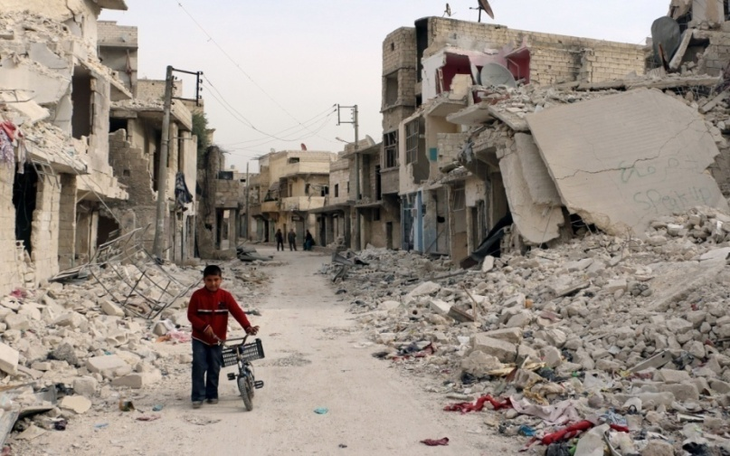
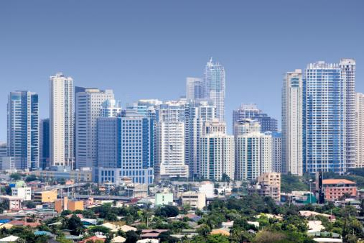
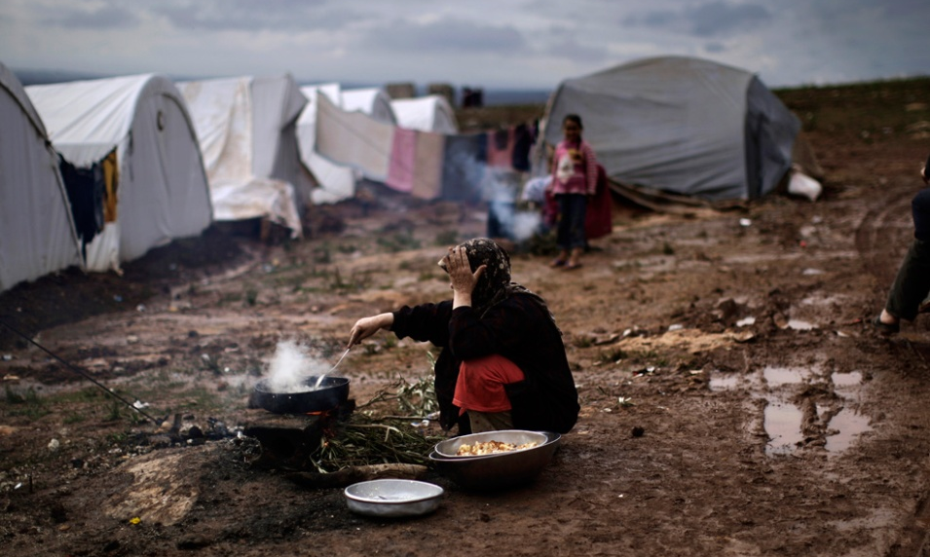
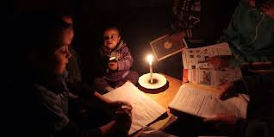
Notes:
In the Middle East, there are countries with high rises and countries where there is only destruction
Countries with nice homes and apartments and countries with no homes but refugees in tents
Countries where lights are never turned off and countries where there is no electricity

Slide 8
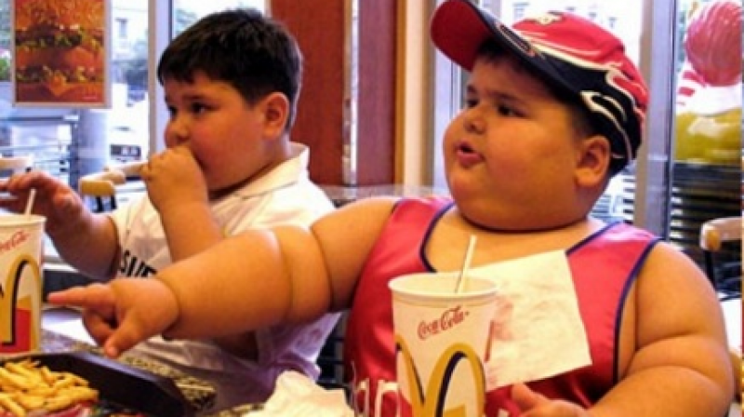
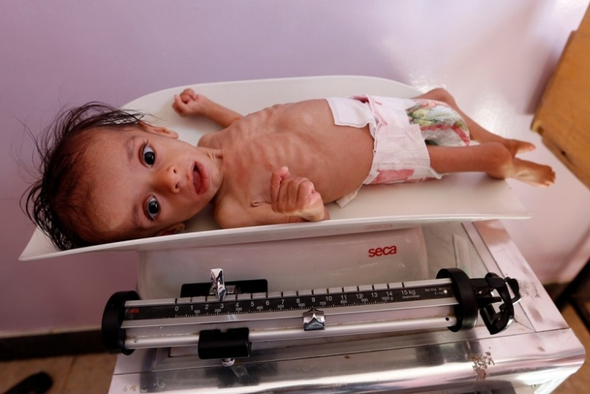
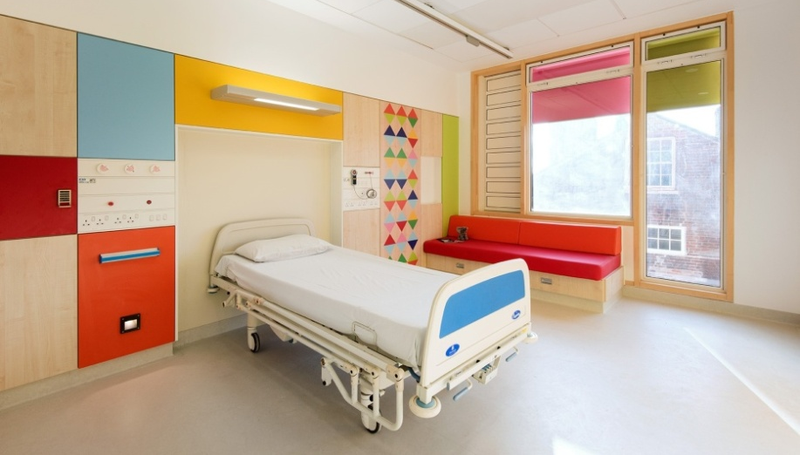
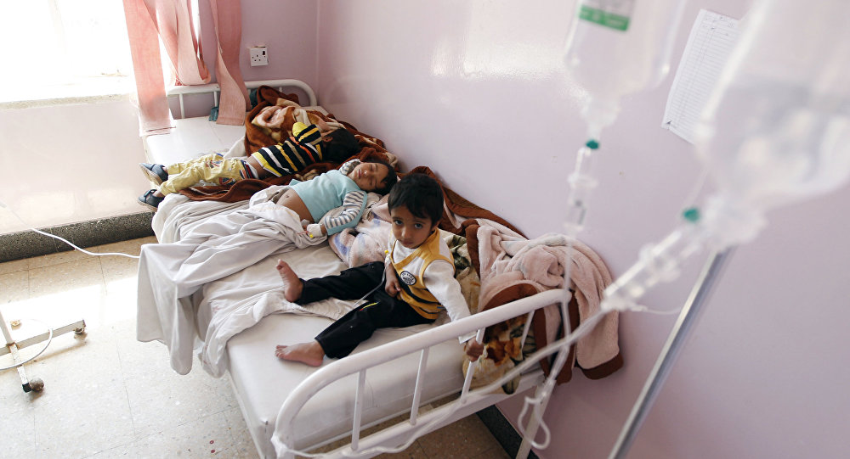
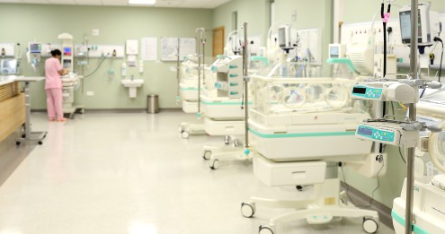
Notes:
Countries where children are obese and countries where children die of malnutrition
Countries with nice well equipped hospitals and countries where children share a bed in the hospital ward
Countries with nice fancy ICUs and countries where newborns share the oxygen supply

Slide 9
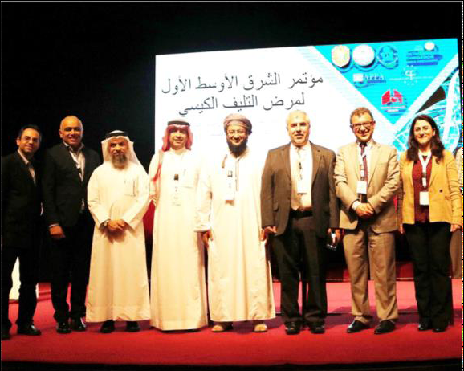
MECFA
Established in 2016
BIG challenges
BIG dreams
Notes:
So in the midst of this diversity MECFA was established.
We at MECFA know that we have big challenges ahead of us but we also have big dreams

Slide 10
MECFA
Notes:
This is probably the current situation in the Middle East

Slide 11
MECFA
Notes:
But this is where we want to be … hopefully in the near future

Slide 12
Many questions ???
What to do?
Where to start?
What are our priorities?
Are these priorities the same for each country?
What are the needs in each country?
Work in the same way in all countries?
Survey
Notes:
So we at MECFA had many questions:
????
Therefore we decided to run a survey

Slide 13
MECFA survey …
Aim:
Mapping of CF care … know what’s out there
MECFA to know what to do… where
Notes:
The aim of the survey was to map the care of CF care across the Middle East and know what’s available in each country so MECFA can decide how to help in each country because of the big differences in the needs.

Slide 14
MECFA survey …
Culture barrier : people do not want to share their data
We do not know all the CF doctors in the region
Not all doctors know MECFA
We had incomplete data ,missing important centers
? Reliable

Slide 15
Demographics
Name of hospital/center
Country
City
Number of total CF patients
Females/males
Number of peds < 18
Number of adults > 18
MECFA wants to know
* Places that provide CF care
* Number of CF patients in ME

Slide 16
Name of hospital/center
Country | Number of centers | Number of cities
Egypt | 2 | 2
Iraq | 1 | 1
Iran | 3 | 3
Jordan | 1 | 1
Kosovo | 2 | 1
Kyrgyzstan | 1 | 1
Lebanon | 1 | 1
Oman | 1 | 1
Palestine | 4 | 2
Saudi Arabia | 1 | 1
Turkey | 7 | 5
Total | 24 | 19

Slide 17
Demographics
24 cf centers
Total number of patients :2010 ,F:847 ,M :1163
<18 y : 1790
>18 y: 220

Slide 18
Available services
NBS : 6/24 (25%)
How do you make CF diagnosis?
Clinical only : 1
Clinical/sweat: 9 (37.5%)
Clinical/sweat/genetics: 14 (58%)
Sweat test method?
Conductivity : 20
Chloridometer :10
Sweat collection?
Gibson Cooke : 12
macroduct system : 14

Slide 19
Available services
Do you have a “CF center”? Officially recognized by authorities?

Slide 20
Available personnel
Ped pulmonologist
Adult pulmonologist
GP with CF experience
Ped GI
Adult GI
Ped endocrinologist
Adult endocrinologist
ENT specialist
ID specialist
Respiratory therapist
PFT tech
Dietitian
Psychologist
Social worker
Specialized CF nurse
Microbiologist
Radiologist
Geneticist
Pediatric surgeons

Slide 21
Available Personnel

Slide 22
Available tests
Complete blood count
Kidney function test
Liver function test
Serum electrolytes
Glucose
HbA1c
Sputum bacterial cultures
Sputum viral cultures
Sputum mycobacterial cultures
Acid fast staining
Flexible bronchoscopy
Bronchoalveolar lavage (BAL)
Vit A level
Vit D level
Vit E level
Vit K level?
Chest X-ray
Sinus CT scan
Chest CT scan
IgE
Aspergillus Abs
Stool elastase
Stool fat collection
Genetic testing for CF – limited panel ?
Genetic testing for CF- extended panel ?
Pulmonary function testing:
Spirometry
Lung volumes
Diffusion capacity
Lung clearance index (LCI)
Bone scan

Slide 23
Available tests

Slide 24
Quality of care
How often do your patients come to clinic visits?
How often do you perform sputum cultures?
How often do you perform PFTs?
What methods do you use for ACT?
Adult patients treated by peds?
Do you have a local registry/database?
Regular CF team meetings?

Slide 25
Quality of care
Time /month | Clinic visit | Sputum culture | PFT
1-3 m | 70.2% | 37.5% | 29.2%
3-6 m | 25 % | 58% | 37.5%
6-12 m | 4.2% | 4 % | 20.8%
>12 m | 0 | 0 | 12.5%

Slide 26
Quality of care
What methods do you use for ACT?

Slide 28
Available medications
Mucolytics
Inhaled antibiotics
Oral antibiotics
IV antibiotics
Antifungals
Pancreatic enzymes
Vitamins
New CF drugs

Slide 29
Available medications

Slide 30
Available medications

Slide 31
Management – other
How do you treat first Pseudomonas acquisition?
When CF patient are admitted, do they share a room?
Do you provide home care services?
Do you have access to lung transplantation?
Does your center conduct patient/family events?
Do you have a clear policy for infection control practices during these events?
Have you had any deaths in your CF patients in the last 5 years?

Slide 32
Management – other

Slide 34
Research
Has your center published any articles related to CF?
Is your center involved in international research projects?

Slide 35
Research

Slide 36
Financial coverage / insurance
Who covers the costs - clinic visits?
Who covers the costs - hospital admission?
Where do CF patients get their
medications from?

Slide 37
Financial coverage – insurance

Slide 38
MECFA survey …
It seems survey is not the best way to get reliable data
We should go for a proper registry to have accurate and reliable data that can be used to improve CF care in our region

Slide 39
MECFA era
It is the time to change the face of CF in the Middle East……
We need to make a difference

Slide 40
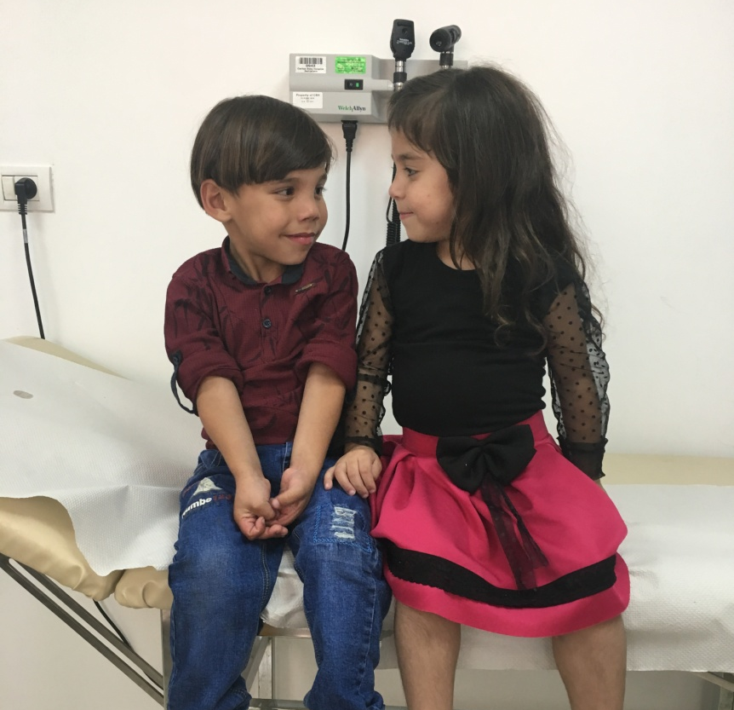
It’s about making a difference in the lives of CF patients

Slide 41
It’s about making a difference

Slide 42
It’s about making a difference

Slide 43
Thank you
CF patients and their families
Dr Pavel Drevinek (Prague, director of European standards of care project)
Notes:
Dr Pavel Drevinek provided us with the survey done in Eastern Europe and we used some of the questions in our survey with his permission

