Slide 1
Con: Staphylococcus Prophylaxis is NOT required in CF
Prof. Dr. Bülent Karadağ,
Marmara University
Division of Pediatric Pulmonology

Slide 4
Prevalence of infections according to age in CF
100
P. aeruginosa
80
60
%
S. aureus
40
H. influenza
20
MRSA
S. maltophilia
B. cepacia
0
0 - 1
2 - 5
6 - 10
11 - 17
18 - 24
25 - 34
35 - 44
>45
Age (yrs)
Cystic Fibrosis Foundation Patient Registry Data. 2005

Slide 5
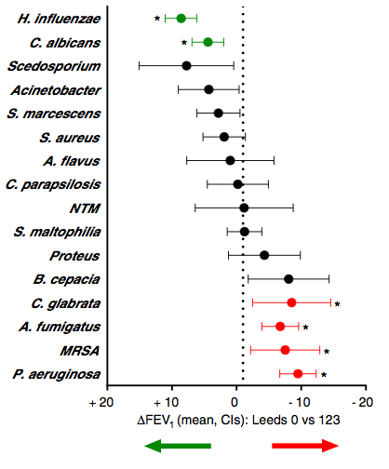
Good and bad bugs
H. influenzae (Hauser AR 2011, Hector A 2016)
S. Aureus (Hauser AR 2011, Hector A 2016)
S. marscenses (Hauser AR 2011, Hector A 2016)

Slide 6
1. Is there any clinical benefit from antistaphylococcal treatment? 2. Does prophylactic antistaphylocccal treatment increase the frequency of P.aeruginosa infection?

Slide 9
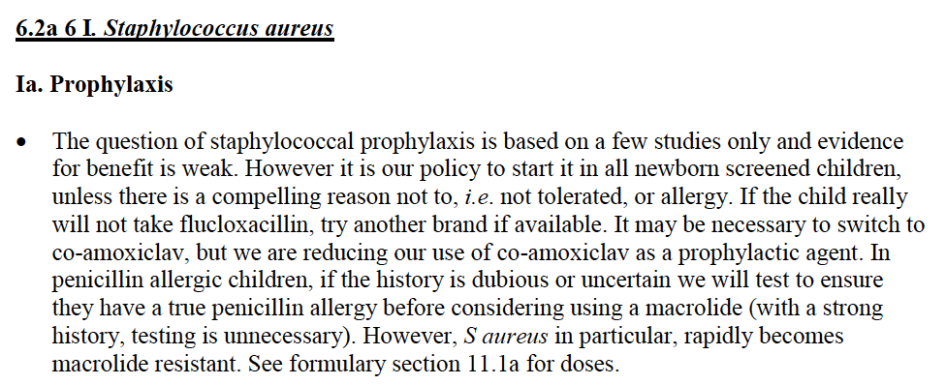

Slide 10
2) Do the British Mean What They Say?
Not necessarily. The British are world experts at understating everything. Be aware that politeness and a sense of informality can be deceptive and that the British rarely talk straight.
A: “Option one might be worth considering.”
What they really mean: I recommend you choose option one B: “Yes, no, it’s certainly an interesting option and one that is definitely worth considering in the longer term and we should absolutely not take it off the table”.
What they really mean: No

Slide 15
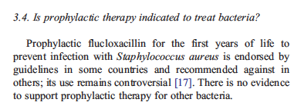

Slide 21
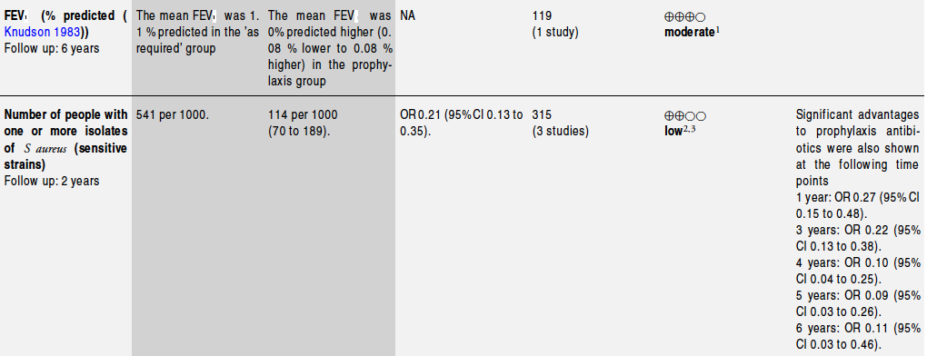

Slide 22
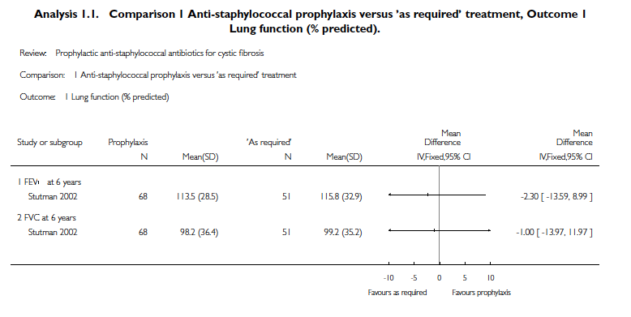

Slide 23
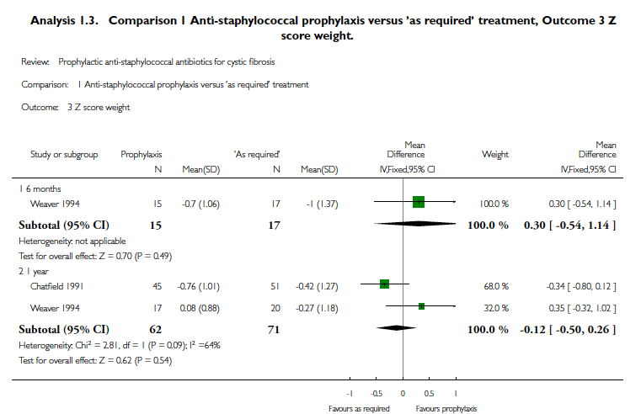
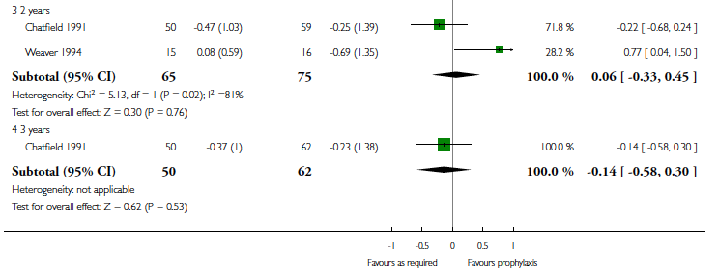

Slide 24
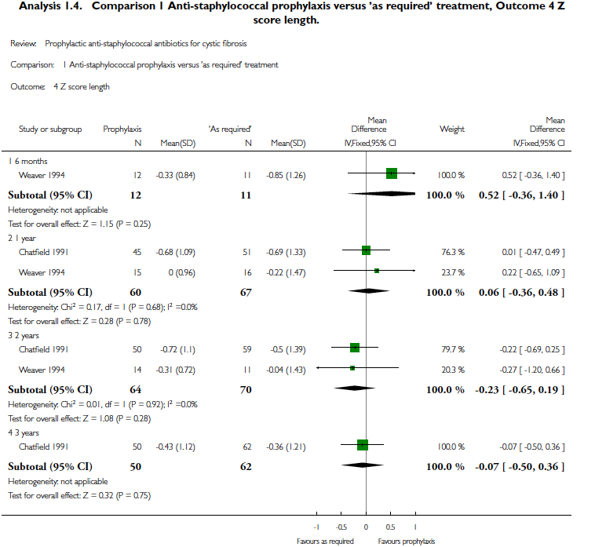

Slide 25
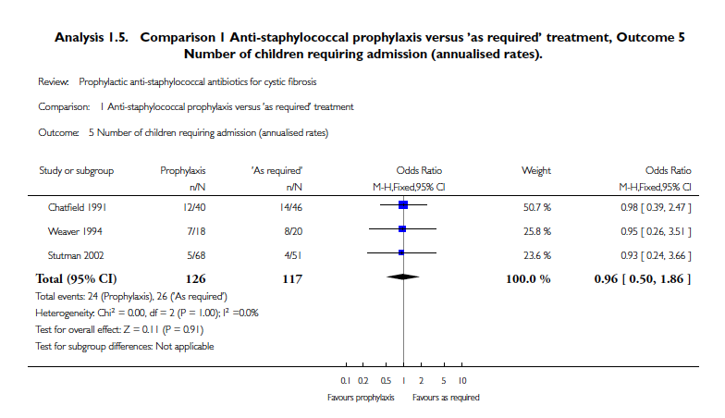

Slide 26
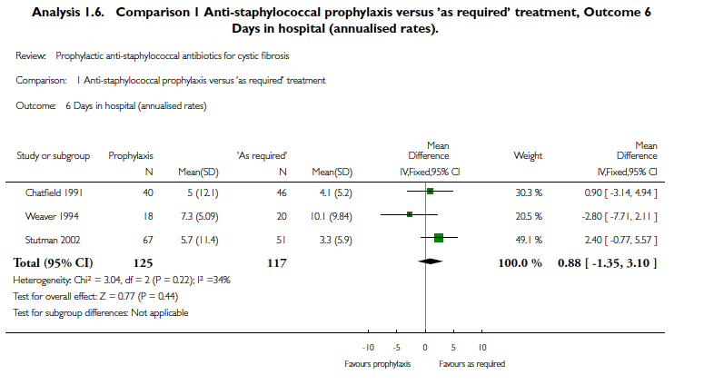

Slide 27
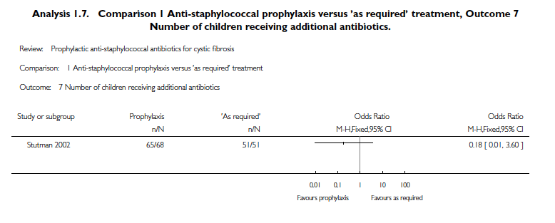

Slide 29
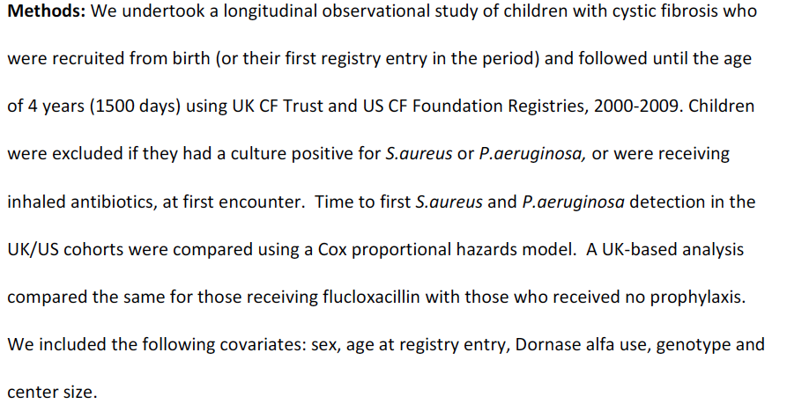

Slide 32
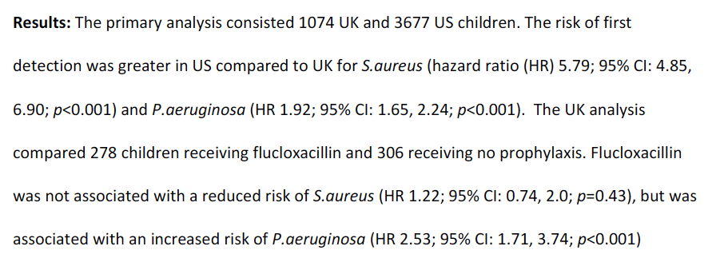

Slide 33
