Slide 1
TRANSITON OF CF PATIENTS INTO ADULTHOOD
Yazan Said, ABP, ABAI
JORDAN
Consultant, Allergy/Immunology and Pediatric Pulmonology
King Fahad Specialist Hospital-Dammam, Saudi Arabia

Slide 2
Childhood chronic diseases Survival
Diagnosis | Survival Info.
Childhood Cancers | 46% of survivors are 20-40 y.o. 18% of survivors are > 40 y.o.
Cystic Fibrosis | Median survial 37 y.o. 50% are > 18 y.o.
Congenital Heart Disease | 85% reach adulthood Over 1,000,000 living with CHD
Down Syndrome | 55-year life expectancy
Hemophilia | 60- year life expectancy
Sickle Cell Disease | 66- year life expectancy
Spina Bifida | > 80% reach adulthood

Slide 4
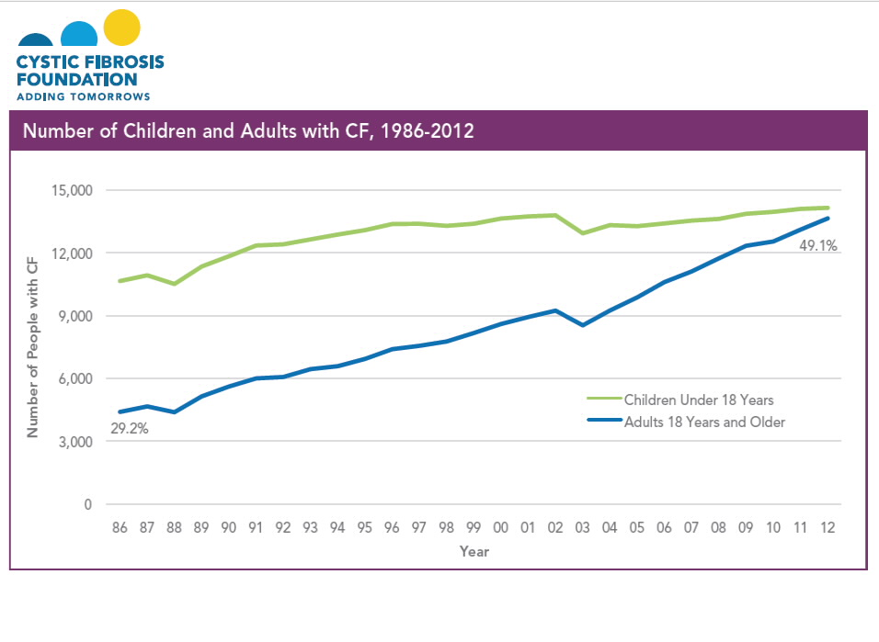

Slide 6
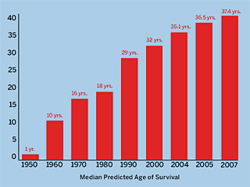
Survival increased over the past 25 years
Diagnosis
Nutrition
Physiotherapy/exercise
Gene discovery
Transplant
Pharmaceutical

Slide 7
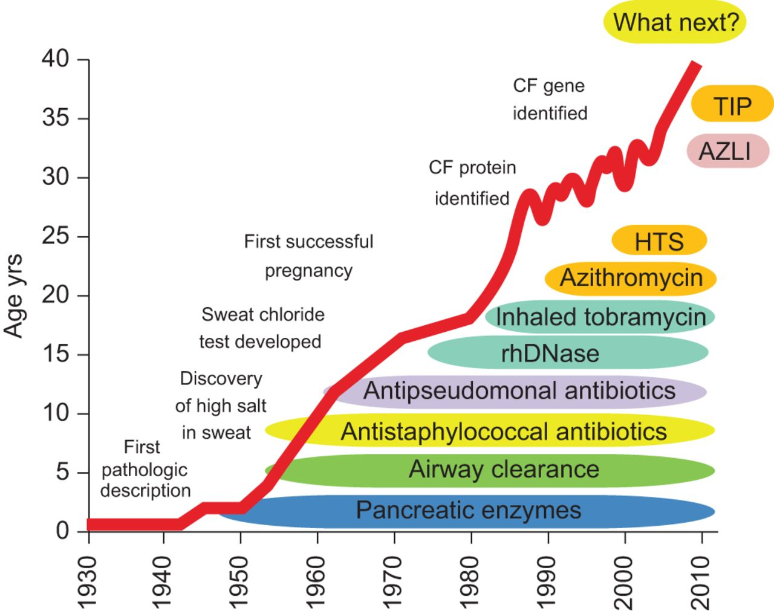
CF Milestones

Slide 8
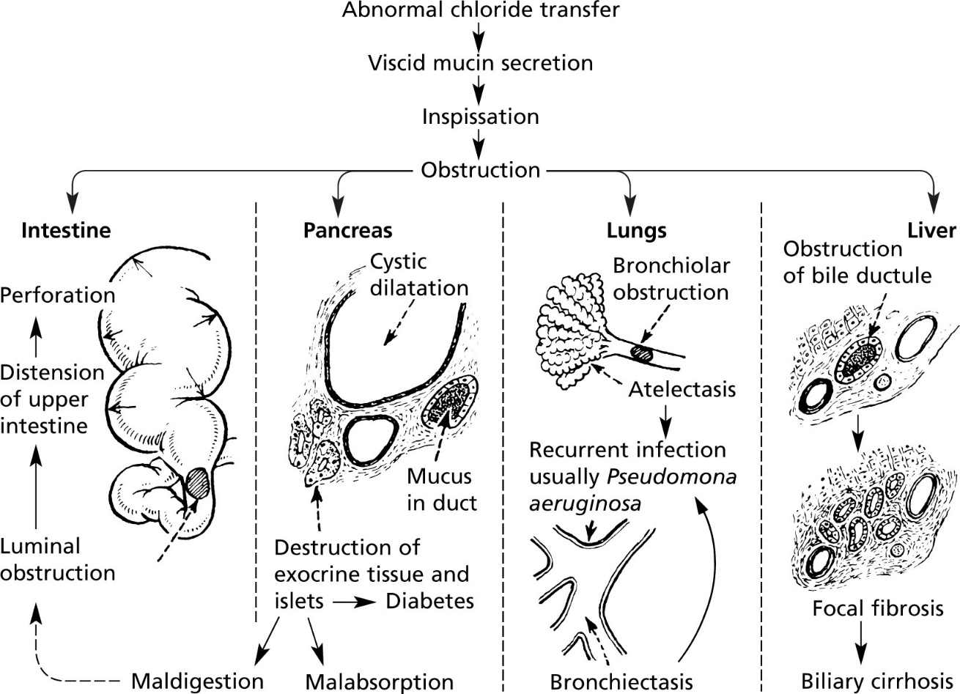
Multisystemic Manifestations and Complications
Diabetes
Osteoporosis
Infertility (male)
Psychosocial
Others

Slide 11
As the health of children/adolescents with CF continues to improve, the emphasis in pediatric care is prevention of disease progression.
The dramatic increase in CF survival has strained adult services attempts to keep pace with the increased adult patient numbers.
The morbidity and most of the mortality associated with CF have shifted to adulthood
The need for age-appropriate CF health care and adult-oriented CF services is now well-accepted, though not yet universally practiced.

Slide 12
Transition Definition
“The purposeful, planned and timely transition from child and family-centered pediatric health care to patient-centered adult-oriented health care.”
Transition from child-centered to adult health-care systems for adolescents with chronic conditions.
A position paper of the Society for Adolescent Medicine. 1993
Society for Adolescent Medicine, 1993
Notes:
Transition – the “purposeful planned movement…from child-centered to adult-oriented health-care systems” (1) – is an important process for any patient with a chronic illness.

Slide 13
Survey of American CF transition
Transfer of care occurred at a median age of 19 years of age (ranged from 14-30 years).
Many centres allowed patients to delay or decline transition, and the initial discussion regarding transition occurred at the relatively late median age of 17 years.
<10% of CF centres had written list of desirable self-management skills, and only one-half consistently performed a readiness assessment.
Improving transition from pediatric to adult cystic fibrosis care: lessons from a national survey of current practices.McLaughlin SE, et al . Pediatrics. 2008 May; 121(5):e1160-6.
Notes:
A comprehensive survey of American CF transition practices has recently been completed (15), and found that although the mandate for transition services was strongly supported by CF centres, there was significant variability in the transition support provided to patients. Transfer of care occurred at a median age of 19 years of age, but ranged from 14 to 30 years of age. Many centres allowed patients to delay or decline transition, and the initial discussion regarding transition occurred at the relatively late median age of 17 years. Less than 10% of centres had a written list of desirable self-management skills, and only one-half consistently performed a readiness assessment, which itself lacked comprehensiveness according to the authors.
Improving transition from pediatric to adult cystic fibrosis care: lessons from a national survey of current practices.McLaughlin SE, Diener-West M, Indurkhya A, Rubin H, Heckmann R, Boyle MP
Pediatrics. 2008 May; 121(5):e1160-6.

Slide 14
Why Transition is Important
Failure to recognize and plan transition may result in patients dropping out of care
Poor transition processes are recognized to have a significant negative effect on morbidity and mortality in young adults with chronic health needs

Slide 15
Consensus Statement on Health Care Transition for Young Adults With Special Health Care Needs
Goal of Transition:
Maximize lifelong functioning and potential through the provision of high-quality, developmentally appropriate health care services that continue uninterrupted as the individual moves from adolescence to adulthood
American Academy of Pediatrics
American Academy of Family Physicians
American College of Physicians
American Society of Internal Medicine

Slide 16
Patient Challenges
Many transitions at once:
Graduate HS, move away, new job
New relationships, new opinions
Focus on independence

Slide 17
Family Challenges
Close ties with pediatric caregivers
Considered an adult at 14-18 y.o. → privacy issues
Lack of confidence in:
Young adult’s ability to adequately provide self-care
Adult medical team

Slide 18
Pediatric Care Team Challenges
Tight bond with patient and family
Limited contact with adult providers and services
Lack of trust in adult healthcare system/providers
Lack of training on how or when to start transition

Slide 19
Institutional & System Challenges
Aging out of treatment
Insurance coverage/Poor reimbursement for transition services
Discontinued from parents’ health insurance
Change in eligibility requirements

Slide 20
Internists’ Transition Concerns
Patient’s maturity
Systems issues
Patient’s psychosocial needs
Family involvement
My medical Competency
Transition coordination

Slide 21
Elements of Health Care Transition
Clinic Policies
Registry
Preparation
Planning
Transfer of care
Transition Completion

Slide 22
1. Clinic Policies
Pediatrics:
When will the transition process begin?
When is the transfer expected to happen?
Adult Medicine:
What age will the clinic start seeing patient?
Outline of what to expect

Slide 23
2.Registry
Pediatrics:
Identify transition-age youth
Start by 12-14 y.o.
Adult Medicine:
Identify young adults by level of complexity
Monitor health care needs

Slide 24
3. Preparation – Pediatric Team
Prepare patients/family for success in adult care system :
Visits without parents
Discuss illness, meds, troubleshooting
Self-management skills
Assess Readiness:
Transition Readiness Assessment Questionnaire (TRAQ):
Identifies areas for more education

Slide 25
4. Planning – Pediatric Team
Health Care Transition Action Plan:
Checklist of goals/expectations prior to transfer
Health Summary:
Chronological account of patient’s past and current medical problems
Emergency Plan:
Actions to be taken during urgent/emergent events

Slide 26
4. Planning – Adult Team
“Get acquainted” visit
Up to one year before transfer
Continue to use and update:
Action Plan
Medical summary
Emergency care plan

Slide 27
5. Transfer of Care – What age?
For most, between 18-21 yrs
Factors to consider:
Is the patient medically stable?
Is the illness terminal?
Has transition readiness been assessed?
What skills are still needed to make a successful transition?

Slide 28
5. Transfer of Care
Pediatrics:
Direct communication with adult PCP and team
Transition package:
Transfer letter
Health summary
Adult Medicine:
Review history and talk to referring physician
Introduce patient to clinic

Slide 29
6. Transition Completion
Pediatric PCP and team remains a resource for adult PCP/team

Slide 30
Summary
In KSA/ME– a geographically, socially and culturally diverse populations
It has not been reported how, and when, CF transition care is practiced in individual pediatric CF clinics
Preparing for a successful transfer of care from pediatric to adult-oriented health care settings is a complex and demanding process.
Small steps over time will make a difference with the ultimate goal of strong CF transition care being common practice in the near future.

Slide 31
THANK YOU
“ Optimal health care is achieved when every person at every age receives health care that is medically and developmentally appropriate.”

