Slide 1
MARMARA UNIVERSITY DIVISION OF PEDIATRIC PULMONOLOGY
RELATION OF SERUM IGF-1 AND IGFBP-3 LEVELS WITH ACUTE EXACERBATION IN CYSTIC FIBROSIS
P. Ergenekon, F. Eser, E. Atag, N. Bas Ikizoglu, E. Erdem Eralp, Y. Gokdemir, S. Turan, A. Bereket,B. Karadag
Notes:
First I would like to thank to the organizing comitee, for their kind invitation.

Slide 2
INTRODUCTION
Cystic fibrosis (CF) is a progressive multi organ disease.
Progressive pulmonary disease is the most important reason for mortality and morbidity.
Besides the clinical analysis, there is an intense research on biomarkers that can help the diagnosis, treatment and tracing of acute pulmonary exacerbation (PE).

Slide 3
INTRODUCTION
Insulin-like growth factor-1 (IGF-1) and insulin-like growth factor-binding protein 3 (IGFBP-3) are decreased in CF which is associated with impaired growth and inflammation.
Treatment-related changes in IGF-1 and IGFBP-3 have been investigated during acute PE.
IGF-1 and IGFBP-3 levels increase significantly after intravenous antibiotics and enteral nutritional support

Slide 4
AIM
To determine the serum levels of IGF-1 and IGFBP-3 in patients with CF
To assess the variations in these hormone levels during PE
To assess their relationship with pulmonary function tests (PFT)
Notes:
OUR AİM İS,

Slide 5
MATERIALS AND METHODS
Study Period: January 2016-June 2017
Study Protocol:
37 patients with CF
0-18 years
Followed by Marmara University Division of Pediatric Pulmonology
Hospitalized due to acute PE and given IV antibiotics
37 healthy control subjects of similar age
Notes:
Our study period was from january twenty sixteen to june twenty seventeen.37 pediatric patients were included to the study followed by our division.

Slide 6
MATERIALS AND METHODS
For CF patients; blood samples were taken in 4 periods to check serum IGF-1 and IGFBP-3
Baseline
First day of the PE treatment
End of the PE treatment
1 month after the end of the treatment (n:16)
Notes:
Baseline blood was drawn when patient does not have pulmonary exacerbation symptoms and second blood was drawn at the first day of treatment thirt at the end of the treatment and last blood sample was drawn 1 month after treatment
there is no symptom and symptoms of exacerbation has occured in the near term
Blood samples were obtained from 16 patients during this period, 1 ay içinde akut alevlenme geçirmeleri yüzünden

Slide 7
MATERIALS AND METHODS
Age at the time of PE
Age at CF diagnosis
PFT
Age by height Z score
Age by weight Z score
Pancreatic insufficiency
Diabetes mellitus
P. aeruginosa and MRSA colonization were also recorded.
Notes:
Demographic variables were recorded

Slide 8
RESULTS

Slide 9
Table-1: Demographic Charasteristics of Our Patients (n=37)
Age (month) (mean$±SD$) | 96,95 $±$ 62,56
Age at diagnosis (month) median (IQR) | 3 (5)
Age by height Z score (mean$±SD)$ | -0,88$±$ 0,93
Age by weight Z score (mean$±SD)$ | -0,96 $±$ 1,35
Age by BMI Z score (mean$±SD)$ | -0,71 $±$ 1,47
Pancreatic Insufficiency n (%) | 31 (83,8)
Diabetes Mellitus n (%) | 2 (5,4)
P.Aeroginosa colonization n (%) | 18 (48,6)
MRSA colonization n (%) | 5 (13,5)
FEV₁ % predicted (Mean±SD) | 78,7 ± 21,98
Notes:
Here are the demographic characteristics of our patients. The mean age was 97 months. 83 percent of the patients have pancreatin ınsuf. 5 percent has d.m. Nearly 50 percent of patients colonised with P.A. Mean fev1 of the patients were 79 percent predicted.

Slide 10
Table-2: IGF-1 and IGFBP-3 Levels According to Different Periods
 | Baseline | First Day of PE Treatment | Last Day of PE Treatment | P value
IGF-1 (ng/ml) Mean±SD | 128,28 ± 89,54 | 98,91 ± 76,16 | 139 ± 87,52 | <0.001
IGFBP-3 (µg/ml) Mean±SD | 3,49 ± 1,37 | 2,93 ± 1,51 | 3,90 ± 1,52 | <0.001
Notes:
The ıgf 1and ıgfbp-3 levels of the patients were found significantly lower than the baseline level. And also their levels that were taken last day of the treatment were significantly higher then the first day of the treatment

Slide 11
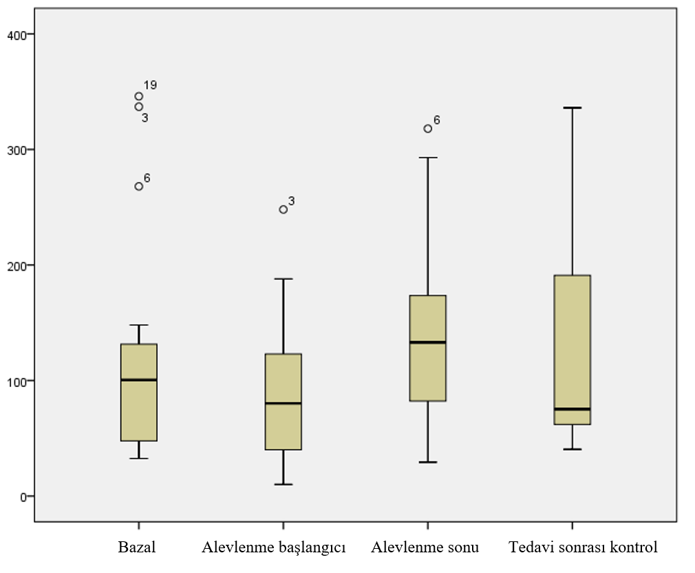
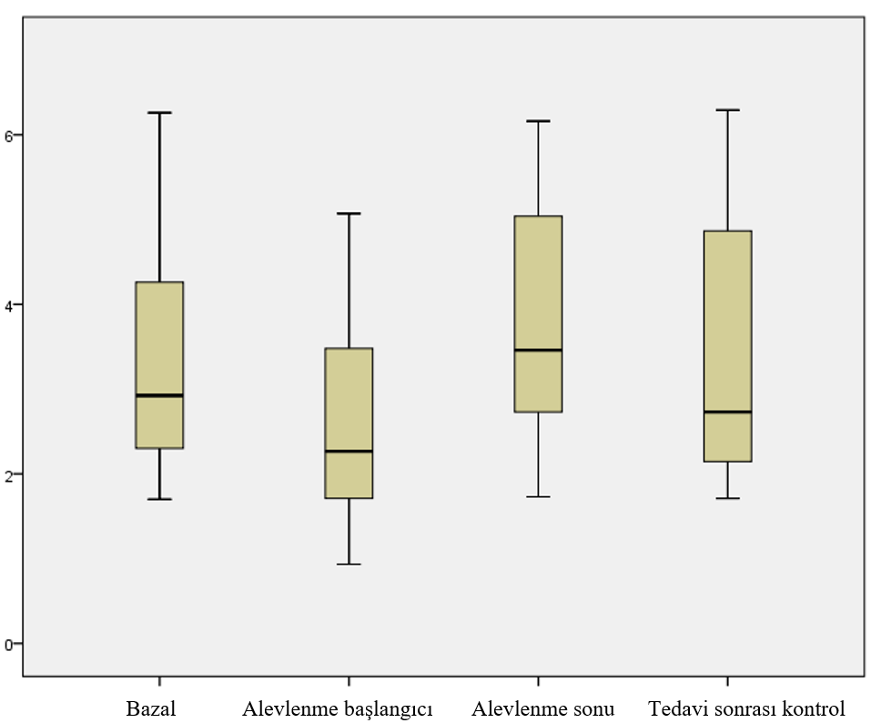
IGF-1 and IGFBP-3 levels in all 4 periods (n:16/37)
Baselim
Baseline Before treatment After treatment After 1 month
Baseline Before treatment After treatment After 1 month
IGF-1
IGFBP-3
Notes:
there was a significant difference for ıgf-1 and ıgfbp-3 ,between the first day of the treatment and the post treatment control period

Slide 12
In 16/37 patients in the post-treatment control period, no significant differences were found between;
the end of PE and control after treatment for IGF-1 (p=0.278)
the end of PE and control after treatment for IGFBP-3 (p=0.66)
baseline and control after treatment for IGF-1 (p=0642)
baseline and control after treatment for IGFBP-3 (0.938)
Notes:
NO SİGNİFİCANT DİFFERENCE was found between post treatmet control period and the other periods.

Slide 13
Table- 3: Comparison of IGF-1 and IGFBP-3 in all 4 periods
 | r value | P value
Baseline | 0.867 | <0.001
At first day of the PE treatment | 0.877 | <0.001
At the end of the PE treatment | 0.877 | <0.001
1 month after the end of the treatment | 0.879 | <0.001
Notes:
There was a positive corelation for ıgf 1 and ıgfbp3 between all perıods

Slide 14
Table- 4: Comparison of IGF-1, IGFBP-3 and PFT in all 4 periods
 | r value | P value
Baseline IGF-1 and FEV₁ | 0.091 | 0.704
Baseline IGFBP-3 and FEV₁ | -0.44 | 0.855
First day of the exacerbation treatment IGF-1 and FEV₁ | 0.177 | 0.456
First day of the exacerbation treatment IGFBP-3 and FEV₁ | 0.061 | 0.800
At the end of exacerbation treatment IGF-1 and FEV₁ | 0.092 | 0.699
At the end of exacerbation treatment IGFBP-3 and FEV₁ | -0.191 | 0.421
1 month after the end of the treatment IGF-1 and FEV₁ | -0.167 | 0.693
1 month after the end of the treatment IGFBP-3 and FEV₁ | -0.238 | 0.570
Notes:
There was no correlation between fev1 and hormone levels for all perıots.

Slide 15
IGF-1 and IGFBP-3 levels were not associated with:
Gender
Pancreatic insufficiency
DM
P.aeruginosa colonization
MRSA colonization
Notes:
GEREK VAR MI???

Slide 16
Table- 5: Comparison of IGF-1 and IGFBP-3 between CF and healthy subjects
 | CF (mean$±SD)$ | Control group (mean$±SD)$ | P value
IGF-1 | 128,28±89,54 | 293,37±184,34 | P<0,001
IGFBP-3 | 3,49±1,37 | 5,83±0,71 | P<0,001
IGF-1 and IGFBP-3 were positively correlated with age
¹Bereket A., et al., Hormone Research in Paediatrics, 2006. 65(2): p. 96-105.
²Yüksel B., et al.. Journal of clinical research in pediatric endocrinology, 2011. 3(2): p. 84.
Notes:
Hormone values were significantly lower in CF patients than the healthy control group

Slide 17
Conclusion
CF patients have lower IGF-1 and IGFBP-3 levels compared to the normal population
IGF-1 and IGFBP-3 levels in CF patients
are decreased by infection
may have significant benefit on the diagnosis of exacerbations and the evaluation of response to treatment
may reflect healthy situation
Further and larger group studies are needed to be used as a biomarker for treatment adequacy

Slide 18
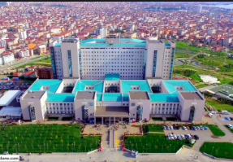
Thank you for your attention…

