Slide 1
Dr Majid AL Jabri
Pulmonary specialist
Sultan Qaboos University Hospital
OMSB specialty, MRCPCH ( UK ), Arab Board , DCH, MD
22.3.2018 Izmir Turkey

Slide 2
Phenotypic and genetic characteristics of Cystic fibrosis patients in Oman
Dr. Hussein Alkindi, Dr. Asma Alfarsi, Dr. Majid Al Jabri
Sultan Qaboos University Hospital (SQUH)
Child Health Department
Sultanate Of Oman

Slide 3
Introduction
Cystic fibrosis (CF) is an inherited autosomal recessive multi-organs disease with considerable variations in the clinical manifestations among different populations.
It is present in Omani population but there is lack of published data on the clinical and genetic characteristics of Omani patients

Slide 4
Objective
To understand the characteristics of CF patients who are followed up in SQUH by looking at different characteristics

Slide 5
Methods
It was a retrospective cross- section study from January 2010 to December 2016.
We analyzed 45 cystic fibrosis patients following in our CF Centre at SQUH.
They were diagnosed based on the clinical features, positive sweat chloride test and or positive CFTR genetic mutation.
The data were collected from hospital electronic patient’s records

Slide 6
Cont..
looking at different characteristics :
Age at onset of symptoms
Age at diagnosis
Age distribution
Mode of presentation
Bacterial colonization
CFTR gene mutations
Geographic distribution
Family history
Complications

Slide 7
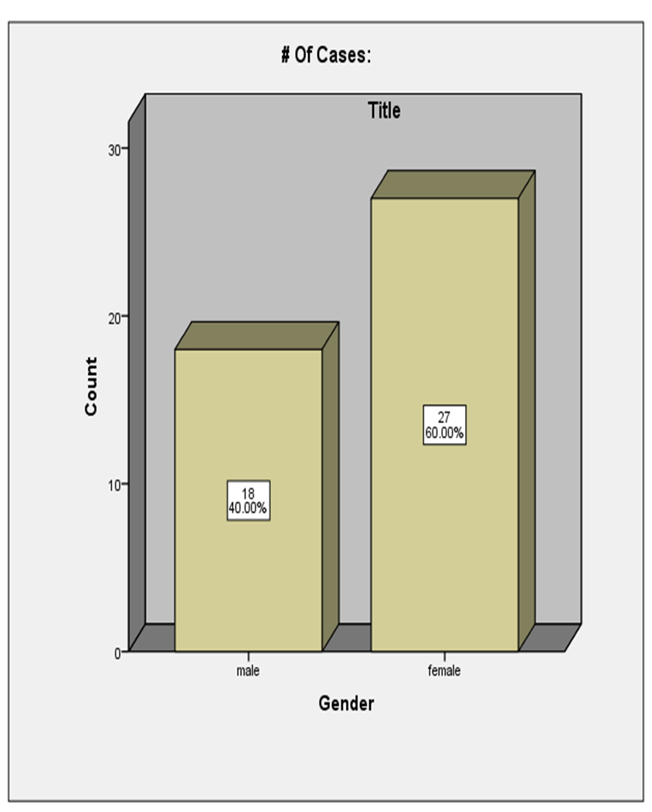
Results
During that period, a total of 45 patients with cystic fibrosis were included in the study.
It was composed of 18 males (40%) and 27 females (60%).
27
60%
18
40%
male
female

Slide 8
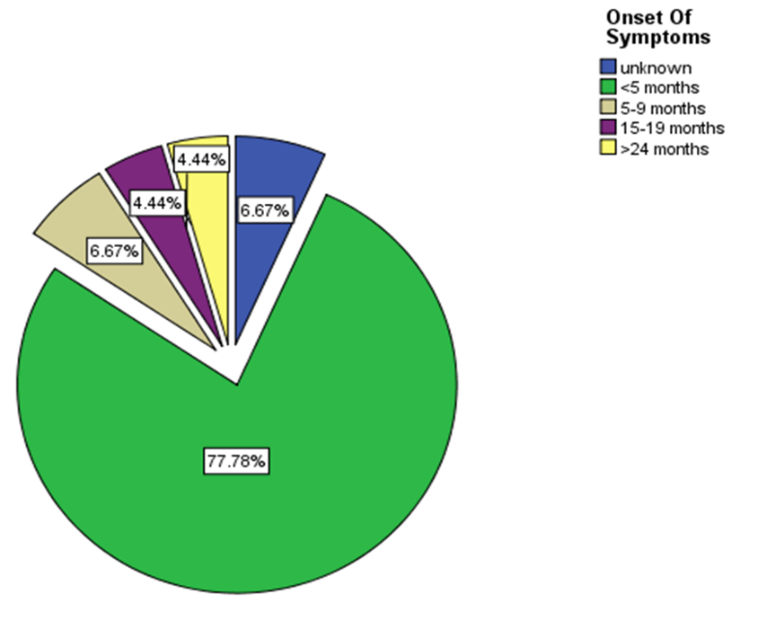
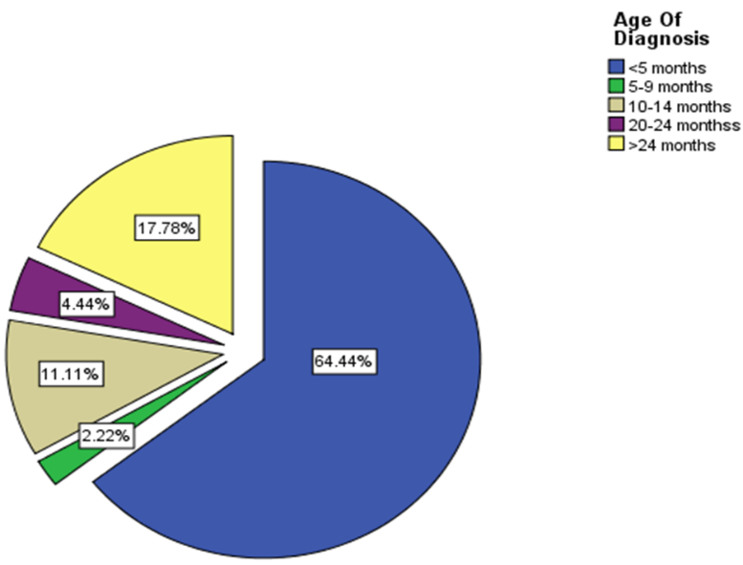
The vast majority of the patients had an early onset of the symptoms. About 77.78 % were less than 5 months of age and 82.22% were diagnosed at <24 months
_{64.44%}
_{77.78%}

Slide 9
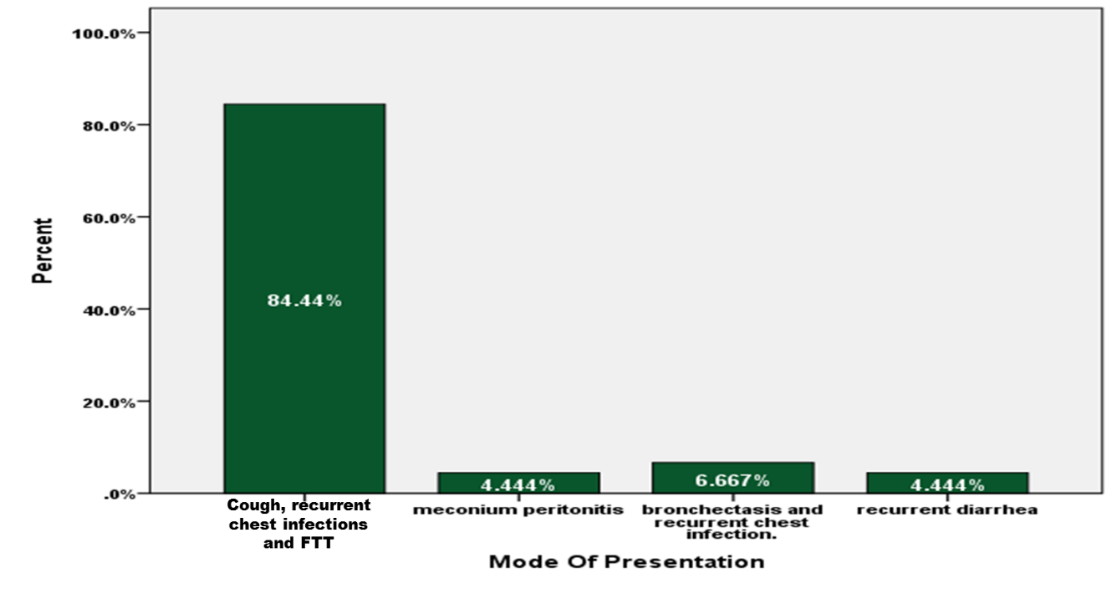
Mode of presentation

Slide 10
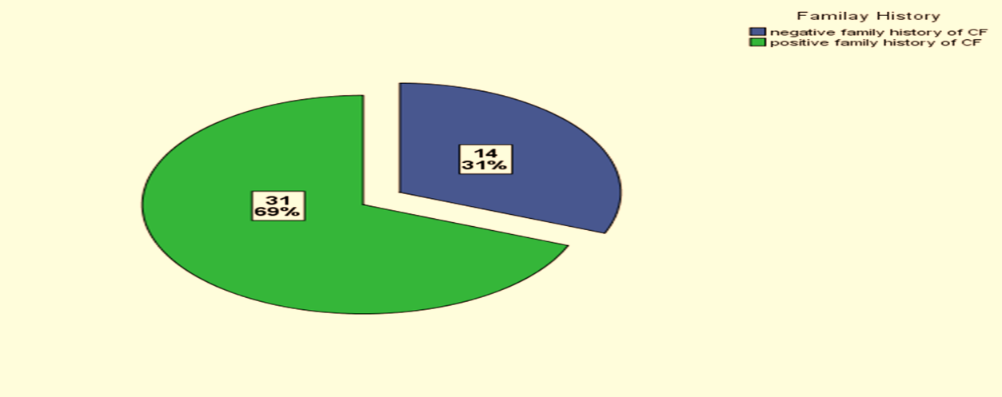
Family history of cystic fibrosis disease in our patients:
31
69%
14
31%

Slide 11
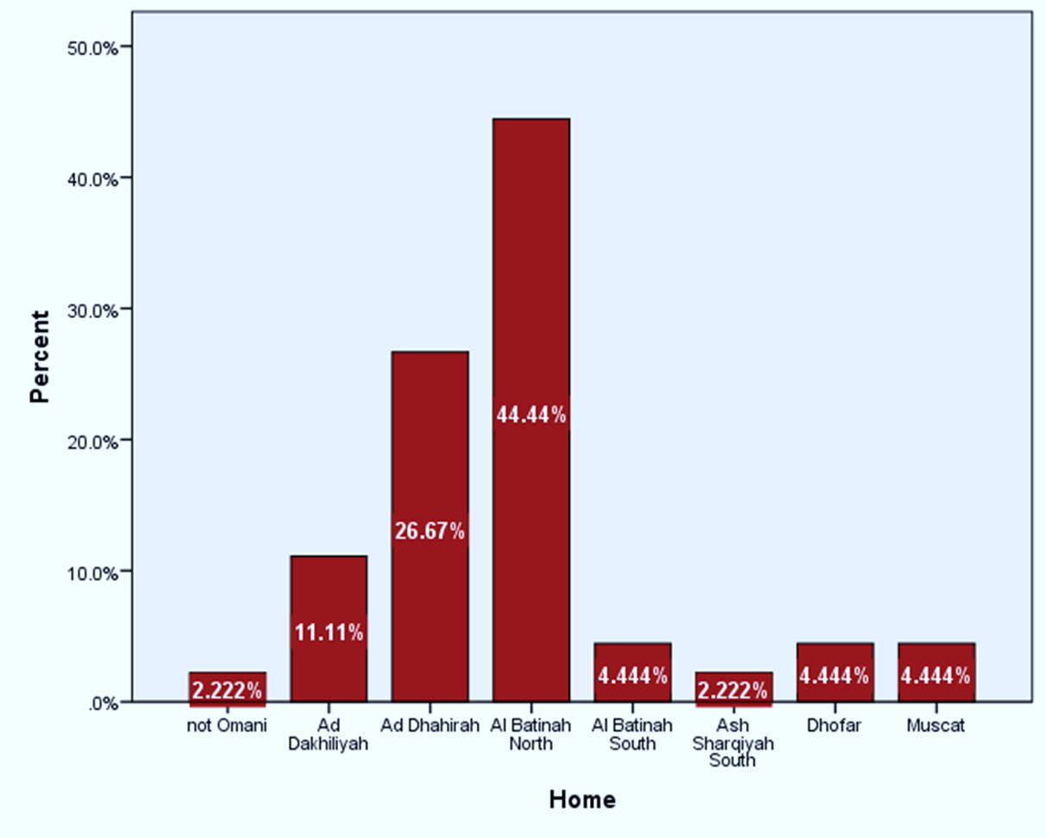
Distribution of cystic fibrosis patient according to the home town

Slide 12
Types of mutation among total 45 CF patients
Type of mutation: | Frequency: | Percentage:
S549R | 34 | 75.6
DF508 | 3 | 6.7
3849+10kbc>T | 3 | 6.7
3120+1G>A | 4 | 8.9
3120+1G>A and D508 | 1 | 2.2
Total: | 45 | 100

Slide 13
7%
75%
9%

Slide 14
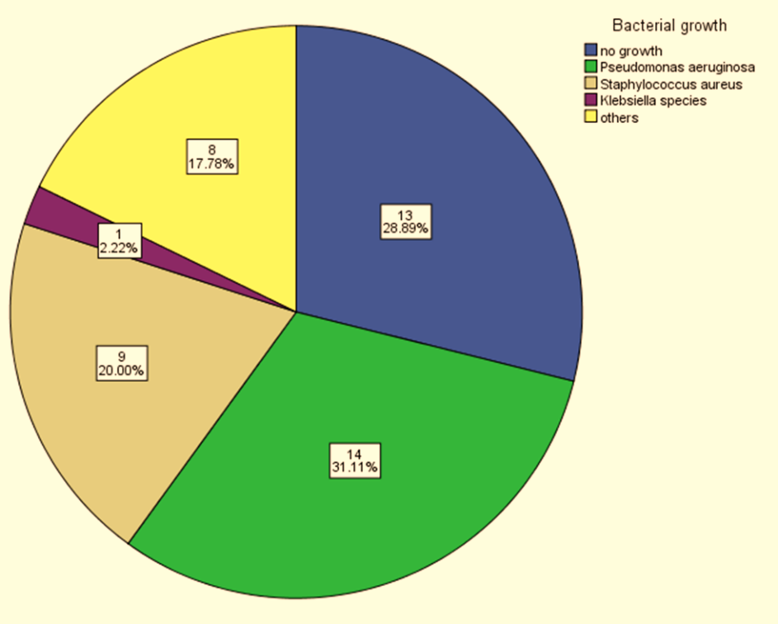
Bacterial colonization
13
28.89%
19
20.00%
Staph aureus
14
31.11%
Pseudomonas

Slide 15
The complications which our cystic fibrosis suffered from
Complication: | Frequency: | Percentage:
Pancreatic insufficiency: | 36 | 81 %
Diabetes: | 4 | 8.89 %
Low bone density: Number who did the test: 15 | 5 | 33.3 %

Slide 16
Discussion

Slide 17
It is well known that cystic fibrosis disease in non-Caucasian population is uncommon (Liu et al., 2015).
In Our study we have identified 45 patients
(27 [60%] females and 18[40%] males)
In comparison to other studies:
Chinese study where the females presented with a percentage of 61.9% in compare to males (Gjevre et al., 2006).
“Women have been described to have worse outcomes than males, particularly in response to respiratory infections“(Harness-Brumley et al., 2014).
Gjevre, J., Case, A., Taylor-Gjevre, R. and Lemire, E. (2006). 2 A novel homozygous CFTR mutation in a Chinese man with infertility. Journal of Cystic Fibrosis, 5, p.S1.

Slide 18
We observed that common initial presentation is significantly associated with lungs diseases
In our study , patients who presented with meconium ileus [4.44%] had the worst survival and lung disease outcomes
In comparison to other studies:
meconium ileus (MI) may be the first manifestation of CF in the neonatal period, occurring in approximately 20 %
The early diagnosis with meconium ileus is indicating the severity of the cystic fibrosis phenotype that may lead to shortened survival.
del Ciampo, I., Oliveira, T., del Ciampo, L., Sawamura, R., Torres, L., Augustin, A. and Fernandes, M. (2015). Early manifestations of cystic fibrosis in a premature patient with complex meconium ileus at birth. Revista Paulista de Pediatria (English Edition), 33(2), pp.241-245

Slide 19
We found that most of our patients are diagnosed at age less than five months. Due to the appearance of symptoms of the disease very early and the recurrence of the chest infection
It emphasized the need for neonatal screening
“Early diagnosis of CF through neonatal screening combined with aggressive nutritional therapy can result in significantly enhanced long-term nutritional status” (Farrell et al., 2001).
Farrell, P., Kosorok, M., Rock, M., Laxova, A., Zeng, L., Lai, H., Hoffman, G., Laessig, R. and Splaingard, M. (2001). Early Diagnosis of Cystic Fibrosis Through Neonatal Screening Prevents Severe Malnutrition and Improves Long-Term Growth. PEDIATRICS, 107(1), pp.1-13.

Slide 20
The mutation spectrum of CF in Oman
“The mutation spectrum of CF in Oman revealed six CF-causing mutations, p.S549R, ∆F508, 3120+1G>A, L578delTA, p.A357T and 3849+10kbC->T” (AlKindy, 2014).
“Our mutation spectrum tends to overlap with those mutations observed in different regions of the Arab world and is less common to that of Europe” (AlKindy, 2014).
AlKindy, H. (2014). Novel Mutation in the CFTR Gene of Cystic Fibrosis Patients in Oman.Journal of Molecular Biomarkers & Diagnosis, 05(02).

Slide 21
The mutation spectrum of CF in Oman cont..
In contrast to the west, p.S549R appears to be the most common mutation in Omani patients with a percentage of 75.6%.
However, “The delta F508 (∆F508) is the most prevalent mutation worldwide, accounting for 66-70% and 90% cases in the Western population”(AlKindy, 2014).
AlKindy, H. (2014). Novel Mutation in the CFTR Gene of Cystic Fibrosis Patients in Oman.Journal of Molecular Biomarkers & Diagnosis, 05(02).

Slide 22
Conclusion
In our patients there are certain characteristics which are different from other cystic fibrosis in other regions.
Studying the different phenotypes of cystic fibrosis among the population will help in dealing with the disease with a better management and awareness in order to prevent the complications.
This study has encouraged us to start new born screening for early detection of cystic fibrosis .
Furthermore, the different genotypes variation might help in future to find out specific medical or gene therapy

Slide 23
References
AlKindy, H. (2014). Novel Mutation in the CFTR Gene of Cystic Fibrosis Patients in Oman.Journal of Molecular Biomarkers & Diagnosis, 05(02).
Zybert, K., Mielus, M., Mierzejewska, E., Ottarzewski, M. and Sands, D. (2014). 16 Influence of newborn screening on the age of diagnosis in cystic fibrosis patients. Journal of Cystic Fibrosis, 13, p.S49.
Dennis, E., Coats, M., Griffin, S., Hale, J., Novak, L., Briles, D. and Crain, M. (2015). The Effects of CFTR and Mucoid Phenotype on Susceptibility and Innate Immune Responses in a Mouse Model of Pneumococcal Lung Disease. PLOS ONE, 10(10), p.e0140335.
Conrad, D. and Bailey, B. (2015). Multidimensional Clinical Phenotyping of an Adult Cystic Fibrosis Patient Population. PLOS ONE, 10(3), p.e0122705.
Nick, J. and Nichols, D. (2016). Diagnosis of Adult Patients with Cystic Fibrosis. Clinics in Chest Medicine, 37(1), pp.47-57.
Gjevre, J., Case, A., Taylor-Gjevre, R. and Lemire, E. (2006). 2 A novel homozygous CFTR mutation in a Chinese man with infertility. Journal of Cystic Fibrosis, 5, p.S1.
Ormond, K., Mills, P., Lester, L. and Ross, L. (2003). Effect of family history on disclosure patterns of cystic fibrosis carrier status. American Journal of Medical Genetics, 119C(1), pp.70-77.
Farrell, P., Kosorok, M., Rock, M., Laxova, A., Zeng, L., Lai, H., Hoffman, G., Laessig, R. and Splaingard, M. (2001). Early Diagnosis of Cystic Fibrosis Through Neonatal Screening Prevents Severe Malnutrition and Improves Long-Term Growth. PEDIATRICS, 107(1), pp.1-13.

