Slide 1
CF Adult Care Challenges in Turkey
Derya KOCAKAYA
Marmara University, School of Medicine
Department of Pulmonary Medicine and Critical Care

Slide 2
Marmara University, Department of Pulmonary Medicine and Critical Care
Founded in 1987
First Medical Intensive Care Unit in Turkey – 2002
5 Outpatient clinics
1 Inpatient clinic (12 beds; 2 isolated)
8 Medical ICU beds - 3rd level
8 General ICU beds - 2nd level
1 Bronchoscopy unit
1 EBUS unit

Slide 3
Adult Pulmonary Medicine Team

Slide 4
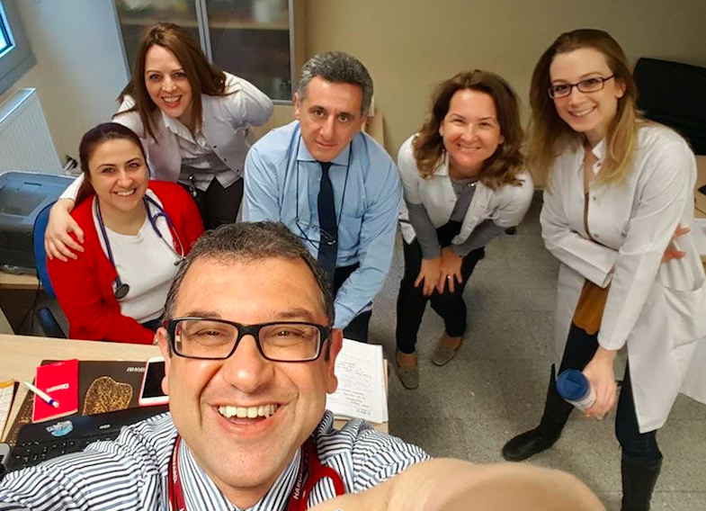
CF Adult Care
For 15 years, adult CF patients are managed in collaboration with pediatric pulmonary physicians
For the last 10 years, more patients started to be followed

Slide 5
CF Adult Care
50 adult CF patients
Follow-up visits: at least 4 times a year
Some are more often
Any CF patient is evaluated at the same day if they walk-in to outpatient clinics
Most of them are in direct contact with us for their problems

Slide 6
CF - Adult patients
50 patients – regularly
28 patients –no follow up for the last 5 years
11 patients – died
2 – Lung transplantations
1 in Turkey
1 in Europe
2 – follow up in Europe

Slide 7
CF - Adult patients
28 Female
22 Male
Mean age: 26.7 years
Mean BMI: 20.36
6 patients with DM
32 patients with exocrine pancreatic insufficiency
Mean FEV1 52.6% FVC 63.0%

Slide 8
Microbiology – Chronic Infection
Pseudomonas aeruginosa infection – 34
MRSA - 3
M. abcessus - 2
Acinetobacter spp - 2
1 w/ nocardia
MSSA - 11
E. coli - 2
ABPA- 5
1 w/ MRSA, 2 w/ MSSA

Slide 9
CF – Treatment
Chronic infection
Acute infection (inpatient/ outpatient)
Nutrition counseling
Pancreatic enzyme replacement
Treatment of DM and osteoporosis
Vitamin replacement
CF education and counseling
Respiratory Physiotherapy
Evaluation for lung transplantation

Slide 11
Challenges – transition clinics !!!

Slide 12
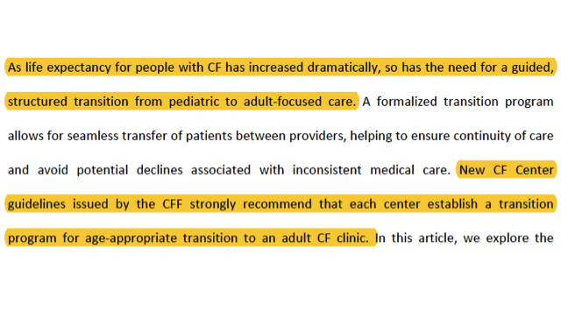

Slide 13
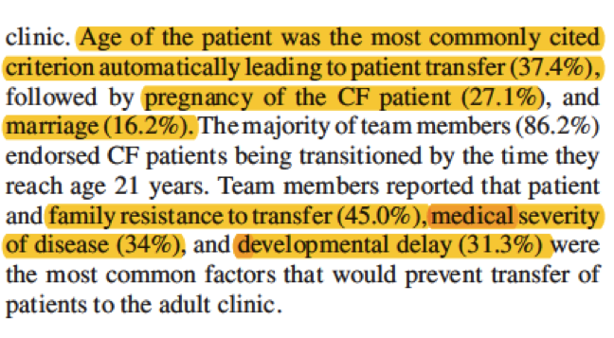

Slide 14
Limitations in adult CF care
Limited physical resources – managing CF care in a busy hospital , particularly for inpatient treatments (single-room accommodation)
Lack of dedicated psychological support esp. for patients w/ severe respiratory problems
Lung Transplantation

Slide 15
Improvements – Team members dedicated to CF
Dietician
Physical Therapy and Rehabilitation Specialist / Respiratory Physiotherapist / Cardiopulmonary Rehabilitation Unit
Geneticist
Infectious Diseases and Microbiology Specialist
Gastroenterologist
CF nurse

Slide 16
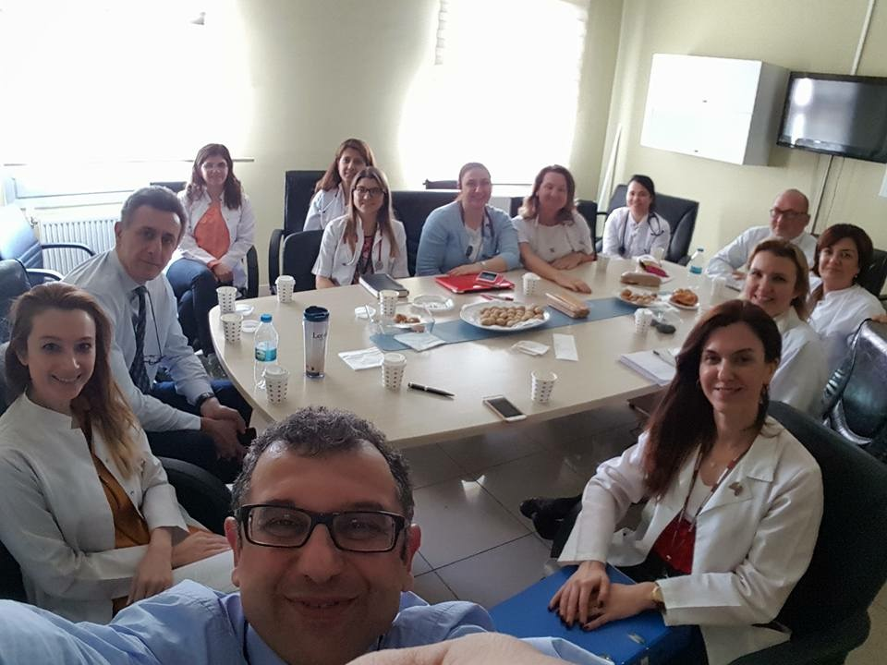
Thank you..

