Slide 1

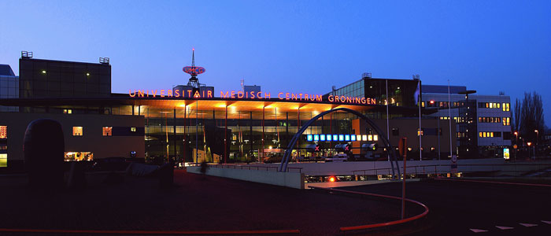
Home-made therapies for CF; a recipe for lower treatment costs
Prof. dr. D.J. Touw, hosp pharm, clin pharmacol, toxicol
RUG/UMCG, Dept. Clinical Pharmacy and Pharmacology
3rd ME CF symposium 2019

Slide 2


Disclosure
DJT is a member of the European Pharmacopoeia Committee

Slide 3
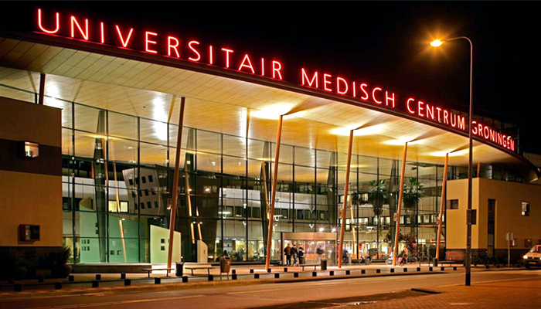
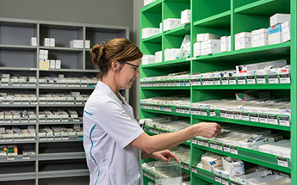
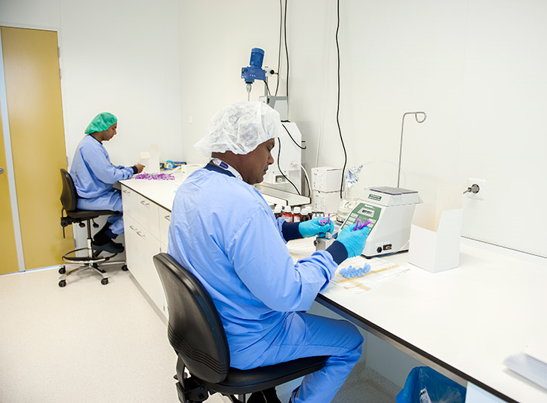
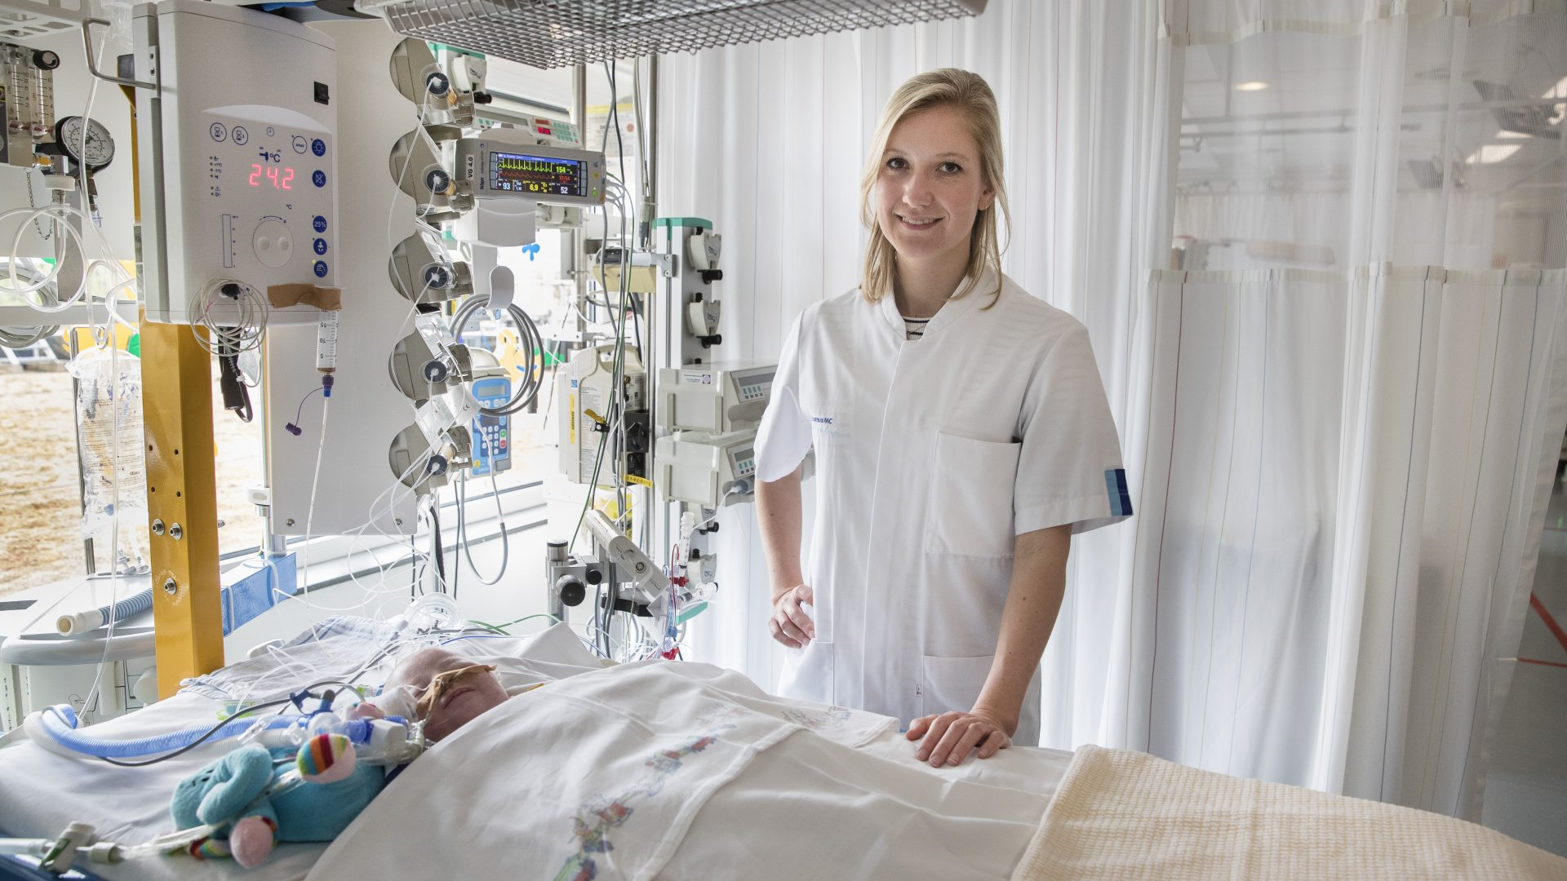

Slide 4
Outline
Legal aspects for the preparation of drugs
Examples for pharmacy preparations relevant to CF
Other ideas to reduce costs in CF drug treatment
Conclusions

Slide 5
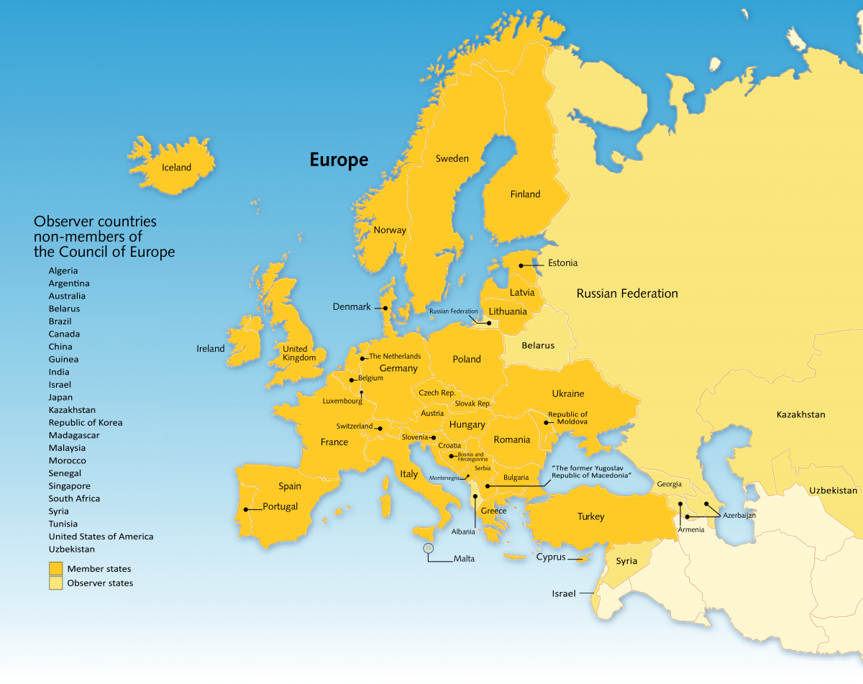
Legal requirements for drugs
Quality of medicines:
Regulated by laws and by Pharmacopoeias
Europe:
European Pharmacopoeia
British Pharmacopoeia

Slide 6

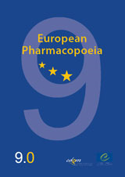

Legal requirements for drugs

Slide 7
Some relevant legal requirements for drugs
General quality requirements for pharmaceutical products and specific quality requirements for pharmaceutical compounds are laid down in monographs published in the European Pharmacopoeia
According to the European Directive drugs and pharmaceutical compounds are produced in GMP certified facilities
Facilies are inspected by competent authorities (e.g. health inspectorates)

Slide 8
Some relevant legal requirements for drugs
For the EU and countries that have adopted the European Pharmacopoeia: Ph Eur
For other countries:
  Ph Eur
  United States Pharmacopoeia
  British Pharmacopoeia (= Ph Eur)
  Japanese Pharmacopoeia

Slide 9
Some relevant legal requirements for drugs
General rule (EU):
Patented formulated drugs and pharmaceutical compounds: not allowed to produce yourself (except for HIV treatment and WHO essential drugs)
When a drug is off-patent:
  For your own patients -> no GMP required
  For other hospitals -> GMP required

Slide 10
Price problems in CF
Drug | Dose | Unit cost | Annual cost
Ivacaftor | 2 dd 150 mg | $ 420 | $ 306,600
Tobramycin for inhalation | 2 dd 300 mg | $ 52 | $ 19,000
Dornase alfa | 2 dd 2.5 mg | $ 38 | $ 28,000
Aztreonam for inhalation | 2 dd 75 mg | $ 48 | $ 26,000
https://www.ncbi.nlm.nih.gov/books/NBK349135/table/T56/

Slide 11
Price problems in CF
Dutch ministry of health:
  ‘Because of the exorbitant prices of drugs we are investigating under which conditions hospital pharmacists may produce patented drugs to reduce costs’

Slide 12
Price problems in CF
Examples of expensive drugs for CF where are cheaper options:
  Tobramycin for inhalation
  Aztreonam for inhalation
  Hypertonic saline for inhalation
  Gentamicin for inhalation (alternative for tobramycin)
  Amikacin for inhalation

Slide 13
Tobramycin for inhalation
Tobramycin solution for inhalation:
Your pharmacist can easily make this drug for your own patients:
  Tobramycin sulphate 300 mg
  Water for injections ad 5 ml
  Adjust pH to 6-7
  Fill in 5 ml injection vials and sterilise 15 min 121ºC
Quality control:
  Tobramycin identity confirm
  Tobramycin quantity 90-110%
Estimated costs (2 dd 300 mg)
  Tobramycin for inhalation $ 52/dose
  Self prepared tobramycin for inhalation $ 6/dose
  Tobramycin for injection $ 18/dose (larger volume!)

Slide 14
Aztreonam for inhalation
Aztreonam powder for injection:
  Aztreonam 1000 mg
  Isotonic saline 100 ml
  Inhale 7.5 ml
Estimated costs (2 dd 75 mg)
  Aztreonam for inhalation $ 48/dose
  From generic aztreonam for inj. $ 8/dose

Slide 15
Hypertonic saline for inhalation
Your pharmacist can easily make this drug for your own patients:
  Sodium chloride 700 mg
  Water for injections ad 10 ml
  Fill in 10 ml injection vials and sterilise 15 min 121ºC
Quality control:
  Sodium chloride identity confirm
  Sodium chloride quantity 90-110%
If there is no access to drugs:
  One teaspoon of kitchen salt
  One coffeecup with boiled and cooled water

Slide 16
Other opportunities to save costs
Beta lactam antibiotics as continuous infusion:
  Using their pharmacodynamic properties
  Using sensitivity of the micro-organism
Using drug-drug interactions
Dose on body height in stead of weight

Slide 17
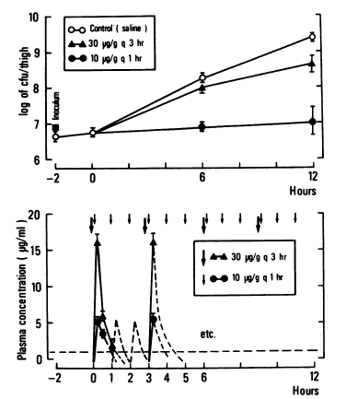
Beta-lactam antibiotics
Bacterial growth with two dosing regimens of ticarcillin in neutropenic mouse P. aeruginosa infection models:
Control
Dose | T>MIC | Outcome
30 mg/kg q 3hrs | 35% | Growth
10mg/kg q 1h | 60% | No growth
MIC
Gerber, J Inf Dis 1983

Slide 18
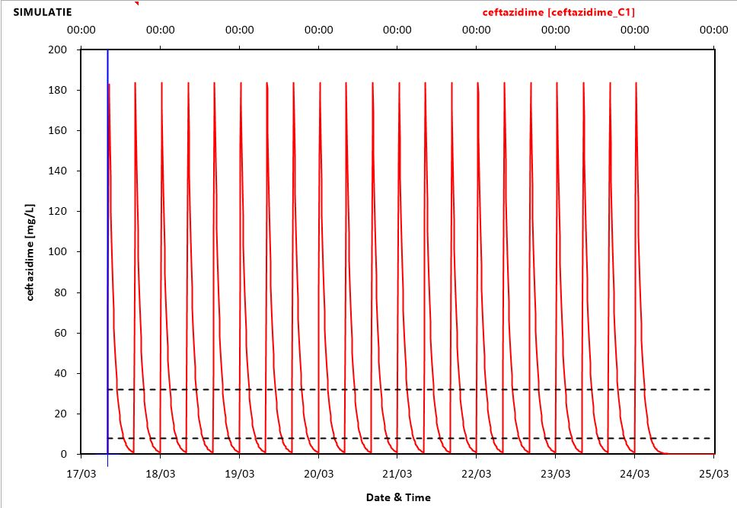
Ceftazidime i.v.
EUCAST breakpoint P. aeruginosa MIC 8 mg/L
CF patient, 55 y/o, 50 mg/kg every 8 hours
32 mg/L
8 mg/L

Slide 19
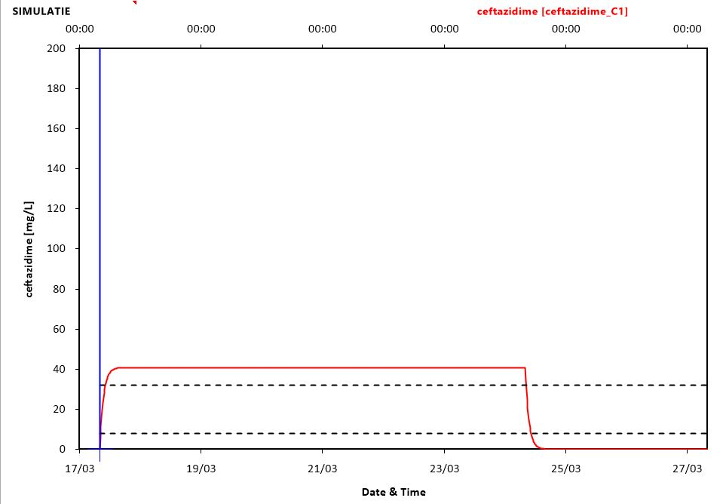
Ceftazidime i.v.
EUCAST breakpoint P. aeruginosa MIC 8 mg/L
CF patient, 55 y/o, 100 mg/kg/24 h continuously -> Target is 32 mg/L
Potential savings:
66% on preparation time
66% on disposables
33% on drugs
32 mg/L
8 mg/L

Slide 20
Home intravenous treatment

Slide 22
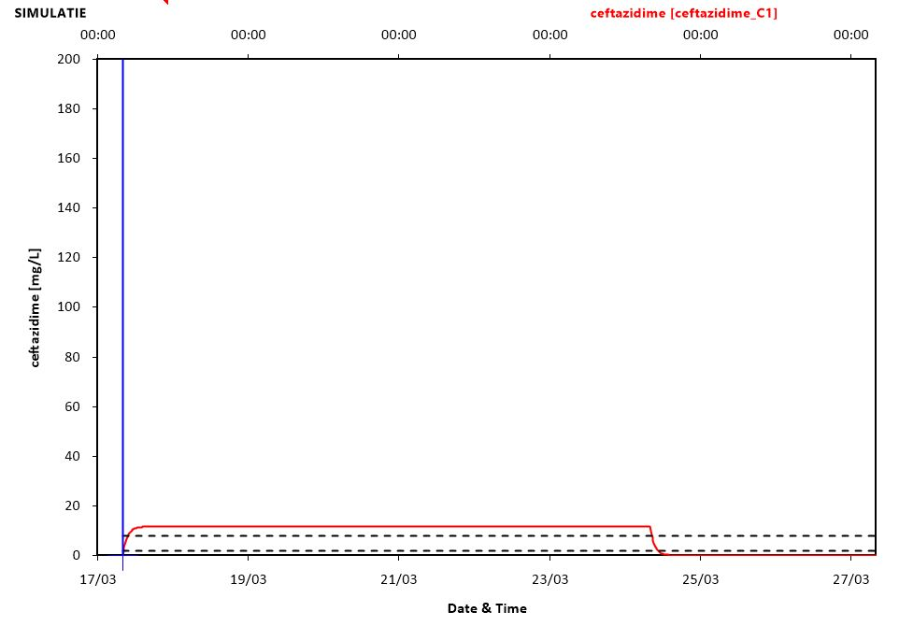
Ceftazidime i.v.
Sensitive P. aeruginosa MIC 2 mg/L -> target 8 mg/L
CF patient, 55 y/o, 50 mg/kg continuously
Potential savings:
66% on preparation time
66% on disposables
66% on i.v. drugs
8 mg/L
2 mg/L

Slide 23
Use drug-drug interactions
HIV:
  Subtherapeutic doses of ritonavir are used to boost atazanavir and lopinavir
CF:
  Ivacaftor is a substrate of CYP3A4 and ritonavir is a strong inhibitor of CYP3A4
  50 mg ritonavir increases ivacaftor AUC _{0->inf} 20 fold¹ -> potentially 20 fold dose reduction
1) Liddy, Br J Clin Pharmacol 2017

Slide 24
PK changes of tobramycin in CF
BMI groups:
1: <18.5
2: 18.5-24.99
3: 25-29.99
4: ≥30 kg/m²
Al Ghanem, manuscript in preparation

Slide 25
PK changes of tobramycin in CF
BMI groups:
1: <18.5
2: 18.5-24.99
3: 25-29.99
4: ≥30 kg/m²
Al Ghanem, manuscript in preparation

Slide 26
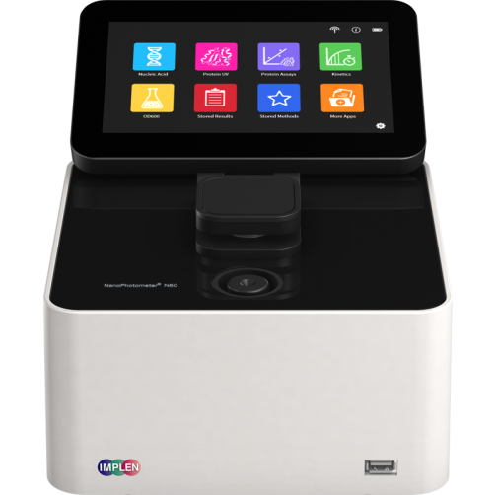
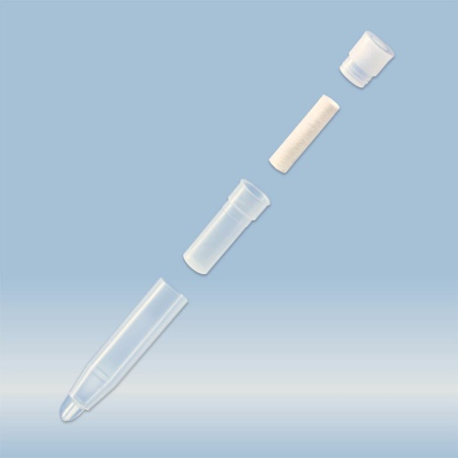
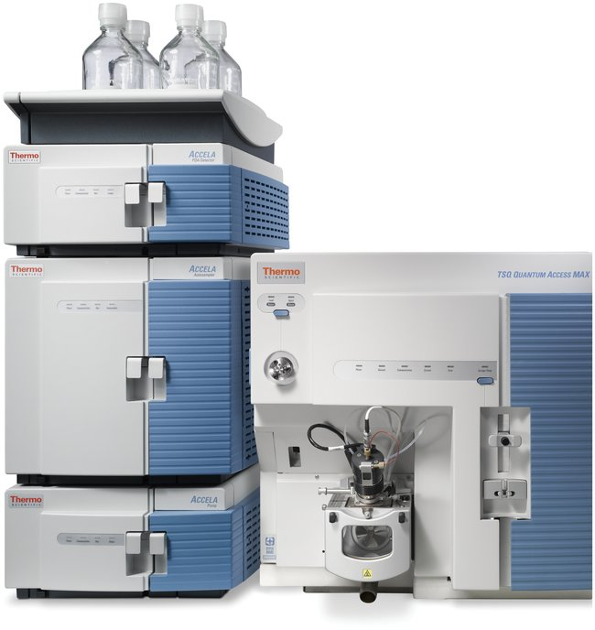
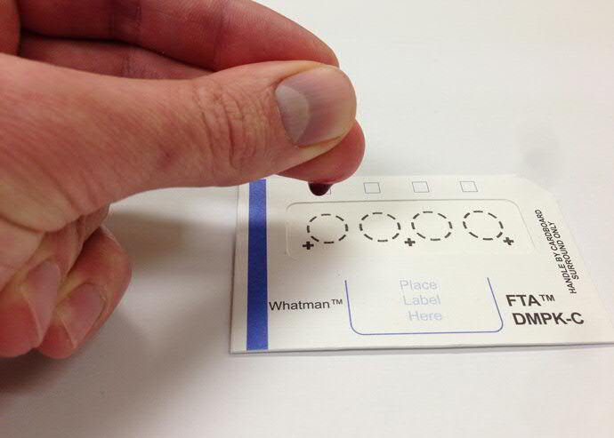
Future directions in cheaper drug assays
Saliva
  Salivette
  Nanophotometer
Blood
  Dried Blood Spots (DBS)
  Central laboratory

Slide 27
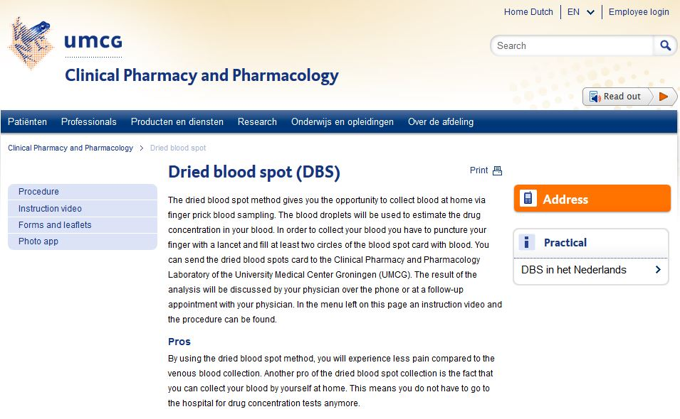
UMCG DBS instructions

Slide 28
Conclusions
You can make some expensive drugs very easily yourself
  By preparing from compounds of pharmaceutical quality
  Using i.v. formulations for inhalation
Think about clever use of drug-drug interactions
You may also think about adjusting antibiotic dose based on sensitivity measurement of bacteria
Aminoglycosides dosed on body height give more predictable peak concentrations than dosing on body weight -> less drug monitoring?
Cheaper and easily accessible assays are under development

Slide 29

Time for
d.j.touw@umcg.nl

