Slide 1
OPMERKING
Als je de afbeelding aanklikt en delete, dan kan je de afbeelding vervangen.
De afbeelding neemt automatisch de vorm aan van de figuur.
De afbeelding binnen de figuur positioneren kan onder Opmaak – Bijsnijden.
Per ongeluk de figuur verplaatst? RMK op de slide in de linkerzijbalk: Dia herstellen.

Slide 2
The impact of tube feeding on pulmonary function in children and adults with Cystic Fibrosis: A registry study
Dimitri Declercq / CF Center
D. Libeert₍₁₎, S. Wanayma₍₂₎, D. Declercq₍₁₎₍₃₎, M. Thomas₍₂₎, S. Van Daele₍₁₎, F. De Baets₍₁₎, S. Van Biervliet₍₁₎
⁽¹⁾Ghent University Hospital, CF Center, Belgium ⁽²⁾Belgian CF registry, Scientific Institute of Public Health (WIV-ISP), Brussels, Belgium ⁽³⁾Co-Chair, European Cystic Fibrosis Nutrition Group, CF Centre, Ghent University Hospital, Gent, Belgium

Slide 3
Enteral tube feeding
(S.J. Schwarzenberg et al., 2016)
multiple retrospective studies report improvement in age- dependent anthropometrics
some studies report improvement in lung function
Tube feeding (TF) is often used to maintain nutritional status and improve the respiratory condition. However long-term results on pulmonary function outcomes are not yet clear.

Slide 4
Enteral tube feeding
Methods
Retrospective, longitudinal study
Inclusion criteria from Belgian CF Patient Registry (BCFR): Cases: ETF between 2000-2013 (n=113)
Median ETF duration 2 yr (1-5 yrs)
2 Controls/ case: Matched at index year: age, gender, pancreatic status and genotype class (n=223)
Exclusion
< 3 observations post-matching
Transplant before introduction of ETF

Slide 5
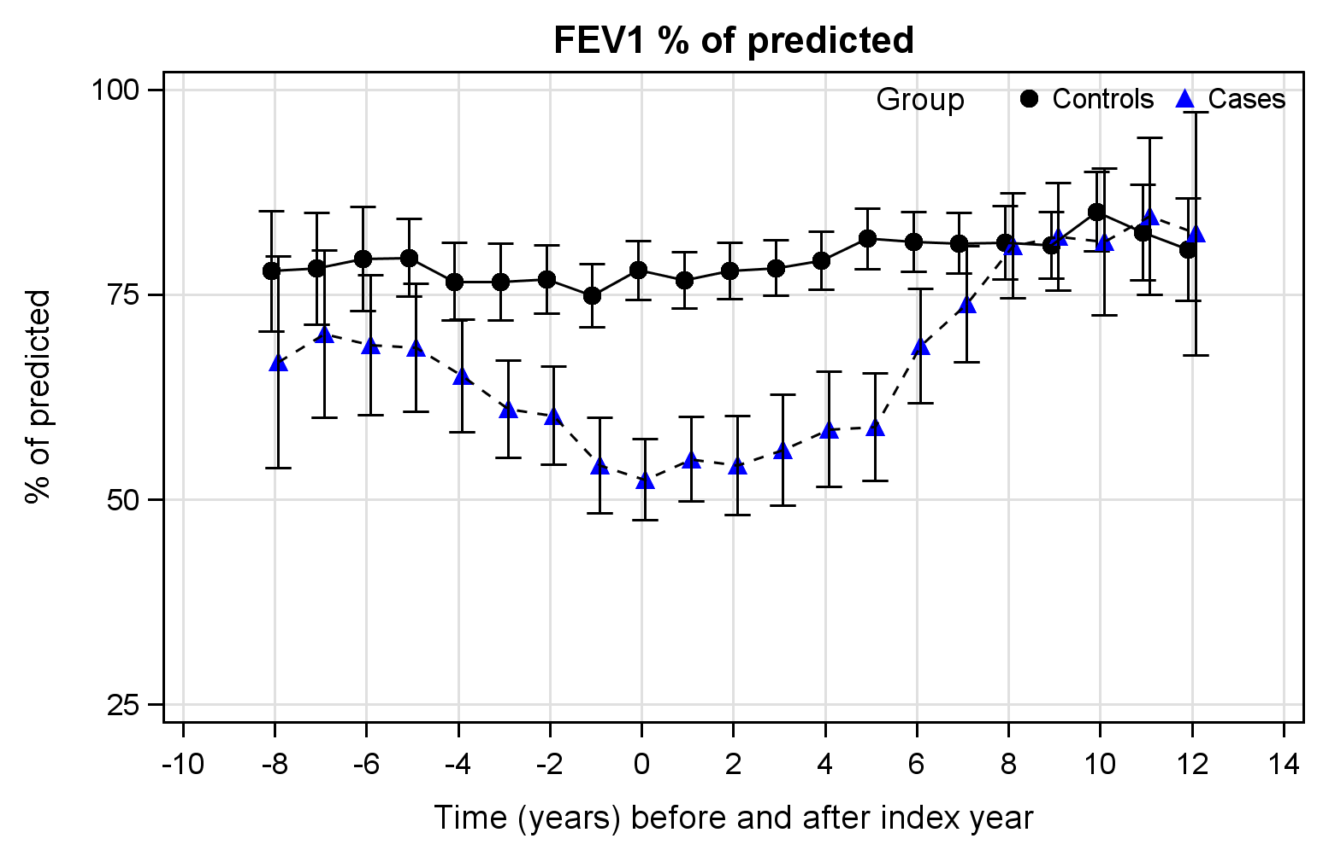
Enteral tube feeding
Results
Controls were significant better at every evaluation point
Significant decrease in hospitalization days and IV AB days after ETF introduction BUT sign. higher mortality and transplantation in ETF group

Slide 6
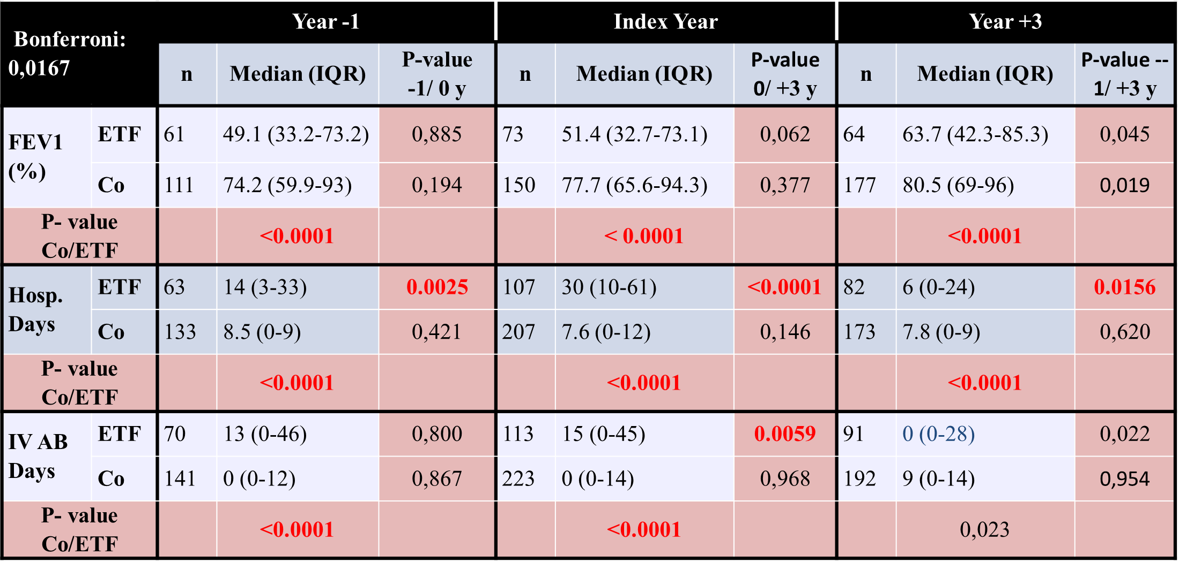
Enteral tube feeding
Results

Slide 7
Enteral tube feeding
Conclusion
Cases eventually receiving ETF: worse pulmonary status at index year + at first entry in the BCFR => more hospitalization days & IV antibiotic days
After introduction of ETF: Pulmonary function stabilized BUT at lower level → Number of hospitalizations & IV AB decreased. More Transplantations & more deaths were observed in first 3 years.
Data has recently been published in JCF https://doi.org/10.1016/j.jcf.2018.01.004

Slide 8
Dimitri declercq
Dietician - diabeteseducator
Department of Pediatrics CF Center

