Slide 1
Cystic Fibrosis Research in the Middle East “Challenges and Opportunities”
Ibrahim A. Janahi, MD, FCCP, FRCPCH
Division Chief, Pediatric Pulmomnology Sidra-Medicine
Professor of Clinical Pediatrics, Weill Cornell Medicine- Qatar

Slide 2
Key Points “Cystic Fibrosis Research in the Middle East “
Research Challenges
Cystic Fibrosis Research Studies
Research Opportunities
First Main Challenge
“Research sponsors/Clinical Investigators “Physician”
Disease Pool
Overview of Cystic Fibrosis
Recruitment
CF Facts
Second Main Challenge
“Research Regulations”
Cost Saving
Common Mutations
Third Main Challenge
“Patients”
Emerging Market

Slide 3
Cystic Fibrosis Research in the Middle East
Overview of Cystic Fibrosis
Cystic Fibrosis Facts
Common Mutations

Slide 4
CYSTIC FIBROSIS OVERVIEW
Cystic Fibrosis Overview
Cystic fibrosis (CF) is a lethal, monogenic disorder that affects multiple organ systems of the body;
As per a Cystic Fibrosis Foundation annual report, 60,000 to 70,000 people across the world suffer from CF (this estimate is based on the data available from the existing registries in developed countries (primarily the United States, Europe, and Australia);
The estimated frequency of CF per live birth in Caucasians is believed to be 1 in 2000–2500 children.
CF has been estimated to fall in the range of 1 in 30,000 to 1 in 50,000, incidence of the disease has been reported in the range of 1 in 2000 to 1 in 5800 live births;
As per a recent report on extrapolated CF prevalence rates, it is projected that 34,357 patients in India and 41,898 patients in China may have CF;
The high prevalence of CF in these countries may be accountable due to the large population (>1 billion) of these countries.
These prevalence extrapolations for CF are only rough estimates derived by applying the prevalence rates from the United States (or a similar country) to the population of other countries, and therefore may not reflect the actual prevalence of CF

Slide 5
Middle Eastern Countries Cystic Fibrosis Facts
Cystic Fibrosis Overview
The road for survival improvement of cystic fibrosis patients in Arab countries,International Journal of Pediatrics and Adolescent Medicine. volume 2, Issue 2,2015,Pages 47-58,ISSN 2352-6467,https://doi.org/10.1016/j.ijpam.2015.05.006.

Slide 6
Cystic Fibrosis Most Common Mutations
Cystic Fibrosis Overview

Slide 7
Cystic Fibrosis Most Common Mutations (cont’d)
Cystic Fibrosis Overview

Slide 8
Research Challenges in the Middle East
First Main Challenge
“Research sponsors/Clinical Investigators “Physician”
Second Main Challenge
“Research Ethics Capacity”
Third Main Challenge
“Patients”
Clinical question
Clinical research vs. clinical practice
Globalization
Research Ethics and regulatory laws
Perception of Research in the Middle East

Slide 9
Infrastructure of Clinical Research
Research Ethics Capacity and Regulations
Patients
Research sponsors
Industry;
Academia
Government;
Nonprofit organizations;
Patient advocates
Clinical Investigators
+
Physicians
Time;
Funds;
personnel;
Materials/medical supplies;
Support systems (informatics)
Notes:
Transforming Clinical Research in the United States: Challenges and Opportunities: Workshop Summary (2010)
Chapter: 3 Challenges in Clinical Research; https://www.nap.edu/read/12900/chapter/4

Slide 10
First Main Challenge
“Research sponsors/Clinical Investigators “Physicians”

Slide 11
a. Prioritizing of Clinical Research Question
Challenges
No clear prioritization of the gaps in medical evidence to efficiently allocate clinical research resources to effectively fill these evidence gaps;
The divergence between the priorities of society and industry is notable, could be resolved by addressing the current gaps in clinical research and medical decision making;
The peer review process for research grants is inherently conservative and fails to reward innovative research into areas about which little is known;
Biased research question in Industry-sponsored trials for unique interests;
Officially registered and should obtain regulatory approvals;
Largely conducted worldwide to gain U.S. Food and Drug Administration (FDA) approval to market a new drug or a previously approved drug for a new indication
National Health Strategies should be put in place addressing the national priorities.
Notes:
"3 Challenges in Clinical Research." Institute of Medicine. 2010. Transforming Clinical Research in the United States: Challenges and Opportunities: Workshop Summary. Washington, DC: The National Academies Press. doi: 10.17226/12900. ×

Slide 12
b. The Divide Between Clinical Research and Clinical Practice
Challenges
i-Challenges facing investigators in academic health centers
the time and financial demands of clinical practice;
the overall shortage of specialists and subspecialties;
the increasing complexity of regulations;
the increasing complexity of contracts;
the lack of local supportive infrastructure;
inadequate research training;
less enjoyment from participation (e.g., increasing business aspects, contract research organization pressures); and
data collection challenges (medical records, reimbursement, quality control, pay for performance).
Notes:
"3 Challenges in Clinical Research." Institute of Medicine. 2010. Transforming Clinical Research in the United States: Challenges and Opportunities: Workshop Summary. Washington, DC: The National Academies Press. doi: 10.17226/12900. ×

Slide 13
b. The Divide Between Clinical Research and Clinical Practice (cont’d-2)
Challenges
ii-Challenges confronting community physicians
Busy patient practices and the associated billing and reporting requirements leave them with limited time for research (lack of protected time);
Lack of a supportive clinical research infrastructure, especially in the form of administrative and financial support;
A lost revenue stream; if there is a financial disincentive for physicians to refer their patients to clinical trials. Physicians who do so must often refer those patients away from their care; thus each patient referred represents a lost revenue.
Notes:
:"3 Challenges in Clinical Research." Institute of Medicine. 2010. Transforming Clinical Research in the United States: Challenges and Opportunities: Workshop Summary. Washington, DC: The National Academies Press. doi: 10.17226/12900. ×

Slide 14
b. The Divide Between Clinical Research and Clinical Practice (cont’d-3)
Challenges
iii- Challenges facing patients
Geographical Challenges; Patients may reside far from study centers
Procedural challenges; Number of clinic visits required by the study protocol, significant travel and time costs may be associated with participation, extensive paperwork associated with the informed consent process can be confusing and burdensome
Study design; Narrow eligibility criteria for participation purposely eliminate many patients who might have the disease being studied but are ineligible because of other characteristics (e.g., age, level of disease progression, exposure to certain medicines)
Challenges in joining clinical trials;
Emotional strain on patients to temporarily leave the care of their regular doctor and receive services from unfamiliar providers
Sometimes there is a mistrust issue of industry-sponsored trials among the public, which can further complicate the already difficult decision about whether to join a trial.

Slide 15
c. Globalization of Clinical Research/Trials and Research Funds
Challenges
Globalization is a positive trend overall. However, the current situation in which clinical research is being sent abroad is unsustainable;(clinical studies/trials in a number of other countries cost less than the primary funded site)
The overall cost associated with gathering the necessary resources to conduct a clinical trial is an important factor in the choice of a trial site (i.e. physician salaries in a number of countries are lower than in others which reduces the opportunities in countries with higher costs to be part of this globalization)
Narrow incentives for physician participation in clinical research
Shrinking of clinical research workforce
Clinical investigation is not an attractive career option for academics and professionals anymore, given the challenges faced;
The majority of phase III clinical trials are conducted by extramural researchers.

Slide 16
c. Globalization of Clinical Trials and Research Funds (cont’d-2)
Challenges
Relative Cost Indexes of Payments to Clinical Trial Sites
Country | Cost of Clinical Trials Relative to the United States
United States | 1.00
Australia | 0.67
Argentina | 0.65
Germany | 0.50
Brazil | 0.50
China | 0.50
Russia | 0.41
Poland | 0.39
India | 0.36
Transforming Clinical Research in the United States: Challenges and Opportunities: Workshop Summary (2010) .Chapter: 3 Challenges in Clinical Research; https://www.nap.edu/read/12900/chapter/4

Slide 17
Second Main Challenge
“Research Ethics Capacity”
a. National Regulations
b. Institutional Capacity
c. Regulatory Committees
d. Researchers
e. Middle Eastern Research Ethics Conflict Zone

Slide 18
Research Ethics Capacity and Mapping
Challenges
An ecological model adapted from a framework developed by Lavery and Hyder (2001).
(a) National capacity: national laws and guidelines in research ethics, legal and regulatory mechanisms for oversight of clinical trials and RECs/IRBs, and budget priorities for research funding and training programs in research ethics;
(b) Institutional capacity/ commitments: organizational structures and procedures that support and promote a culture of ethical conduct (e.g., conflict of interest policies, appeal mechanisms, systems of awards and penalties), and institutional curriculum and degree programs in ethics and research ethics;
(c) Research ethics committee (REC/IRB) capacity: diversity of membership, training of members; adequate budgets, and policies that support the independence of RECs;
(d) Researchers’ knowledge, attitudes, and practices in research ethics: awareness of research ethics guidelines, respect for REC authority, optimal practices regarding informed consent and other human subjects protections, and responsible conduct of research;
(e) Research participants and conflict zones.

Slide 19
Aspects of Research Ethics An ecological model adapted from a framework developed by Lavery and Hyder (2001)
Challenges

Slide 20
Aspects of Research Ethics (cont’d) An ecological model adapted from a framework developed by Lavery and Hyder (2001)
Challenges

Slide 21
a. National Capacity in Middle Eastern Countries
Challenges
Thirteen Arab countries in the Middle East were explored in 2012
National research ethics and regulations were; reviewed against /assessed for
The review comprised of a complete list of protections; confidentiality, ICFs, ethics Committees, and others
Two groups were distinguished; 1st group will have one or more research ethics, while the 2nd don’t
Reviewed against | Assessed for
Declaration of Helsinki | National codes
International Conference of Harmonization (ICH) | Regulations
Guidelines for Good Clinical Practice (GCP) | Guidelines
International Organization of Medical Sciences (CIOMS) | Documentation
WHO | List of Protections
Alahmad et al.; licensee BioMed Central Ltd. 2012.BMC Medical Ethics201213:34 https://doi.org/10.1186/1472-6939-13-34
Notes:
Alahmad et al.; licensee BioMed Central Ltd. 2012.BMC Medical Ethics201213:34 https://doi.org/10.1186/1472-6939-13-34
Accepted: 29 November 2012
Published: 12 December 2012

Slide 22
a. National Capacity (cont’d-2) Regulations found in the Explored Middle Eastern Countries
Challenges
Table (1): Research ethics guidelines found in the explored countries
Many differences exist in terms of whether countries in the Middle East have research ethics guidelines or not Countries were classified into two main groups; The first major group already have guidelines and can be divided into two subgroups Group (A): have special national research ethics guidelines; as is the case for Saudi Arabia, Qatar, Bahrain, Kuwait, the UAE, and Jordan Group (B); have general documents that contain some paragraphs about research ethics as in Egypt and Lebanon; The second major group comprises of countries that have no special guidelines but either refer to international guidelines;
Notes:
Alahmad et al.; licensee BioMed Central Ltd. 2012.BMC Medical Ethics201213:34 https://doi.org/10.1186/1472-6939-13-34
Accepted: 29 November 2012
Published: 12 December 2012

Slide 23
a. National Capacity (cont’d-3) Regulations found in the Explored Middle Eastern Countries
Challenges
Table (2): Ethical protection stated in research ethics documents
Overall, (5) guidelines were found among the explored countries that contain at least two or more protections; The Qatari guidelines contains the most protections (19), followed by the Saudi “Clinical Trial Requirement Guidelines” (15 protections); Others protections: The Saudi “Ethics of the Medical Profession (5); The Jordanian guidelines (3); The Lebanese guidelines (2).
Alahmad et al.; licensee BioMed Central Ltd. 2012.BMC Medical Ethics201213:34 https://doi.org/10.1186/1472-6939-13-34
Notes:
Alahmad et al.; licensee BioMed Central Ltd. 2012.BMC Medical Ethics201213:34 https://doi.org/10.1186/1472-6939-13-34
Accepted: 29 November 2012
Published: 12 December 2012

Slide 24
a. National Capacity (cont’d-4) Regulations found in the Explored Middle Eastern Countries
Challenges
Table (3): External references mentioned
(8) of the guidelines reviewed refer to external resources, (5) refer to international guidelines, while the other (3) claim to respect Islamic law. (5) Followed The Declaration of Helsinki; (4) Followed the ICH-GCP; (2) Followed the Nuremberg Code and Belmont report; (1) Followed International Organization of Clinical Sciences (CIOMS).
Alahmad et al.; licensee BioMed Central Ltd. 2012.BMC Medical Ethics201213:34 https://doi.org/10.1186/1472-6939-13-34
Notes:
Alahmad et al.; licensee BioMed Central Ltd. 2012.BMC Medical Ethics201213:34 https://doi.org/10.1186/1472-6939-13-34
Accepted: 29 November 2012
Published: 12 December 2012

Slide 25
a. National Capacity (cont’d-5) Development of Research Ethics
Challenges
Figure(1): Development of Research Ethics
Efforts have been made to regulate research ethics in some countries in the Middle East. These efforts aims for new regulations that contain all or most of the protections mentioned in the international guidelines; Most of the GCC (The Cooperation Council for the Arab States of The Gulf) made advanced steps in this regard compared with non-GCC countries.
J Empir Res Hum Res Ethics. 2013 Dec; 8(5): 40–51. DIO:10.1525/jer.2013.8.5.40
Notes:
Alahmad et al.; licensee BioMed Central Ltd. 2012.BMC Medical Ethics201213:34 https://doi.org/10.1186/1472-6939-13-34
Accepted: 29 November 2012
Published: 12 December 2012

Slide 26
b. Institutional Capacity/Commitments
Challenges
Definition:
Organizational structures and procedures that support and promote a culture of ethical conduct (e.g., conflict of interest policies, appeal mechanisms, systems of awards and penalties), and institutional curriculum and degree programs in ethics and research ethics
Training Initiatives in the Middle East region; UNESCO database reveals four diploma programs in ethics at;
University Hassan II in Morocco; A graduate program in Forensic Medicine, Medical Law, Dentology and Ethics
Universite’ de Sousse in Tunisia; a graduate program in bioethics;
University in Qatar; A Basic Biomedical Ethics course;
King Saud Bin Abdulaziz University for Health Sciences in Saudi Arabia; Program for Medical Residents;
The King Abdullah International Research Center offers the only master’s degree program in bio-ethics in the region.
Enhancing Research Ethics Capacity.J Empir Res Hum Res Ethics. 2013 Dec; 8(5): 40–51. DIO:10.1525/jer.2013.8.5.40

Slide 27
C. Research Ethical Committees Capacity (RECs)
Challenges

Slide 28
C. Research Ethical Committees Capacity (RECs/IRBs)..cont’d-2
Challenges

Slide 29
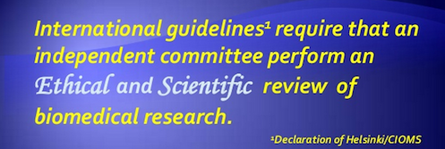
C. Research Ethical Committees Capacity (RECs)..cont’d-3
Challenges

Slide 30
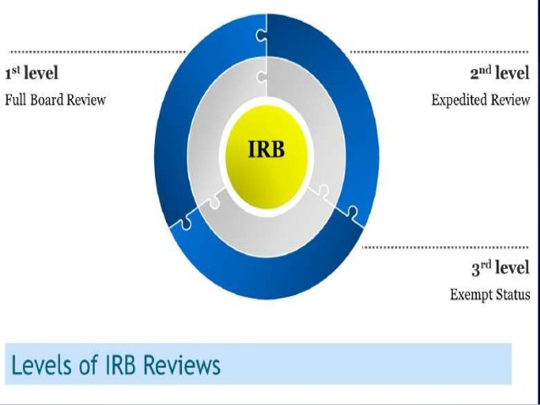
C. Research Ethical Committees Capacity (RECs)..cont’d-4 REC/IRB-Types of Review
Challenges

Slide 31
C. Research Ethical Committees Capacity (RECs)..cont’d-5 RECs/IRB Decisions
Challenges

Slide 32
C. Research Ethical Committees Capacity (RECs)..cont’d-6 Challenges Discovered in Reviews
Challenges

Slide 33
C. Research Ethical Committees Capacity (RECs)..cont’d-7 No Central IRB Model
Challenges

Slide 34
C. Research Ethical Committees Capacity (RECs)..cont’d-8 Data Safety Monitoring Board (DSMB)
Challenges

Slide 35
D. Researchers Training Challenges in Qatar (iHEED)
Challenges

Slide 36
D.Training Researchers (cont’d-2) (MERETI).. Middle East Long-Term Trainees by Country (2004-2010)
Challenges
Notes:
Silverman H, Edwards H, Shamoo A, Matar A. Enhancing Research Ethics Capacity in the Middle East: Experience and Challenges of a Fogarty-Sponsored Training Program. Journal of empirical research on human research ethics : JERHRE. 2013;8(5):40-51. doi:10.1525/jer.2013.8.5.40.

Slide 37
e. Middle East; Research Ethics in the Conflict Zone
Challenges
Attention should be paid while conducting research in the Middle East to
1- National Research Ethics;
2- Various cultural factors that will affect how people will respond to the addressed research question (including fearing of their own safety);
3-How various parties to conflict in the area will react to your presence;
4-The feasibility and flexibility of the research you plan on conducting
(highly unpredictable and delicate environment);
5- The level of risk you are willing to accept in order to undertake your research;
Nothing risked nothing gained
versus
Dead researchers tell no tales

Slide 38
Third Main Challenge
“Patients”
Perception of Research in the Middle East

Slide 39
iii-Patients Perception of Research in Qatar
Challenges
A Population based questionnaire was carried out among the general public in Qatar, administered 2517 questionnaires to examine clinical research participation, of which 2379 complete forms were analyzed. Residents of Qatar, 18 years or above in age were surveyed, anonymously, following verbal consent. .
Factors contributed to participation in research:
Participants previous research experience was associated with positive outcomes
More than ten years of stay within Qatar was a statistically significant determinant of willingness to participate
Barriers to participation :Time constraints, lack of trust in and poor awareness about clinical research are main barriers to participation.
Outcomes: evidence based policies for improvement in recruitment strategies/Culturarely compatible recruitment strategies must be devised for the diverse population of Qatar that demonstrates multispectral factors for accepting or declining participation.
Notes:
Perceptions and attitudes to clinical research participation in Qatar,Contemporary Clinical Trials Communications,Volume 8,2017;241-247;ISSN 2451-8654,https://doi.org/10.1016/j.conctc.2017.10.010.(http://www.sciencedirect.com/science/article/pii/S2451865417301096)

Slide 40
Perception of Research in Qatar (cont’d-2) Demographics of Surveyed Population
Challenges
Notes:
Perceptions and attitudes to clinical research participation in Qatar,Contemporary Clinical Trials Communications,Volume 8,2017;241-247;ISSN 2451-8654,https://doi.org/10.1016/j.conctc.2017.10.010.(http://www.sciencedirect.com/science/article/pii/S2451865417301096)

Slide 41
Perception of Research in Qatar (cont’d-3) Motivations of Participation in Clinical Research
Challenges
To help others’ (31.8%, n = 27);
thought it might improve my access to health care’ (24.7%, n = 21) were the prime motivators for participation.

Slide 42
Perception of Research in Qatar (cont’d-4) Reasons for Declining Participation in Clinical Research
Challenges
The main reasons for declining participation included:
time constraint (47.8%, n = 11);
‘fear’ (13.0%, n = 3);
lack of awareness about clinical research (8.7%, n = 2);
lack of interest (8.7%, n = 2);

Slide 43
Research Opportunities in the Middle East
Disease Pool
Recruitment
Emerging Market
Cost Saving

Slide 44
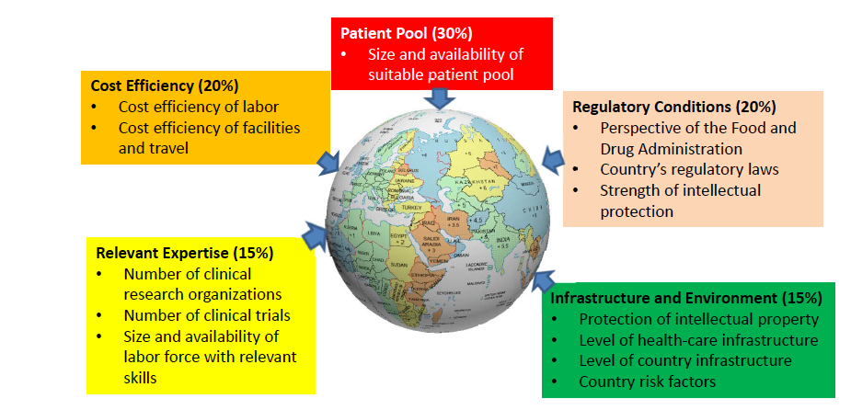
Middle Eastern Countries Attractiveness for Clinical Trials
Opportunities
Nair, Satish & Ibrahim, Halah & Celentano, David. (2013). Clinical Trials in the Middle East and North Africa (MENA) Region: Grandstanding or Grandeur?. Contemporary clinical trials. 36. 10.1016/j.cct.2013.05.009.

Slide 45
i-Disease pool
Opportunities
Genetic and cultural differences within the local populations of the MENA offer unique opportunities for medical research. (different ethnicities, the high rate of consanguineous marriages and the geographic isolation of subpopulation making up the region all contribute to the distinct gene pool of the MENA region);
Epidemiological data for the region indicates a growing incidence of chronic respiratory diseases such as asthma, COPD and bronchitis, hypovitaminosis D;
Metabolic risk prevalence data reflects the potential health risks for the population of this region (One-third of the MENA population);
At least 57% of the total deaths on average in the region are due to the three major non-communicable diseases; of cardiovascular disease (37%), cancer (13%) and diabetes (7%);
The International Diabetes Federation estimates a two-fold increase in Type I diabetes in children 14 years or younger by 2030 for the region, and high prevalence of Type 2 diabetes among the local population in the GCC
Nair, Satish & Ibrahim, Halah & Celentano, David. (2013). Clinical Trials in the Middle East and North Africa (MENA) Region: Grandstanding or Grandeur?. Contemporary clinical trials. 36. 10.1016/j.cct.2013.05.009. (12) Clinical Trials in the Middle East and North Africa (MENA) Region: Grandstanding or Grandeur?. Available frohttps://www.researchgate.net/publication/236948498_Clinical_Trials_in_the_Middle_East_and_North_Africa_MENA_Region_Grandstanding_or_Grandeur [accessed Mar 17 2018

Slide 46
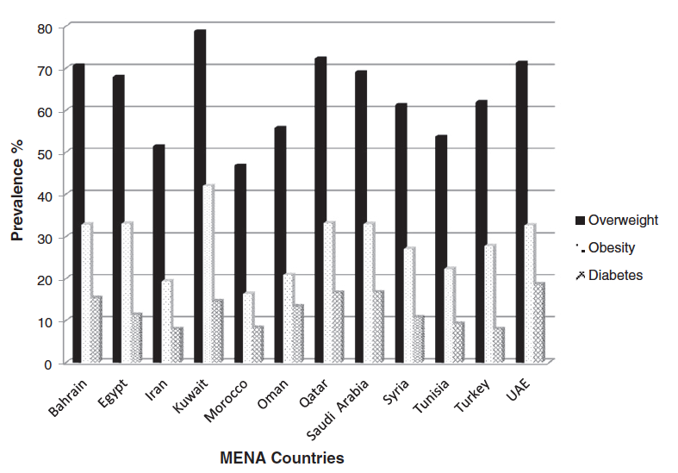
i-Disease pool(cont’d-2)
Opportunities
Prevalence of overweight, obesity and diabetes in MENA countries. Data for the MENA region was compiled and generated from World Health OrganizationNon-communicable Diseases, Country profiles 2011. Body mass index: 25-29.9 (overweight) and
>30 (obese)
Contribution of CVD, cancer and diabetes towards the percentage of
total deaths in MENA countries. Data for the MENA region was compiled and
generated from World Health Organization Non-communicable Diseases,
Country profiles 2011
Nair, Satish & Ibrahim, Halah & Celentano, David. (2013). Clinical Trials in the Middle East and North Africa (MENA) Region: Grandstanding or Grandeur?. Contemporary clinical trials. 36. 10.1016/j.cct.2013.05.009. (12) Clinical Trials in the Middle East and North Africa (MENA) Region: Grandstanding or Grandeur?. Available frohttps://www.researchgate.net/publication/236948498_Clinical_Trials_in_the_Middle_East_and_North_Africa_MENA_Region_Grandstanding_or_Grandeur [accessed Mar 17 2018

Slide 47
ii-Recruitment “The clinical Trial Subject Density”
Opportunities
The clinical trial subject density, expressed as actual number of clinical trial subjects per million population is less than 1% for the MENA region;
Additionally, clinical trial productivity measured as aggregated average number of patients per site is almost two-fold higher in the MENA region than developed markets in the West;
The MENA region accounts for only about 0.5% of global clinical trial sites. 6% of eligible subjects actually participate in a clinical trial;
Subject recruitment is anticipated to grow significantly in the GCC cluster given the economic development/state-of-the-art hospitals and medical centers/joint ventures between public hospitals and international health care providers /the growth of Joint Commission International (JCI) accredited health facilities/and technological advances.
Notes:
Nair, Satish & Ibrahim, Halah & Celentano, David. (2013). Clinical Trials in the Middle East and North Africa (MENA) Region: Grandstanding or Grandeur?. Contemporary clinical trials. 36. 10.1016/j.cct.2013.05.009

Slide 48
iii-Cost Saving (MENA region/GCC “Gas Price Index”)
Opportunities
Nearly one-third of Phase 3 trials for the 20 largest US pharmaceutical companies are outsourced (55%) to reduce cost;
Clinical trial cost-savings for the MENA region, particularly the GCC states, was assessed relative to the global gas/petrol price index, which allows for objective comparison of costs between countries;
Clinical trials cost significantly less (59%) in the GCC and MENA countries, respectively, as compared to the average total cost of 300 million US dollars for a clinical trial in the US.
Nair, Satish & Ibrahim, Halah & Celentano, David. (2013). Clinical Trials in the Middle East and North Africa (MENA) Region: Grandstanding or Grandeur?. Contemporary clinical trials. 36. 10.1016/j.cct.2013.05.009.

Slide 49
iv-Emerging Market “Average Per Capita Expenditure on Healthcare”
Opportunities
The Middle East combined with the African Pharmaceutical market is projected to grow at a compound annual growth rate of around 11-14% during 2010–2013 (Economic development/ change in the epidemiological health profile in the MENA region);
An indicator for growth in the GCC cluster is the average per capita expenditure on healthcare;
GCC cluster spending at US $ 895 is placed higher than the global average (US $ 864). When compared to the UK (US $ 3285), Germany (US $ 4629) and the United States (US $7410), the average per capita expenditure on healthcare is at least 7-9 times less;
The expected growth of pharmaceutical sales alone is a strong driving force to move clinical trials to this emerging market region.
Nair, Satish & Ibrahim, Halah & Celentano, David. (2013). Clinical Trials in the Middle East and North Africa (MENA) Region: Grandstanding or Grandeur?. Contemporary clinical trials. 36. 10.1016/j.cct.2013.05.009.

Slide 50
References
Hanaa Banjar, Gerhild Angyalosi,The road for survival improvement of cystic fibrosis patients in Arab countries,International Journal of Pediatrics and Adolescent Medicine. volume 2, Issue 2,2015,Pages 47-58,ISSN 2352-6467,https://doi.org/10.1016/j.ijpam.2015.05.006.
Transforming Clinical Research in the United States: Challenges and Opportunities: Workshop Summary (2010) Chapter: 3 Challenges in Clinical Research; https://www.nap.edu/read/12900/chapter/4
"3 Challenges in Clinical Research." Institute of Medicine. 2010. Transforming Clinical Research in the United States: Challenges and Opportunities: Workshop Summary. Washington, DC: The National Academies Press. doi: 10.17226/12900.
Alahmad et al.; licensee BioMed Central Ltd. 2012.BMC Medical Ethics201213:34 https://doi.org/10.1186/1472-6939-13-34
Silverman H, Edwards H, Shamoo A, Matar A. Enhancing Research Ethics Capacity in the Middle East: Experience and Challenges of a Fogarty-Sponsored Training Program. Journal of empirical research on human research ethics : JERHRE. 2013;8(5):40-51. doi:10.1525/jer.2013.8.5.40.
Perceptions and attitudes to clinical research participation in Qatar,Contemporary Clinical Trials Communications,Volume 8,2017;241-247;ISSN 2451-8654,https://doi.org/10.1016/j.conctc.2017.10.010.(http://www.sciencedirect.com/science/article/pii/S2451865417301096)
Nair, Satish & Ibrahim, Halah & Celentano, David. (2013). Clinical Trials in the Middle East and North Africa (MENA) Region: Grandstanding or Grandeur?. Contemporary clinical trials. 36. 10.1016/j.cct.2013.05.009

Slide 51
Research Challenges and Opportunities in the Middle East
MECFA-March 2018
Thank You

