Slide 1
Middle East CF Association Adel S. Alharbi, MD.FCCP President, MECFA
Challenges of CF Management in
the Middle East:
Introduction to MECFA

Slide 2
CF In the Middle East
Rising population but still lack of diagnosis a prominent problem.
Different levels of support from State Health Programs.
Varying access to necessary drugs and therapies.
No CF Centers working with interdisciplinary teams following Western standards.
No CF registries collaborating with each other in the region. No accurate data reflecting numbers, medium age of survival or comparable treatment plans.
Little support for the Research community.
Lack of knowledge about CF.
Low numbers of patients surviving to adulthood.
Few support organizations for patients and families.

Slide 3
Introduction to MECFA
Formed in 2016 by a group of dedicated CF clinicians
A CF Medical and Scientific member organization for the Middle East region
Our Mission: Working to increase disease awareness and to disseminate information about the treatment and management of cystic fibrosis in the Middle East.
List of Member Countries: Armenia Azerbaijan Bahrain Oman Egypt Iran Iraq Jordan Kuwait Lebanon Pakistan Palestine Qatar Saudi Arabia Syria Turkey UAE Yemen and Sudan.
We welcome members, visit our website at www.mecfa.org/members to learn more about becoming a member of MECFA.
MECFA Board of Directors
Dr. Adel S. Alharbi, President,
Prof. Dr Bulent Karadag, Vice Presidents
Prof. Dr Ibrahim Janahi, Treasurer
Dr Basil Elnazir, Secretary
Dr Nisreen Rumman, Board Member
Dr Yazan Said, Board Member
Dr Hussein Alkindy, Board Member
Dr Mohsen Aljimi, Board Member.
Notes:
The Middle East CF Association is a community of clinical professionals committed to improving the survival and quality of life for people born with cystic fibrosis in the Middle East. MECFA was established in 2016 by Dr Adel S. Alharbi and Prof, Bulent Karadag. MECFA is a registered non-profit member organization with headquarters in Izmir, Turkey. MECFA plays an important role in developing a network between CF health professionals, patients, and other groups affiliated with rare disease. Our members engage in high quality medical practice treating cystic fibrosis patients, they guide research, newborn screening and data collection and work towards implementing EU and NA CF standards of care in the Middle East. MECFA offers opportunities that help translate scientific and medical progress into the efficient delivery of effective medical care. MECFA works to develop resources that guide our members in advancing CF care in the region.

Slide 4
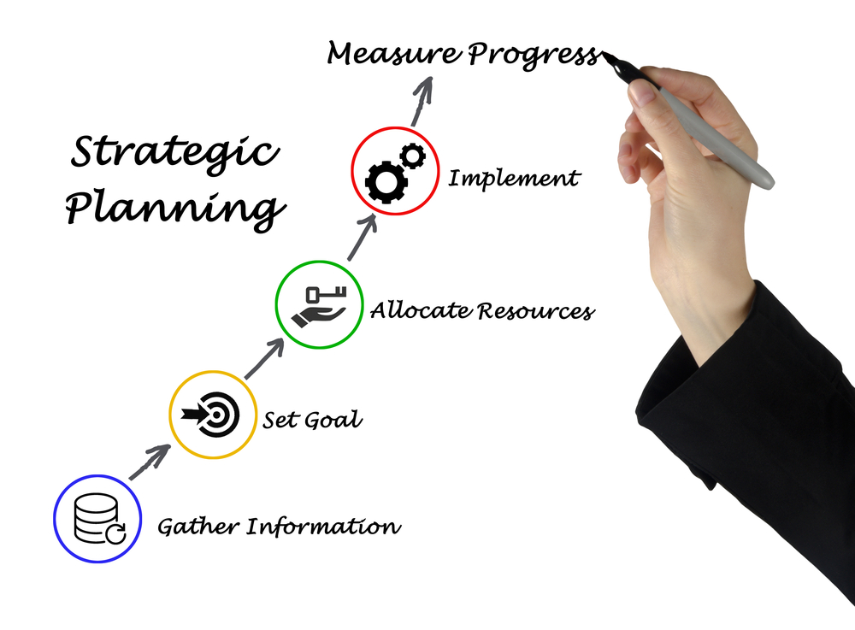
MECFA 3 year strategic plan
MECFA identified a Strategic Plan was vital to provide the organization with direction for decision making over the next 3 years, plus a blueprint for action by the management team.
We have identified six major activity areas of the organisation:
Key Activity 1 – Support the development of CF Care Centres – CF Specialist teams.
Key Activity 2 – Offer education and information in the treatment of cystic fibrosis and advance awareness in the region.
Key Activity 3 – Develop and maintain a Middle East CF Patient Registry.
Key Activity 4 – Support the development of Newborn Screening programs in the region.
Key Activity 5 – Initiate, advance and support research and clinical trials in the region.
Key Activity 6 – MECFA Development/Business Management.
Notes:
Developing a strategic plan was a priority for MECFA, a blueprint for identifying key activity areas of foucs. Discuss the time it took to work together with the board and staff to create the MECFA strategic pan. MECFA's first year of operation was successful due to having a solid plan of acion to follow.

Slide 5
MECFA Programs
Setting goals and aiming high!

Slide 6
MECFA Education Program
Annual regional conference - MECFC
CF Center development and Interdisciplinary team Certification Courses
Collaborated with SPPA to host CME workshops, working with partners for future workshops
Using the MECFA website to post patient and family information, sharing conference presentations and treatment information

Slide 7
Surveying the Middle East
Projects main goal is to support the development of CF Centers staffed with trained clinicians and allied health professionals.
As a newly established association, our first step is to organize a questionnaire to be circulated to MECFA members to indicate the status of cystic fibrosis care in the region.
We will also collect basic data to evaluate the current number of diagnosed patients, to gather information on Newborn Screening in the region, to assess the health status of patients, to understand access and treatment protocols and to identify existing genetic data.
Dr Nisreen Rumman, Chair of the CF Center Development working group will go into detail about this project later in the program.

Slide 8
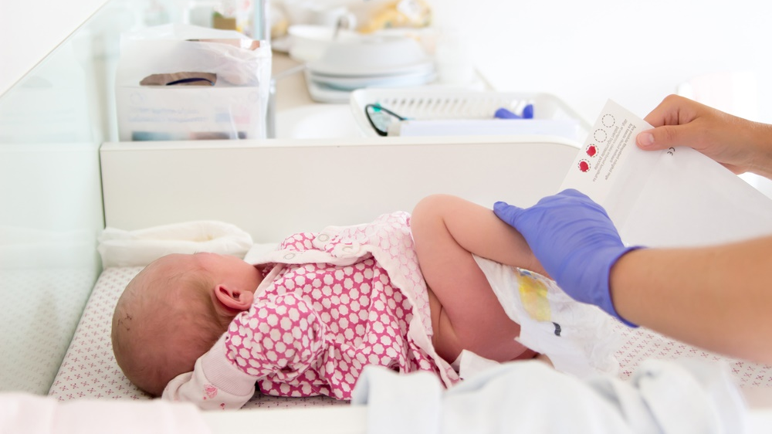
Regional NBS Program
An NBS program in the Middle East will enable standardized CF care in the region while generating reliable data to the MECFA CF Registry and increase the quality of healthcare provided to CF patients.
Specific aims of the MECFA CF Neonatal Screening Committee
To support the implementation of Newborn Screening (NBS) for CF in the Middle East countries,
To monitor performance and compare protocols to optimize effectiveness,
To encourage enrolment of all infants identified through NBS in clinical trials, and
To determine the optimal management of infants with an equivocal diagnosis following newborn screening.

Slide 9
Research and Clinical trial Program
The Middle East CF community is growing. Patients are being diagnosed earlier and more frequently. The region offers new mutations and has a substantial number of patients using the newly FDA approved cystic fibrosis (CF) drugs that target the genetic defect that causes CF.
State of the art medical facilities, laboratories and access to government funding.
The Middle East will contribute vastly to on-going research that we hope will one-day lead to a cure.
Prof Ibrahim Janahi, Chairperson of the MECFA Research Committee will present more information on research in the Middle East later in the program.

Slide 10
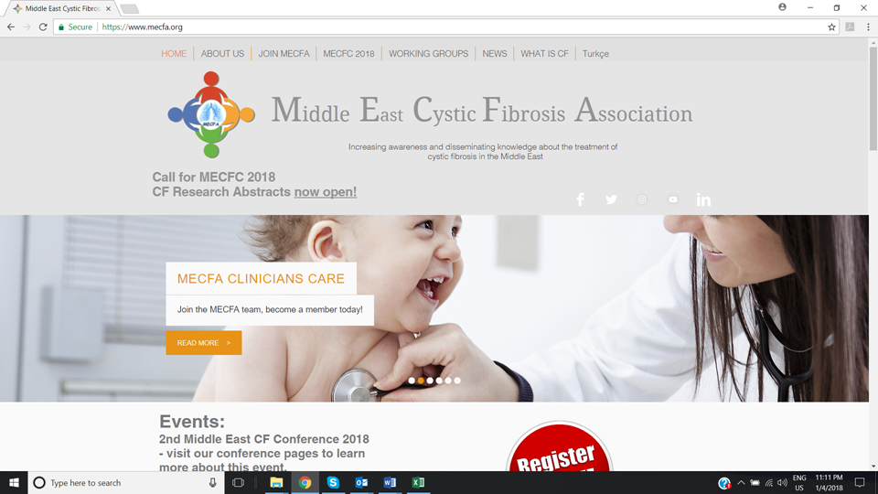
Awareness
MECFA launched a social media campaign to spread awareness about CF treatment and to promote MECFA.
A MECFA social media awareness campaign is incorporating all necessary platforms to connect with clinicians, allied health professionals, public health officials, patients, families and the public at large.
MECFA launched www.mecfa.org in January 2017 to disseminate information about Cystic Fibrosis to clinicians, allied health professionals, patients and families.
Visit our website to connect to our multiplatform social media campaign. www.mecfa.org (English) www.mecfa-tr.org (Turkish)

Slide 11
Future Programs
We keep reaching higher!

Slide 12
Middle East CF Patient Registry
A future goal for MECFA is to develop a CF Patient Registry connecting the region to share data that will lead to improved outcomes for patients while expanding disease research.
Notes:
A CF patient registry can be a powerful tool to observe the course of disease; to understand variations in treatment and outcomes; to examine factors that influence prognosis and quality of life; to describe care patterns, including appropriateness of care and disparities in the delivery of care; to assess effectiveness; to monitor safety and harm; and to measure quality of care.

Slide 13
MECFA future meetings
3rd MECFC 2019
Istanbul, Turkey
March 21-23.2019
Theme “ Challenges of CF care in Middle East”
4th MECFC 2020
Jordan

Slide 14
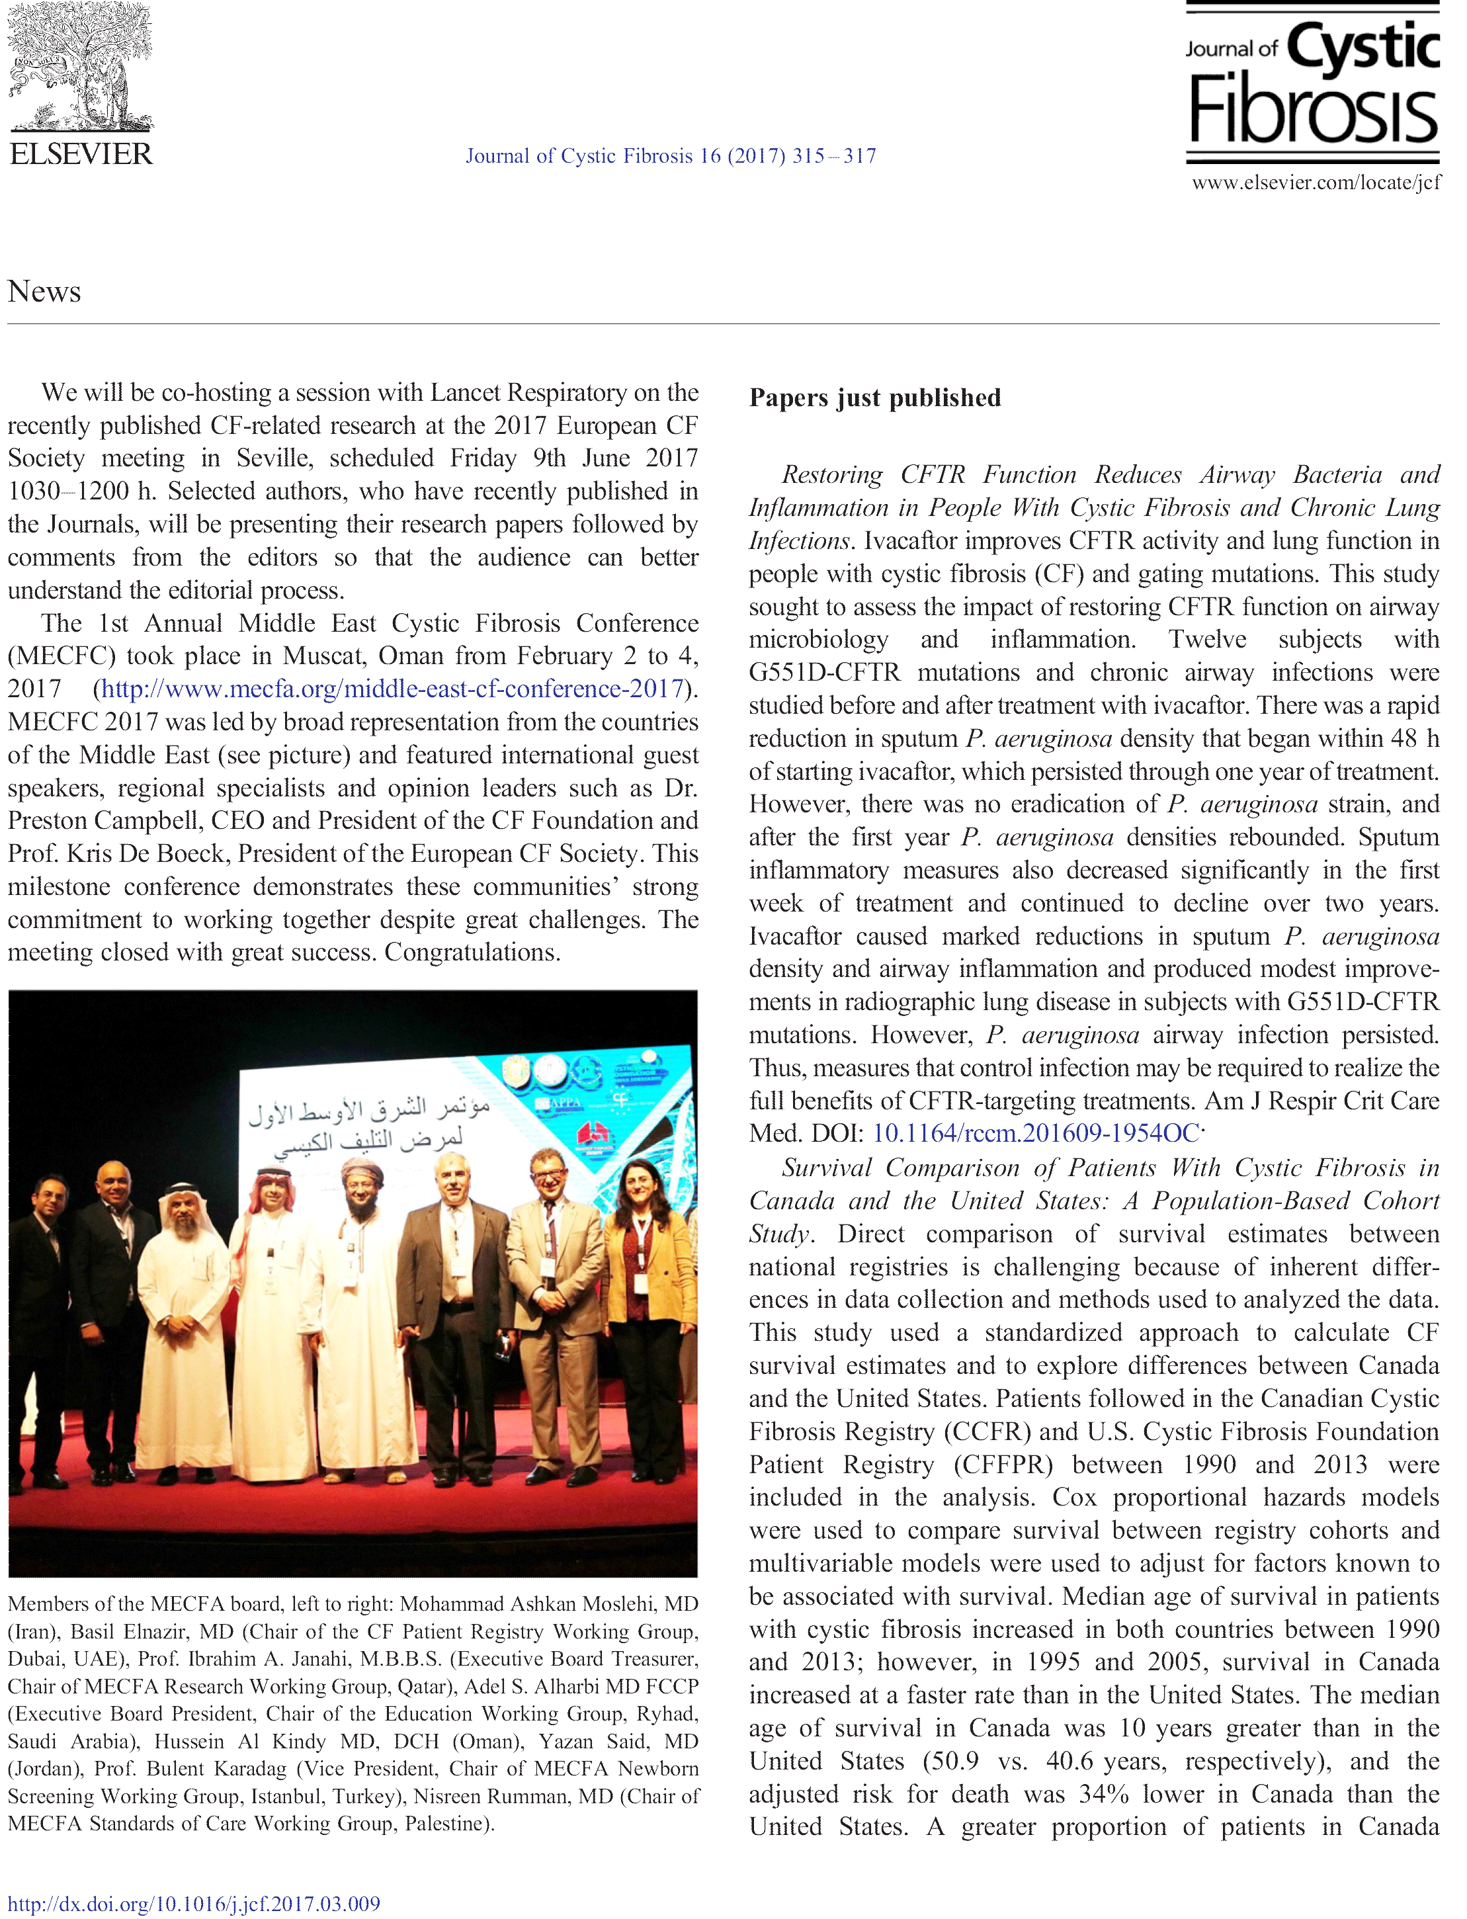
Partners for Progress
Notes:
Thank the CF Foundation for supporting the conference and the development of MECFA with a grant. Thank the ECFS, Prof. Kris De Boeck for getting MECFA mentioned in the Journal of CF. And your regional partners ORS, SPPA APPA for their help in networking with regional clinicians and sponsors.

Slide 15
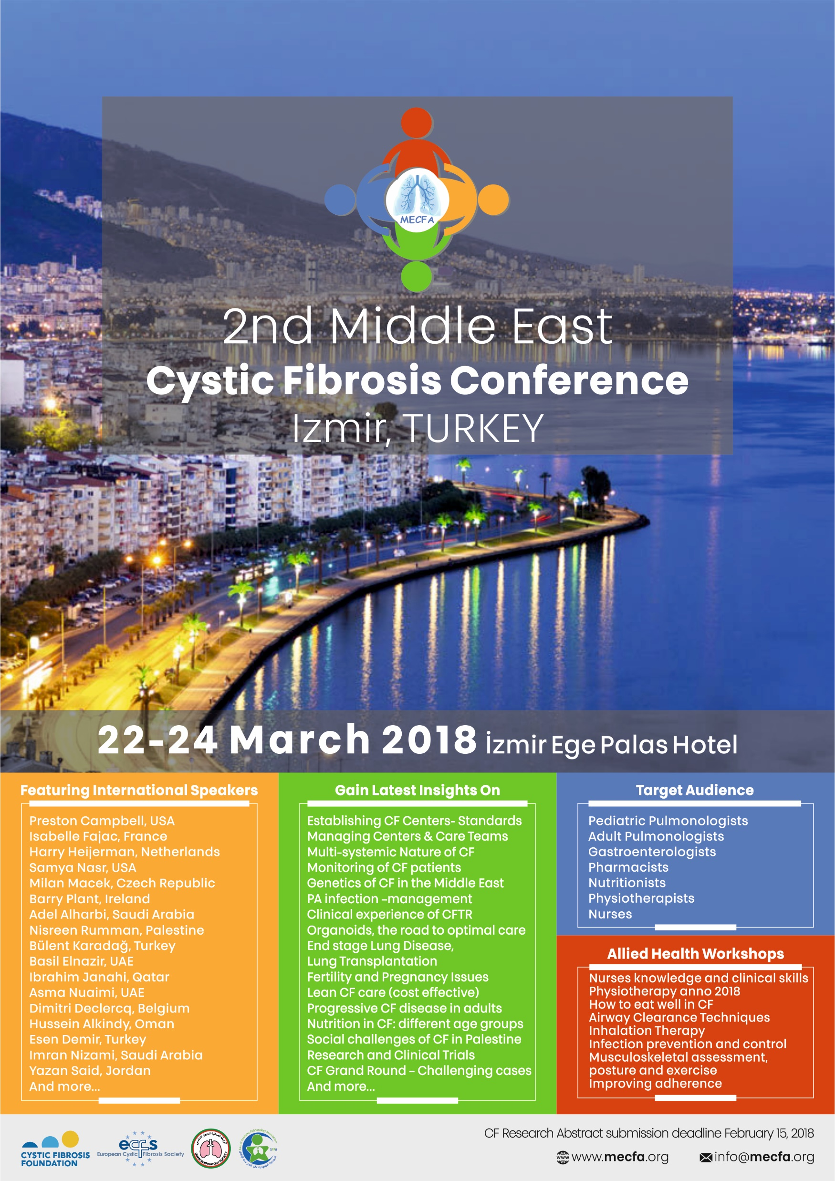
THANK YOU
We hope you enjoy the
2nd Middle East
CF Conference.

