Slide 1
Physical Therapy in CF
Beyond Airway Clearance
Chris Tapley, MS, PT

Slide 2
No Longer a Childhood Disease
According to 2017 Cystic Fibrosis Foundation Patient Registry Data
Children born in the US between 2013 and 2017 can expect to live into their mid-40s.
Life expectancy for CF patients in Canada and the U.K. is similar, with patients living well into their 40s and beyond
CF is no longer a disease of childhood

Slide 3
So what?
We have to take into consideration what these kids will look like as adults
Posture, cardiopulmonary health, bone health and quality of life have to be considered
These need to be addressed as early as possible

Slide 4
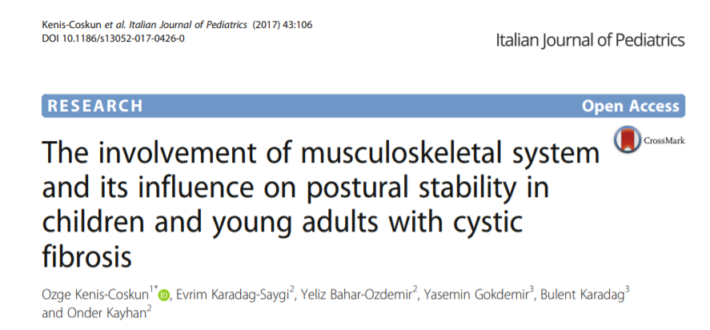
Postural Changes
Notes:
Fifty-one patients with CF and 94 healthy controls participated in the study.
Standardized postural screening showed the CF group had significantly more pathological findings than the control group in lower extremity appearance and movement and spine appearance and movement domains. tandem walking speed was also significantly higher in controls vs CF group.
Recommended a systematic musculoskeltal examination.

Slide 5
Why does posture matter?
Every muscle of the trunk is both a respiratory and a postural muscle
Soda-pop can model of postural control
Diaphragm is dependent on the abdominal and the intercostals for effective and efficient contraction
Do kids with CF decrease activity because they don’t like it or because they can’t meet postural and respiratory demands

Slide 6
Physical Therapy Role
Passed Screening
Postural Screening
No Intervention Necessary
Problem Treated
Failed Screen
Specific Testing
Specific Interventions

Slide 7
Urinary Incontinence (UI)
Systematic Review of 12 articles
Prevalence of 5-76%
UI limited airway clearance, exercise and spirometry
Disease severity not a predictor
Frayman, K.B., Kazmerski, T.M. and Sawyer, S.M. ( 2017) A systematic review of the prevalence and impact of urinary incontinence in cystic fibrosis. Respirology, 23: 46– 54. doi: 10.1111/resp.13125.

Slide 8
What do we do?
Do a basic Screening
Do you leak (urine or feces)?
Do you leak at night?
Do you have a hard time with bowel movements?
Consider abdominal massage for constipation
Referral to qualified pelvic floor therapist if available
Treat Postural Deficits

Slide 9
Bone Mineral Density
Meta-analysis of 10 studies assessing bone disease in CF patients
888 patients
Pooled prevalence of osteoporosis in the adult CF population of 23.5%
Pooled prevalence of osteopenia was 38%
Pooled prevalence of vertebral and other fractures were 14% and 19.7%
Vertebral fractures primarily in thoracic vertebrae.
Paccou, J., Zeboulon, N., Combescure, C., Gossec, L. and Cortet, B. (2010) The prevalence of osteoporosis, osteopenia, and fractures among adults with cystic fibrosis: a systematic literature review with metaanalysis. Calcif Tissue Int 86: 17.

Slide 10
What can we do?
Encourage early bone health
Maximize Nutrition
Adequate Weight Gain
Maximize Physical Activity
Early involvement of Physical Therapy

Slide 11
Activity Recommendations
Exercise and Habitual Physical Activity for People With Cystic Fibrosis: Expert Consensus, Evidence-Based Guide for Advising Patients.
Swisher, Anne; PT, PhD; Hebestreit, Helge; Mejia-Downs, Anne; PT, MPH; Lowman, John; PT, PhD; Gruber, Wolfgang; MSc, PhD; Nippins, Matt; PT, CCS; Alison, Jennifer; PT, PhD; Schneiderman, Jane; CEP, PhD
Cardiopulmonary Physical Therapy Journal. 26(4):85-98, December 2015.
DOI: 10.1097/CPT.0000000000000016

Slide 12
Activity Recommendations
Habitual Physical Activity
Children through adolescents
60 minutes of daily activity
Adults
150 minutes or more per week
Aerobic Activity
>7 through adulthood
30-60 minutes of vigorous activity daily

Slide 13
Activity Recommendations
Strength Training
Under age 12
no formal program, all body weight activities
13 and older
Formal resistance training 2–3 times per week per muscle group
Other Activities
Under age 12
Encourage normal motor development, including agility and balance/ coordination
13 and older
Encourage muscle activities to help prevent or minimize adverse postural changes

Slide 14
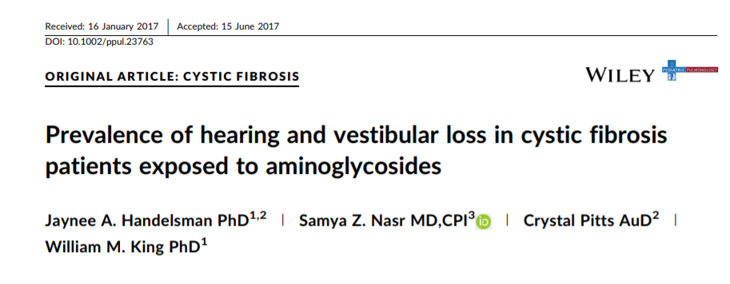
Vestibular Dysfunction
Pediatric Pulmonology. 2017;52:1157–1162.
Notes:
71 patients,
56 (79%) patients have vestibular system dysfunction
15 (21%) have normal vestibular system function.
16 patients (23%) have hearing loss.
In considering the relationship between auditory and vestibular function, 12 (17%) demonstrated both normal hearing and normal vestibular function
13 (18%) have both hearing loss and abnormal vestibular function.
Of the 55 (78%) patients with normal hearing, 43 (61%) have vestibular dysfunction
3 (4%) of patients with normal vestibular function have hearing loss.

Slide 15
For Children under 5 years
Does your child complain of dizziness or show signs of dizziness?
Does your child have frequent motion sickness (nausea or vomiting) in the car, on a swing?
Does your child dislike riding on elevators, escalators or walking over bridges?
Does your child seem to be clumsy, have poor balance or frequent falls compared to other children their age?

Slide 16
Children/Adolescents over the age of 5 years
Does your child complain of dizziness or show signs of dizziness with movement?
Does your child have difficulty reading or complain of blurry vision, jumping letters, when reading a book or in school?
Does your child complain of frequent motion sickness (nausea or vomiting) riding in a car, swinging, or moving objects such as amusement rides, elevators or escalators?
Does your child’s hand eye coordination seem age appropriate during play or sporting activities?
Does your child’s balance seem normal for their age; do they have frequent tripping or falls?
Does your child complain of migraine headaches associated with imbalance or vertigo?

Slide 17
Thank You!

