Slide 1
DEVELOPING CF CENTERS IN THE REGION – THE MA-MI PROJECT

Slide 2
Samya Nasr, M.D. Professor of Pediatrics Director, Cystic Fibrosis Center President, Michigan Thoracic Society Coordinator, State of Michigan CF NBS Program University of Michigan Medical School Ann Arbor, Michigan, USA

Slide 3
Outlines
What is A CF Center- CFF Standards
Marmara CF Center
Collaboration between Marmara and University of Michigan CF Centers “MaMi” collaboration
Adjusting the US CF Center Requirement for the Available Resources in Turkey

Slide 4
What Is A US CF Center
To be accredited as a CF Center:
- The Center should have adequate physicians
and support staff
- CF Center mission according to CFF Guidelines
- Have accredited Sweat Testing lab.
- CFF accreditation visit every 5 years or sooner

Slide 5
What is the CF Center Structure Minimum Requirement
CF Center Director
CF Center Associate Director
CF Center Coordinator
SW, Nurse, Dietician, RT, PT, administrator
Recommended: psychologist, pharmacist
Involvement of: Endocrinologist, GI, ID

Slide 6
CFF Accreditation Requirements
Three Missions:
Patient care and quality of care
Participating in Research; clinical (PI
initiated or Multi-Center) and basic science
Teaching: faculty, trainees and public

Slide 7
Establishing CF Center, Challenges
Having adequate personnel
Securing salary support from the hospital
Having adequate clinic space
Appropriate inpatient rooms / space
Infection control guidelines, Implementations & Challenges

Slide 8
The Marmara- Michigan “MaMI” Project
First Exploratory visit 10/31- 11/2/ 2018

Slide 10
CF Care in Turkey
Marmara CF Center is the major CF center in Istanbul. Second largest in Turkey
Six other smaller CF clinics in the Asian side of Istanbul
One big and 2 small CF clinics in the European side
Most of the patients from the other centres are sent to Marmara CF center at least once a year for follow up
The pediatric pulmonologists in Istanbul are either a graduate of Marmara program or good friends with the faculty members at Marmara pediatric pulmonary program

Slide 11
CF Care in Turkey- Continue
There is a large CF center in Ankara; Hacettepe University CF center
There are a total of 25 CF Centers in Turkey, serving app. 3,000 patients.

Slide 12
CF Care in Turkey- Continue
CF patients in the eastern part of the country are
followed by pediatricians and consult with the pediatric
pulmonologists in other parts of Turkey.
Diyarbakır, Gaziantep are the centers follwing patients
in the Eastern and the Southeastern Turkey.

Slide 13
Marmara University Faculty of Medicine, Division of Pediatric Pulmonology
Center Director: Bülent Karadağ
Full time Pediatric Pulmonologists: Ela Erdem Eralp
Yasemin Gokdemir
Two other Pediatric Pulmonologists semiretired
Two CF nurses: Gülfidan Karasöğüt, Burcu Süzer - Funded by Ronald McDonald Foundation and Abbott
Half time dietitian dedicated to the center and another dietitian that rotates between the other CF clinics in Istanbul

Slide 14
Marmara CF Center
Patients 0 - 17 Years Old: 300
Patients 18 Years and Older: 43
There is NBS in Turkey started in 2015
The adult pulmonary group in Marmara Univ. are taking care of the
patients >18 years of age. They were very engaged and interested
in collaborating with U of M adult CF program
All patients are genotyped. The government is covering the costs
Royal Brompton Hospital and ECFS clinical care guidelines are used
They have been participating in ECFS registry since 2015

Slide 15
Marmara CF Center Other divisions involvement
Pediatric Gastroenterology follows all CF patients. Low BMI was
discussed and the U of M BMI algorithm and publications were shared &
Appetite stimulants use & Lit. was discussed with them
Adult GI are following the adult patients with the adult pulmonary group
Pediatric & Adult Endocrinology are following patients with FTT & CFRD
Microbiology lab directed by Prof. Aysegul Karahasan seems appropriate
Physical therapy ( Dr. Ozge Kenis, Prof. Dr. Evrim Karadag
Saygı& PT techs) follow patients in the outpatient and inpatient settings

Slide 16
Sweat Testing
Accredited by the Turkish Ministry of Health (MoH) as CF
diagnostic &Treatment Center
Quality Improvement documentation approved by MoH
Quantitative pilocarpine iontophoresis testing has been performed for sweat chloride according to CLSI document C34-A3 since 2013 without modifications
MoH has issued a guideline based on CLSI C34-A3 in 2015
Testing is done at >3 weeks of age and older

Slide 17
Marmara CF Center IP&C
Infectious Diseases are involved in antibiotics choices
There was no IP&C policy in outpatient clinics or inpatient
That was discussed and the use of gowns and masks started
U of M clinic rooms’ cleaning protocol was shared with them
They reported that their patients refuse to use masks in the hospital/ clinic areas

Slide 18
Teaching
Marmara University Faculty of Medicine students are taught about CF during the pulmonary rotation and inpatient rounding
Formal and informal lectures are provided to residents and Medical Students
Residents follow CF patients in the inpatient & clinic during
2 months of pediatric pulmonary rotation (4 days/a week)
There are two fellows. Fellows are responsible for CF patients management on the ward and outpatient clinic. They are also encouraged to be involved in CF research
Educational activities for patients & families are performed annually in collaboration with KIFDER (the Turkish Family Advisory Board)

Slide 19
Research Publications
“Evaluation of children with cystic fibrosis by impulse oscillometry when stable and at exacerbation.” Sakarya A, Uyan ZS, Baydemir C, Anık Y, Erdem E, Gokdemir Y, Karadag B, Karakoc F, Ersu R. Pediatr Pulmonol. 2016 Nov;51(11):1151-1158
“Effect of inhaled steroids on clinical and inflammatory parameters in children with cystic fibrosis.” Uyan ZS, Ünlügüzel Üstün G, Haklar G, Çakır E, Oktem S, Ersu R, Karadağ BT, Karakoç F, Dağlı E. Turk J Med Sci. 2017 Nov 13;47(5):1432-1440.
“ The involvement of musculoskeletal system and its influence on postural stability in children and young adults with cystic fibrosis.” Kenis-Coskun O, Karadag-Saygi E, Bahar-Ozdemir Y, Gokdemir Y, Karadag B, Kayhan O. Ital J Pediatr. 2017 Nov 21;43(1):106.

Slide 20
Research Publications-Continue
“Performance Evaluation of a New Coulometric Endpoint Method in Sweat Testing and Its Comparison With Classic Gibson&Cooke and Chloridometer Methods in Cystic Fibrosis.” Gokdemir Y, Vatansever P, Karadag B, Seyrekel T, Baykan O, Bas Ikızoglu N, Ersu R, Karakoc F, Haklar G. Front Pediatr. 2018 May 22;6:133.
“ Hypoglycemia is common in children with cystic fibrosis and seen predominantly in females.” Haliloglu B, Gokdemir Y, Atay Z, Abali S, Guran T, Karakoc F, Ersu R, Karadag B, Turan S, Bereket A. Pediatr Diabetes. 2017 Nov;18(7):607-613.
“Development of immune reactive trypsinogen (IRT) and pancreatitis associated protein (PAP) kits for early diagnosis of cystic fibrosis at newborn screenings”. Fatma Yücel (PI at the national level), Bülent Karadağ (PI at the center level)

Slide 21
Administration
Dean of the Faculty : Prof. Hakan Gündüz, Pediatric PM&R. Fellowship trained in the US
Administrator of the Hospital: Prof. İsmail Cinel, Anaesthiologist
Both were very supportive and excited about the possibility of collaboration with MECFA, CFF and U of M CF center.

Slide 22
Need for Improvement / Challenges
Having stable adequate personnel
Securing salary support from the hospital/ MoH & donations
Need for IP&C policy/ Guidelines
Challenges of implementation of IP&C guidelines
Inadequate clinic space

Slide 23
Need for Improvement / Challenges-Continue
Most patients are not scheduled regularly
That makes prior preparation for clinic very difficult, adds stress to the nurse coordinator and the rest of clinic staff. Also it makes implementing IP&C difficult
Poor nutritional data
Poor FEV1 data especially in teenage years despite use of Pulmozyme and BD. Few patients have access to HS & the use of inhaled antibiotics is limited

Slide 24
Short Term Recommendations
Implementation of IP&C. They plan to look at organisms the year before & the year after implementation as a QI initiative
Install HEPA filter in PFT lab, if possible
Reconfigure the clinic space to allow for 2 CF clinic rooms with the PFT lab in between
Implement a QI project to improve nutritional data
A step to improve FEV1, the team will work with the hospital pharmacists to have HS available for patients

Slide 26
Short Term Recommendations- Continue
Partnering with KIFDER (the Turkish Family Advisory Board) to educate the patients and families about the importance of IP&C and wearing masks in the hospital
Work with KIFDER to educate the patients & families to schedule clinic appointment ahead of time & reduce the walk-in clinic appointments & help organize clinics better
Collaborate with KIFDER to implement IP&C policy and reduce patient-patient interactions in the clinic area

Slide 27
Future Plans/Collaborations
To implement a state of the art, world class multidisciplinary CF Center in Istanbul, Turkey
To establish a care center able to manage all clinical aspects of patients with CF
To follow the best evidence-based care guidelines and adapting them to Turkey’s setting

Slide 28
Future Plans/Collaborations
To improve clinical outcomes of patients with CF seen at the Center
To improve the nutritional status measured by BMI
To improve the lung function measured by FEV₁% and by FEF 25-75% predicted

Slide 29
Future Plans/Collaborations
To focus on Quality Improvement work
The team at UM will work closely with Marmara CF Center (MaMi) to establish QI projects in the short term and in the long term
Work started in a QI project addressing BMI using UM algorithms and protocols

Slide 30
Future Plans/Collaborations
To train a multidisciplinary expert CF Team based on resources available in Turkey
The training will occur in collaboration with the UM CF Center. Training and exchange of knowledge will occur both in person in the US and Turkey and on line exchange

Slide 31
Future Plans/Collaborations
Involving all CF center faculty and staff at both institutions
Current visit includes CF Center Director, RT, PT & dietitian
UM team will be coming once a year for face to face visit to Marmara CF Center
Marmara team will be coming once a year to visit UM
Marmara Ped. Pulm. fellow will be coming this summer for 2 months rotation at UM
There will be on line meetings between the visits to follow up on progress and start joint research

Slide 32
Future Plans/Collaborations
Goal is to achieve, in 5-8 years a median life expectancy approaching 30 years of age
This will be accomplished by using evidence-based, state of the art healthcare delivery, operating under strict quality improvement principles, ongoing multidisciplinary team training, and establishing a meaningful clinical research initiative

Slide 33
Recommendations for CF Infection Prevention & Control (IP&C)

Slide 34
Current Updates
Recommendations for IP& C in CF
Education: Healthcare personnel, patients & families should be updated on the guidelines. /Adherence should be monitored by the CF team
Minimizing transmission/acquisition: Assume that ALL CF patients could have transmissible pathogens & should be separated by 6 feet (does not apply to members of the same household)
Hand hygiene (includes all personnel that come in contact with patients)
Immunizations: Healthcare personnel should be vaccinated as well as CF patients & family members (including influenza)

Slide 35
CFF recommends that CF centers work with their institutional IP&C teams to develop protocols, checklists and audits to standardize implementation for:
Cleaning and disinfecting multi-use items (e.g., patient care equipment, oximeters, iPADs, computers)
Cleaning and disinfecting surfaces in the healthcare environment (i.e., CF clinic, pulmonary function test rooms, hospital rooms, sinks and showers).
CFF recommends that healthcare personnel should disinfect their stethoscopes before and after use on each patient in accordance with institutional IP&C policies.

Slide 36
IP&C Recommendations- Continue
CFF recommends that all healthcare personnel implement Contact Precautions, i.e., wear a gown and gloves, when caring for people with CF regardless of the respiratory tract culture results, in clinic & inpatient settings
CFF does not recommend that people with CF wear gowns or gloves in CF clinic, in other ambulatory healthcare settings, or while hospitalized

Slide 37
IP&C Recommendations- Continue
Recommendations for IP&C: CF Clinics
Recommend minimizing time in common waiting areas (ie staggered clinic schedule)
Any individual infected with Burkholderia spp should be scheduled on separate days
All CF patients should wear surgical masks in any healthcare facility to reduce risk of droplet precautions (also includes public restrooms in such facilities)

Slide 38
More Outpatient clinics
Stagger clinic schedule
Place people with CF in an exam room upon arrival in the clinic
Use a pager system or personal cell phone to alert people with CF that exam room is available
Keep person with CF in one exam room while CF team rotates through it
Do not share common items, (e.g., clinic computer and toys) and request that people with CF bring their own recreational items to clinic
CFF recommends that all newly diagnosed people with CF are separated from other people with CF in clinic until adequate IP&C education has been provided to them and their family

Slide 39
CFF Recommends That PFTs Are Performed In One Of The Following:
In the exam room at the beginning of the clinic visit
In a negative pressure room (Airborne Infection Isolation Room)
In a PFT lab with either portable or integrated high- efficiency particulate [HEPA] filters
In a PFT lab without HEPA filtration, allowing 30 minutes to elapse before next person with CF enters PFT lab

Slide 40
Hand-held Reusable Nebulizers (E.G., Home Equipment) Be Managed As Follows:
(1) After each use, clean, disinfect, rinse with sterile water and air dry away from sink.
(2) The nebulizer can be reprocessed (e.g., by steam sterilization) after each use if it is performed according to the manufacturer’s instructions, CFF recommendations for home care, and the nebulizer can be returned to the patient in time for the next treatment.

Slide 41
IP&C Recommendations: Inpatient Settings
Similar to outpatient setting
Individuals visiting CF patients should follow local hospital IP&C policies for the use of masks, gowns, and gloves
All healthcare personnel should use Contact Precautions for ALL CF patients (gown and gloves)

Slide 42
Recommendations for IP&C: Non-healthcare Settings
Only one person with CF can attend CF Foundation-sponsored, healthcare-sponsored, or CF Center sponsored indoor events to reduce risk of person-to-person transmission
CF patients can attend the previously mentioned events outdoors, but most remain 6 feet or 2 meters apart from others with CF.
CF patients should avoid direct contact with individuals with skin/soft tissue infections caused by MRSA, unless wounds are covered, hand hygiene is used, and no personal items shared
Should avoid activities that generate dust from soil to decrease exposure to potential pathogens (ie Aspergillus)

Slide 44
Recommendations to address the Psychosocial Impact of IP&C
Providing age-targeted educational tools
Providing counseling to address psychosocial issues
Collaborate with Child Life staff
Provide accommodations/ outlets to relieve psychosocial stress on inpatient/outpatient infection control guidelines

Slide 45
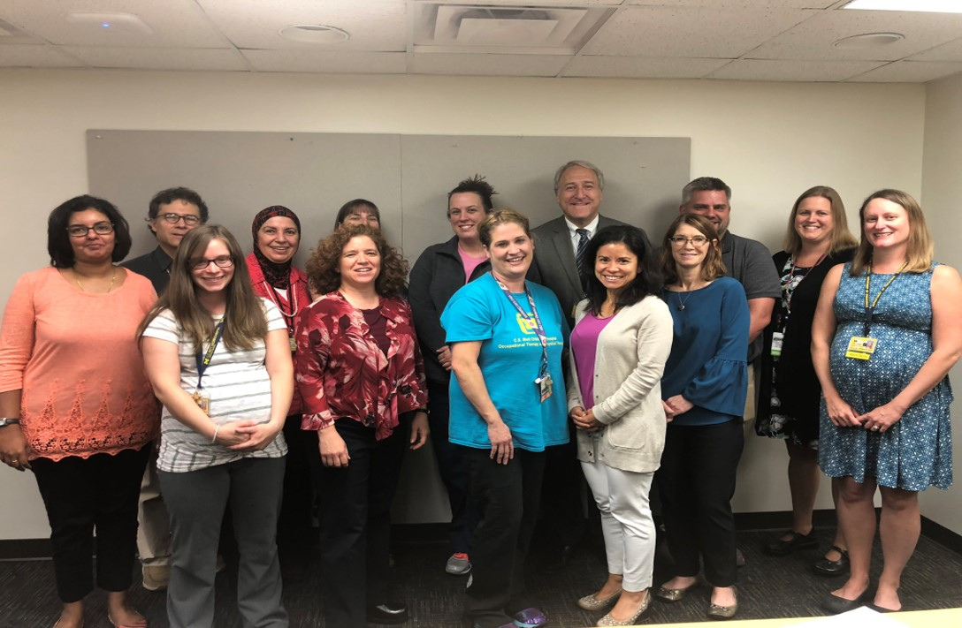
THANK YOU

Slide 46
What Is A CF Center
Over 120 CF Centers accredited by the CFF
Centers usually consist of Pediatric and Adult CF Programs
Affiliate CF Centers are usually smaller centers. Usually affiliated with accredited CF Center geographically close to the center

Slide 47
Guidelines for Personnel Time Allotments to CF Centers
1. M.D.’s: 1 Full Time Equivalent (FTE) per 100 – 150 patients. There is a minimum requirement of 2 M.D.’s per center.
2. R.N.: 1 FTE per 100 – 200 patients.
3. Social Worker: 1 FTE per 100 – 200 patients.
4. Dietitian: 1 FTE per 100 – 200 patients.
5. Respiratory Therapist: 1 FTE per 100 – 200 patients.

Slide 49
Future Plans/Collaborations
To establish a network of CF centers across Turkey
Once the pilot project with UM CF Center has been consolidated, we hope to work with Hacettepe CF center to develop 2 regional CF Centers that meet CFF guidelines, as a part of National CF Center Network
This network will be encouraged to meet the requirements of CFF for center accreditation with necessary modifications.

Slide 50
Care Of Nebulizers In The Hospital
Nebulizers are for single patient use only
Aseptic technique is always followed when handling the nebulizer and dispensing medications
Single dose vials of medication used in nebulizers are preferred
hand-held disposable nebulizers be managed as follows:
(1) After each use, rinse out residual volume with sterile water
and wipe mask/ mouthpiece with an alcohol pad
(2) Discard the nebulizer every 24 hours

Slide 51
Recommendations for IP&C: Healthcare Personnel with CF
Should not provide care for other CF patients
CF patients interested in healthcare career seek counseling from their CF care team
Healthcare personnel with CF should inform their employers’ Workforce Health & Safety Dept. about their diagnosis to minimize transmission/acquisition (disclosure is confidential)

