Slide 1

Lean Practice in Cystic Fibrosis
Harry Heijerman
University Medical Centre Utrecht
Utrecht
The Netherlands

Slide 2
Disclosures Harry Heijerman:
Grants/Research Support: Gilead, Novartis, GSK, Vertex
Speakers Bureau/Honoraria: PTC, Novartis, Vertex, Raptor, Gilead
Consulting Fees: Vertex, Raptor, PTC, Gilead

Slide 3
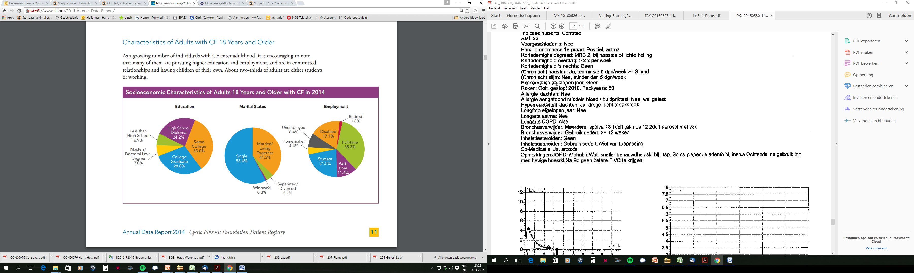
CFF annual data report 2014

Slide 4
Lean thinking concepts in health care:
Defining "value" from a patient perspective
Identifying "waste" and non-value-added activity
Identifying and improving "value-streams"
Creating better "flow" for patients and processes
Preventing errors and improving quality in a systematic way
Creating an environment of continuous improvement

Slide 5
Successful lean healthcare efforts result in measurable improvements in patient outcomes:
improved quality,
less harm due to preventable errors,
better access,
shorter waiting times,
better service.

Slide 6
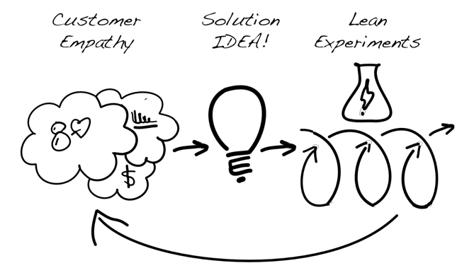
Lean innovation process

Slide 7
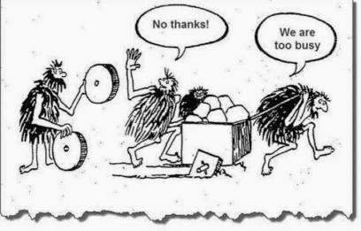
Every patient or member of your team can contribute

Slide 8
Some examples

Slide 9

CFRD
Annual screening for CFRD should begin by age 10 years in all CF patients who do not have CFRD.
Screening for CFRD should be performed using a 2-h 75-g OGTT. (ADA-E; Consensus)
Glucose measurements: Fasting, 1 hour post, 2 hour post.

Slide 10
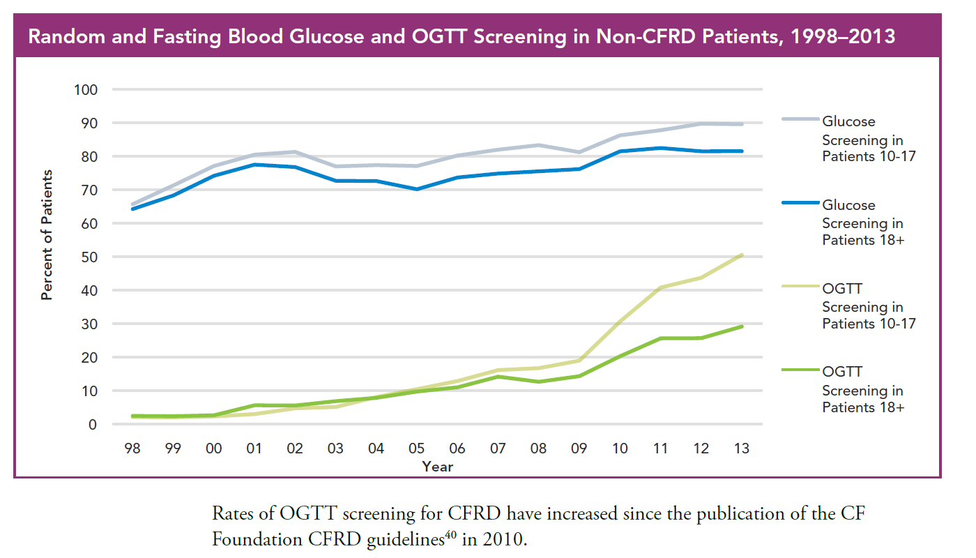

Slide 11
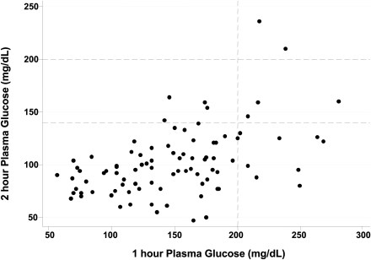
BUT: driving two hours without eating………
&
have to stay in the hospital for at least 2 hours.
When: Fasting glucose levels are not expected to be elevated
when OGTT’s are yearly done
&
1 hr PG levels appear to be more sensitive compared to 2 hr PG levels
and elevated PG1 levels are associated with worse pulmonary function.
Brodsky. Diabetes Care 2011

Slide 12
Lean thinking concepts:
Defining "value" from a patient perspective
Fasting and 2 hr post glucose levels have no added value for the patient.
Identifying "waste" and non-value-added activity
This may be considered as waste of resources and time.
Identifying and improving "value-streams"
Value based health care
Creating better "flow" for patients and processes
Better protocol for OGTT (only 1hr post level, no fasting= Glucose Challenge Test)
Preventing errors and improving quality in a systematic way
No false negative 2 hr PG levels
Creating an environment of continuous improvement
Enthousiastic staff and patients, high compliance.

Slide 13
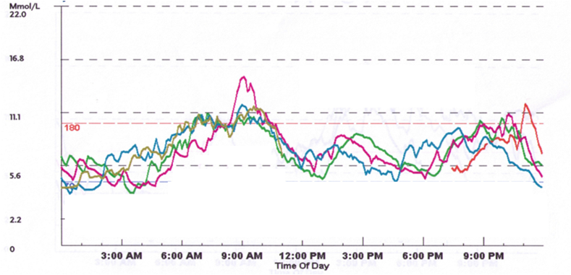
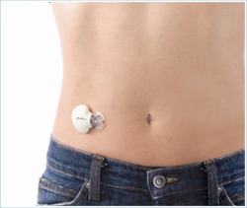
When there is a impaired or positive GCT as determined by 1 hr PG:
(glucose levels are measured in very short time)
3 x 24hr continuous glucose measurement, send back by mail to the CF clinic.
Done by CF nurse practitioners at the same day.
CF doctor (pulmonologist) and CF np take care of treatment of CFRD.

Slide 14
Inhaled therapies

Slide 15
Cayston: Cayston care service: commercial health care provider MEDIQ
Tobi : commercial provider Alloga
Colistin/Colbreathe: commercial provider ApotheekZorg
Etc. etc.

Slide 16
Medicaton for inhalation challenge test
FEV1 before and after inhalation
- bronchoconstriction (> 10-15%)
- cough (intolerable)
Prevents waste and possible pulmonary detorioration.

Slide 17
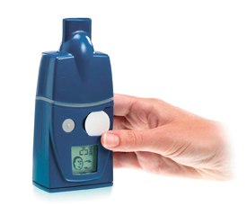
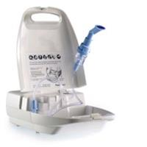
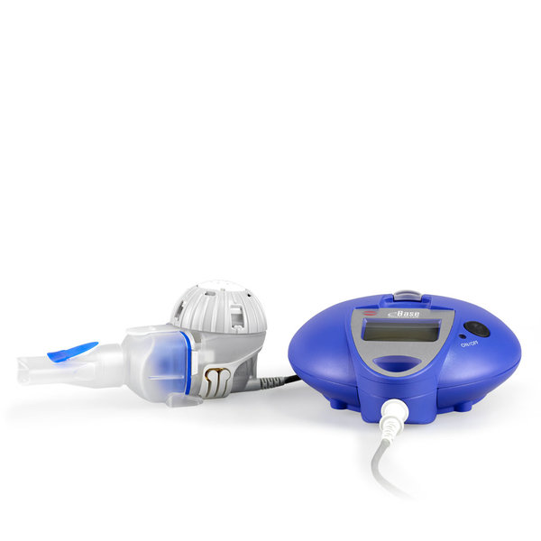
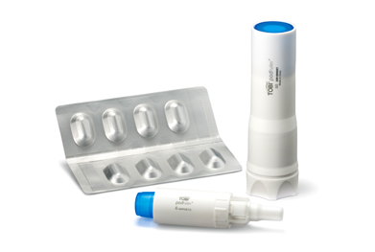
CF specialised nurse
Everything in stock……. and delivered by the Public Hospital Pharmacy

Slide 18

Lean thinking concepts in health care:
Defining "value" from a patient perspective
Identifying "waste" and non-value-added activity
Identifying and improving "value-streams"
Creating better "flow" for patients and processes
Preventing errors and improving quality in a systematic way
Creating an environment of continuous improvement

Slide 19
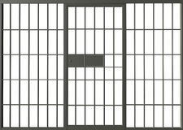
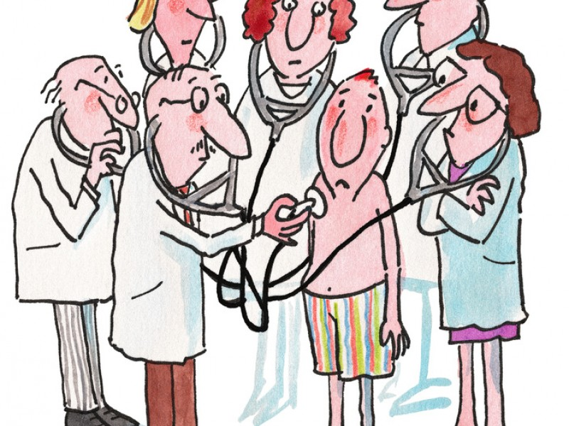
Yearly check-up for patients with CF.
Yearly lock up for patients with CF.

Slide 20

Just ticking off boxes?
Pulmonologist
Gastro-enterologist
Endocrinologist
ENT specialist
CF nurse
Dietician
Physiotherapist
Social worker
Psychologist
Pharmacist

Slide 21
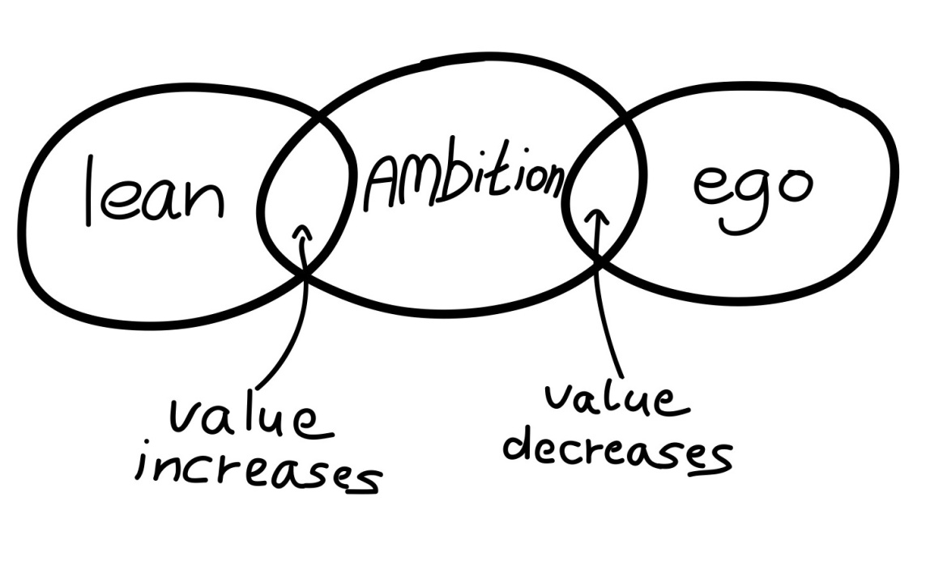
Tick off professionals before………
Pulmonologist
Gastro-enterologist
Endocrinologist
ENT specialist
CF nurse
Dietician
Physiotherapist
Social worker
Psychologist
Pharmacist
CF specialist
& CF nurse
&
Patient
+/-
+/-
+/-
+/-
+/-
When: now, next visit, separate visit?
How: physical, E-mail, Skype, Phone?

Slide 22
Out of hospital treatment.

Slide 23
The Netherlands
Public pharmacy’s (2014): 2370
Number of CF patients (2014): 1450
CF = Polypharmacy or better: Hyperpharmacotherapy
- drug interactions
- drug allergy
- drug provided by national pharmacy services
(Organized by pharmaceutical companies)
- expensive drugs (risk for the local pharmacy)
- impossible to provide prescribed drugs (e.g. vitamins)
- new expensive drugs (Kalydeco, Orkambi)
- adherence to therapy.
- home IV’s, often taken care of by other parties.
The hospital takes it all………

Slide 24
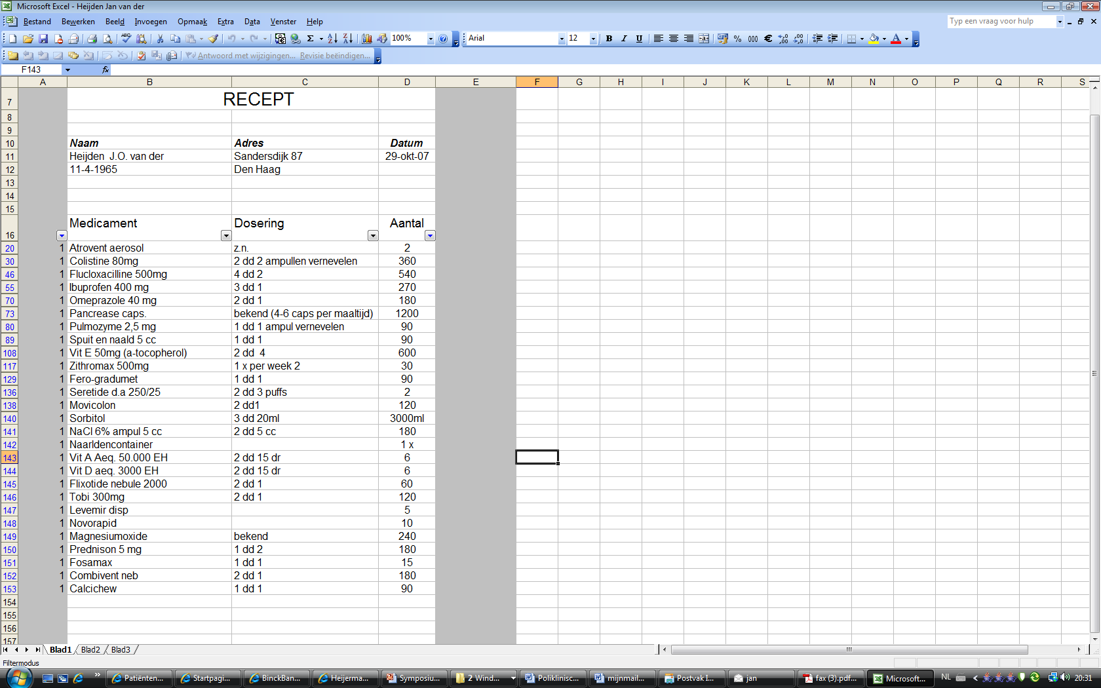
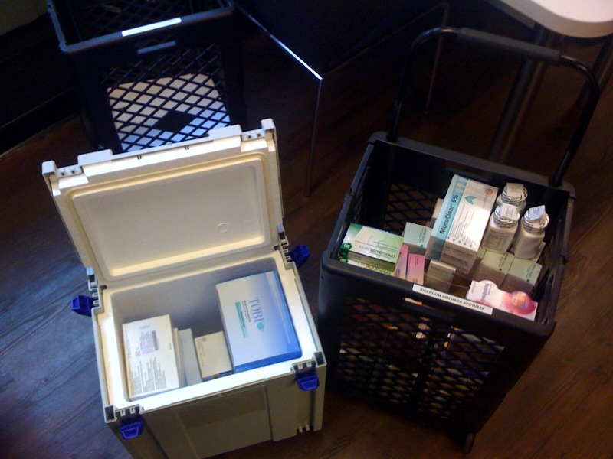

Slide 25
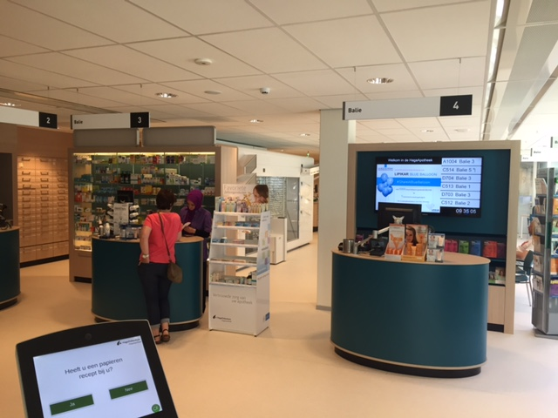
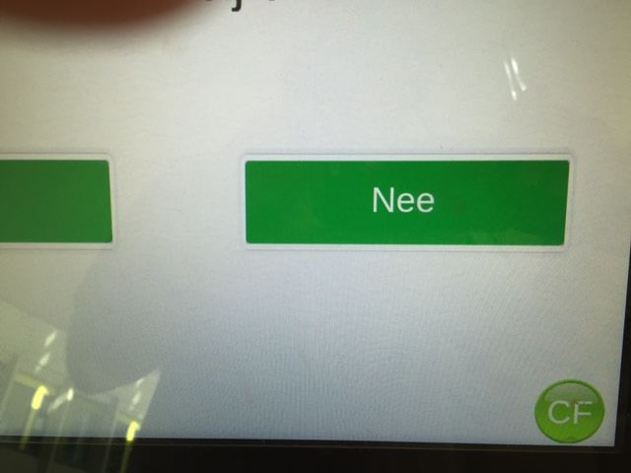

Slide 26
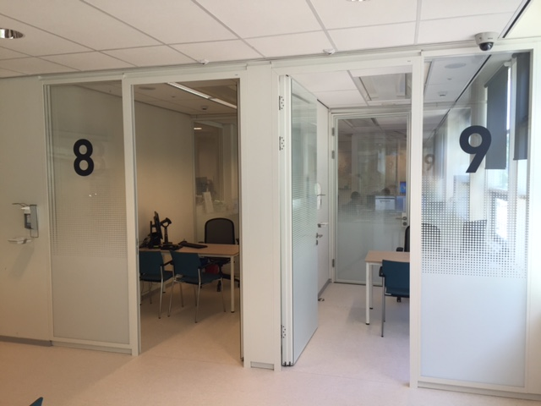

Slide 27
Public pharmacists (2 dedicated to CF care)
Part of the CF team.
Visit ECFC yearly
Take part in National educational activities.
Have personal contact with all CF patients.
Close collaboration with hospital pharmacy
Home IV care, hospital pharmacy prepares
Public pharmacy takes care of delivery and monitoring.

Slide 28
Flow chart of home IV care
Outpatient clinic
Indication for IV treatment
Daily time slot for central line (Intervention radiology)
3 hour admission with he start of IV treatment
(control for allergy)
During these hours the hospital prepares the cassettes/pumps
And the CF nurse gives education on Home IV treatment.
Patient goes home the same day with IV medication for one week.

Slide 29
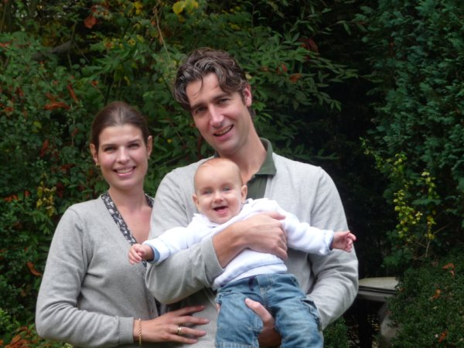

Slide 30
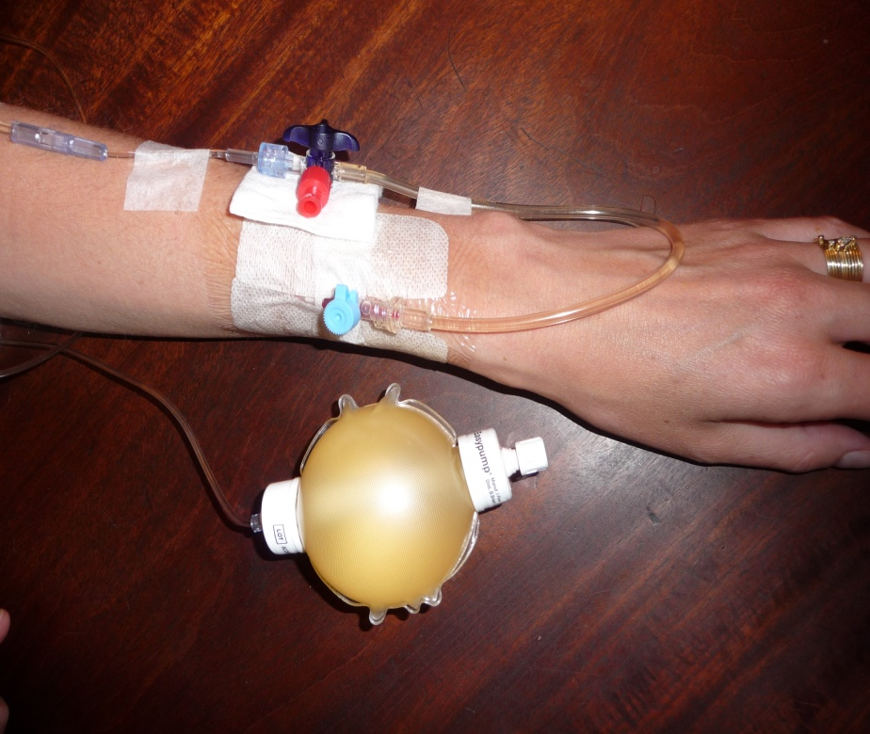
Home IV treatment
Measuring tobramycin
serum levels by “dry blood spot”

Slide 31


Aminoglycosides – toxicity: hearing, vestibular, renal.
Optimal dosing, limited blood samples, limited dosing adjustments
(Daan Touw)
Hospital Pharmacy
Outpatient
Pharmacy
Dry blood spot

Slide 32
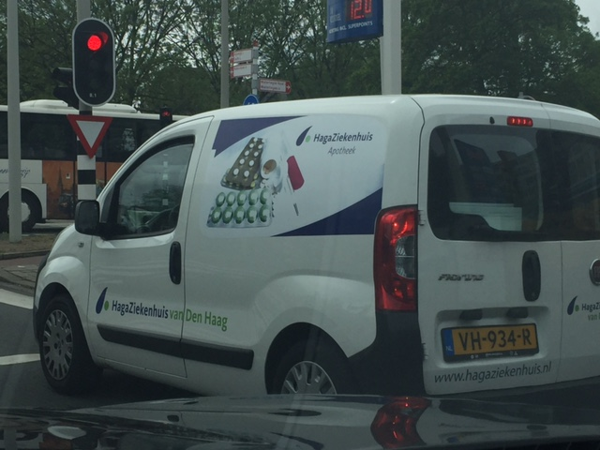

Slide 33
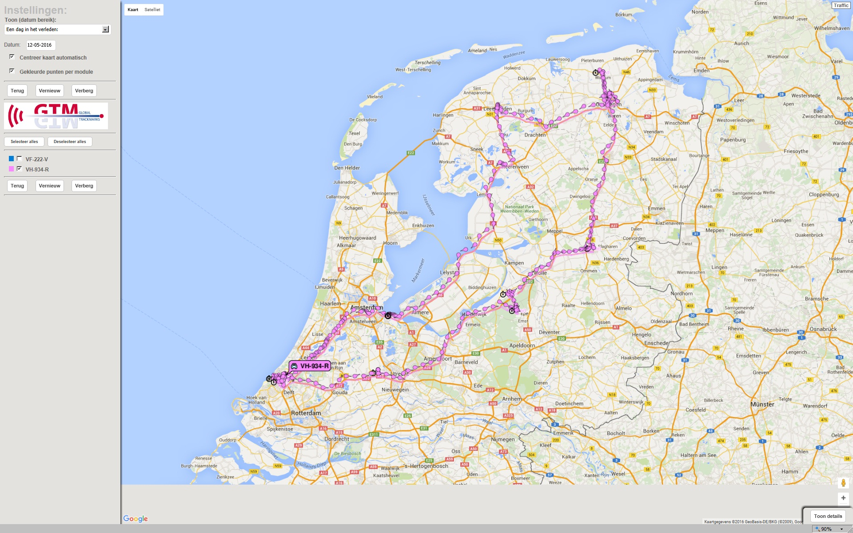

Slide 34
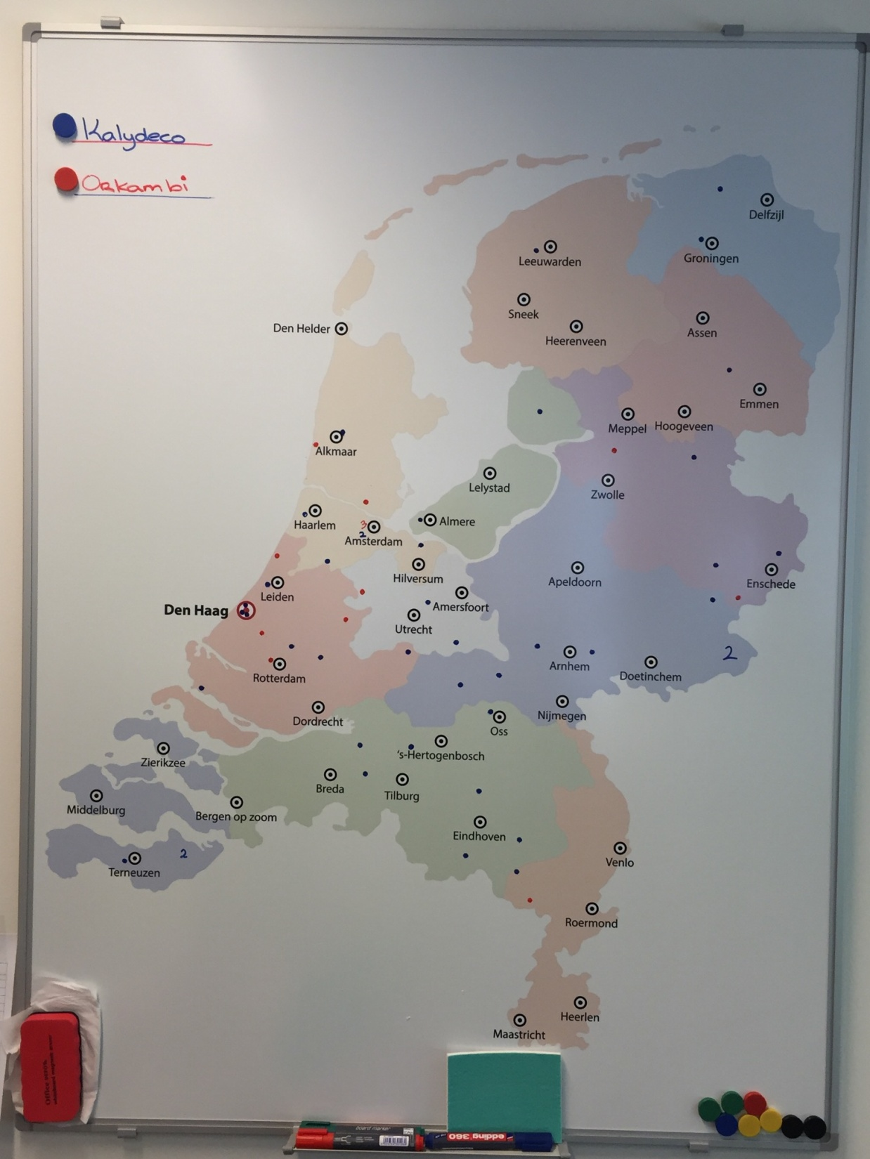

Slide 35
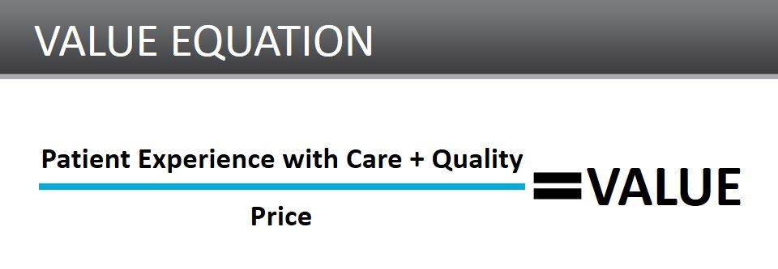
Time + disturbance of daily life
Michael Porter

Slide 36
Lean innovation process
THINK out of the BOX

Slide 37


What is BOX?
Procedures
Culture
Policies
Regulations

Slide 38
