Slide 1

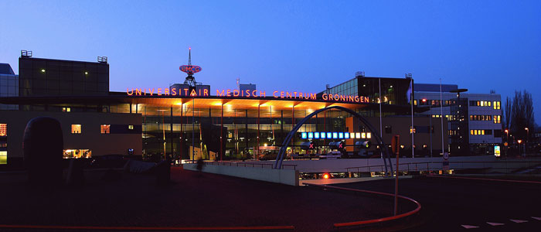
Pharmacokinetics and Therapeutic Drug Monitoring in CF
Prof. dr. D.J. Touw, hosp pharm, clin pharmacol, toxicol
RUG/UMCG, Dept. Clinical Pharmacy and Pharmacology
3rd ME CF symposium 2019

Slide 2


Disclosure
DJT reports grants from Chiesi and Astellas and ZONMW outside this topic

Slide 3


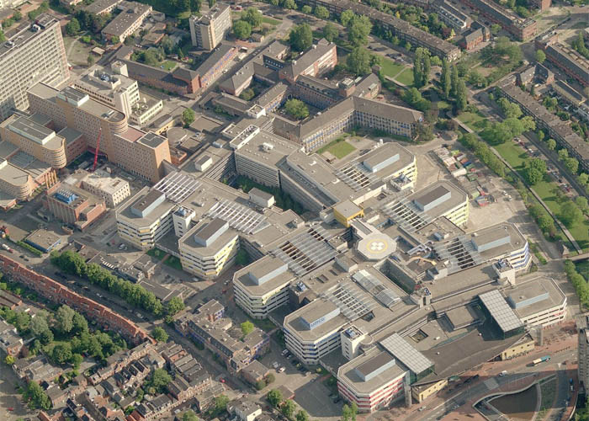


Slide 4
Outline
PK/PD of beta lactam antibiotics
PK/PD of aminoglycosides
PK confounders influencing PK in CF
Role of TDM to optimise aminoglycoside therapy
Conclusions

Slide 5

Basic principles of antibiotics
Pharmacokinetic/ Pharmacodynamic (PK/PD) principles:
  Concentration dependent antibiotics: bacterial killing increases with increasing concentration
  Time dependent antibiotics: bacterial killing is independent from concentration
Bacterial
Killing
Rate
Aminoglycosides
Fluoroquinolones
B-Lactams
Local concentration

Slide 6
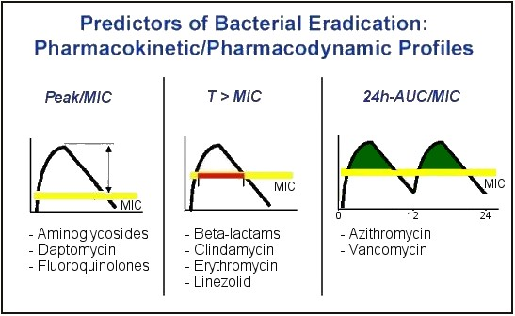
Pharmacodynamic principles:

Slide 7
Beta-lactam antibiotics

Slide 8
PK/PD principle: Time C > MIC
Beta-lactams

Slide 9
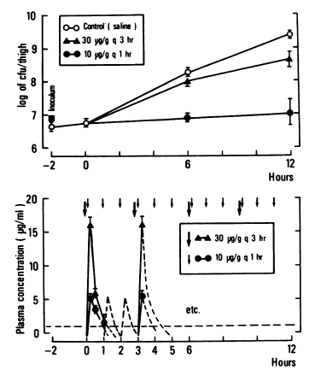
Beta-lactam antibiotics
Bacterial growth with two dosing regimens of ticarcillin in neutropenic mouse P. aeruginosa infection models:
Control
Dose | T>MIC | Outcome
30 mg/kg q 3hrs | 35% | Growth
10mg/kg q 1h | 60% | No growth
MIC
Gerber, J Inf Dis 1983

Slide 10
Continuous infusion
P. aeruginosa exposed to ceftazidime c.i.
Steady-state free concentrations studied:
  1x MIC (o - - o)
  4x MIC (+——+)
  16x MIC (Δ - - Δ)
control
Mouton, AAC 1994

Slide 11
Clinical evidence for c.i.
ICU patients infected with P aeruginosa who received piperacillin – tazobactam for a P. aeruginosa infection
  Cohort A: 3375 mg every 4-6 hours given as 30 min infusion (Intermittent infusion, N=92)
  Cohort B: 3375 mg every 8 hours given as 4 hours infusion (Extended infusion, N=102)
Lodise, CID 2007

Slide 12
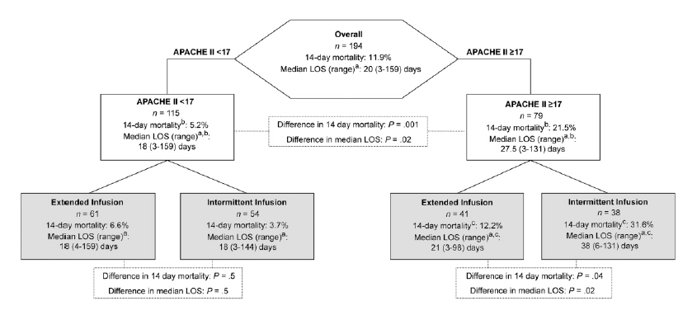
Clinical evidence for c.i.
Lodise, CID 2007

Slide 13

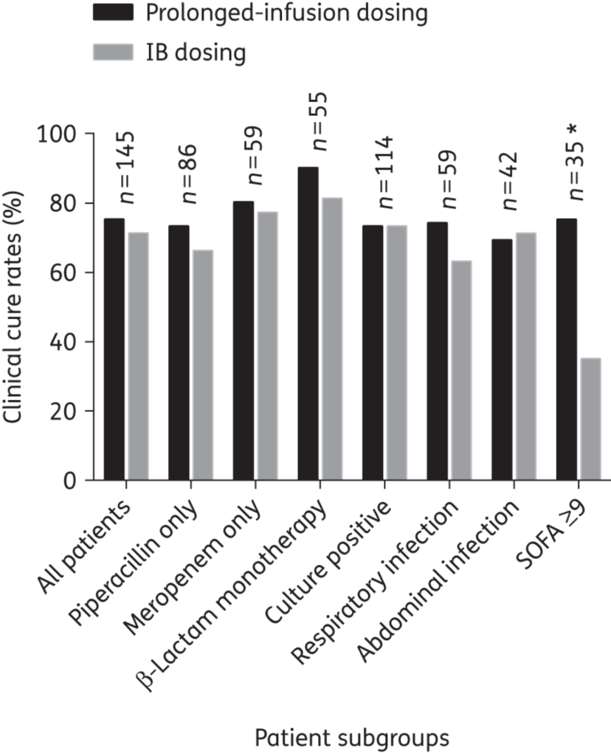
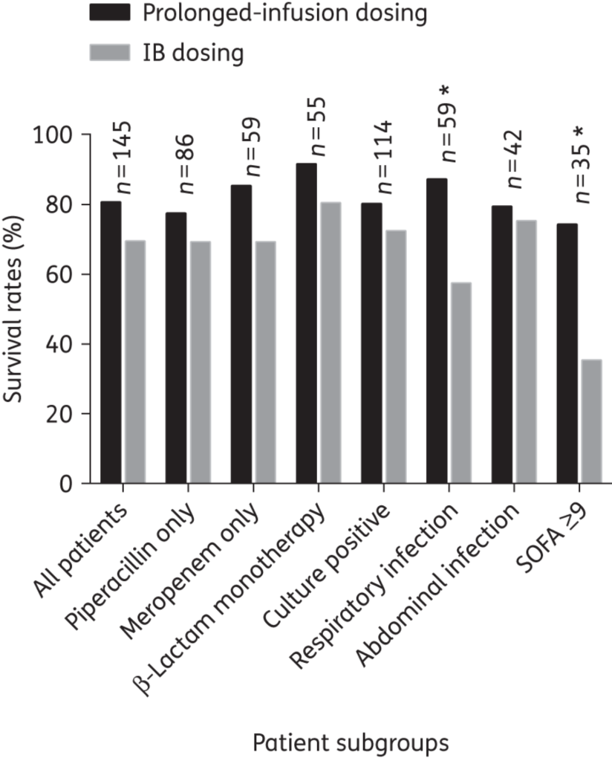
DALI study
From: Is prolonged infusion of piperacillin/tazobactam and meropenem in critically ill patients associated with improved pharmacokinetic/pharmacodynamic and patient outcomes? An observation from the Defining Antibiotic Levels in Intensive care unit patients (DALI) cohort
J Antimicrob Chemother. 2015;71(1):196-207. doi:10.1093/jac/dkv288
Date of download: 3/25/2017
© The Author 2015. Published by Oxford University Press on behalf of the British Society for Antimicrobial Chemotherapy. All rights reserved. For Permissions, please e-mail: journals.permissions@oup.com
Notes:
13

Slide 14
Aminoglycosides

Slide 15
PK/PD principle: Cmax / MIC
Aminoglycosides

Slide 16

Aminoglycosides, efficacy
Infected thigh experiment
Relationship between maximal concentration (times MIC) and bacterial killing
Craig, Scand J Inf Dis 1990

Slide 17
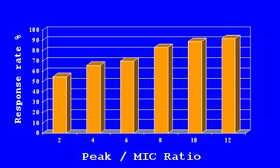
Aminoglycosides, efficacy
Initial serum peak level | Died (%) | Survived (%)
< 5mcg/ml | 21 | 79
>= 5mcg/ml | 2 | 98
Moore, J Inf Dis 1984; Moore, J Inf Dis 1987

Slide 18
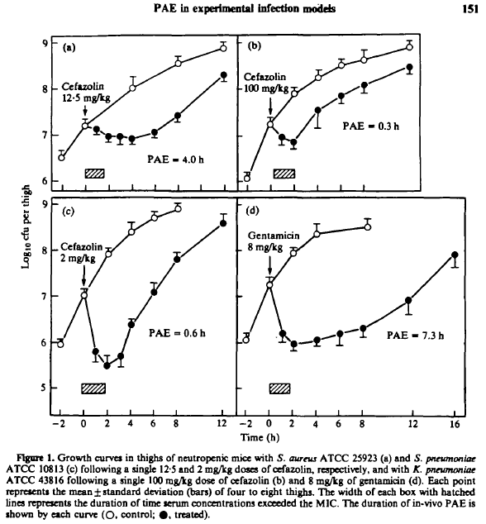
Post MIC effect
Time > MIC
Craig, JAC 1993

Slide 19
Topic study
Aim: efficacy and toxicity of tobramycin 10 mg/kg o.d. versus 3.3 mg/kg t.i.d. in children and in adults with CF
Smyth, Lancet 2005

Slide 20
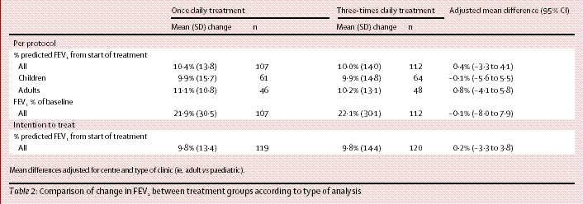
Results, efficacy
Equally effective
Smyth, Lancet 2005

Slide 21
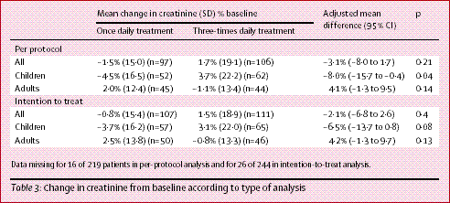
Results, renal toxicity
Less toxic
Smyth, Lancet 2005

Slide 22
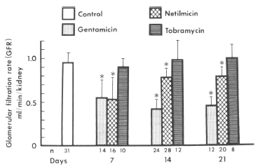
Aminoglycosides, toxicity
GFR loss in animals related to drug and days of treatment
Cojocel 1984

Slide 23
Which is more toxic, gentamicin or tobramycin 1 dd?
Study
  Retrospective study in a 600 bed general hospital
Patients
  General hospital population
  Gentamicin group → 2008 – 2009
  Tobramycin group → 2010 – 2012
  No difference in treatment protocol over the years: TDM after 1st dose
Primary outcome
  Difference in serum creat (end – start treatment)
Van Maarseveen, JAC 2014

Slide 24
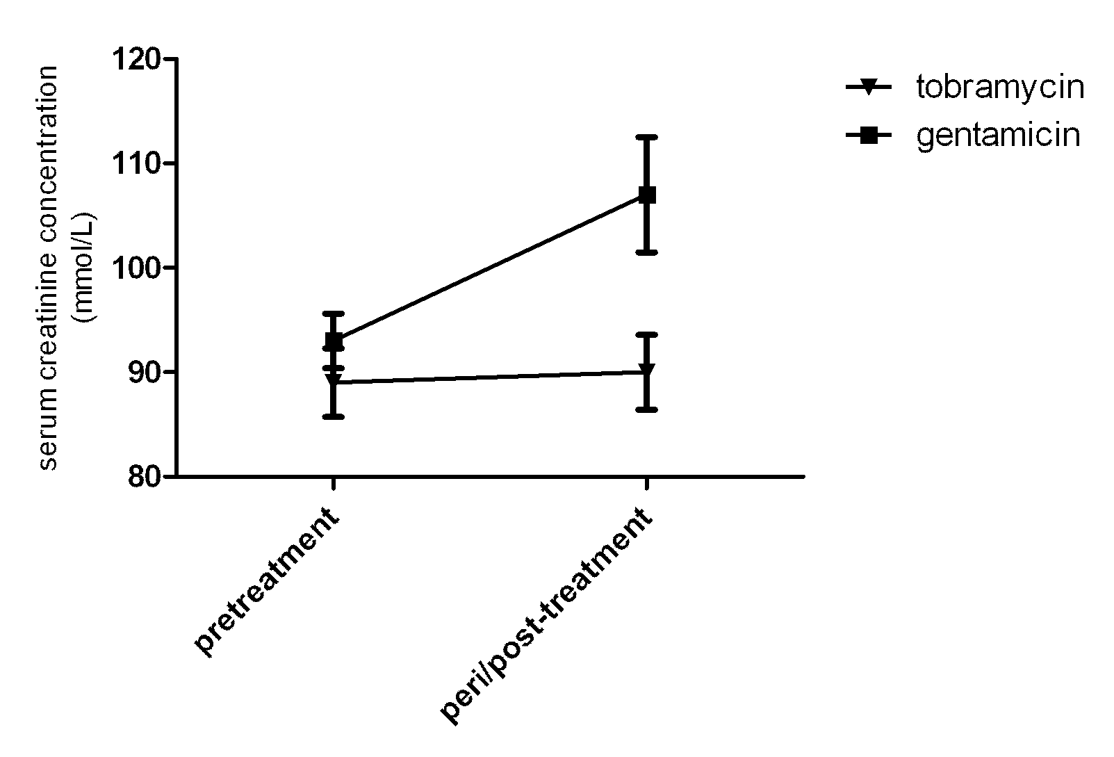
Results
RIFLE stage | gentamicin (n=202) | tobramycin (n=186) | OR | 95%-CI | p-value
R | 43 | 19 | 2.4 | 1.2-4.7 | 0.01
I | 11 | 7 | 1.5 | 0.5-3.8 | 0.48
F | 5 | 2 | 2.3 | 0.4-12.0 | 0.45

Slide 25
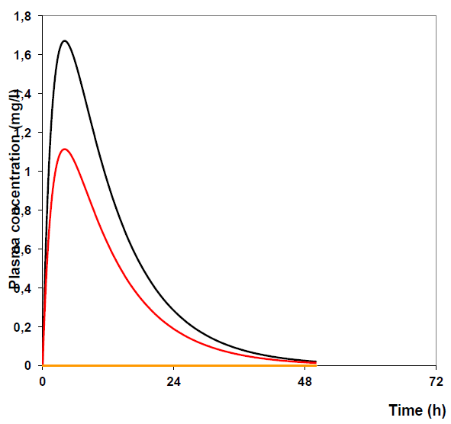
Pharmacokinetic confounders
Volume of distribution
  Determines Cmax / AUC
Clearance
  Determines AUC
Vd
CL

Slide 26
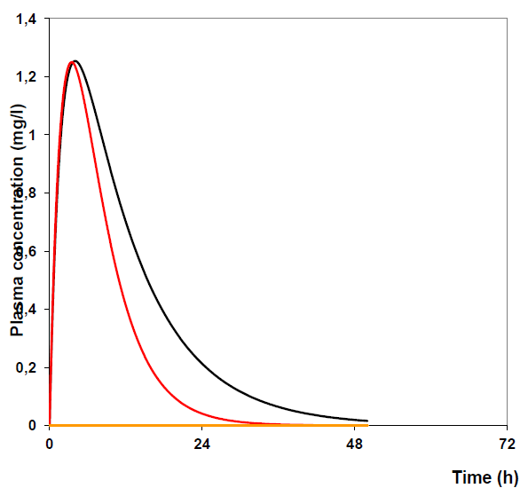
Pharmacokinetic confounders
Volume of distribution
  Determines Cmax/AUC
Clearance
  Determines AUC
Vd
CL

Slide 27
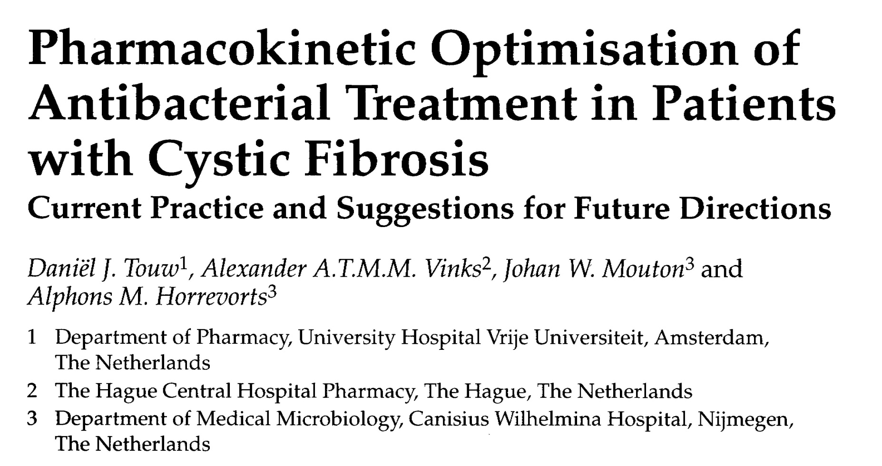
Pharmacokinetics of Antimicrobial drugs in CF
Clin Pharmacokinet 1998; 35: 437-459

Slide 28
Pharmacokinetics in CF
No changes observed compared with healthy controls:
  Aminoglycosides
  Fluoroquinolones
  Imipenem
  Vancomycin
Differences observed compared with healthy controls:
  Aztreonam
  Ceftazidime
  Penicillin
  Co-trimoxazole
Touw, Clin Pharmacokinet 1998

Slide 29
PK changes of tobramycin in CF
BMI groups:
1: <18.5
2: 18.5-24.99
3: 25-29.99
4: ≥30 kg/m²
Al Ghanem, manuscript in preparation

Slide 30
PK changes in CF
Decreasing body mass index:
  Volume of distribution increases
  lower peak level
  higher dose required
Relatively good clearance
Hepatic metabolism for some drugs increased (in particular glucuronidation)
-> Fore many, but not for all drugs we need to dose relatively higher compared to non-CF patients.

Slide 31
Therapeutic drug monitoring of aminoglycosides
Using optimally chosen sampling times for aminoglycosides:
  Peak: level 30 min after administration
  Trough: not wait until the next dose but 6-12 hours after administration
Has demonstrated better efficacy¹ and less toxicity^{1,2,3}
1) van Lent-Evers 1999, 2) Bartal 2003, 3) Smyth 2005

Slide 32
Summary

Slide 33
Beta-lactam antibiotics
Concentration beta-lactam must be at least 50% of the dosing interval >MIC
Beta-lactam antibiotics have a minimal post-MIC effect
Decreasing the dosing interval increases efficacy more than increasing the dose,
Continuous infusion is most effective, target free concentration is at least 4xMIC (but higher dosing does not give more efficacy)

Slide 34
Aminoglycosides
Cmax dependent bacterial killing
Marked post MIC effect allowing extended intervals thereby reducing toxicity
Gentamicin is more toxic than tobramycin
PK/PD optimal dosing guided by TDM is less toxic and more effective

Slide 35

Thank you for your attention, but …
d.j.touw@umcg.nl

