Slide 1


Challenges in CF : Physiotherapy
Assistant Prof Özge Keniş Coşkun
Marmara University Physical Medicine and Rehabilitation

Slide 2

What we can utilize?
Postural Drainage, Percussion, Vibration
Positive expiratory pressure
  Bottle
  Acapella, Aerobika etc…
High frequency chest wall oscillator (VEST)
Respiratory exercises

Slide 3
What we should utilize more?
Autogenic drainage
Intrapulmonary percussive ventilation
Aerobic exercises

Slide 4
We aim for
Independence
Positive coping skills
Decreased family and treatment burden
Longer, happier life

Slide 5
Main Challenges
Treatment burden
Caregiver burden
Getting to know your body- Body awareness
Socioeconomic challenges
Money
Data is scarce
Navigating through with the experience we have

Slide 6
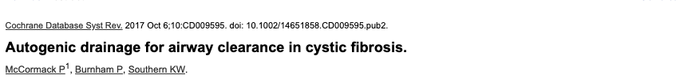
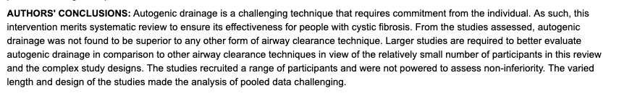

Slide 7


Slide 8
A total of three retrospective studies assessed adherence to ACT among CF patients with mean age ranging from 11.2 to 23.1 years
Proportion of CF patients with high adherence to ACT via one or multiple techniques of autogenic drainage, active cycle of breathing, positive expiratory pressure, flutter device, or PD&P ranged from 14% to 60%

Slide 9
It was found that patients with less severe disease had poor adherence to ACT, likely resort to ACT only when irreversible lung damage has occurred
reasons for poor adherence to ACT
  not enough time to do ACT’ (28%)
  cannot be bothered’ (16%)
  do not enjoy ACT technique’ (8%)
  32% could not provide any reason

Slide 11
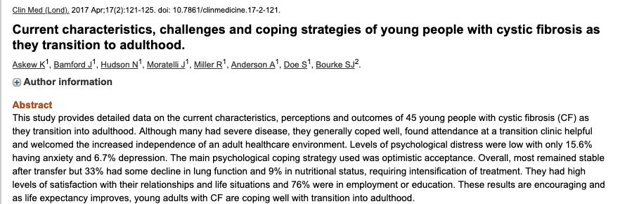

Slide 12
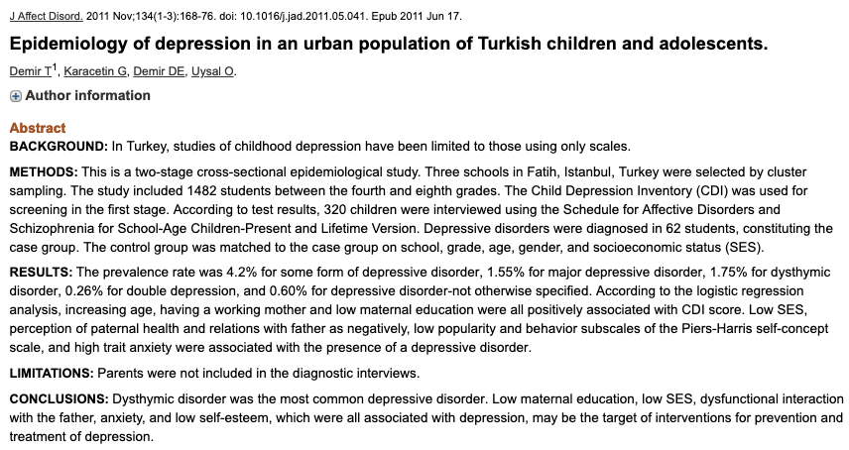

Slide 13
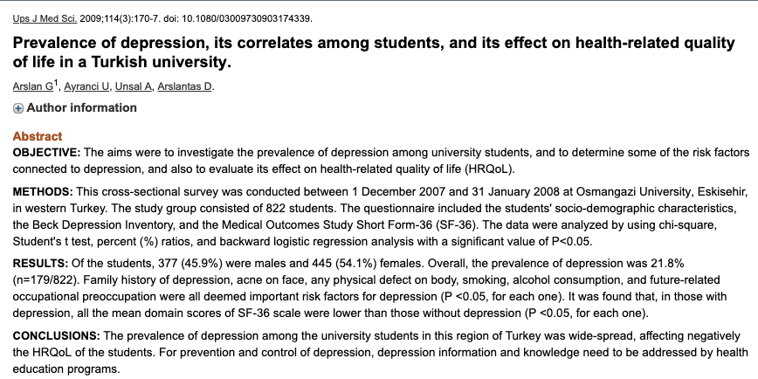

Slide 14

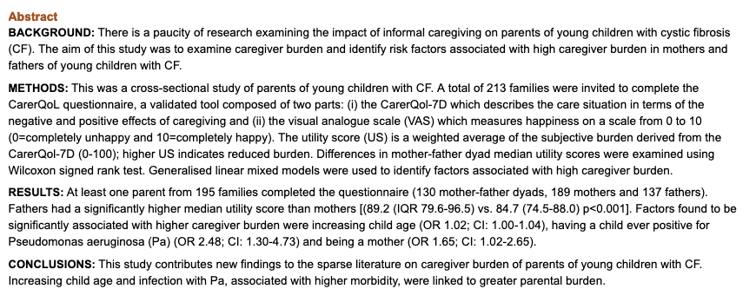

Slide 15
Our Data
A total of 44 children and 58 caregivers (28 mothers, 3 fathers and 14 mother-father dyads)
35 of the mothers were housewives
19 of them went to primary school only
mean age was 10.4±2.00
mean FEV1 was 83.1±22.6
28 (62.2%) was male
12 (26.7%) had Psa colonization

Slide 16
Our Data
The mean ZCB scores for mothers were 30.51 ± 10.7 while it was 27.52 ± 9.21 for fathers and were not significantly different (p=0.32)
Caregiver Burden mother score | CFQ-physical | CFQ-emotional | CFQ- body image | CFQ-treatment
 | r = -0.522 p= 0.001 | r = -0.482 p= 0.01 | r = -0.449 p= 0.003 | r = -0.333 p= 0.033

Slide 17

Thank you ozgekenis@gmail.com

