Slide 1



Molecular Analysis of Cystic Fibrosis Patients in West Bank, Palestine
By
Hilal Abu-Rmaileh¹,
Suhail Ayesh¹, Amal Nassar², Bishara Fashho², Bassam Abu-Libdeh^{1, 3}, Nisreen Rumman^{2, 3}
¹Molecular Genetics Laboratory, Makassed Hospital, Jerusalem, Palestine.
²Caritas Baby Hospital, Bethlehem, Palestine.
³Pediatric Department, Makassed Hospital, Jerusalem, Palestine.

Slide 2
Aims
To genetically confirm the diagnosis of CF patients in West Bank, Palestine that were previously diagnosed only on the basis of clinical presentation and sweat chloride test.
To identify the most common CFTR mutations in the Palestinian population in order to establish a routinely used mutation panel for screening of suspected cases and future newborn screening (NBS) once established.

Slide 3
Methods
Study Group:
A total of 100 patients from 60 different Palestinian families suffering from classic form of CF and having a sweat chloride concentration of >60 mmol/L.
Molecular Analysis Strategy:
Published mutations (Palestinians & Middle Eastern countries)
ARMS assay
Multiplex PCR assay
Negative for common mutation
Sequencing of CFTR exons
Negative for sequencing
MLPA
DNA sequencing

Slide 4

Results
We genetically confirmed CF diagnosis in all patients (mutation detection rate of 100%).
Fifteen distinct CF disease causing mutations were identified.
R1066C
L1082P
c.1393-1G>A
Q1100P
CFTRdele2
c.313delA
F508del
c.2051_2052delAAinsG
W1282X
c.1585-1G>A
N1303K
G85E
I175V
c.1210-12T[5]
c.2988+1Kbdel8.6Kb
CFTR gene
Exon #
1
2
3
4
5
6
7
8
9
10
11
12
13
14
15
16
17
18
19
20
21
22
23
24
25
26
27
Chromosome 7
Figure 1: Schematic representation of the location of mutations identified.

Slide 5
Figure 2: Frequencies of CFTR mutations detected in CF patients in West Bank, Palestine.

Slide 6
Totally accounting for 70% of alleles
The most
frequent mutation
c.1393-1G>A
17%
F508del
14%
W1282X
11.5%
c.2988+1Kbdel8.6Kb
G85E
CFTRdele2
10%
9%
8.5%
The rest nine mutations account for 30%

Slide 7
Figure 3: Genotypes of all 100 patients.
79 homozygotes for one CFTR mutation
21 compound heterozygotes for two different mutations
Total: 25 various genotypes identified.

Slide 8
15 Mutations
Previously reported in Palestinians
Not reported in Palestinians before: I175V, c.1210-12T[5] and R1066C
Novel missense mutation in exon 20 (c.3245T>C, p.Leu1082Pro) described for the first time in a female CF patient
11
3
1

Slide 9
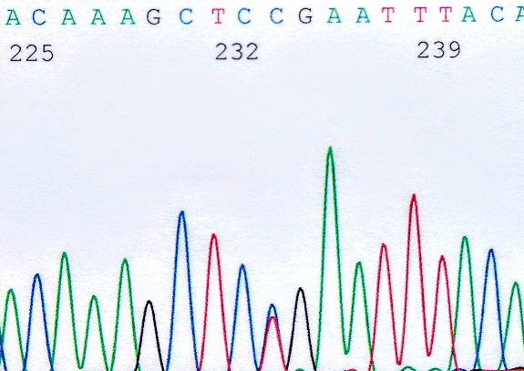
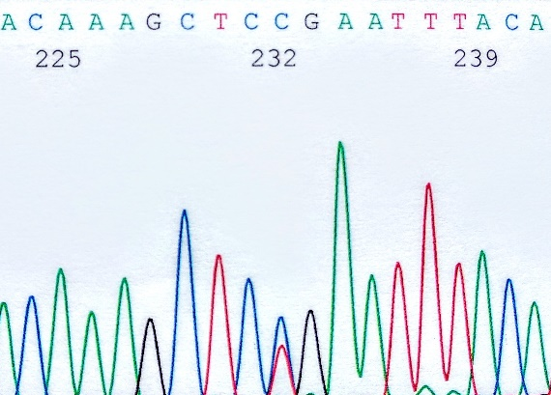
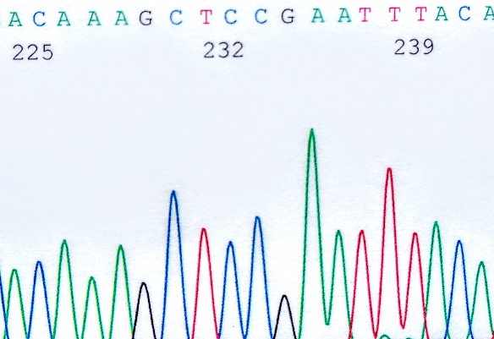
L1082P Heterozygous
L1082P Heterozygous
L1082P Homozygous
Figure 4: DNA sequences of CFTR gene for the patient and her parents.

Slide 10

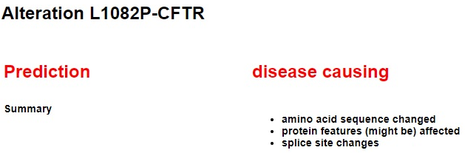


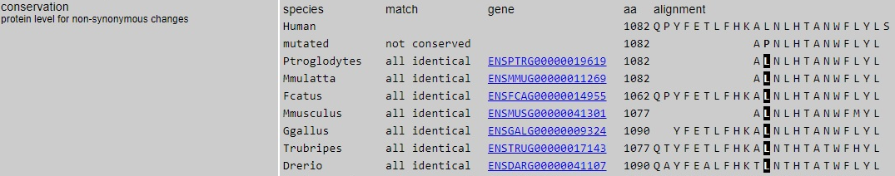
Predicting the potential disease causing effect of this mutation (L1082P) on CFTR function was evaluated using PredictSNP and MutationTaster web servers.
L1082P mutation was found at a highly conserved position, indicating an important role for this residue.

Slide 11
Conclusion
Our results have broadened the mutation spectrum of CF in the West Bank, Palestine.
They will serve as the basis for establishing a national CF mutation panel to be used for rapid detection of suspected cases, prenatal diagnosis and any future NBS.
Next Step:
Screening of CF patients in Gaza Strip, Palestine.

