Slide 1


Effect of induced sputum on
Microbiology outcome in Cystic fibrosis patient
Khalid Zahraldin , Amal Alnaimi , Ranai Arar , Amjad Tuffaha
Department of Pediatrics, Section of Pediatric Pulmonology, Hamad Medical Corporation, Doha, Qatar
Dr. Khalid Zahraldin
MBBS,MRCPCH ,ABHS-P
Hamad Medical Corporation
Pediatric Pulmonology Associate Consultant

Slide 2
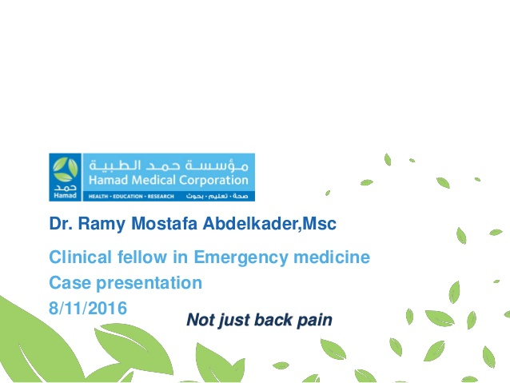
Introduction

Slide 3
Chronic infection and inflammation play a central role in the life-shortening lung disease of cystic fibrosis (CF), beginning in the first few months of life and often silent.
Antibiotic therapy directed against organisms isolated from airway samples is crucial not only in the treatment of acute pulmonary exacerbations in patients with CF but also to delay the onset of chronic P aeruginosa infection and to slow the decline in pulmonary function.

Slide 4
Oropharyngeal swabs (OP) swabs and Broncho alveolar lavage (BAL) are the specimens most commonly obtained to ascertain airway infection in non-expectorating children with CF.
Since oropharyngeal cultures have a poor positive predictive value. Broncho alveolar lavage (BAL) remains the “gold standard” for defining airway microbiology and inflammation in young children, but has important limitations.
Sputum is the preferred specimen from those subjects who are capable of expectorating.

Slide 5
Induction of sputum offers the potential of a rapid, direct, non-invasive, and inexpensive way of collecting multiple samples of airway secretions.
The objective of this study is to evaluate the microbiological yield of IS samples compared to OP swabs and ES samples.

Slide 6
Materials and Methods

Slide 7
Patients
This is prospective cross-sectional comparative study
Patients attending the cystic Fibrosis clinic at Hamad Medical Corporation in Qatar for routine outpatient appointments were invited to enter the study.
The patients in these study were selected based on inclusion/exclusion criteria:
Inclusion criteria :
  Diagnosis of CF (by sweat chloride > 60 mmol/L and/or two confirmed disease causing CFTR mutations)
  Age between 2 and 18 years
Exclusion criteria:
  Acute respiratory distress or hypoxia (oxygen saturation <92% in room air)
  Hemoptysis
  Forced expiratory volume in 1 second (FEV1) <40% predicted
  History of intolerance of inhalation of hypertonic saline

Slide 8
Study Design
Simultaneous oropharyngeal swab (OP) or expectorated sputum (ES) (if possible) and induced sputum (IS) samples were collected over 18 months.
Patients were asked to provide a sputum sample. If the child could not expectorate, an oropharyngeal swab specimen was obtained.
The procedures were conducted according to a standard infection control at Hamad Medical Corporation.

Slide 9
All subjects received nebulized salbutamol (2.5 mg<5 years of age, or 5 mg>5 years of age), followed by nebulized HS (4ml of 7% solution) after 10 minutes (jet nebulizer).
Following inhalation of HS, children who were unable to expectorate were given a session of physiotherapy ,If they were still unproductive, Oropharyngeal suction will be performed (size 10 catheter/sterile mucus extractor ).
All patients were observed at least 30 minutes in the clinic before discharge and auscultation was performed before and after procedure.
The collected specimens were taken to the microbiology lab for processing within 30 minute of sampling.

Slide 10
Results

Slide 11
Patients (n = 41) | Results
Female sex, n (%) | 18 (43%)
Age in years, mean ± SD | 8.7 ±5.2
CF Genotype I123V mutation, n (%) Other CFTR mutation ,n (%) | 35(85%) 6 (15%)
FEV1 in % predicted, mean ±SD | 85 ±15
Total number of (ES) samples collected, n (%) | 18(44%)
Total number of (OP) samples collected, n (%) | 23(56%)
Total number of (IS) samples collected, n (%) | 41(100%)
Table 1: Baseline characteristics

Slide 12
organisms | Oropharyngeal swab and expectorated sputum | Induced sputum
Negative culture results | 5 (12%) | 6 (15%)
Pseudomonas aeruginosa | 6 (15%) | 5 (12%)
Methicillin- Sensitive S aureus (MSSA) | 21(51%) | 24 (59%)
Methicillin-Resistant S aureus (MRSA) | 2 (5%) | 2 (5%)
Haemophilus influenzae | 12 (30%) | 15 (37%)
Streptococcus pneumoniae | 2 (5%) | 1 (2%)
Streptococcus pyogenes | 2 (5%) | 3 (7%)
Moraxella catarrhalis | 2 (5%) | 5 (12%)
Klebsiella pneumoniae | 1 (2%) | 1 (2%)
Stenotrophomonas maltophi | 0 (0%) | 1 (2%)
Table 2: Culture positivity for various CF organisms

Slide 13
Figure 1: Microbiologic yield of HS-induced sputum compared to preinduced sputum

Slide 14
41
26 Patients
Identical results in pre - and post- HS induced sample
3 patients
No growth in pre- and post -HS induced samples
23 Patients
Identical pathogen s in pre-and post-HS induced samples
15 Patients
Different culture result in Pre and post -HS induced sample
7 Patients
one additional pathogen in post -HS induced sample
4 Patients
One additional pathogen in pre-induced samples
2 Patients
Two additional pathogen in post – HS induced samples
2 Patients
Isolated different pathogen in pre-and post -HS induced samples
Summary of culture result from pre and post induced sputum samples

Slide 15
The overall number of cultures positive for potential CF pathogens was not different between preinduced and HS-induced samples 36 and 35 respectively.
However, discrepancies between preinduced and HS-induced culture results were seen in 15 of 41 patients (37%), whereas in 9 cases HS-induced samples yielded additional organisms compared with preinduced samples, 4 cases, additional pathogens were identified only in preinduced samples. In the remaining two patients, different bacteria were found in the samples obtained by the two techniques.
There was no difference in the detection of Methicillin-Resistant S aureus(MRSA).
when comparing preinduced and HS- induced samples in this cohort. Pseudomonas aeruginosa were identified in 15% of preinduced and 12% HS- induced samples.

Slide 16
Conclusion

Slide 17
This study shows that sputum induction is possible, safe and acceptable in cystic fibrosis children.
IS samples did not generate a higher microbiologic yield compared to OP and ES samples in the CF patients studied specifically in our cohort rather than the whole CF population all over the world

Slide 18
Thank you…

