Slide 1
Current and Future Assessment of Respiratory Function in CF
Isabelle Fajac
Cochin Hospital, Paris, France
MECF Conference, Izmir, 23 March 2018

Slide 2
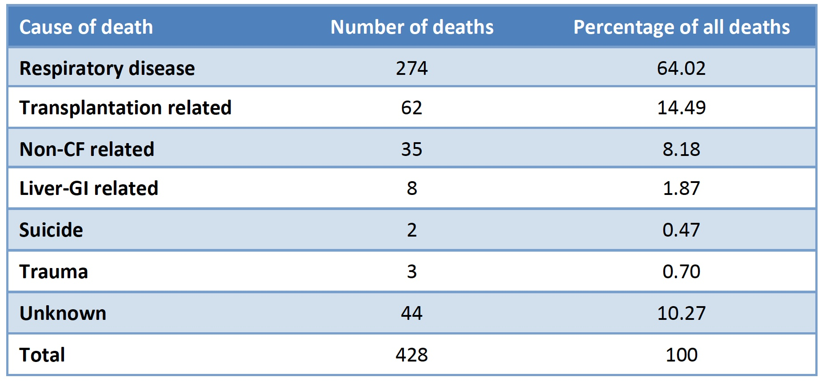
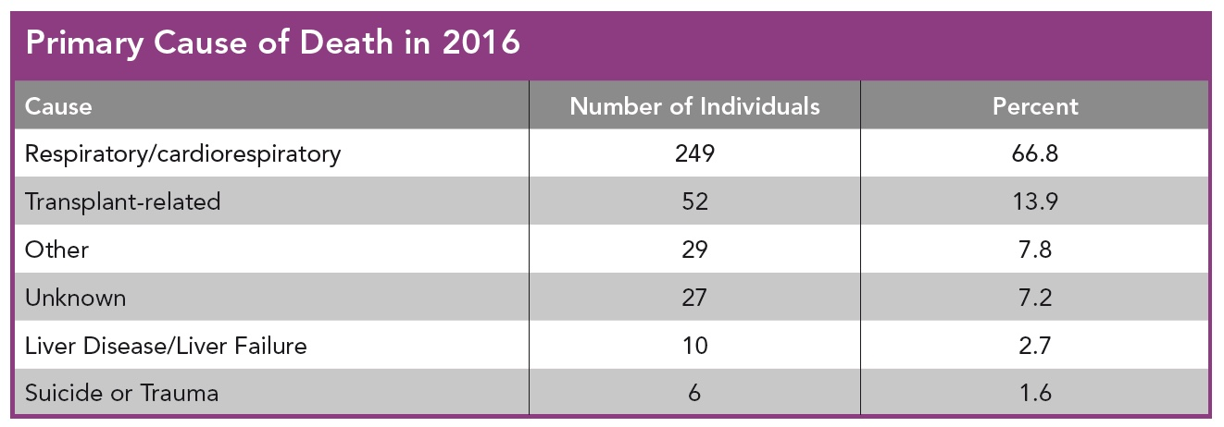
Respiratory Disease Remains
the Major Cause of Death in CF
EU Registry, 2015
US Registry, 2016

Slide 3
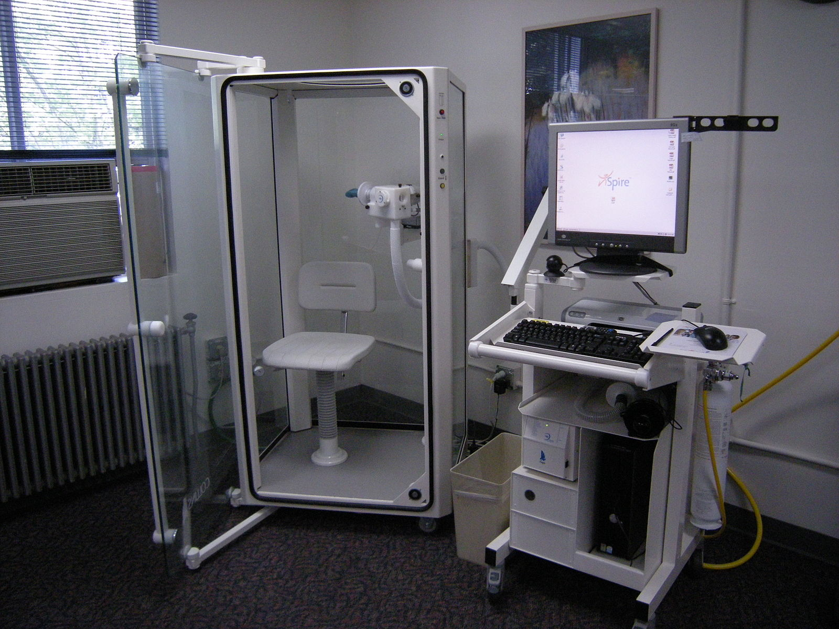
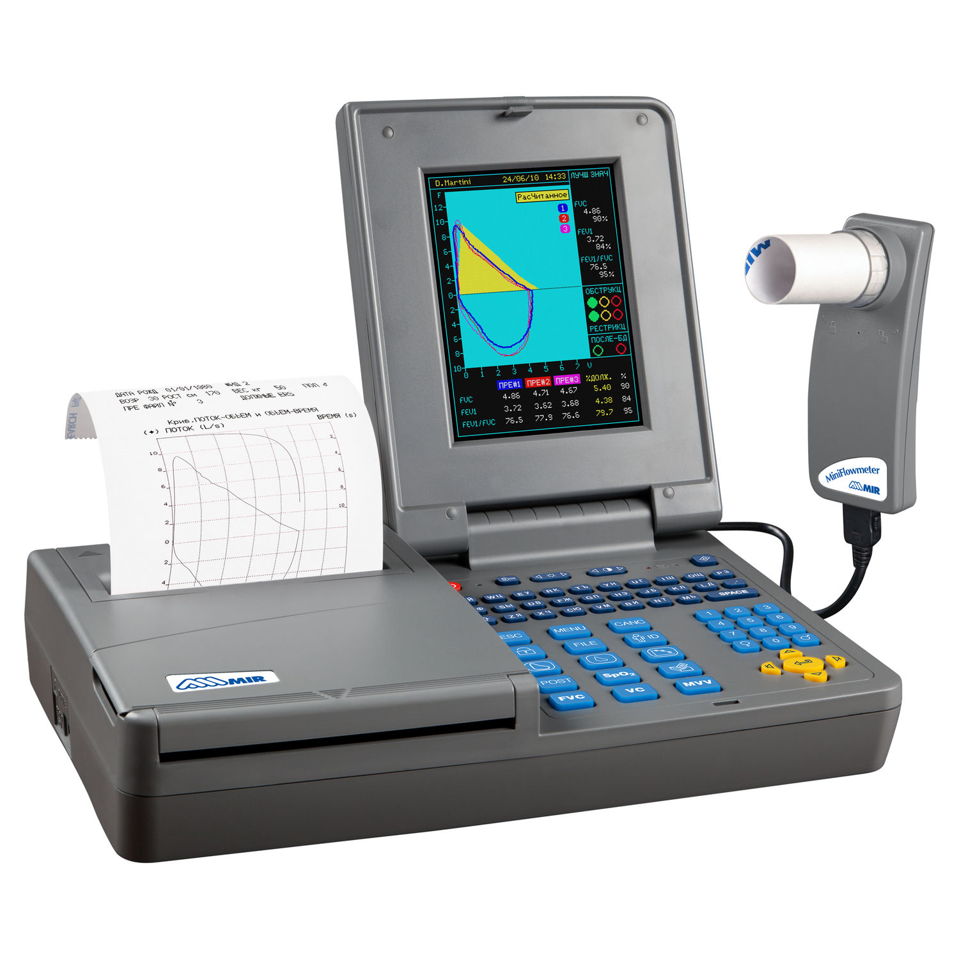
Respiratory Function Assessment
Body Plethysmography
Spirometry
Measures mobilisable lung gas volumes: Forced Vital Capacity (FVC) and the volume expired in the first second of an FVC manoeuvre: FEV1
Measures non mobilisable lung gas volumes: Functional Residual Capacity (FRC), Total Lung Capacity (TLC) and Residual Volume (RV)
Notes:
Sealed chamber; TGV: thoracic gas volumes
elevated values of residual volume suggest early gas trapping and early airway disease

Slide 4
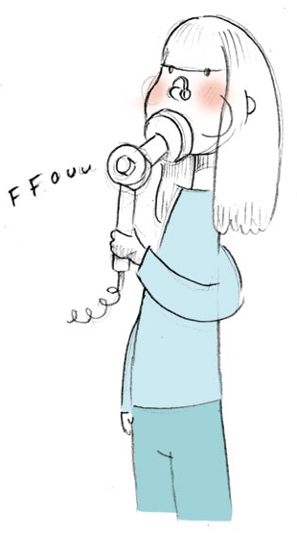
FEV1: a Very Attractive Test
Many assets:
Very well-known index of airway obstruction
Equipment widely available
Highly standardised (Eur Respir J 2005; 26:319-38)
Simple manœuvre easily done in patients above 6 yrs of age
Quick and non-invasive test
Reproducible and repeatable with no toxicity
Results readily available
Reference values (Eur Respir J 2012; 40:1324-43)
Few flaws:
Requires subject's cooperation and a well-trained examiner
Poorly sensitive
Notes:
No localized information

Slide 5
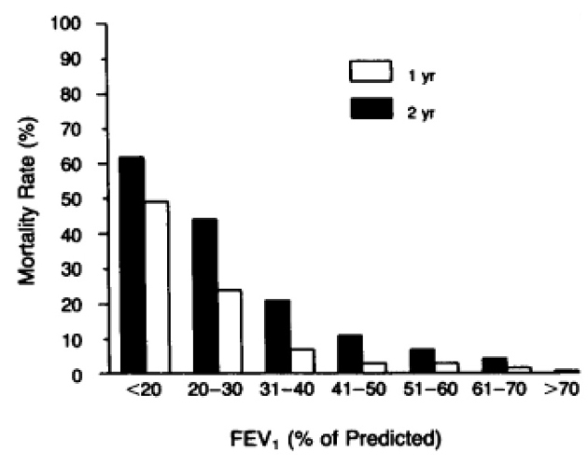
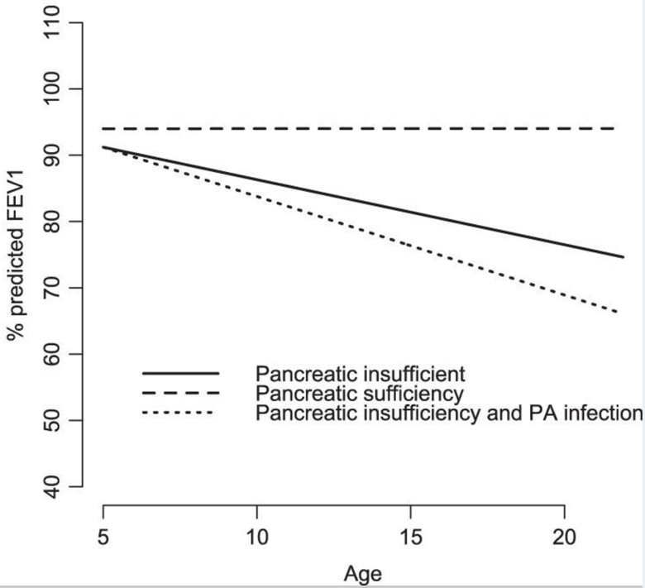
FEV1 is the Strongest Clinical Predictor of Mortality and a Marker of Morbidity in CF
Kerem et al, N Engl J Med 1992;326:1187– 91
Taylor-Robinson et al, Thorax 2012;67:860-6
Other markers such as FVC or FEF25-75 have similar trends but increased variability with repeat measurements
Notes:
They probably offer no real advantage since compared to FEV1, FVC has similar variability and FEF25-75 has increased variability with repeat measurements.
Beside PA infection and pancreatis status, other clinical factors associated with FEV1 decline: BMI and CFRD ( ECFS PR 2014, ERJ – Kerem et al)

Slide 6
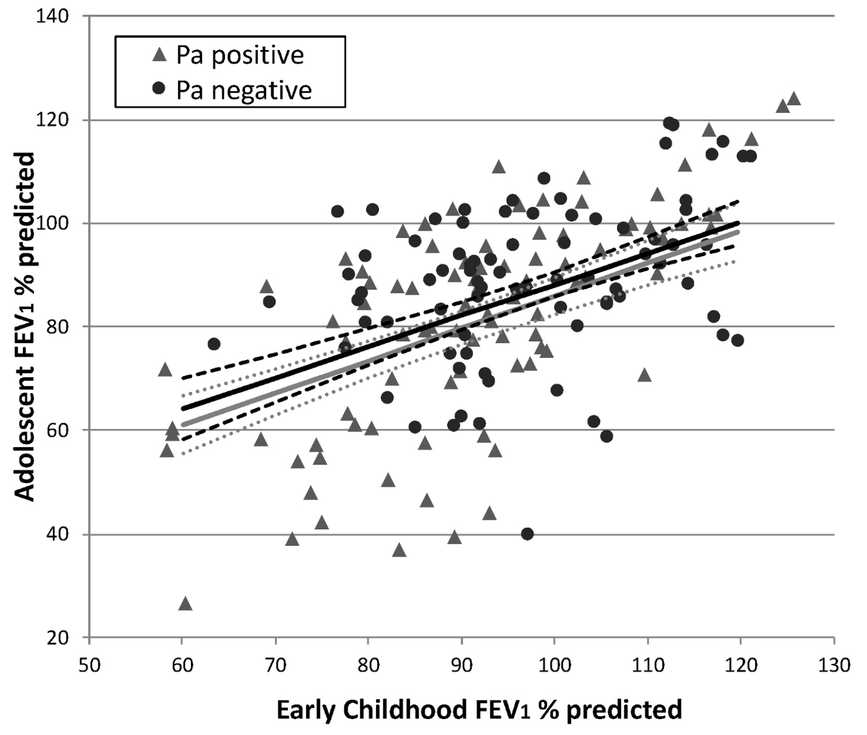
Childhood FEV1 is the Strongest Predictor of
Adolescent Lung Function
The association between FEV1 in early childhood and adolescence is only partially explained by infection with Pseudomonas aeruginosa before age 6.
Pittman et al, PLoS ONE 2017, 12(5):e0177215
Notes:
Lower FEV1 in early childhood (6 to 8 years of age) is strongly associated with lower FEV1 in adolescence, and that this association is only partially explained by infection with Pa before age 6.

Slide 7
FEV1 Is One of the Most Influential
Drivers of Patient Management
Defining lung disease stage
Defining disease aggressiveness phenotype
Supporting diagnosis of pulmonary exacerbation
Evaluating response to exacerbation management
ECFS Standards of Care, 2005-2018:
Patients should be seen every 1–3 months and every visit should include:
Routine physical examination
Measurement of weight
Oximetry
Spirometry
Sputum or cough swab cultures.

Slide 8
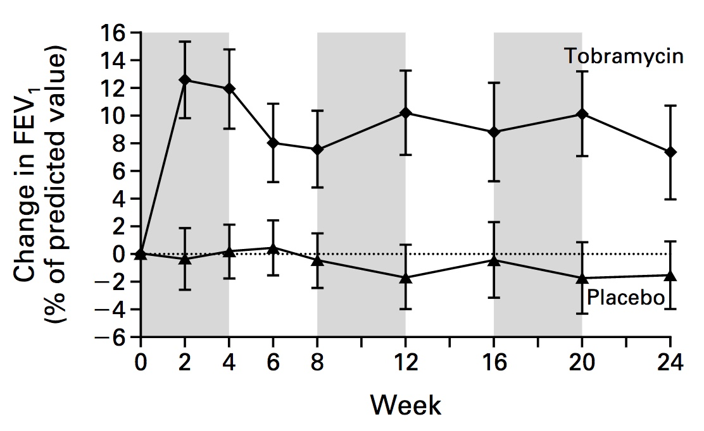
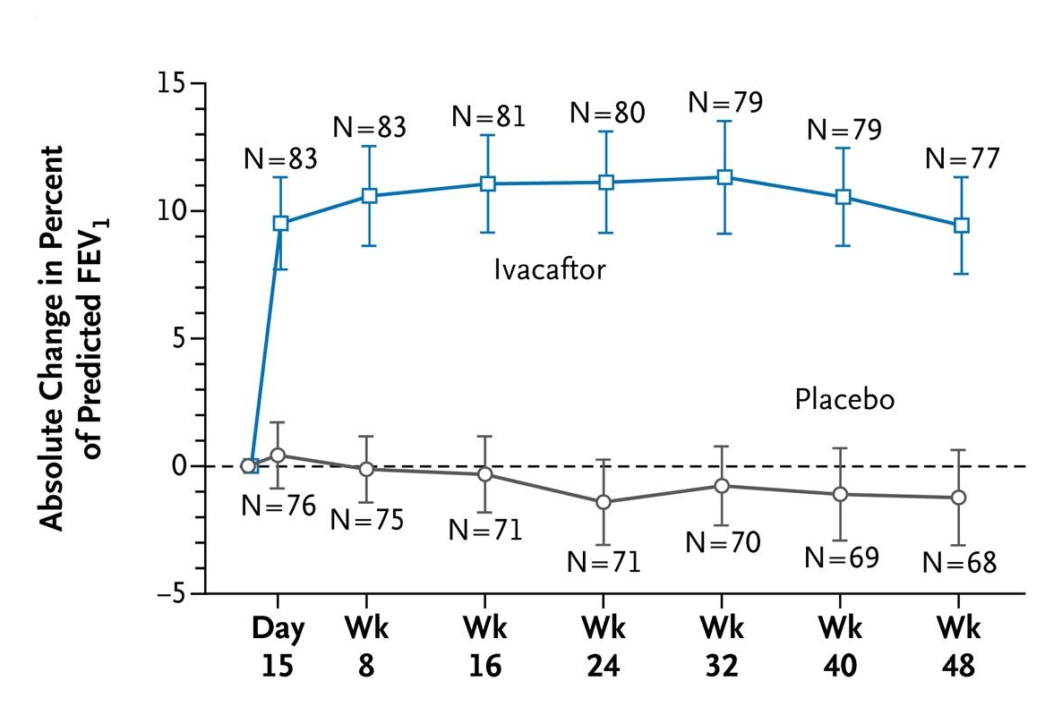
FEV1 Responses to Treatment
Inhaled Tobramycin
Ivacaftor
Ramsey et al, NEJM 1999;340:23-30
Ramsey et al, NEJM 2011;365:1663-72
FEV1 is a key endpoint in clinical trials
What FEV1 improvement can be considered clinically relevant?
A Minimal Clinically Important Difference needs to be defined
Notes:
Changing the FEV1 rate of decline would be the most meaningful effect but this is not feasible in practice since it would require a long study duration and/or a large sample size (Konstan, JCF 2010). A treatment effect equivalent to the average annual loss in FEV1 can be considered as clinically relevant.

Slide 9
FEV1 Has Some Limitations for CF
Respiratory function of children with CF needs to be assessed
More patients maintain FEV1 in the normal range
Diminished rates of decline in FEV1 with successive birth cohorts
FEV1 is difficult to obtain in children below 6 years of age
FEV1 is not a sensitive measure of early lung disease
US Registry, 2016
Notes:
CF lung disease progresses even in the absence of symtoms. Spirometry is not a sensitive of early lung disease
There may be considerable obstruction in peripheral airways that would affect ventilation distribution and gas exchange but would have little effect on function tests designed to reveal obstruction. (the Lung's quiet zone: Mead edito NEJM 1970)
The proportion of 18-year-olds in the normal/mild category (FEV1 ≥70 percent predicted) has increased from 31.1 percent in 1989 to 71.6 percent in 2014

Slide 10
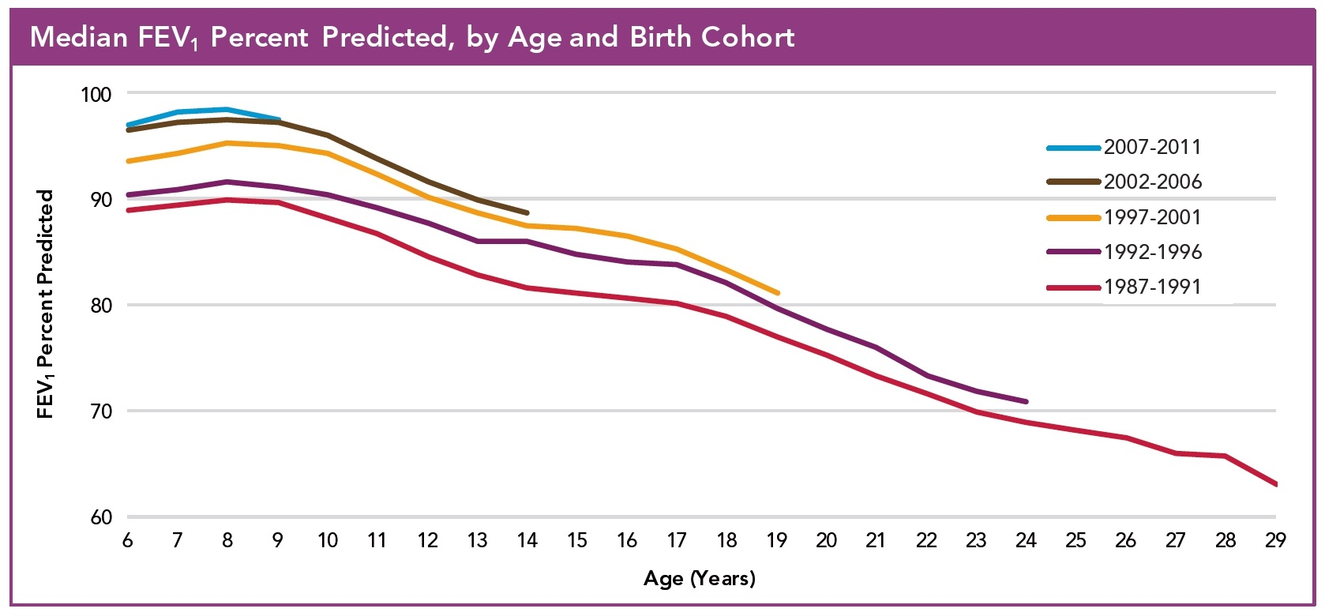
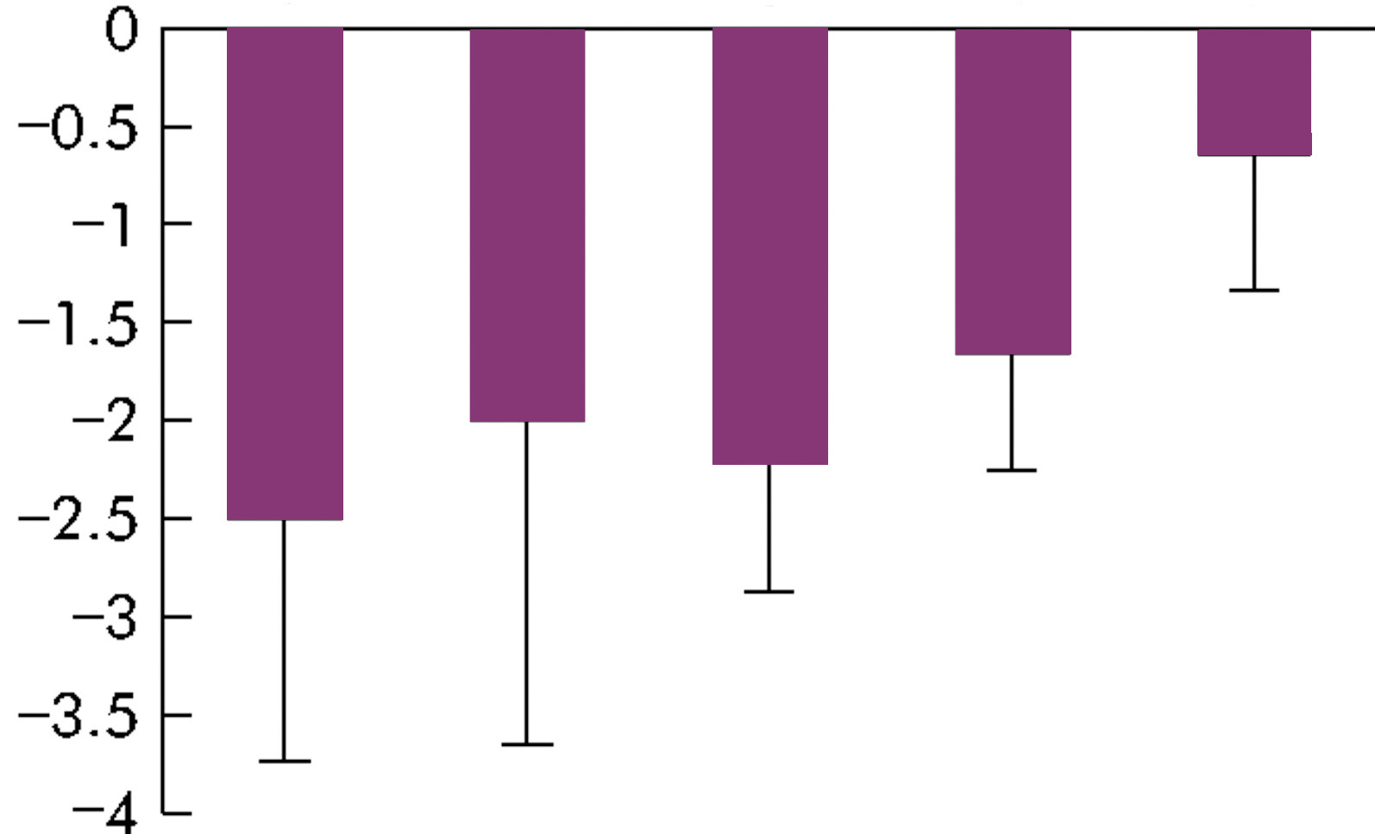
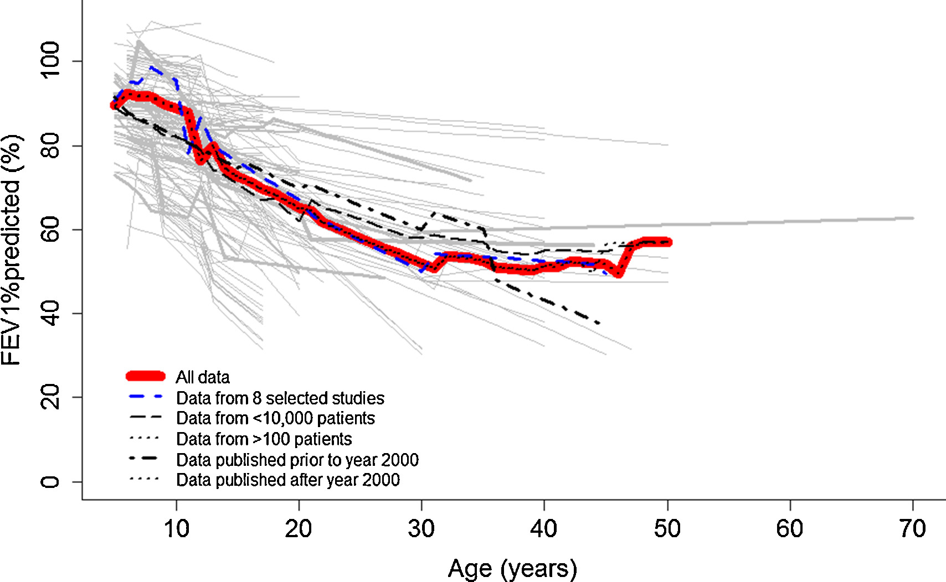
Diminished Rates of Decline in FEV1 with Successive Birth Cohorts?
Age 18-22
Birth cohort
1960-4
1965-9
1970-4
1975-9
1980-4
FEV1 slope (%pred)
Que et al, Thorax 2006;61:155-7
US Registry, 2015
Harun et al, Paediatr Respir Rev 2016;20:55-66
Notes:
Registry: Median FEV1 percent predicted has improved more than 10 percentage points for people with CF of all ages since 1986; however, the lines are nearly parallel, suggesting that the rate of decline in adolescence remains the same.
Although the median changes are low, the variability is high, with 5 to 20% of the population having changes more than 10% predicted.
The yearly decline in FEV1 depends on the baseline characteristics of the population such as birth cohort, age, pancreatic status and baseline lung function. The rates of decline in lung function in young adults with CF diminish with successive birth cohorts and patients infected with Pseudomonas traditionally had a greater average decline in FEV(1) (-1.6% v -1.1%) (Que 2006, Thorax). Konstan et al (JCF 2010) report mean rates of FEV1 change in a population of CF > 6 years and with baseline FEV1 above 70%. Median age specific year to year changes in FEV1 % predicted (Liou 2010, JCF) vary from close to 0% up to 4% during adolescence and young adulthood. A mean (SD) year to year change in FEV1 of only -1.22 (9.17) was also reported in the Belgian population (De Boeck ERJ 2011).
Overall lung function progression is shown to be nonlinear and have high variability in the rate of decline over a life time in patients with cystic fibrosis FEV1%predicted observations are the highest and most stable between 5-10 years of age, afterwards the steepest decline of FEV1%predicted is noted from 11 to 15 years of age followed by a reduced decline up to 30 years of age. After the of age of 30 FEV1%predicted appears relatively stable.

Slide 11
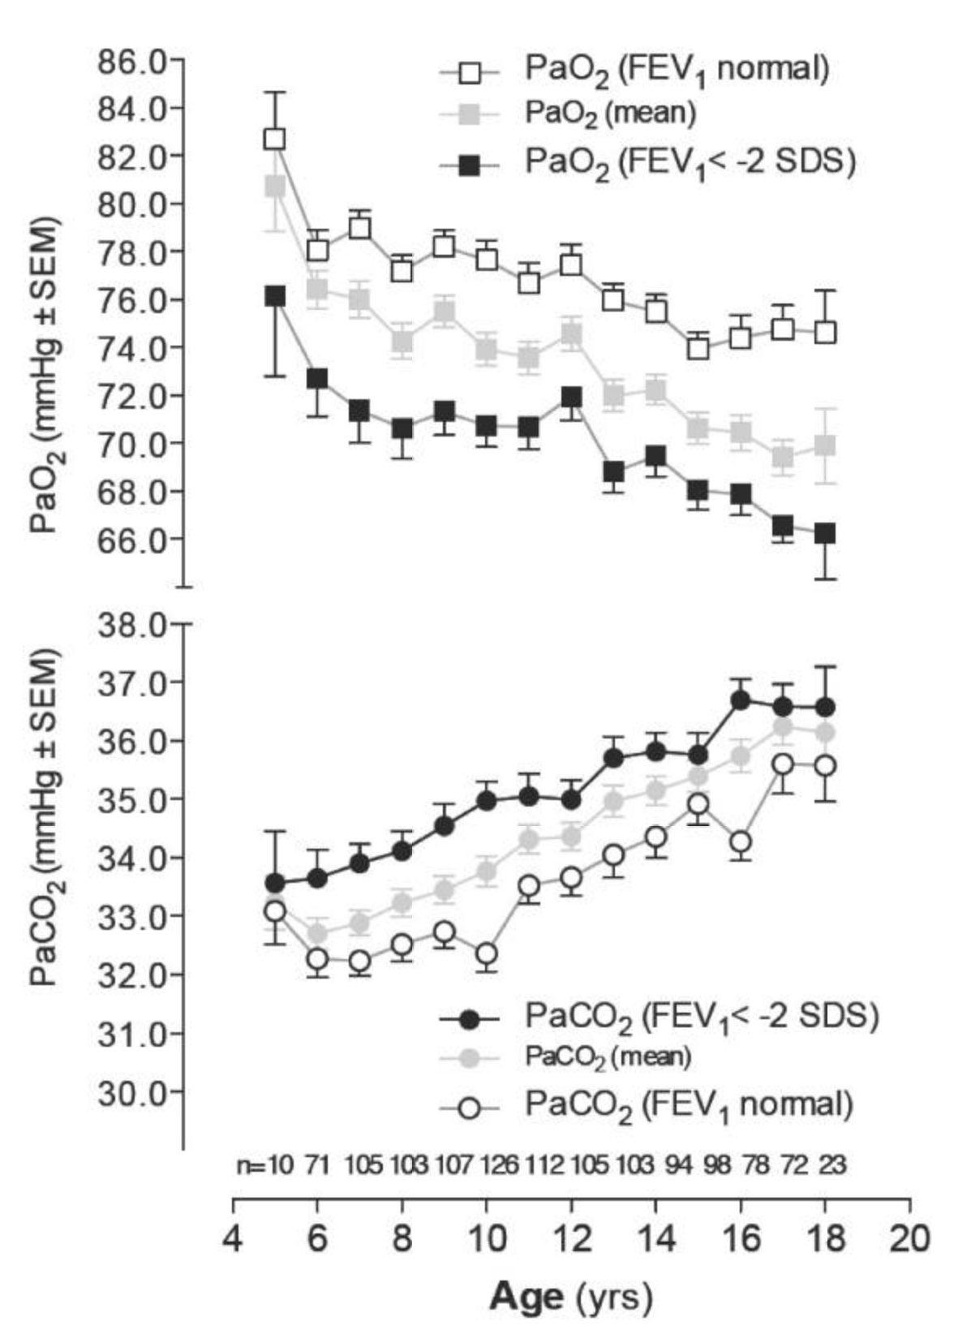
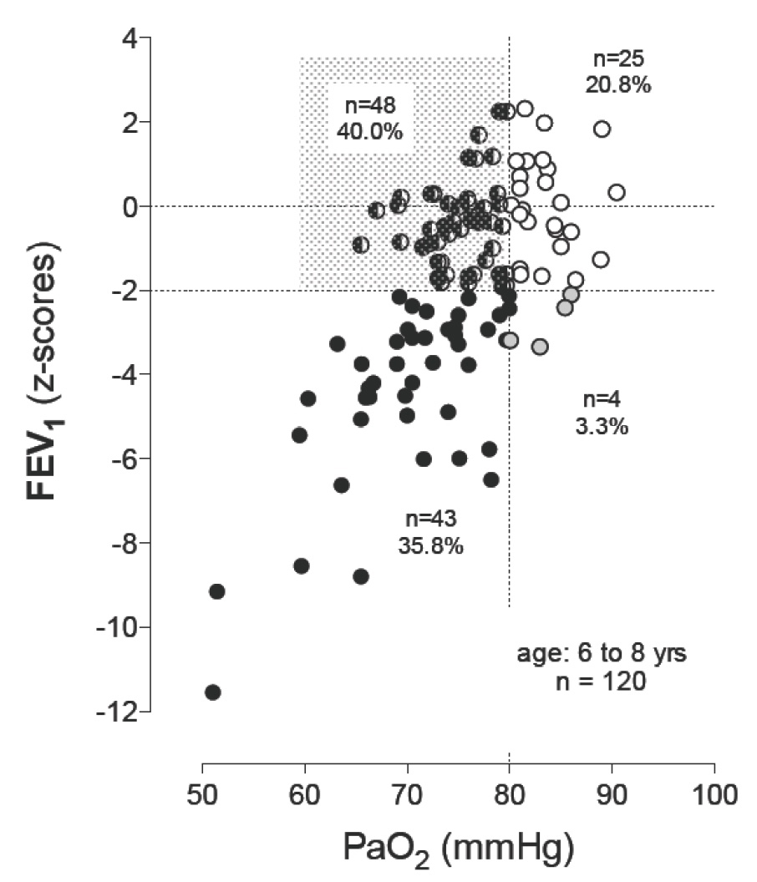
Gas Exchange: Blood Gas Measurements
Kraemer et al, Respir Res 2009; 10:106-118
Oxymetry at each visit
Blood gaz measurements if SaO2 < 95%
Severity criteria: PaO2 < 55 mmHg and PaCO2 > 50 mmHg
Notes:
Study in 178 children: linear decline in PaO2 with age and PaO2 decline stratified according to normal or abnormal FEV1; for PaCO2: transient stagnation at a young age before rising at later ages, especially for patients with a normal FEV1.( Transient hypocarbia (<34 mmHg) in some patients before rising PCO2).
Close correlation between PO2 and FEV1, but: 40% of the patients presented with a normal FEV1 and had hypoxemia (PO2 < 80 mmHg)
SaO2 < 95% sur oxymétrie: gaz du sang recommandés, notamment pour vérifier capnie
Signe gravité: PaO2 < 55 mmHg et PaCO2 > 50 mmHg: Les valeurs de PaO2 (< 55 mmHg) et de PaCO2 (> 50 mmHg) appartiennent aux critères principaux de choix pour l’inscription sur liste de greffe.
Supplémentation en O2: si SaO2 nocturne < 88-90% pendant = de 10% du temps ou si SaO2 < 88-90% à l'exercice
Greffe (Orens et al 2006 J of Heart and Lung Transplantation): Guidelines for Referral
•FEV₁ below 30% predicted or a rapid decline in FEV₁—in particular in young female patients.^{41–43}
•Exacerbation of pulmonary disease requiring ICU stay.⁴¹
•Increasing frequency of exacerbations requiring antibiotic therapy.
•Refractory and/or recurrent pneumothorax.
•Recurrent hemoptysis not controlled by embolization.
Guideline for Transplantation
•Oxygen-dependent respiratory failure.
•Hypercapnia.
•Pulmonary hypertension.⁴⁴

Slide 12
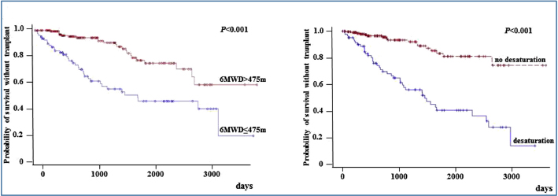
Exercise Testing in Cystic Fibrosis
Link between aerobic exercise and survival in CF
Incremental exercise test to measure peak oxygen uptake:
Evaluates respiratory, cardiovascular or peripheral limitation
Equipment for gas exchange measurement is expensive
Added burden to patients and care centers
Hebestreit et al, Respiration 2015;90: 332-351
Field tests such as 6-min walk test or shuttle test:
Usually measure submaximal exercise capacity
Mostly used to follow lung transplant candidates
Martin et al, Respir 2013; 107:1881-7
Notes:
Prognostic value of 6MWD and desaturation during 6MWT
Kaplan–Meier analyses of the risk of death or lung transplant according to 6MWD and to SpO₂ during 6MWT are shown in Fig. 4. A 6MWD ≤475 m or a SpO₂ ≤90% during the 6MWT were associated with higher risk of death or lung transplant (both analyses, P < 0.001). : a low 6MWD (≤475 m) or a desaturation (SpO₂ ≤90%) during the 6MWT were associated with increased risk of death without transplant or lung transplant.

Slide 13
Is there Another Biomarker with Similar
Assets than FEV1 and More Sensitivity?
Feasible
Reliable
Predictive of prognosis
Normal values
Track records
AND:
Doable in children below 6 years of age
Able to detect early lung disease
More responsive to intervention
Notes:
Is FEV1 obsolete?

Slide 14
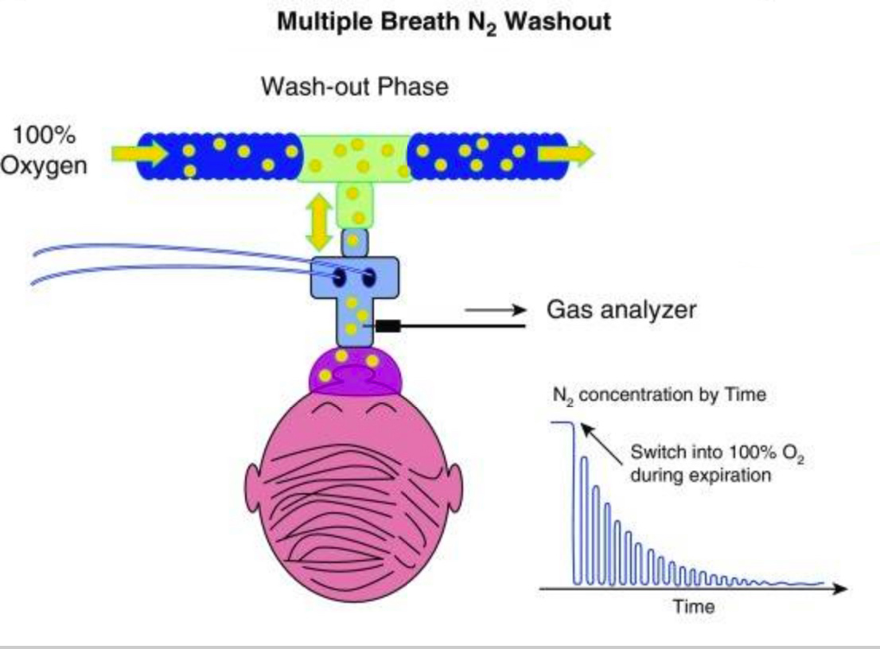
Lung Clearance Index
LCI is determined by washout of an inert gas during tidal breathing
LCI is calculated as the cumulative expired volume required to reduce the concentration of the inert gas 40-fold. It is expressed as a ratio to functional residual capacity.
Airway disease leads to ventilation inhomogeneity, longer washout time and increased LCI
Notes:
CEV: Volume exhaled to wash the tracer gaz out of the lung
FRC: functional residual capacity
LCI= CEV/FRC

Slide 15
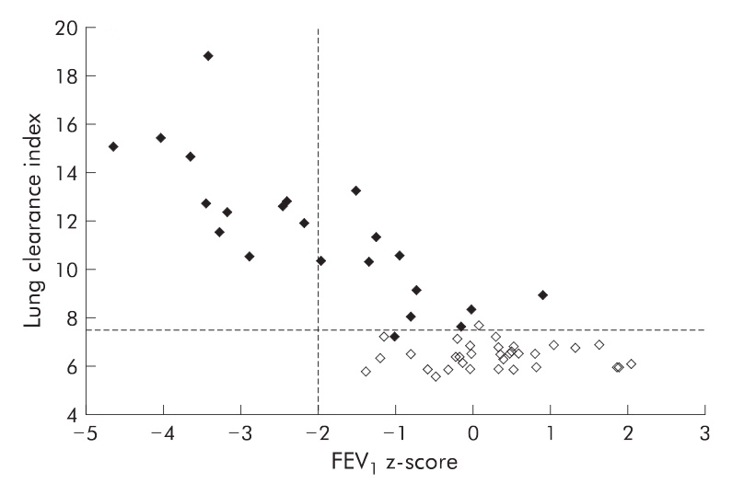
LCI Is More Sensitive Than Spirometry
to Detect Early Airway Disease
Approximately half of the children with CF had normal spirometric results, but nearly all of these children had abnormal ventilation distribution.
Aurora et al, Thorax 2004; 59: 1068-73
Notes:
In this cross sectional study we compared spirometric measurements and ventilation distribution, measured by LCI, in a cohort of school age children with CF and in a matched cohort of school age control children. Approximately half of the children with CF had normal spirometric results, but nearly all of these children had abnormal ventilation distribution.
The relationship between LCI and FEV1for both subject groups is shown in fig 2A. In healthy children there was no relationship between LCI and FEV1 but in children with CF LCI and FEV1 were negatively correlated (r2= 0.63,p,0.0005). This figure also shows that, whereas 11 of the 22 children (50%) with CF had an FEV1 within the normal range, with some of these children having an FEV1 z-score greater than zero, only one of 22 (5%) had a normal LCI.

Slide 16
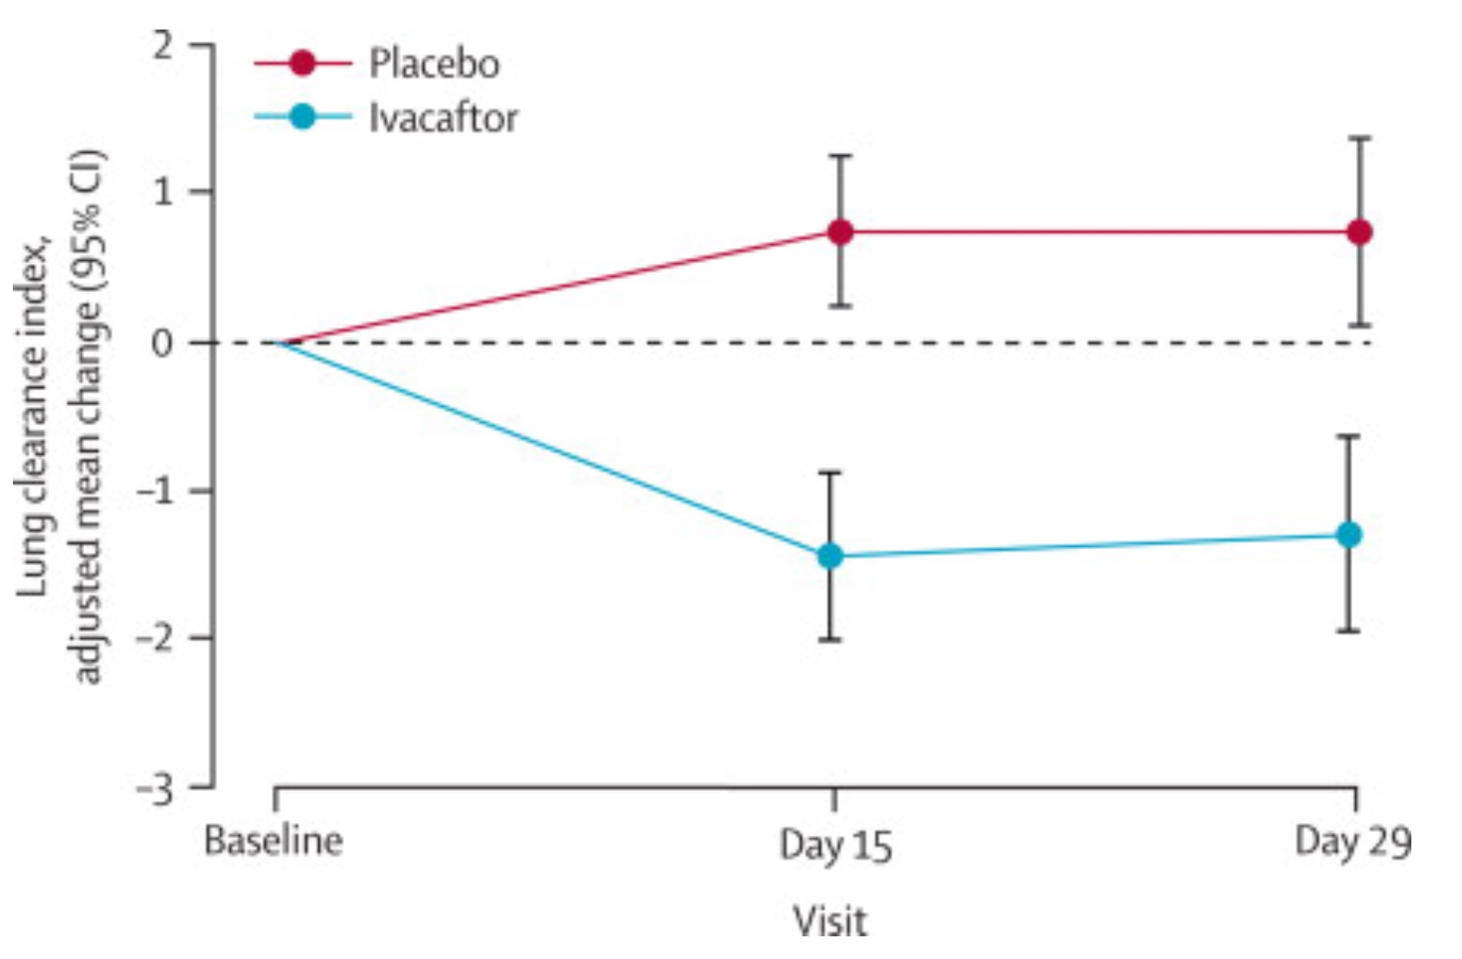
LCI Is Responsive to
Therapeutic Interventions
A phase 2, multicentre, placebo-controlled, double-blind, crossover study of ivacaftor treatment in patients with CF and at least one G551D-CFTR allele, and an FEV₁ >90% predicted
Davies et al, Lancet Respir Med 2013;1:630-8
Notes:
This phase 2, multicentre, placebo-controlled, double-blind 2×2 crossover study of ivacaftor treatment was conducted in patients with cystic fibrosis, at least one G551D-CFTR allele, and an FEV₁ >90% predicted. Patients also had to have an LCI higher than 7·4 at screening, age of 6 years or older, and a weight higher than or equal to 15 kg. Treatment with ivacaftor led to significant improvements compared with placebo in LCI (difference between groups in the average of mean changes from baseline at days 15 and 29 was −2·16 [95% CI −2·88 to −1·44]; p<0·0001).
Mean change from baseline in lung clearance index in cystic fibrosis patients with a G551D-CFTR and preserved spirometry: a randomised controlled trial
Enfants et adultes
Amélioration moyenne de 2,16 unités
Autres études avec RhDNase ou serum salé hypertonique, orkambi (open-label, 6-11 ans).

Slide 17
Lung Clearance Index
for Lung Function Assessment
Assets:
Feasible in all ages
More sensitive than spirometry to detect early airway disease (Aurora et al, Thorax 2004; 59: 1068-73)
Responsive to therapeutic interventions (Subbarrao AJRCCM 2013; 188:456-60; Davies et al, Lancet respir med 2013;1:630-8)
Gaps in knowledge:
Choice of device and gas, standardization across systems
Is improvement in LCI a predictor of lower rate of FEV1 decline or pulmonary exacerbation rate?
Data on usefulness in clinical practice
Saunders et al, Curr Med Res Opin 2017;33:613-620
Notes:
Requires passive cooperation with tidal breathing… equipment for very young
Subbarao: hypertonic saline; Davies: ivacaftor
Obtaining good quality data often challenging
Clinical practice and interpretation guidelines, evidence to support its role in clinical decision making

Slide 18
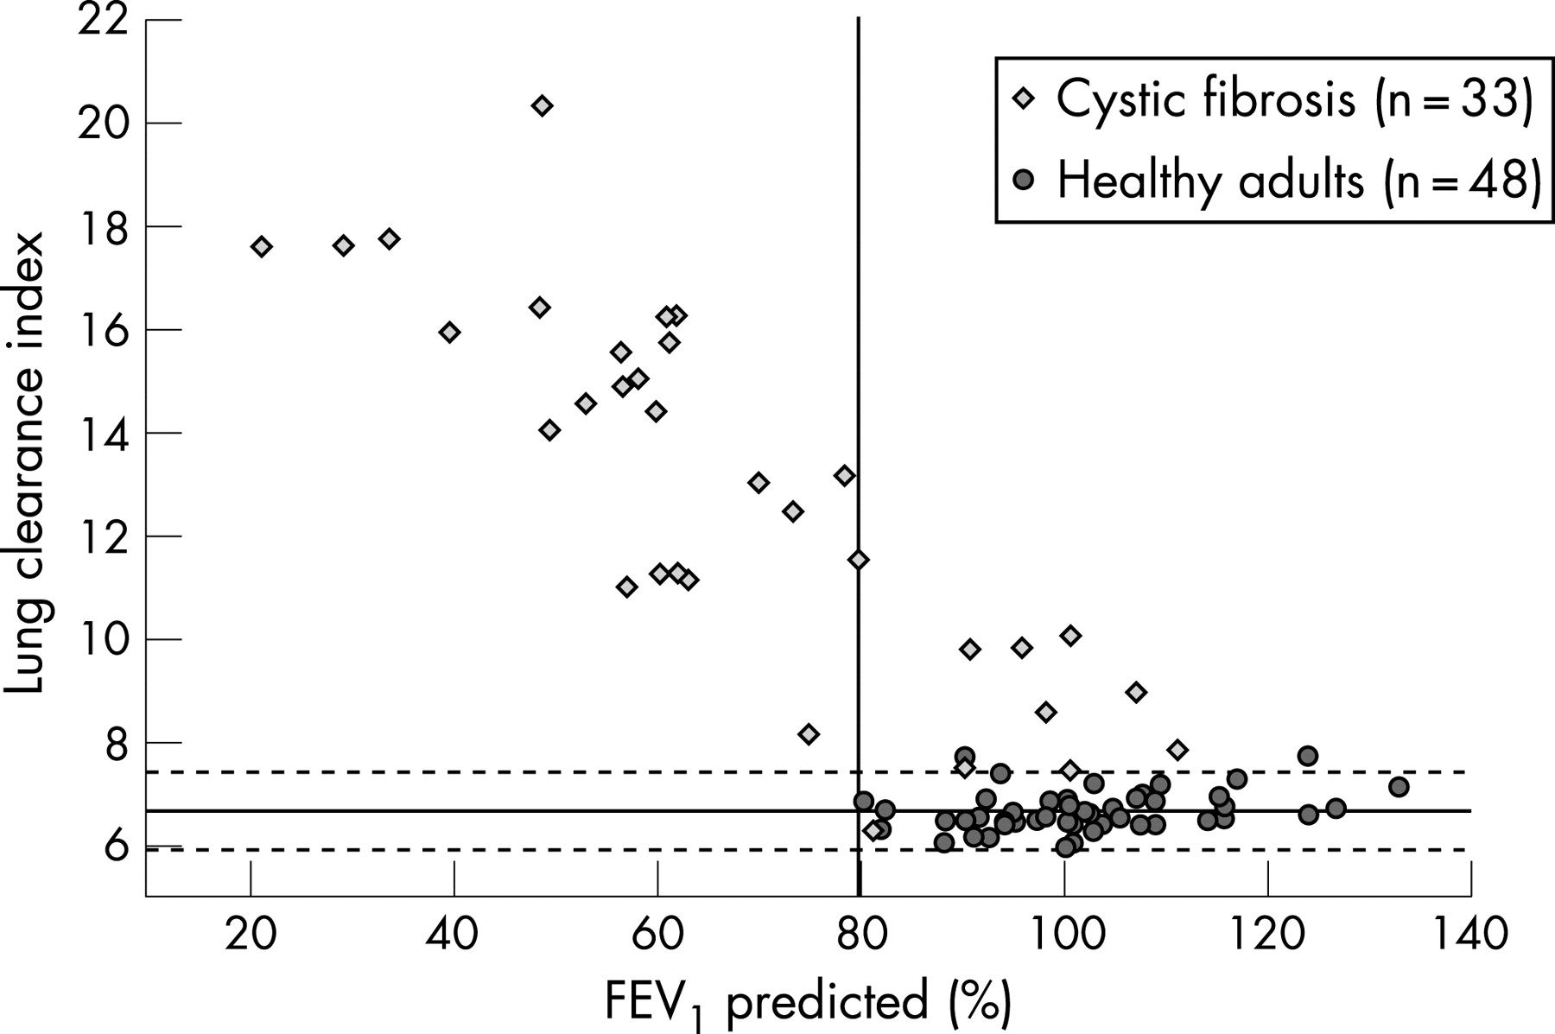
Could LCI Ever Replace FEV1?
Attractive…
Horsley et al, Thorax 2008; 63:135-40
… BUT: in patients with obstructive airway disease and abnormal FEV1:
Long measurement times, great variability
Caution with interpretation: the result doesn't take into account areas of completely trapped gas: LCI index could be less abnormal than it should be

Slide 19
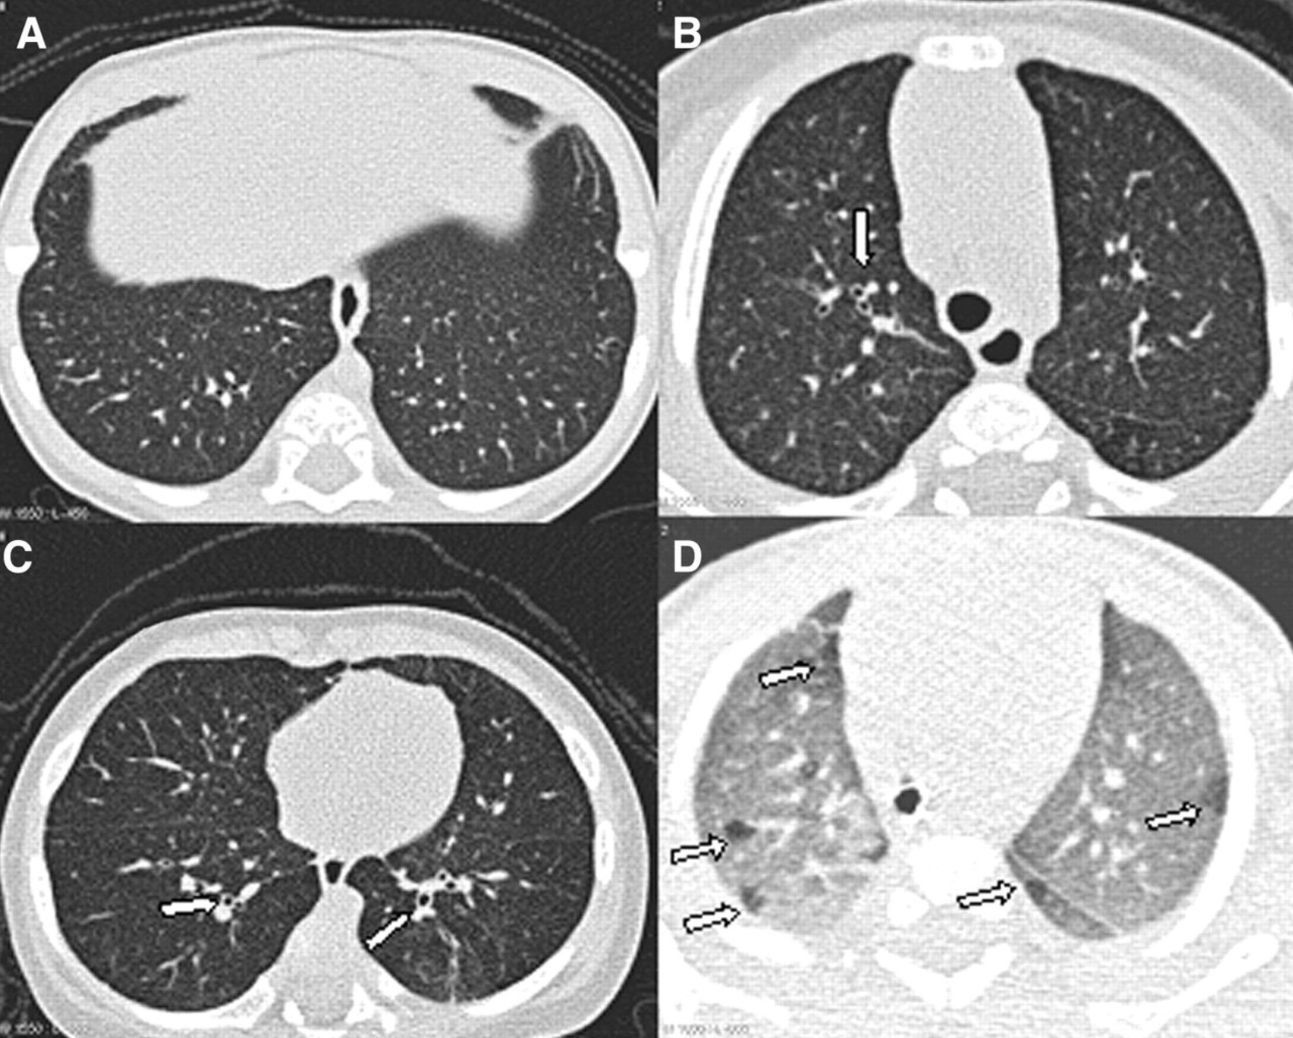
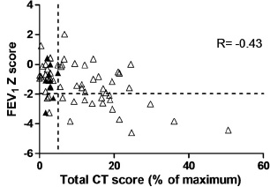
Chest CT Has a Higher Sensitivity Than FEV1
To Detect Pulmonary Disease
Infants with CF at 3 months of age
Sly et al, AJRCCM 2009;180:146-52
Owens et al, Thorax 2011;66:481-8
BUT:
Lack of diagnosis criteria of DB in infants: is airway artery ratio cut-off of 1 valid?
Some bronchiectasis are reversible: prognostic relevance?
Need of a Chest-CT score: no standardization, training needed, time consuming
Notes:
CT is the gold standard to detect bronchiectasis (Hansell 1998, Radiol Clinics North Am). A single bronchiectatic airway can be easily detected using CT.
Representative images from chest computed tomography scans showing (A) normal scan, (B) bronchial dilatation (arrow), (C) bronchial wall thickening (arrows), and (D) gas trapping (arrows). Images in A, B, and C were obtained at full inspiration (inspiratory pressure, 25 cm H₂O), and the image in D was obtained at end expiration.

Slide 20
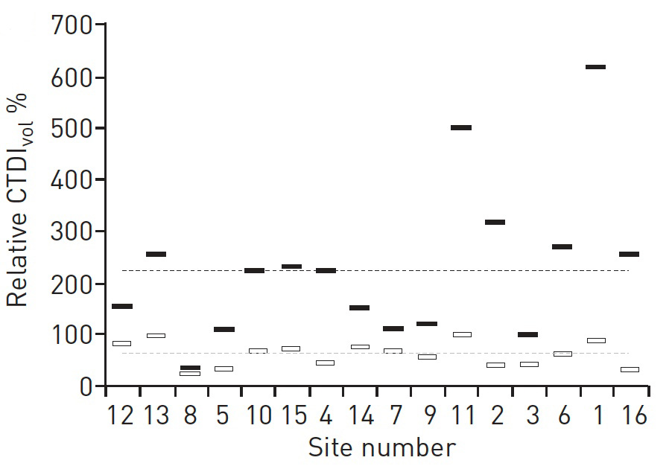
Chest CT Issues:
Radiations and Standardization
Radiations are associated with excess risk of malignancy
Cumulative effective dose is important, especially in children with chronic disorders
Images should be obtained at the lowest possible radiation
Recommended dose
for an adult
Recommended dose
for a newborn
Kuo et al, ERJ 2016;47:1706-17
A large variety was found in CT protocols, image quality and radiation dose usage among centres. Standardization is possible but still in its infancy.
Notes:
Computed tomography dose index (CTDI) vol values relative to the dose applied to the child phantom for the phantoms representing a newborn (white bars) and young adult (black bars). Grey and black dashed lines correspond to the recommended relative dose for a newborn and young adult, respectively. The applied dose for the newborn and adult phantoms relative to the dose for the child phantom is shown in figure 1b. The horizontal lines in figure 1b correspond to the median relative dose levels of 64% and 223% for the newborn and adult phantom, respectively. The deviation of the bars from these lines indicates how well the dose for a newborn child was reduced and, conversely,
increased for an adult relative to the dose for a 5-year-old child. For instance, site 10 was in agreement with the recommended dose levels for both absolute and relative values.

Slide 21
Chest CT as a replacement for FEV1? NO
Chest CT to complement FEV1? YES
Chest CT is not a functional biomarker
Chest CT provides a structural assessment of early lung disease
Chest CT can monitor progression of lung disease
BUT:
Frequent assessment is not possible
Normal values in the very young are lacking
More data on treatment response and timelines are needed
Standardization is needed and possible, but not in place yet
A validated automated score is needed

Slide 22
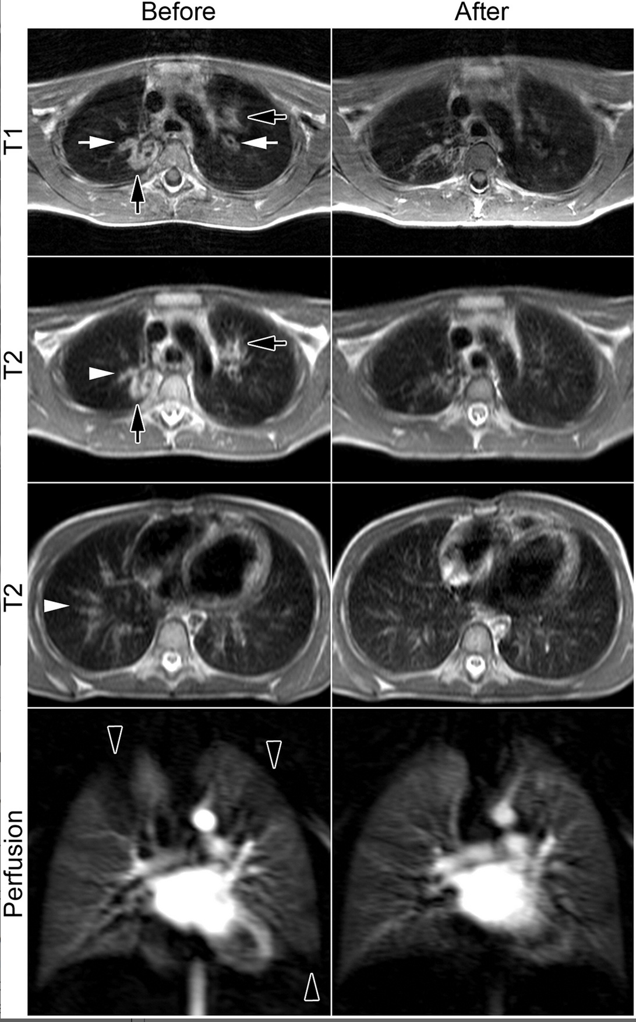
Magnetic Resonance Imaging and CF
Very attractive imaging technique:
No limitation due to radiations
Can be used at all ages
Can detect structural and functional abnormalities
Can show response to therapy
New MRI methods in development
Current status and issues:
High technical requirements
Cost of noble gases
Tolerance
Standardization
Longitudinal studies needed: sensitivity and variability
Wielpütz et al, AJRCCM 2014:189:956-65
Notes:
For many years, mainly due to the low proton density and constant motion during respiration, MRI of the lung had been rather challenging
Bronchial wall thickening/bronchiectasis mucus plugging and perfusion deficits
but challenging below 6 years of age
Still poorly sensitive for small airway disease
Hyperpolarized noble gas MRI

Slide 23
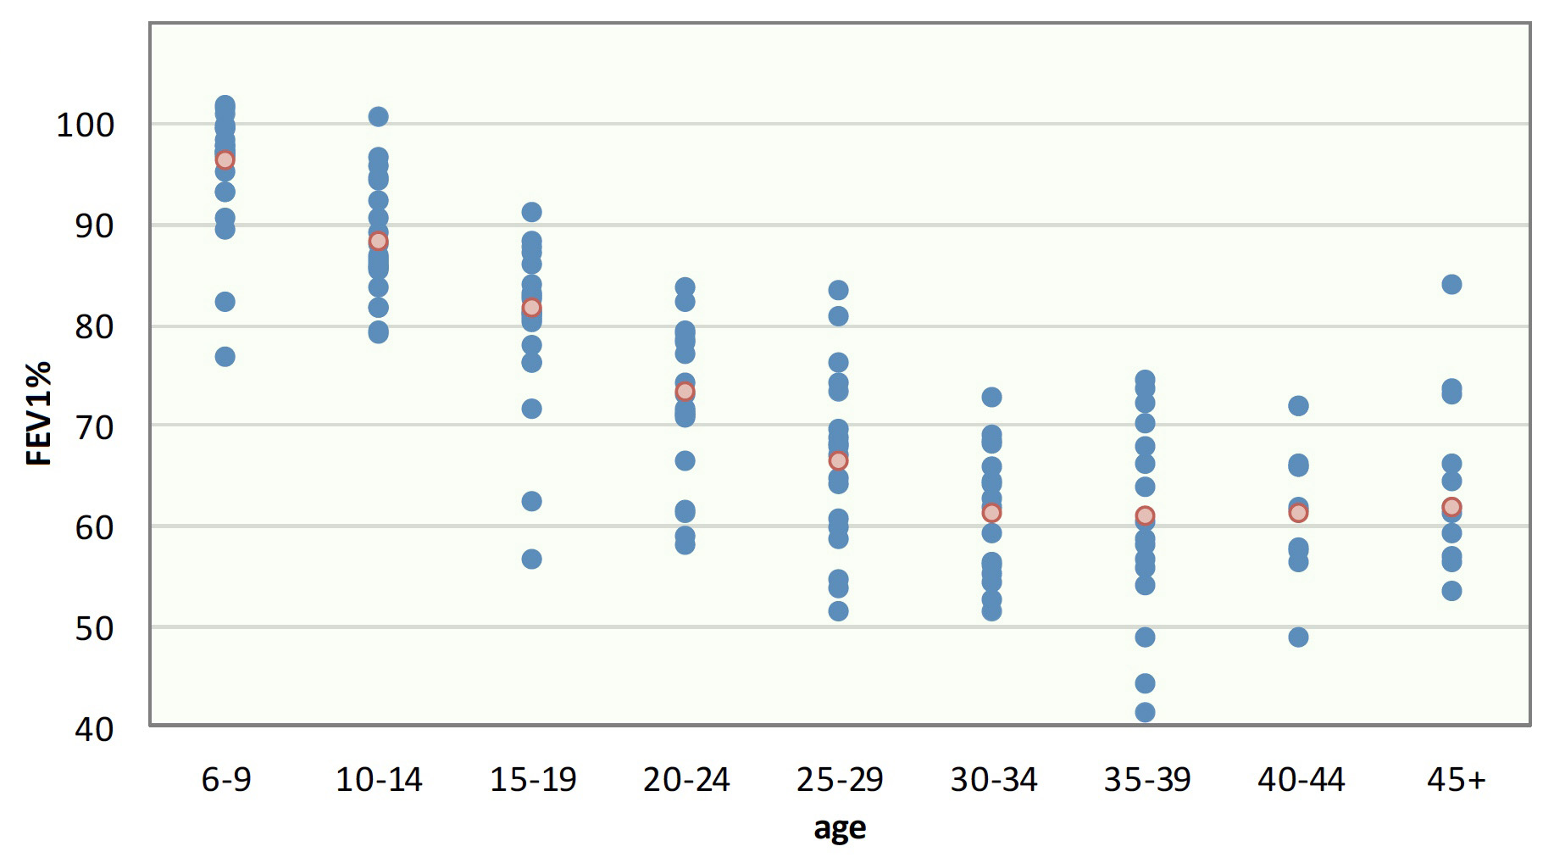
Assessment of Respiratory Disease in CF
Fonctional Assessment
LCI
FEV1 %
0-6
ECFS Registry Report, 2014
Structural assessment and scoring: Chest-CT / MRI
Lab of 2050: Dynamic imagery allowing zone assessment of function and structure?
Notes:
Median FEV1% of predicted by age group and by country. Patients aged 6 years or older who have never had a lung transplant. Each country is represented by a dot (in blue) and the overall estimate is in red. The general pattern shows that the FEV1% slowly decreases until the age of 30-34, and then levels out. The patients in the oldest age groups are patients that survived, and may therefore represent the patients with less disease severity. There is considerable variability between countries.

